Slide 1
Lethal Means Safety Counseling to Reduce Suicide Risk
August 2017

Slide 2
Presentation Outline
Why? Lethal means safety during a critical period can save a Veteran’s life
Who? Strategies to promote Lethal Means Safety (LMS) should be discussed with all Veterans with High or Intermediate Acute or Chronic suicide risk
What? Providing Lethal Means Safety Counseling (LMSC) & information about accessing tangible materials to facilitate lethal means safety (e.g., firearm locking devices, medication disposal kits) will save lives
Notes:
1

Slide 3
Why? Evidence and Reasoning in Support of Lethal Means Safety
Notes:
2

Slide 4
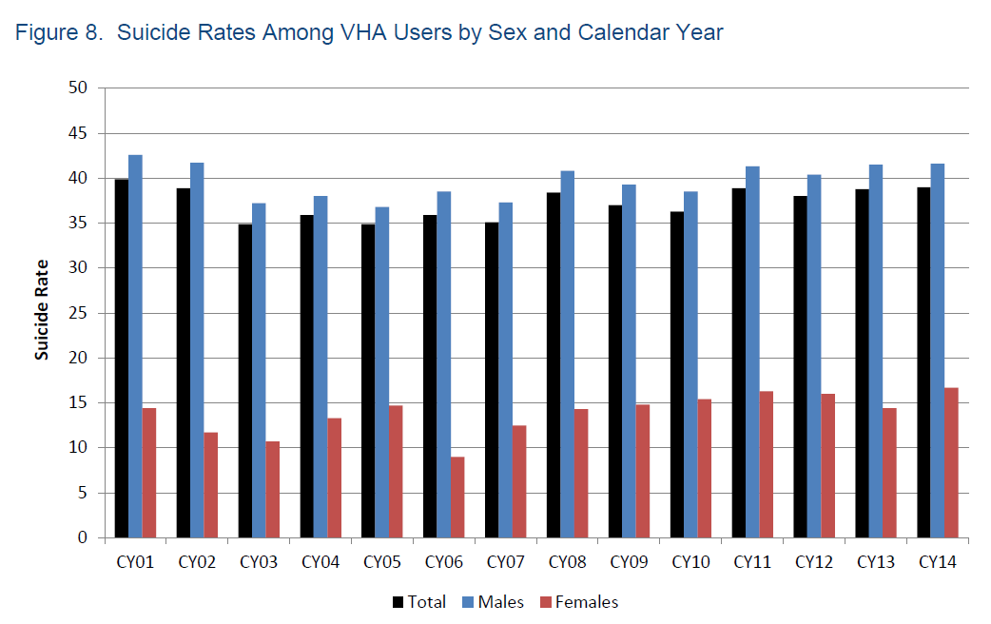
Suicide Rates among VHA Users by Sex & Year
“Suicide among veterans and other Americans 2001-2014,” VHA Office of Suicide Prevention, August 3 2016, page 16, Fig 8

Slide 5
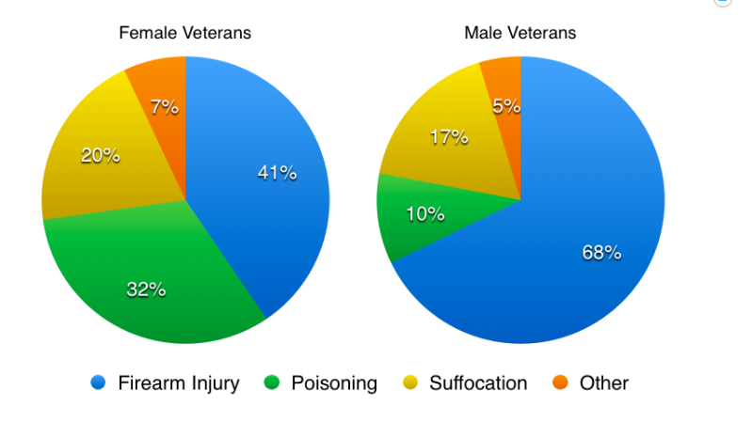
U.S. Veterans & Suicide Methods - 2014
“Suicide among veterans and other Americans 2001-2014,” VHA Office of Suicide Prevention, August 3 2016, page 16, Fig 8

Slide 6
U.S. Veterans & Firearms
Veterans…
  Have a high degree of familiarity with firearms
  Are more likely to own firearms than those in the U.S. general population
    – 1 in 2 owns at least one firearm
    – 1 in 3 stores a firearm loaded & unlocked
  Are more likely to die from firearm-related suicide than those in the U.S. general population
E Cleveland et al. Firearm ownership among American Veterans, Under Review; “Suicide among veterans and other Americans 2001-2014,” VHA Office of Suicide Prevention, August 3 2016; Simonetti et al. Firearm storage practices among Veterans with and without suicide risk factors, Under Review
Notes:
5

Slide 7
Lethality of Suicide Methods
5% Fatal
85-90% Fatal
Firearm Injury
All other methods
CDC WISQARS: Deaths from death certificate data; nonfatal incidents estimated from national sample of hospital emergency departments

Slide 8
Lethality of Suicide Methods
5% Fatal
85-90% Fatal
Firearm Injury
All other methods combined
CDC WISQARS: Deaths from death certificate data; nonfatal incidents estimated from national sample of hospital emergency departments

Slide 9
Firearm Access & Suicide
More than 15 U.S. case-control and cross-sectional studies have found that firearm access is an independent risk factor for suicide
Firearm ownership rates, independent of underlying rates of suicidal behavior, largely determine variations in suicide mortality across the 50 states
Miller et al. 2013. American Journal of Epidemiology, 178(6), 946-955.
Notes:
8

Slide 10
Are firearm owners just more suicidal than non-owners?
Are people who live in homes with guns more likely to have…
…experienced a mental health problem? | Yes | No
…seriously considered suicide? | Yes | No
…attempted suicide? | Yes | No
Sorenson et al. 2008. Evaluation Review, 32: 239-256; Ilgen et al. 2008. General Hospital Psychiatry, 30(6): 521-527; Miller et al. 2009. Injury Prevention, 15:183-187; Betz et al. 2011. Suicide and Life-Threatening Behavior, 41(4): 384-391.
Notes:
9

Slide 11
Are firearm owners just more suicidal than non-owners?
Are people who live in homes with guns more likely to have…
…experienced a mental health problem? | Yes | No
…seriously considered suicide? | Yes | No
…attempted suicide? | Yes | No
Sorenson et al. 2008. Evaluation Review, 32: 239-256; Ilgen et al. 2008. General Hospital Psychiatry, 30(6): 521-527; Miller et al. 2009. Injury Prevention, 15:183-187; Betz et al. 2011. Suicide and Life-Threatening Behavior, 41(4): 384-391.
Notes:
10

Slide 12
Are firearm owners just more suicidal than non-owners?
Are people who live in homes with guns more likely to have…
…experienced a mental health problem? | Yes | No
…seriously considered suicide? | Yes | No
…attempted suicide? | Yes | No
Sorenson et al. 2008. Evaluation Review, 32: 239-256; Ilgen et al. 2008. General Hospital Psychiatry, 30(6): 521-527; Miller et al. 2009. Injury Prevention, 15:183-187; Betz et al. 2011. Suicide and Life-Threatening Behavior, 41(4): 384-391.
Notes:
11

Slide 13
Are firearm owners just more suicidal than non-owners?
Are people who live in homes with guns more likely to have…
…experienced a mental health problem? | Yes | No
…seriously considered suicide? | Yes | No
…attempted suicide? | Yes | No
Sorenson et al. 2008. Evaluation Review, 32: 239-256; Ilgen et al. 2008. General Hospital Psychiatry, 30(6): 521-527; Miller et al. 2009. Injury Prevention, 15:183-187; Betz et al. 2011. Suicide and Life-Threatening Behavior, 41(4): 384-391.
Notes:
12

Slide 14
U.S. Veterans & Lethal Medications
10% of male and 32% of female Veteran suicides were due to intentional poisoning in 2014
Most attention (appropriately) is now on opiate medications
  prescribed and unprescribed
  Particularly patients receiving opiates + benzos
Other medications are commonly implicated:
  Acetaminophen
  Antipsychotic / antidepressant
  Anti-seizure
Notes:
13

Slide 15
Other Lethal Means & Environmental Risks
Strangulation
Cutting with sharp objects
Jumping from heights
Suicides in inpatient VHA units
Notes:
14

Slide 16
Most Suicidal Crises are Brief
Among 153 survivors of nearly fatal suicide attempts:
  47% said it took less than 1 hour between their decision to attempt suicide and their actual attempt
  24 % said it took less than 5 minutes for them to act
  For a Veteran in crisis, lethal means safety during a critical period can make all the difference
Simon et al. 2001. Suicide and Life Threatening Behavior, 32(1 Suppl):49-59
Notes:
Abstract:
Suicide attempts often are impulsive, yet little is known about the characteristics of impulsive suicide. We examined impulsive suicide attempts within a population-based, case-control study of nearly lethal suicide attempts among people 13-34 years of age. Attempts were considered impulsive if the respondent reported spending less than 5 minutes between the decision to attempt suicide and the actual attempt. Among the 153 case-subjects, 24% attempted impulsively. Impulsive attempts were more likely among those who had been in a physical fight and less likely among those who were depressed. Relative to control subjects, male sex, fighting, and hopelessness distinguished impulsive cases but depression did not. Our findings suggest that inadequate control of aggressive impulses might be a greater indicator of risk for impulsive suicide attempts than depression.

Slide 17
Subsequent Suicide Attempts
What proportion of serious attempters eventually die by suicide?
75% 45% 25% 10%
Owens et a; Br J Psychiatry. 2002 Sep; 181:193-9.
Notes:
16

Slide 18
Subsequent Suicide Attempts
What proportion of serious attempters eventually die by suicide?
75% 45% 25% 10%
Owens et a; Br J Psychiatry. 2002 Sep; 181:193-9.
Notes:
17

Slide 19
Summary: Why Does LMS Matter?
Lethality varies greatly by method
  – 90% of firearm-related attempts result in death
  – 5% of all other attempts combined result in death
The acute phase of a suicidal crisis is often brief
90% of those who survive a suicide attempt do not go on to die by suicide

Slide 20
Perspectives: Veterans & VHA Providers
Focus group interviews with Veteran mental health patients, their families, along with their VHA clinicians and peer specialists
  – Veterans agreed that VHA providers have a role to play in addressing gun access with Veterans at risk for suicide
  – Most participants suggested that family and friends be involved in discussions about firearm safety
Walters et al. 2012. General Hospital Psychiatry. Azrael et al. April 2014. AAS Presentation.
Notes:
19

Slide 21
Clinicians Perceptions of the Importance of Asking about Guns
% Reporting “Extremely Important”
VHA behavioral health clinicians (N = 112) (2015, unpublished data).
Notes:
Qualtrics survey, N = 72 SFVAMC MH clinicians, May 2014.
Response categories are “Not at all important,” “Unimportant” “Neither Important nor Unimportant,” “Important,” and “Extremely Important.”

Slide 22
The Patient Perspective: 2015 National Firearm Survey
Online survey of a nationally representative sample U.S. Veterans
61% response rate
Questions about firearm ownership
Betz et al. Annals of Intern Med. 2016;165(8).

Slide 23
“…at least sometimes appropriate to talk about this with a healthcare provider?”
Gun owner
Non-owner in a
gun household
Non-gun
household
Betz et al. Annals of Intern Med. 2016;165(8).

Slide 24
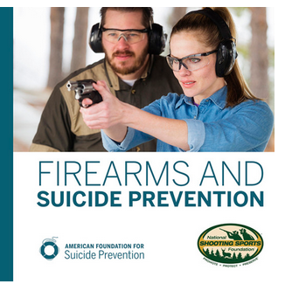
Perspectives: Firearm Advocacy Organizations
Many advocates for gun ownership recognize that mental health concerns are relevant to gun safety (e.g., National Shooting Sports Foundation, Maryland Licensed Firearm Dealers Association)
Image: http://www.nssfblog.com/nssf-afsp-suicide-prevention-partnership/

Slide 25
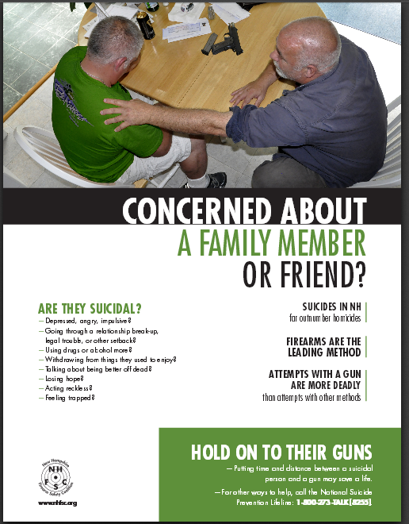
Perspectives: Firearm Business Community
Firearm retailers are partnering with suicide prevention programs nationally to promote lethal means safety among at-risk customers
New Hampshire Firearm Safety Coalition’s Gun Shop Project
  www.nhfsc.org
(Vriniotis et al. Suicide & Life-Threatening Behavior, 2015;45(2):157-63.)

Slide 26
Summary of Stakeholders Opinions
National leaders, directives from VHA, advocates for gun ownership and firearm businesses, and many Veterans (including gun owners) and their families agree with promoting lethal means safety among at-risk Veterans

Slide 27
Who? Veterans who may Benefit from LMS
Notes:
26

Slide 28
Therapeutic Risk Management
Clinically and medico-legally informed model for the assessment and management of suicide risk
3 main components
  – Augmentation of clinical risk assessment with structured
  instruments
  – Risk stratification tool with respect to severity and temporality
  – Collaborative development of a safety plan

Slide 29
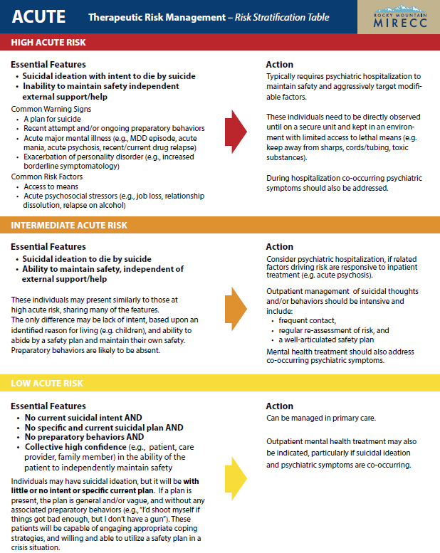
Acute Risk and LMSC
Available at: https://www.mirecc.va.gov/visn19/trm/

Slide 30
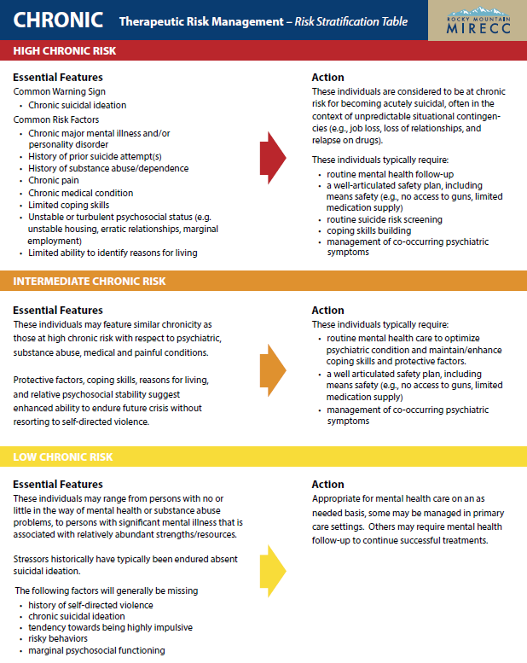
Chronic Risk and LMSC
Available at: https://www.mirecc.va.gov/visn19/trm/

Slide 31
Low Acute & Chronic Risk
  Lethal means safety counseling may be indicated based on your judgement
    Protective factors?
    Engagement in care & trajectory?
    Expected life stressors?
Available at: https://www.mirecc.va.gov/visn19/trm/

Slide 32
What? LMSC & Tangible Materials to Facilitate Lethal Means Safety
Notes:
31

Slide 33
Simply Put….
Working with Veterans and their caregivers, friends or family members to facilitate limiting access to lethal means during high-risk periods

Slide 34
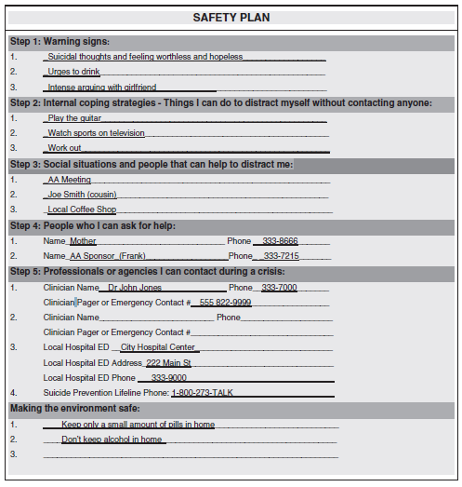
You’re Already Doing This

Slide 35
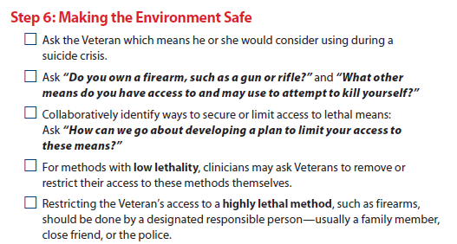
You’re Already Doing This
http://www.mentalhealth.va.gov/docs/VA_SafetyPlan_quickguide.pdf
.

Slide 36
What? LMSC – The Conversation
Notes:
35

Slide 37
Approaches to LMSC
LMSC is patient-centered, rather than a one-size-fits-all intervention
Effective LMSC involves careful consideration of the language and stance we use with patients
Whenever possible, LMSC involves ongoing follow up
We still have a lot to learn about what constitutes effective LMSC for Veterans

Slide 38
Factors That May Impact Your Approach
Your relationship with the Veteran
Your knowledge about their access to guns or lethal medications
Your knowledge of and comfort with guns or other means
Urgency of situation
Reasons for gun ownership or necessity of prescribed medications
Patient’s willingness to consider recommended changes
Opportunity for follow up

Slide 39
The Message Matters
370 undergrads in the Southeast US
Randomized to hear scripts about firearm safety in a hypothetical clinical encounter
Asked about:
  Acceptability
  Intention to follow clinical recommendations
Theory of Reasoned Action
Stanley et al. Arch Suicide Res. 2016 Apr 13:1-17.

Slide 40
Group 1
‘‘My goal is to keep you alive and to protect you from hurting yourself or others.…..Because I am concerned about your well-being, I want to have a conversation about means safety’’
Stanley et al. Arch Suicide Res. 2016 Apr 13:1-17.

Slide 41
Group 2
‘‘My goal is to keep you alive and to protect you from hurting yourself or others.…..Because I am concerned about your well-being, I want to have a conversation about means restriction”
Stanley et al. Arch Suicide Res. 2016 Apr 13:1-17.

Slide 42
The Message Matters
“I want to have a conversation about means safety.’’
  More preferable
  Greater intent to follow clinical recommendations to limit firearm access
Stanley et al. Arch Suicide Res. 2016 Apr 13:1-17.

Slide 43
Raising the Issue - One Example
“Lots of Veterans have guns at home. What some Veterans in your situation have done is store their guns away from home until they’re feeling better, or lock them and ask someone they trust to hold onto the keys. If you have guns at home, I’m wondering if you’ve thought about a strategy like that.”
“If temporarily storing them elsewhere is not an option, perhaps we can discuss some alternative ways to keep you safe until you’re feeling better.”

Slide 44
Principles of Motivational Interviewing
Evocation
  Critical elements of change (desires, ability, reasons, needs) are within the person and the provider’s task is to draw them out.
Collaboration
  The person is the expert, the provider is a resource, and they work together.
Autonomy
  The person, not the provider, must decide to change and provide the motivation for it.

Slide 45
LMS for Firearms: Temporary off-site storage during at-risk periods
Friend or relative
  Provided they aren’t prohibited from possessing firearms
Storage facility
  Ammunition must be stored separately
Police departments
  Some police departments will store temporarily at no charge
Pawn shops
  Pawning the guns for a very small loan amount is reliable storage option; interest fees of ~15-20% monthly
Gun stores or gun clubs
  Some may offer free or inexpensive storage options for people they know

Slide 46
LMS for Firearms: other options
    Any step(s) that increase the time and distance between a suicidal impulse and a gun will reduce suicide risk.
    A locked gun poses a lower suicide risk than an unlocked gun
    An unloaded gun poses a lower suicide risk than a loaded gun
  Store guns unloaded
  Store ammunition out of the home
  Store guns and ammunition separately
  Lock the gun
  Store gun in a safe
  Disassemble the gun

Slide 47
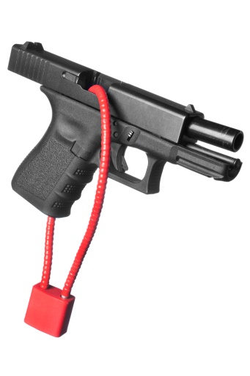
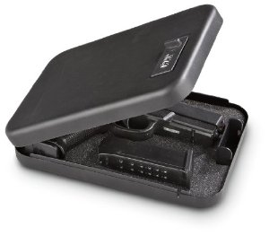

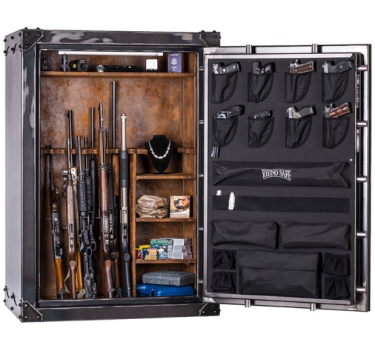
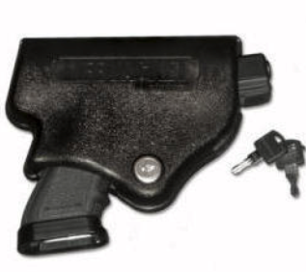
Locking Options
  Cable Lock
  Trigger Lock
  Lock Box
  Lifejacket
  Gun Safe / Cabinet

Slide 48
Keys to Success of Onsite Storage Options
  Give the lock key to someone else
  Asking someone to change safe combination
  Temporarily disassemble gun and store components (e.g., firing pin) with someone else

Slide 49
Summary of Safe Storage Options
Safest option is temporary off-site storage during high-risk time periods
Other options:
  Lock it
  Unload it
  Remove ammunition
  Disassemble it
Multiple options for locking devices are available
Ideally - Keep the key components elsewhere

Slide 50

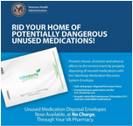
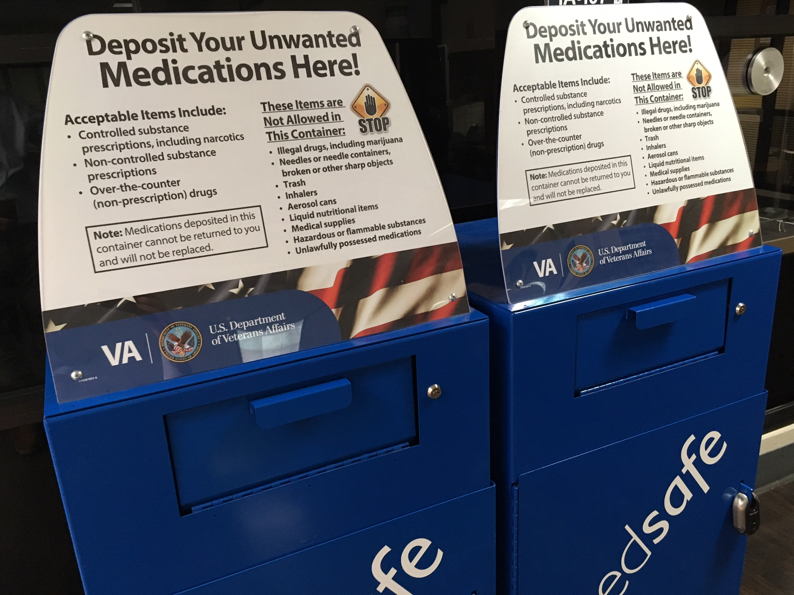
LMS for Medications
Essential Meds
Blister packets for home medications
Unneeded Meds
Medication disposal kits
Medication disposal bins in VHA facilities
Flushing, coffee grounds, trash, etc…
Notes:
https://www.fda.gov/drugs/resourcesforyou/consumers/buyingusingmedicinesafely/ensuringsafeuseofmedicine/safedisposalofmedicines/ucm186187.htm

Slide 51
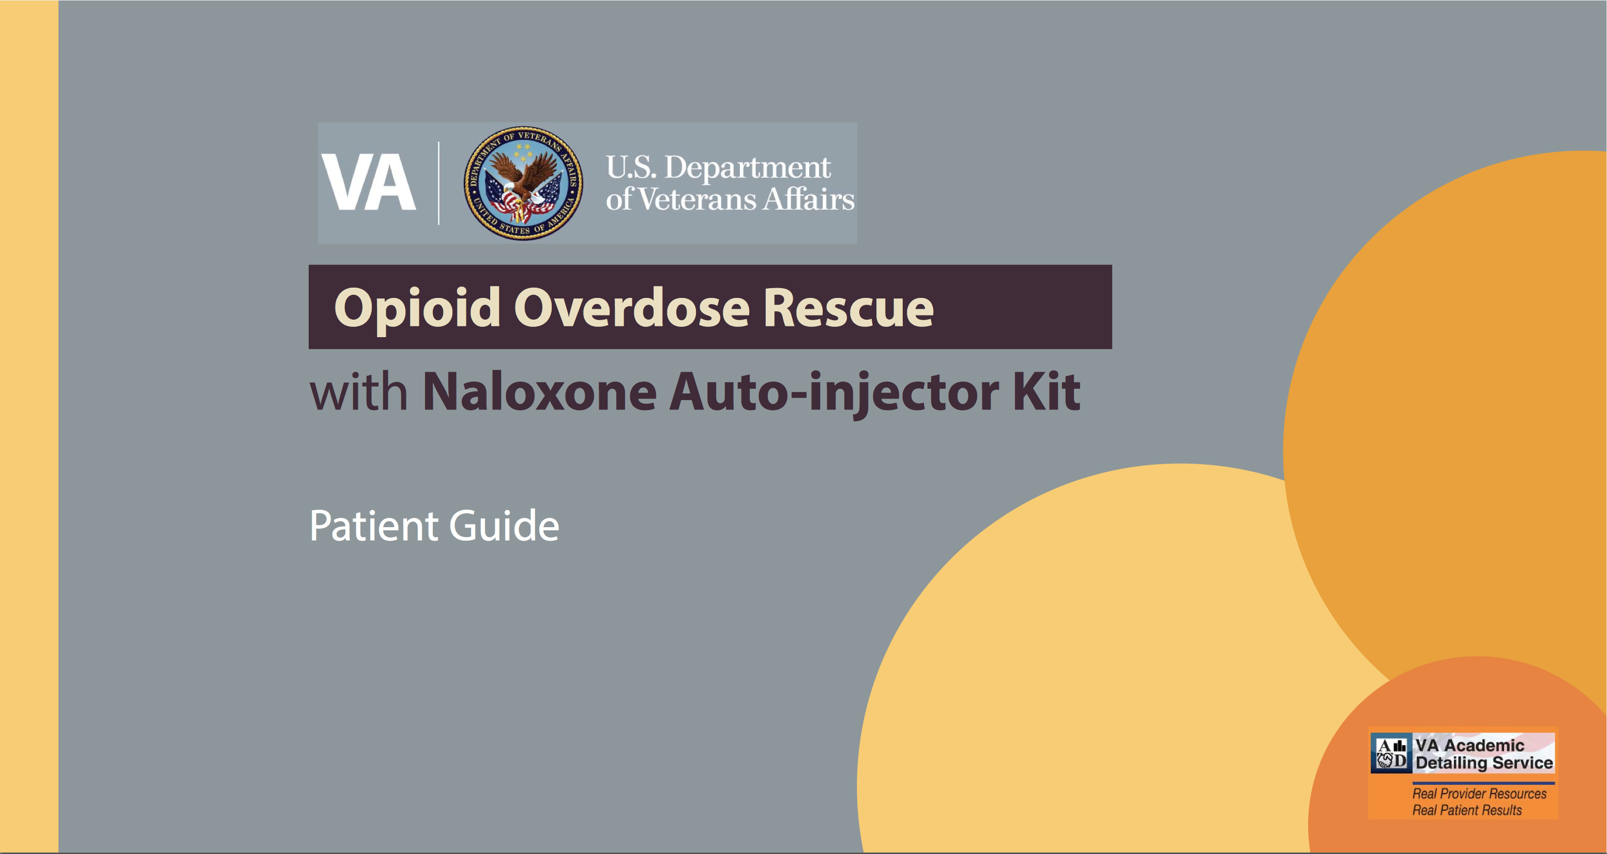
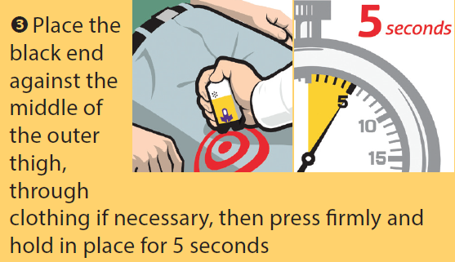
LMS for Patients on Opioids
Indicated for patients with:
  Suicide risk + access to opioids (prescribed or unprescribed)
  Unintentional overdose risk (STORM Tool) + access to opioids
Naloxone nasal spray and autoinjectors available via the VHA pharmacy
Trainings available at PBM.VA.GOV
https://www.pbm.va.gov/PBM/AcademicDetailingService/Documents/Naloxone_Auto_Injector_Kit_Instructions.pdf

Slide 52
LMS in the Hospital
243 suicides occurring in VA mental health units between 1999 & 2011
Mills et al. General Hospital Psychiatry 35 (2013) 528–536

Slide 53
Guidance on Environmental Safety
Mills et al. General Hospital Psychiatry 35 (2013) 528–536

Slide 54
LMSC Documentation
Essential for healthcare providers to document their discussion about lethal means and LMSC
For example-
  – “Given Veteran’s moderate acute risk for suicide, we discussed lethal means safety. Veteran agreed to have his brother store his firearm until the primary driver of his suicide risk (lack of housing) resolves.”
  – “Veteran remains at high chronic risk for suicide. Veteran shared that he has large amounts of unused and unneeded medications at home. I provided him with instructions regarding how to safely dispose of these medications. Veteran stated that he will call me tomorrow to confirm that he has disposed of these medications.”

Slide 55
Ongoing VHA Efforts
Stay tuned for additional resources
  Online training resources
  Supplemental videos
  Further distribution of locking devices, medication disposal equipment, and guidance on use

Slide 56
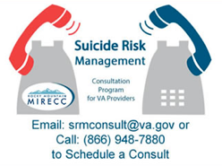
Suicide Risk Management Consultation Program
Consultation at no cost for VHA Providers with general
or specific questions about Suicide Risk Management
  Lethal means safety counseling
  Assessment
  Conceptualizing suicide risk
  Pharmacotherapy
  Evidence-based resources for suicide risk management
https://www.mirecc.va.gov/visn19/consult

Slide 57
Lethal Means Safety in Action
Most 18-21 year-olds in Israel serve in the Israel Defense Force (IDF)
Early 2000s: 90% of IDF suicides were by firearm and most occurred on weekend leave
2006: IDF implemented a policy requiring soldiers to leave their weapons on base during weekend leave
Suicide rate decreased by 40%
Weekend suicides dropped significantly
Weekday suicides did not
Lubin et al. 2010. Suicide and Life-Threatening Behavior, 40(5), 421-424

Slide 58
Summary
Suicide prevention is a priority
Facilitating LMS among at-risk patients is considered an essential, evidence-based component of effective prevention programs.
Broad agreement that promoting LMS is important.
Most Veteran suicides are firearm-related but medications are also an important cause of death; especially among female patients.
Use Therapeutic Risk Management to identify which patients should receive LMSC.
The conversation requires practice – be on the lookout for more training and materials from VHA.

Slide 59
For More Information
Means Matter website: www.meansmatter.org
Free course on LMSC (CALM-Online): training.sprc.org
Veterans Crisis Line: veteranscrisisline.net

Slide 60

Thank you! Questions or Comments?
Joe Simonetti, MD, MPH
Joseph.Simonetti@va.gov
Bridget Matarazzo, PsyD
Bridget.Matarazzo@va.gov
@RMIRECC
MIRECC Podcasts @ https://www.mirecc.va.gov/visn19/index.asp

