Slide 2
Advancing Suicide Prevention Best Practices in Peer Support for Service Members, Veterans, and their Families
2017 DoD/VA Suicide Prevention Conference

Slide 3
Disclaimer
The views, opinions, and content expressed in these presentations do not necessarily reflect the views, opinions, or policies of the Center for Mental Health Services (CMHS), the Substance Abuse and Mental Health Services Administration (SAMHSA), or the U.S. Department of Health and Human Services (HHS).

Slide 4
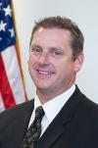
Introductions
Charles H. Smith, Ph.D.
SAMHSA Regional Administrator, oversees Region VIII, which includes Colorado, Montana, North Dakota, South Dakota, Utah, and Wyoming

Slide 5
Presenters
Cicely K. Burrows-McElwain, L.C.S.W.-C.
Military and Veteran Affairs Liaison
National Policy Liaison Branch
Division of Regional and National Policy/Office of Policy,
Planning, and Innovation, SAMHSA
Donna Aligata, R.N.C. Project Director
SAMHSA’s SMVF TA Center
Policy Research Associates, Inc.

Slide 6
Key Areas for our Discussion
Learn about SAMHSA’s work in serving Military and Veterans
Understand the operations of the SMVF TA Center
Review the SPPEER Virtual Implementation Academy Model
Learn about promising outcomes for several states in the pilot cohort

Slide 7
Collaboration Across Federal Agencies
U.S. Department of Defense

Slide 8
Interagency Task Force on Military and Veterans Mental Health
2012 Executive Order directing DoD, VA, and DHHS to collaboratively focus on 8 key domains related to SMVF populations nationwide

Slide 9
The SMVF TA Center
Since 2008, SAMHSA’s Service Members, Veterans, and their Families (SMVF) Technical Assistance (TA) Center has held 8 Policy Academies and 6 Implementation Academies on specific topics of interest to states
49 states, 4 territories, and the District of Columbia have attended one or more of these events and received assistance from the SMVF TA Center in meeting their priorities

Slide 10
The SMVF TA Center (cont’d)
Work with teams across the country gaining a broad perspective on emerging trends and best practices for SMVF
Connects our teams to national experts
Shares lessons learned from other states
Offers a variety of technical assistance opportunities

Slide 11
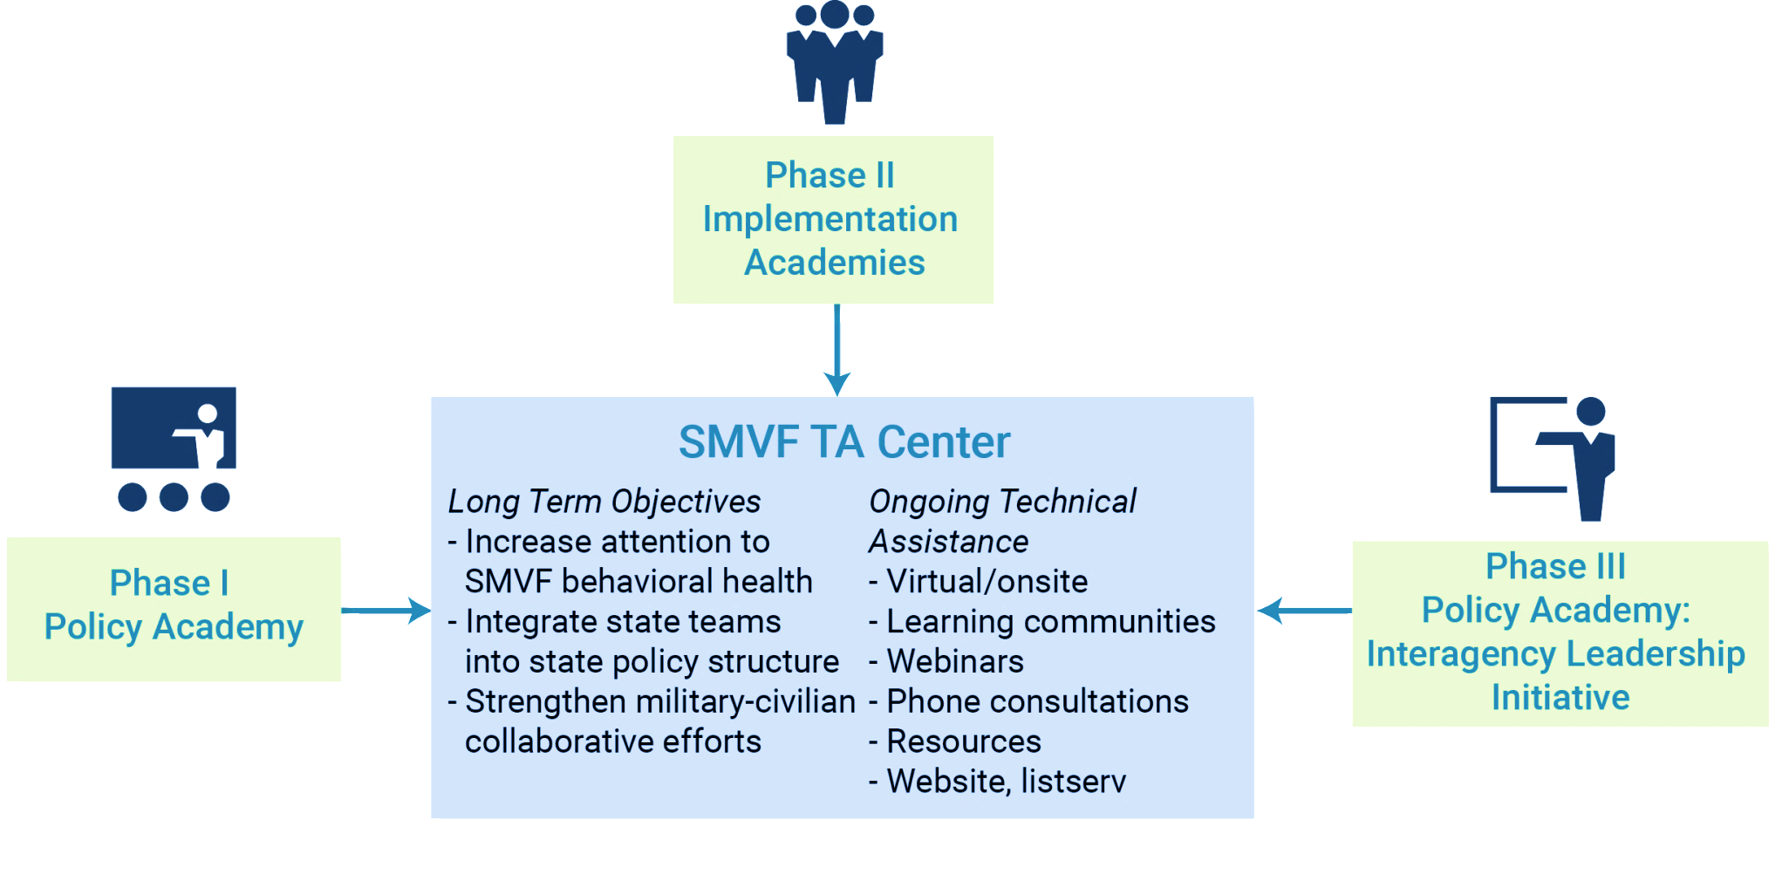
Technical Assistance

Slide 12
Technical Assistance Opportunities
Webinar
Live web-based seminar convening several subject matter experts focused on a single topic, addressing a large web-wide audience
Learning Community
Collaborative, multi-session meeting facilitated by SMVF TA Center and subject matter experts to discuss and problem solve with 5-10 state SMVF team members on a specific topic
Virtual Workshop
Live web-based seminar, similar to a webinar, but focused on SMVF team members as primary audience
Individualized Technical Assistance Call
Short scheduled phone call facilitated by SMVF TA Center and joined by subject matter expert and state SMVF team member or as a platform for multiple states to discuss specific issues

Slide 13
Interagency Teams Bridge the Gaps
The behavioral health needs of SMVF require a comprehensive set of services that no single agency, organization, or level of government could address on its own.
The team leaders brought together stakeholders from multiple state agencies to build a coordinated response to the needs of SMVF.

Slide 14
Agencies Leading Teams
Interagency state teams are led by a governor-appointed team leader, and each team decides which structure best supports the implementation of their interagency strategic plan, state political climate, and culture

Slide 15
Creating a Feasible Interagency State Plan
Reach consensus on common priorities and goals
Streamline and prioritize activities
Include new partners to build on existing strengths, foster innovation, and maximize resources
Identify concrete products and measurable outcomes

Slide 16
Advancing Suicide Prevention Best Practices in Peer Support for Service Members, Veterans, and their Families (SPPEER) Virtual Implementation Academy

Slide 17
SPPEER Objectives
Bring together military and civilian peer leaders with key suicide prevention leaders to create an implementation plan designed to support the adoption of SMVF suicide prevention and trauma-informed best practices.
Encourage peers to incorporate suicide prevention best practices in their efforts
Encourage states and communities to include peers in their comprehensive approach to suicide prevention

Slide 18
SPPEER Logic Model
Key Drivers
Interagency Commitment | Implementation Plan | Technical Assistance
SMVF Suicide Prevention and Peer Support Priorities
Building Community Collaboration
Establishing leadership and ongoing interagency focus on SMVF suicide prevention and peer support
Forming connections and healthy supports in the community
Aligning state SMVF and suicide prevention plans
Increasing Impact of the Peer Workforce
Incorporating suicide prevention best practices into SMVR peer training
Incorporating military cultural competency into peer training
Developing credentialing, licensing, and reimbursement standards for SMVF peers
Implementing Suicide Prevention Best Practices
Applying the Comprehensive Approach to Suicide Prevention
Integrating SMVF with Zero Suicide, community-based mental health programs, and other suicide prevention initiatives
Improving Data Access, Sharing, and Analysis
Screening and assessing needs of SMVF
Mapping Suicide prevention resources and supports
Improving access to and sharing of suicide prevention data
Measuring effectiveness of programs and services
Outcomes Tracking, Evaluation, and Improvements

Slide 19
Participating Delegations
Florida
Illinois
Michigan
Missouri
Pennsylvania
New York City
Texas
Virginia

Slide 20
SPPEER Process
February | March | March | May - September
STEP 1 | STEP 2 | STEP 3 | STEP 4
Orientation Call State/City team lead | Web-based Prep Session(s) All delegations and delegates | Implementation Academy All delegations and delegates | Follow-up TA Single state/city delegates

Slide 21
Priorities
Building Community Collaboration
Increasing Impact of the Peer Workforce
Implementing Suicide Prevention Best Practices
Improving Data Access, Sharing, and Analysis

Slide 22
Best Practices

Slide 23
Cross Collaboration – Thank you to our Partners
Thank you to our partners who assisted with planning and
served as subject-matter experts (SMEs)!

Slide 24
SPPEER State Examples

Slide 25
Building Community Collaboration
Florida established a suicide prevention focused peer support workgroup that meets regularly to discuss key priorities related to SMVF and to provide recommendations to state leadership.
Missouri established a state SMVF suicide prevention committee (19 members) with workgroups and is holding monthly meetings online.
Texas passed legislation entitled the Veteran Suicide Prevention Act requiring the establishment of a coordinated suicide prevention action plan to increase access to services for veterans to prevent suicides among veterans; the bill mandates coordination with multiple agencies and organizations including SAMHSA’s SMVF TA Center; this will complement the other legislation that was passed which will expand the TX Military Veteran Peer Network.
Virginia has formed a connection with the National Guard, Department of Corrections, and statewide Community Health Promotion Council to collaborate in suicide prevention and peer support efforts.

Slide 26
Increasing Impact of the Workforce
Michigan allocated a portion of the Mental Health Block Grant funds for 2017-2018 to train veteran peers in ASIST training.
Illinois provided input on the development of a new Certified Veteran Support Specialist credential.
Missouri reviewed existing suicide prevention trainings to form recommendations for credentialed and non-credentialed peer training programs.

Slide 27
Implementing Suicide Prevention Best Practices
Florida began coordinating with federal and statewide partners to incorporate elements of Zero Suicide to reduce suicide in the state’s veteran community.
Illinois began formulating plans to strengthen networks of suicide survivor peer networks across the state to support postvention efforts.
Michigan National Guard has scheduled a motorcycle ride for suicide prevention in the fall.
Texas submitted a proposal for the National Suicide Prevention Strategy grant, which includes suicide prevention-specific programming that recognizes SMVF as a population of focus.
Virginia began planning for the development of a veteran survey tool to identify veteran prevalence and their patronage at Virginia Community Clinics.

Slide 28
Improving Data Access, Sharing, and Analysis
Florida committed to leveraging their interagency team to develop and employ an SMVF resource inventory across the state.
Pennsylvania began working with the Coroner’s Association to explore data sharing options.
Texas delegation reached consensus to partner with TexVet and Texas A&M Health Science Center on the development of a database that will detail the state’s SMVF demographics.
Virginia has taken preliminary steps to conduct a statewide assessment of provider awareness and access to suicide prevention trained certified peers.

Slide 29
Ongoing SPPEER Technical Assistance
Technical Assistance calls with SMEs:
E.g., Suicide Prevention Resource Center and Peer organizations
Summer Technical Assistance Series:
Catalog of SMEs

Slide 30
Contact Information
SAMHSA:
Region VIII Administrator Charles Smith PhD
Charles.Smith@samhsa.hhs.gov
Cicely Burrows-McElwain, LCSW-C
Phone: (240) 276-1111
E-mail: cicely.burrows-mcelwain@samhsa.hhs.gov
SMVF TA Center:
Donna Aligata, R.N.C.
Phone: (518) 439-7415 ext. 5258
E-mail: SMVFTACenter@prainc.com

