Slide 1
Attempted Suicides and Suicide Deaths in the United States Navy, CY 2014
Tina M. Luse, MPH
Christine E. Glasheen, MPH
Armed Forces Health Surveillance Branch

Slide 2
The views expressed in this presentation are those of the author and do not necessarily reflect the official policy or position of the Department of the Navy, Department of Defense, or the U. S. Government.

Slide 3
EpiData Center Overview
Five Divisions
Reportable and Emerging Infections
Hospital Acquired Infections and Patient Safety
Exposure and Injury Analysis
Behavioral and Operational Health
Application Development and Data Systems Support
Epidemiologists and statistical programmers with support from senior epidemiologists and IT team
Division Officers coordinate resources and schedules to meet deadlines and provide project oversight

Slide 4
Mission
Navy lead for health surveillance.
Provide data analysis for public health surveillance for Navy and Marine Corps members and beneficiaries.
Conduct investigations and studies.
Provide support for outbreak investigations
Provide epidemiologic and data consultation, as well as study design support.
Provide innovative approaches to infectious disease surveillance for the Department of Defense in support of the Global Emerging Infection Surveillance and Response System.
Develop and support public health data collection applications

Slide 5
Behavioral and Operational Health Division
Supports Navy Suicide Prevention Office efforts by conducting multiple epidemiologic and analytic projects
Monthly surveillance of suicide-related behaviors, psychotropic medications, and Post Deployment Health Assessment responses and referrals
Medical record reviews for all Navy suicide deaths
Clinical/administrative data
Quantitative review of AHLTA clinical notes
Analysis of risk factors among Navy suicide attempts and deaths
Ad hoc analyses
4

Slide 6
Background: Suicide Analysis in DON
In coordination with the Navy Suicide Prevention Program (N171), the EpiData Center Department, NMCPHC, has carried out these analyses since 2012
The purpose of this analysis is to provide more details on suicide, both attempts and deaths, than are typically available through any single data source
A timeline approach was created to analyze suicide attempt and death cases at various points of interest prior to a suicide event
The 2014 cohorts of suicide attempts and deaths were analyzed separately by event type
Notes:
Purpose – to look across multiple data sets and analyze in detail attempts and deaths using a timeline approach. More information can be identified then what is available from a single data source

Slide 7
Methods
N171 provided EDC with calendar year (CY) 2014 rosters of active duty Sailors who met the DOD criteria for reportable suicide death or suicide attempt
DODSER was used to identify the event date and unique identifier
Suicide deaths and attempt cohorts were matched to multiple datasets to identify potential risk factors at various time points
A medical record review and suicide risk factor analysis of all encounters 90 days prior to suicide event and 30 days post (attempt only) was also completed
Notes:
Reservists were excluded due to limited medical care within the MHS
There were no attempts and deaths in CY2014
The first attempt per person in the CY was reviewed.

Slide 8
Methods – Data Sources
Electronic medical record (AHLTA)
DODSER
Deployment information
Personnel data
Demographics, medical evaluation boards, transaction data
Encounter data
Inpatient, outpatient, In-theatre
Direct and purchased care
Deployment Health Assessments
Pharmacy transactions

Slide 9
Methods – Timeline Approach
Analysis Time Point 1
Anytime Prior
Analysis Time Point 2
3 Year
Analysis Time Point 3
1 Year
Analysis Time Point 4
90 Days
Analysis Time Point 5
Attempt or Death
Analysis Time Point 6
31 Days After Attempt
1.Prior Suicide Ideation Visit
2.AFQT Scores
1.Deployment History
2.Prior Behavioral Health Encounters
1.PCS Moves
2.Change in Rank
3.DHA Surveys
4.MEBs
5.Transactions
6.Treatment of Substance Abuse
7.Theater Medical Encounters
1.Medical Encounters
2.Provider Notes
3.Selected Medication Use
1.Same Day Medical Care
2.Same Day Events from DODSER
1.Medical Aftercare
2.Provider Notes

Slide 10
Methods: AHLTA Clinical Notes Review Process
Clinical notes from (AHLTA) are reviewed and risk factors are input into a standardized data collection tool
Data includes records from Military Treatment Facilities, Veterans Affairs, and purchased care outside the military treatment system (when available)
Data are entered for each individual medical record
Attention is paid to the timeframe for several risk factors
Suicide Ideation Past vs. Suicide Ideation Current
Data dictionary is consulted for risk factor identification
Trained review team members consult with each other when classification of risk variables is uncertain
9
Notes:
AHLTA - Armed Forces Health Longitudinal Technology Application
Translating Qualitative notes into quantitative data

Slide 11
Methods: Risk Factor Definition Examples
10
Notes:
Give anger example
Does not require a diagnosis

Slide 12
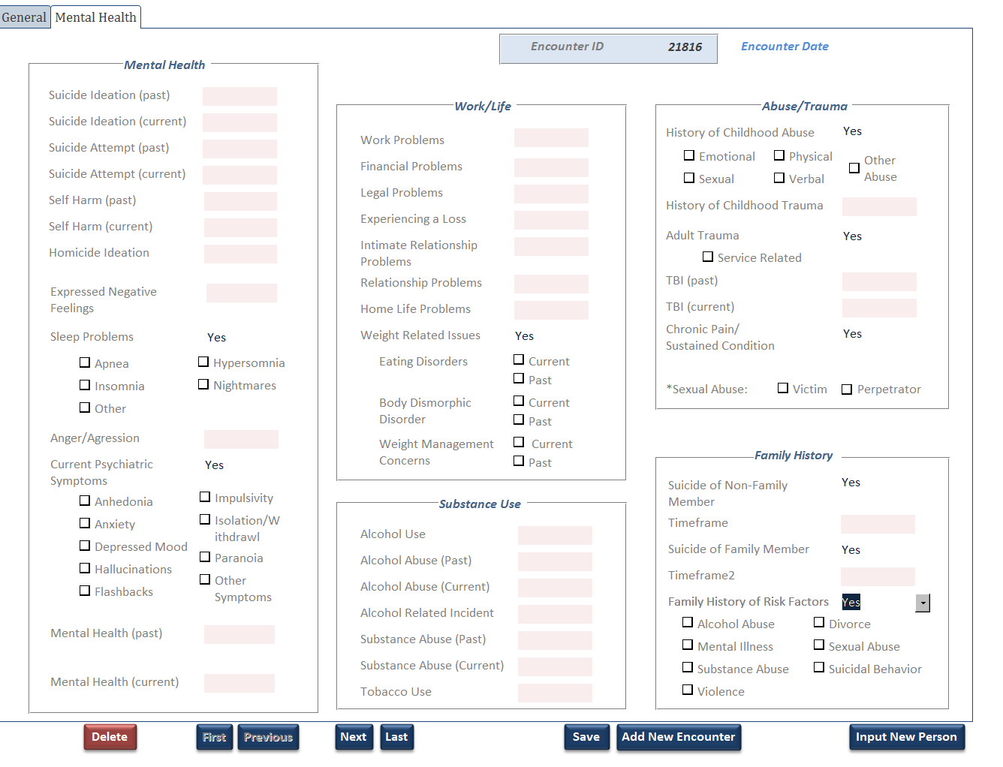
11

Slide 13
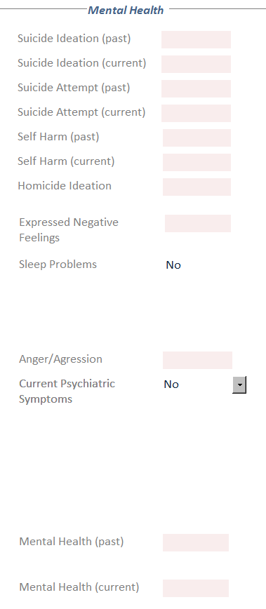
EXAMPLE MEDICAL NOTE
Chief Complaint: Depressive feelings x 3 months
History of Present Illness: Service member was referred by primary care for depressive feelings x 3 mos.
SM admitted has trouble falling asleep and staying asleep. SM claims that he wakes up nearly every night from nightmares. 1 SM denies suicide ideation or intent. 2 He reported thoughts of wanting to die and “not be here anymore” two months ago. 3 Two months ago he took all of his prescription medication (12 pills) and consumed ½ a bottle of tequila. He said he didn’t want to wake up at the time, but a roommate found him and brought him to the ER. 4
No childhood mental health dx. 5
Diagnosis: Axis I: Generalized Anxiety Disorder, 300.2 6
Disposition: Released w/o limitations. F/u as needed in 14 days w/mental health.
12

Slide 14
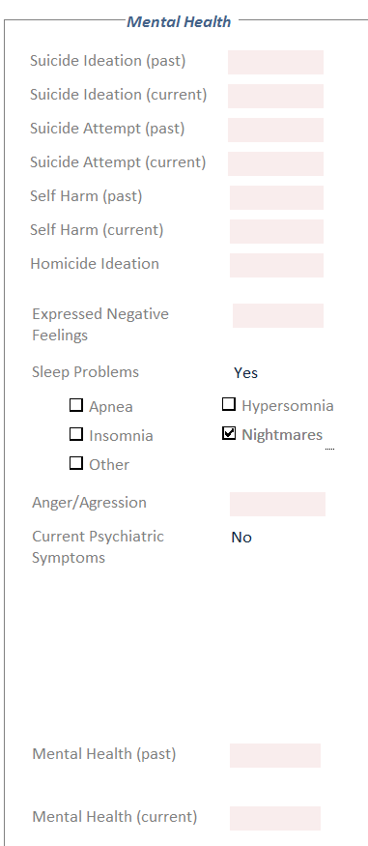
Data Collection
EXAMPLE MEDICAL NOTE
Chief Complaint: Depressive feelings x 3 months
History of Present Illness: Service member was referred by primary care for depressive feelings x 3 mos.
SM admitted has trouble falling asleep and staying asleep. SM claims that he wakes up nearly every night from nightmares. 1 SM denies suicide ideation or intent. 2 He reported thoughts of wanting to die and “not be here anymore” two months ago. 3 Two months ago he took all of his prescription medication (12 pills) and consumed ½ a bottle of tequila. He said he didn’t want to wake up at the time, but a roommate found him and brought him to the ER. 4
No childhood mental health dx. 5
Diagnosis: Axis I: Generalized Anxiety Disorder, 300.2 6
Disposition: Released w/o limitations. F/u as needed in 14 days w/mental health.

Slide 15
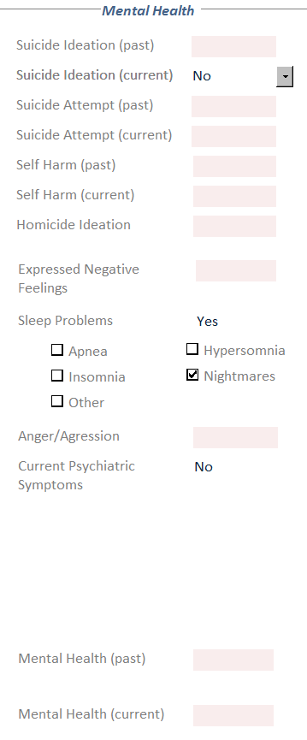
Data Collection
EXAMPLE MEDICAL NOTE
Chief Complaint: Depressive feelings x 3 months
History of Present Illness: Service member was referred by primary care for depressive feelings x 3 mos.
SM admitted has trouble falling asleep and staying asleep. SM claims that he wakes up nearly every night from nightmares. 1 SM denies suicide ideation or intent. 2 He reported thoughts of wanting to die and “not be here anymore” two months ago. 3 Two months ago he took all of his prescription medication (12 pills) and consumed ½ a bottle of tequila. He said he didn’t want to wake up at the time, but a roommate found him and brought him to the ER. 4
No childhood mental health dx. 5
Diagnosis: Axis I: Generalized Anxiety Disorder, 300.2 6
Disposition: Released w/o limitations. F/u as needed in 14 days w/mental health.

Slide 16
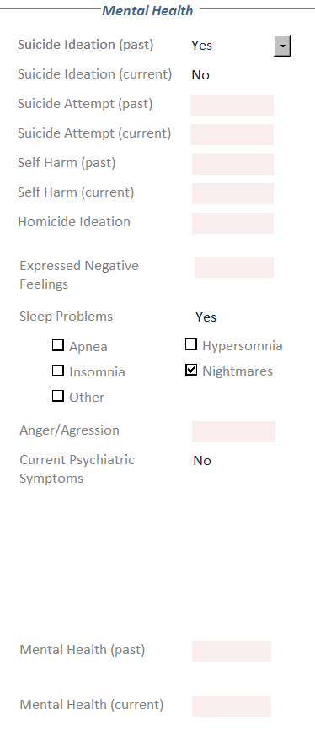
Data Collection
EXAMPLE MEDICAL NOTE
Chief Complaint: Depressive feelings x 3 months
History of Present Illness: Service member was referred by primary care for depressive feelings x 3 mos.
SM admitted has trouble falling asleep and staying asleep. SM claims that he wakes up nearly every night from nightmares. 1 SM denies suicide ideation or intent. 2 He reported thoughts of wanting to die and “not be here anymore” two months ago. 3 Two months ago he took all of his prescription medication (12 pills) and consumed ½ a bottle of tequila. He said he didn’t want to wake up at the time, but a roommate found him and brought him to the ER. 4
No childhood mental health dx. 5
Diagnosis: Axis I: Generalized Anxiety Disorder, 300.2 6
Disposition: Released w/o limitations. F/u as needed in 14 days w/mental health.

Slide 17
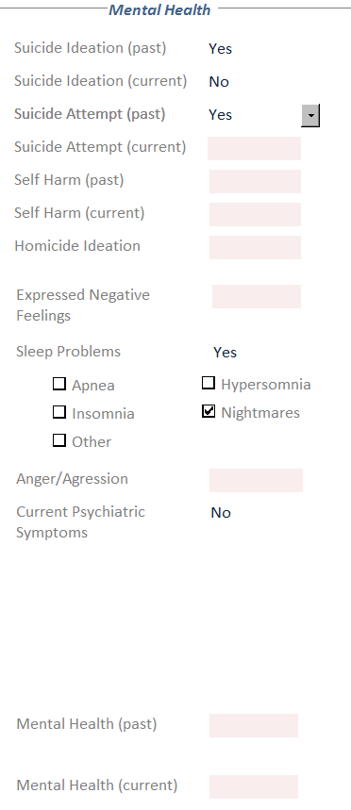
Data Collection
EXAMPLE MEDICAL NOTE
Chief Complaint: Depressive feelings x 3 months
History of Present Illness: Service member was referred by primary care for depressive feelings x 3 mos.
SM admitted has trouble falling asleep and staying asleep. SM claims that he wakes up nearly every night from nightmares. 1 SM denies suicide ideation or intent. 2 He reported thoughts of wanting to die and “not be here anymore” two months ago. 3 Two months ago he took all of his prescription medication (12 pills) and consumed ½ a bottle of tequila. He said he didn’t want to wake up at the time, but a roommate found him and brought him to the ER. 4
No childhood mental health dx. 5
Diagnosis: Axis I: Generalized Anxiety Disorder, 300.2 6
Disposition: Released w/o limitations. F/u as needed in 14 days w/mental health.

Slide 18
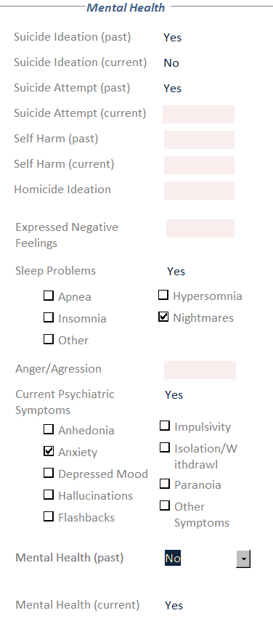
Data Collection
EXAMPLE MEDICAL NOTE
Chief Complaint: Depressive feelings x 3 months
History of Present Illness: Service member was referred by primary care for depressive feelings x 3 mos.
SM admitted has trouble falling asleep and staying asleep. SM claims that he wakes up nearly every night from nightmares. 1 SM denies suicide ideation or intent. 2 He reported thoughts of wanting to die and “not be here anymore” two months ago. 3 Two months ago he took all of his prescription medication (12 pills) and consumed ½ a bottle of tequila. He said he didn’t want to wake up at the time, but a roommate found him and brought him to the ER. 4
No childhood mental health dx. 5
Diagnosis: Axis I: Generalized Anxiety Disorder, 300.2 6
Disposition: Released w/o limitations. F/u as needed in 14 days w/mental health.

Slide 19
Data Collection
EXAMPLE MEDICAL NOTE
Chief Complaint: Depressive feelings x 3 months
History of Present Illness: Service member was referred by primary care for depressive feelings x 3 mos.
SM admitted has trouble falling asleep and staying asleep. SM claims that he wakes up nearly every night from nightmares. 1 SM denies suicide ideation or intent. 2 He reported thoughts of wanting to die and “not be here anymore” two months ago. 3 Two months ago he took all of his prescription medication (12 pills) and consumed ½ a bottle of tequila. He said he didn’t want to wake up at the time, but a roommate found him and brought him to the ER. 4
No childhood mental health dx. 5
Diagnosis: Axis I: Generalized Anxiety Disorder, 300.2 6
Disposition: Released w/o limitations. F/u as needed in 14 days w/mental health.

Slide 20
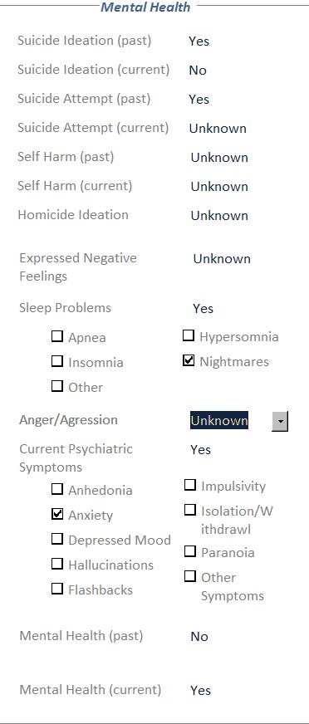
Data Collection
EXAMPLE MEDICAL NOTE
Chief Complaint: Depressive feelings x 3 months
History of Present Illness: Service member was referred by primary care for depressive feelings x 3 mos.
SM admitted has trouble falling asleep and staying asleep. SM claims that he wakes up nearly every night from nightmares. 1 SM denies suicide ideation or intent. 2 He reported thoughts of wanting to die and “not be here anymore” two months ago. 3 Two months ago he took all of his prescription medication (12 pills) and consumed ½ a bottle of tequila. He said he didn’t want to wake up at the time, but a roommate found him and brought him to the ER. 4
No childhood mental health dx. 5
Diagnosis: Axis I: Generalized Anxiety Disorder, 300.2 6
Disposition: Released w/o limitations. F/u as needed in 14 days w/mental health.

Slide 21
Results - Demographics
Demographics | Attempts | Deaths
Population Total | 128 | 53
Sex | 63.3% Male | 98.1% Male
Average Age (Range) | 23 y/o (18-41) | 26 y/o (20-42)
Top Occupations | Medical Specialties (23.4%) Electronics Technician (7.0%) | Machinist’s Mate (11.3%)

Slide 22
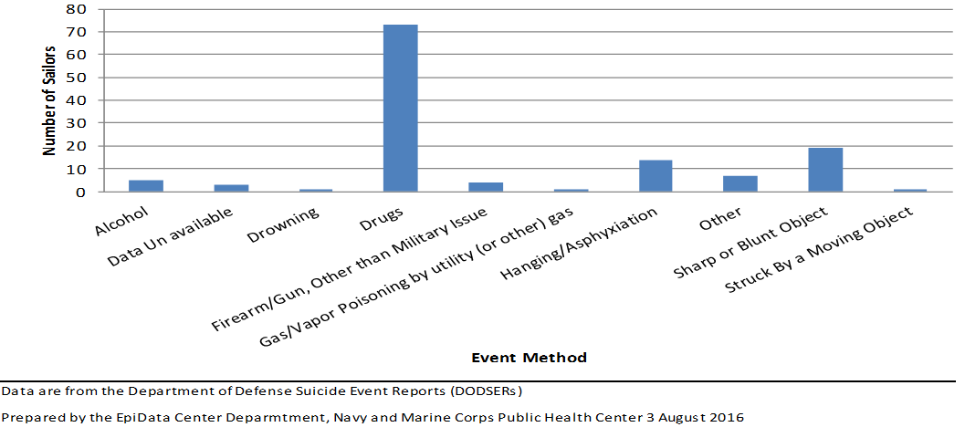
Method of Suicide Attempts (n=128)

Slide 23
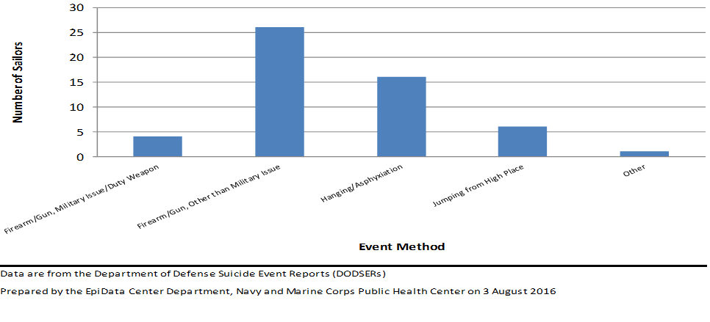
Method of Suicides (n=53)

Slide 24
Prior Medical Encounters with Behavioral Health Conditions, 3 Years Prior to Event
 | Attempts (n=128) | Death (n=53)
Sailors Identified with Behavioral Health Encounter | 83 Sailors (64.8%) | 18 Sailors (34.0%)
Average Days from Last Behavioral Health Encounter to Cohort Event | 74.7 Days (1-1,039) | 221.4 Days (1-892)
Average MHS Behavioral Health Encounters Prior to Cohort Event | 45.6 Encounters (1-242) | 38.6 Encounters (1-241)

Slide 25
Substance Abuse Treatment, One Year Prior to Event
 | Attempts (n=128) | Death (n=53)
Sailors Identified with Substance Abuse Treatment | 19 Sailors (14.8%) 16 Alcohol 3 Drug/Other | 6 Sailors (11.3%) 3 Alcohol 3 Drug/Other
Average Days from Last Alcohol Abuse Encounter to Cohort Event | 96.4 Days (18-347) | --
Average Days from Last Drug Abuse Encounter to Cohort Event | 61.3 Days (25-107) | --

Slide 26
Prior Medical Encounters, 90 Days Prior to Event
 | Attempts (n=128) | Death (n=53)
Sailors Identified with a Medical Encounter | 108 Sailors (84.4%) | 29 Sailors (54.7%)
Average Days from Last Medical Encounter to Cohort Event | 13.9 Days (1-84) | 23.3 Days (1-88)
Average MHS Medical Encounters Prior to Cohort Event | 16.7 Encounters (1-146) | 7.7 Encounters (1-34)

Slide 27
Selected Prescriptions Fills, 90 Days Prior to Event
 | Attempts (n=128) | Death (n=53)
Sailors with a Selected Prescription Fills | 54 Sailors (42.1%) 22 One Prescription 32 Two or More Prescription | 8 Sailors (15.1%) 5 One Prescription 3 Two or More Prescription
Average Number of Prescription Fills | 5.1 Prescriptions (1-25) | 4 Prescriptions (1-11)
Average Days from Last Prescription Fill to Event | 38.0 Days (1-90) | 34.9 Days (1-89)

Slide 28
Behavioral Health Related Risk Factors Identified in AHLTA, 90 Days Prior to Suicide Attempt (n=128)

Slide 29
Life Experience Risk Factors Identified in AHLTA, 90 Days Prior to Suicide Attempt (n=128)

Slide 30
Behavioral Health Related Risk Factors Identified in AHLTA, 90 Days Prior to Suicide Deaths (n=53)

Slide 31
Life Experience Risk Factors Identified in AHLTA, 90 Days Prior to Suicide Deaths (n=53)

Slide 32
Limitations and Discussion
Case reviews are a retrospective analysis of categorical risk variables based on provider documentation and self-report of service member
For variables where a trained reviewer could not determine the best category, consultation with other team members was sought
Results are not generalizable to a larger population
Final report provided to N171
NMCPHC completed 3 reports with 4 years of data
31

Slide 33
Acknowledgements
Dagny Aldrich
Laura Armstrong-Bauer
Michael Birnbaum
Malia Carpio
Anna Carroll
Ashleigh Drake
Jessica Newton
Katy Pelchy
Beth Poitras
Dr. Chris Rennix
Chelsea Saia
32

Slide 34
Questions? Tina Luse, MPH Tina.m.luse,civ@mail.mil 757-953-0449

