Slide 1
Developing a Suicide Deep Dive Data Collection Tool for the Navy
Tina M. Luse, MPH
Christine E. Glasheen, MPH
Armed Forces Health Surveillance Branch

Slide 2
The views expressed in this presentation are those of the author and do not necessarily reflect the official policy or position of the Department of the Navy, Department of Defense, or the U. S. Government.

Slide 3
EpiData Center Overview
Five Divisions
Reportable and Emerging Infections
Hospital Acquired Infections and Patient Safety
Exposure and Injury Analysis
Behavioral and Operational Health
Application Development and Data Systems Support
Epidemiologists and statistical programmers with support from senior epidemiologists and IT team
Division Officers coordinate resources and schedules to meet deadlines and provide project oversight

Slide 4
Staff
Senior epidemiologists - 4
Senior IT developer - 1
Staff epidemiologists -21
Provide project support
Programmers – 8
Prepare data for analysis
Database administrators – 4
Responsible for data acquisition and organization
Help desk personnel - 5
External data collection programs, program support (e.g. eDHA, DRSi, CarePoint)
Management Assistants – 1
Technical Writers - 1

Slide 5
Mission
Navy lead for health surveillance.
Provide data analysis for public health surveillance for Navy and Marine Corps members and beneficiaries.
Conduct investigations and studies.
Provide support for outbreak investigations
Provide epidemiologic and data consultation, as well as study design support.
Provide innovative approaches to infectious disease surveillance for the Department of Defense in support of the Global Emerging Infection Surveillance and Response System.
Develop and support public health data collection applications

Slide 6
Behavioral Health Division
Supports Navy Suicide Prevention efforts by conducting multiple epidemiologic and analytic projects.
Surveillance of behavioral health conditions
Medical record reviews for all USN/USMC suicide deaths
Clinical/administrative data
Quantitative review of AHLTA clinical notes
Participate in Navy interdisciplinary Suicide Case Reviews (‘Deep Dives’)
Analysis of risk factors among Navy suicide attempts and death
Ad hoc analyses
5
Notes:
Surveillance
- PTSD, Depressive Disorder, Alcohol Use Disorder…extended use of psychotropic medications… service members answer and referrals on the Post Deployment Health Reassessment
Clinical/admin
-Personnel records (Demographics), outpatient/inpatient/theater encounters, Deployment Health Assessments, Pharmacy Transactions
Quantitative
-Review of medical notes, summary of notes, evaluate notes for suicide risk factors
Next Presentation

Slide 7
Background
Navy Suicide Deep Dives
Organized by Navy Suicide Prevention Program (N171)
Yearly working group
Consists of a multi-disciplinary team of psychiatrists, psychologists, epidemiologists, social workers, law enforcement, chaplains, and counselors
Comprehensive record review
Collect standardized data on each case
Find common risk factors, opportunities for interventions, and suggest recommendations for future prevention strategies to policymakers
Notes:
Wed at 1:30
Purpose of the Deep Dive
Data lag - the 2017 Deep Dive was for 2015 records (needed to ensure completion of NCIS)

Slide 8
Record Review
Available Data
CNO Report
DODSER
Medical Encounters
Pharmacy Transactions
NCIS/Police Reports
Deployment Histories
Deployment Health Assessments
Family Advocacy Program
Tragedy Assistance Program for Survivors (TAPS)
Personnel Records
FITREPS
PRIMS
Accession
Notes:
Medical Encounter includes Purchased Care
TAPS – Families have to opt in to share their information. We really appreciate families providing these data as sometimes they provide good insights into the lives of the Sailors.

Slide 9
Case Review Process
Cases divided between two groups
59 cases over 5 days
Work in separate rooms
Each person responsible for specific part of review
20-45 minutes to review documentation
15-30 minutes for discussion
Notes:
Each group has representation from each discipline
30 cases in one group and 29 in other
Collection tool is projected on a screen with one epidemiologist entering the data in each room
Team members have laptops with a disk of all data for their cases
For many group members it is the first time they are seeing these data.
Data are secured during breaks and in the evening. No data are stored on laptops.
Timeframes are estimated.

Slide 10
Data Collection Request
For the CY2015 Deep Dive, Navy Suicide Prevention Office (N171) tasked NMCPHC to develop a suicide data collection tool for the Navy deep dive.
Prior to 2015 Deep Dive data were collected in Excel
Lack of data standardization across years
More prone to data entry errors
Did not allow for drop downs selection menus
Unfriendly interface
NMCPHC had previously created a deep dive data collection tool for a Marine Corps suicide project (Summer of 2016)
Notes:
Lack of standardization
- Different people filling it out each year and also changing variables across years.

Slide 11
Step 1: Identify Variables
Used existing N171 Excel tool variables
Met with N171 to identify new variables
Data Categories
Demographics
Military
Suicide Event
Health/Medical
Personal Factors
Personal History
Notes
Data Quality
Notes:
We identified some new variables from research
Removed variables that were found to not add value.

Slide 12
Step 2: Build the Database
Discussed software with EDC IT staff
Microsoft Access
Easy to use
Easy to change
Export functions
Widely available
Government Approved
Developed a specification document for IT staff
Variable name, format, menus, rules
Multiple revisions
Notes:
Time consuming – Give time estimate – Creating specification document took several week, Building the tool took 2 months, Revisions took 2 months
Epidemiologists do not speak in IT language and vice versa

Slide 13
Step 3: Beta Testing
Sent to N171 for review and edits
EDC Epidemiologists and IT staff tested the dataset over multiple weeks
Overall design made sense
Data on front end matched data on back end
Multiple revisions
Notes:
Beta testing took several weeks.
We added and removed variables from Excel
Flow and spelling

Slide 14
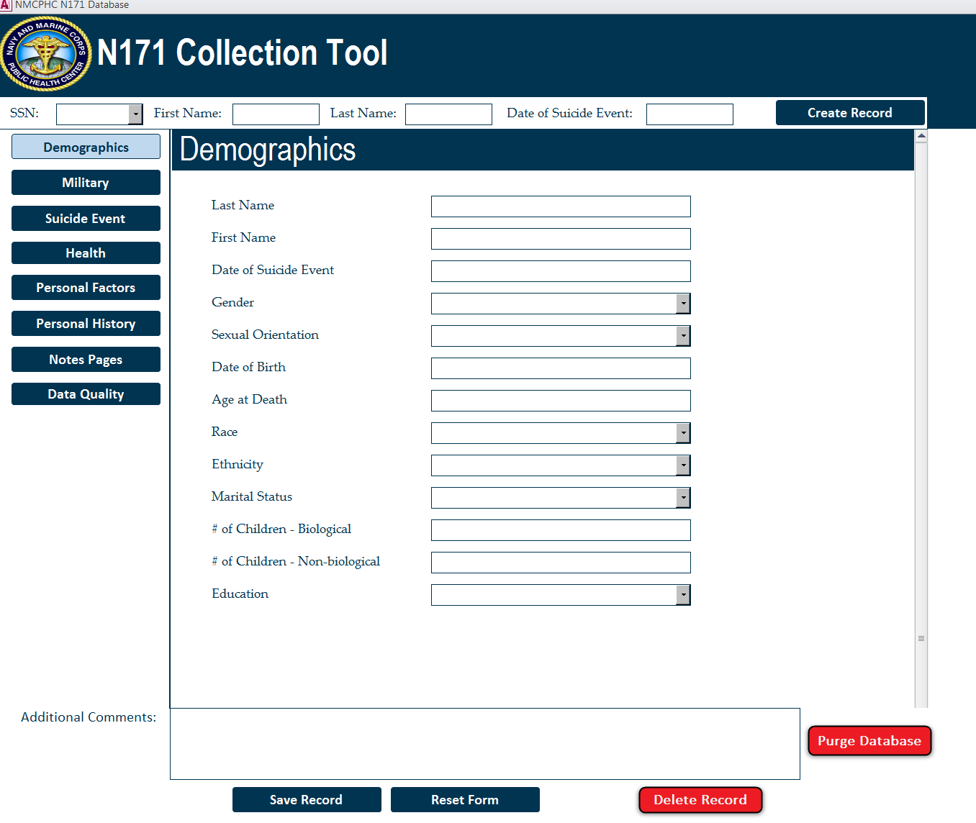
Notes:
Tool Contains 168 variables

Slide 15
Notes:
Tool Contains 168 variables

Slide 16
Notes:
Tool Contains 168 variables

Slide 17
Notes:
Tool Contains 168 variables

Slide 18
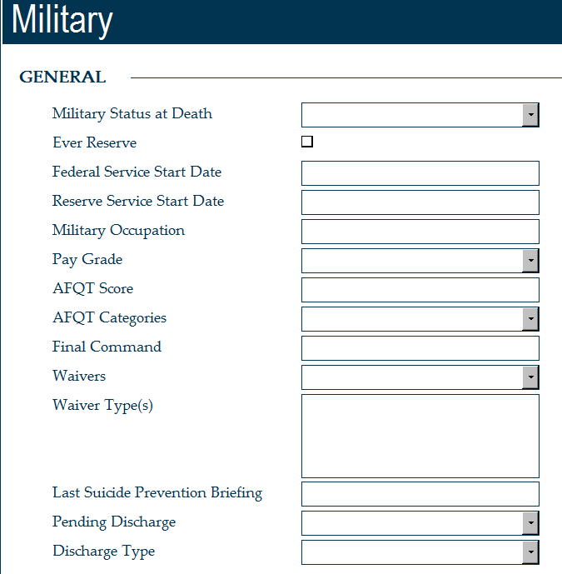
Notes:
Check Boxes
Drop Down Menus
Free Text

Slide 19
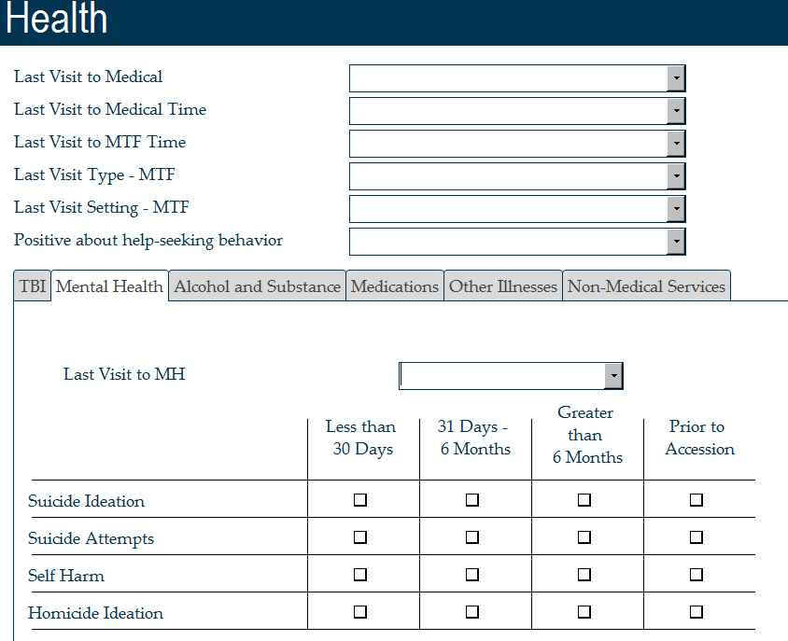
Notes:
Tabs
Much easier to capture Timeframes
Customer identified timeframes.

Slide 20
Data Categories
Demographics
Military
Suicide Event
Health/Medical
Personal Factors
Personal History
Notes
Data Quality

Slide 21
Step 4: Finalize Data Dictionary
Entry created in a data dictionary for each variable available in tool
Included a description, values, and notes
Helps to guide Deep Dive team
Keeps answers consistent across two work groups

Slide 22
Data Dictionary
Variable | Description | Values | Notes
Last Visit to Medical | Location of last medical encounter prior to death | Purchased Care Military VA
Last Visit to Medical Time | Most recent medical encounter prior to suicide | No Visits Same Day as Suicide <30 days 31-6 months 6 months – 1 Year >1 Year Unknown | This encounter and ‘Last visit to Medical’ can be the same encounter. Does not include no-show, cancellations, or left without being seen.

Slide 23
Step 5: Rollout
May 2017 – Deep Dive work groups successfully used collection tool
It worked great and helped the teams stay focused
But there were some lessons learned!

Slide 24
Lessons Learned – Successes
Created in less than four months
Helped facilitate the flow of the Deep Dives
Created clean Excel sheet for analysis post Deep Dive
Saves time
Comment field that flowed across segments was very helpful
At end of Deep Dive, data was exported to facilitate discussion

Slide 25
Lessons Learned – Challenges
Beta testing should occur on computer screen that will be used at Deep Dive (Resolution)
Variable values did not match what was in the available documentation.
Example: Last suicide prevention briefing
Flow of tool should be optimized
Unknown vs. Blank values
Eliminate as much user error as possible
Variable constraints, create sub-tabs, autofill subcategories
The most well thought out tool/dictionary cannot account for all circumstances
Discrepancies still exist between the two work groups

Slide 26
Future State
Data from tool is used in the N171 Deep Dive Report
Can be used for Deep Dives in other services
Tailored for each service
Will be used again next year with minor edits
Variables remain the same

Slide 27
Acknowledgements
IT Programmers
Sean Tosloskie
James McWhorter
Epidemiologists
Michael Birnbaum
Malia Carpio
Alina Rossini
Andrea Harris
Rakel Cleveland
26

Slide 28
Questions? Contact Information Tina Luse, MPH tina.m.luse.civ@mail.mil 757-953-0449

