Slide 1
A Systems Approach to Examining Military Suicides: The Marine Corps Death by Suicide Review Board
2017 DoD/VA Suicide Prevention Conference
Denver, CO
1-3 August 2017
Sandra Morrison, MS, Research and Program Evaluation Section Head, Behavioral Health
Jessica Jagger, PhD, Assistant Branch Head, Behavioral Health

Slide 2
Agenda
Overview
Background
Procedure
Board Members
Data Sources
Methodology
Descriptive Information
Example Findings & Recommendations
Limitations & Way Ahead

Slide 3
Death by Suicide Review Board (DSRB)
Background
In 2016, 37 Active duty Marines died by suicide
The DSRB reviewed each case over three, two-day sessions in the first quarter (calendar) of 2017
Subject Matter Experts from the Marine & Family Program Division used a process-evaluation strategy employing a systems-level approach
Purpose
Review each death by suicide of an active duty Marine in order to obtain information needed to reduce the likelihood of future suicides
The targeted end state for the 2016 DSRB is actionable recommendations for leadership
Structure
The DSRB is intentionally disparate and highlights the limited accessibility to and integration of information available in the field during the time immediately preceding each event

Slide 4
Procedure
Prior to each 2016 DSRB session, individual Board Members reviewed information from one documentation source
Each death by suicide case was reviewed by the board during the session, with each board member briefing key findings from their data source and perceived risk levels (~ 15 minutes per case)
The Board discussed data quality issues and used multiple sources to rectify discrepancies when possible
Once fully briefed, the Board’s discussion centered around whether standards of care and the system of care experienced by the Marine followed best practices (~ 15 minutes per case)
After the review of each case, discussion moved to a systems-level analysis
The Board Members assessed across cases to identify gaps in symptom identification, care communication, and service implementation

Slide 5
DSRB 2016 Board Members
Chairperson: Research and Program Evaluation Section Head, Behavioral Health, Marine and Family (MF) Division
Assistant Branch Head-Integration, Behavioral Health, MF Division
Community Counseling Program Section Head, Behavioral Health, MF Division
Senior Clinical Advisor, Behavioral Health, MF Division
Suicide Prevention Section Head, Behavioral Health, MF Division
Quality Assurance Section Head, Program Assessment, MF Division
Data Surveillance Section Head, Behavioral Health, MF Division

Slide 6
DSRB 2016 Data Sources
Data Source | Description | Example Variables
ACMC 8-Day Brief | Accounting of events surrounding death | Sociodemographics Force Preservation Council Timeline of events
Department of Defense Suicide Event Reports (DoDSERS) | Standardized suicide surveillance data collection across DoD | Behavioral health diagnoses Administrative legal issues Failed relationship status
Armed Forces Health Longitudinal Technology Application (AHLTA) | Medical records | Physical and mental health status Diagnoses Prescriptions
Marine Lookup | Marine Corps career history | Previous duty stations Time in grade PFT/CFT scores
Department of Defense Case Management System (DoDCMS) | Clinical case management systems from Behavioral Health encounters | Case notes Clinical forms Treatment plan
Behavioral Health tracking | Summary of involvement in Behavioral Health systems | START (Suicide Tracking and Reporting Tool) CASA (Child Abuse and Spouse Abuse Central Registry)
December 2016 Demographics | Total Force report | Divorce rate

Slide 7
DSRB Methodology
The methodological approach consists of a retrospective review of a rare event within a population of Marines during 2016. Although similar techniques have been criticized due to reliability, validity, and bias concerns, the nature of death by suicide research prohibits a more rigorous approach (Pouliot & De Leo, 2006)
The DSRB is cognizant of the methodological limitations and strives to minimize methodological errors through the recognition and mitigation of biases:
“Hindsight bias” leads to a false belief that events are more predictable than they are
“Historian’s fallacy” is the erroneous assumption that decision makers involved in the Marine’s environment at the time of the event possessed the same breadth and depth of information as those analyzing the event after the fact
“Post hoc ergo propter hoc” is the error of assuming that because an event follows a factor, the factor caused the event to occur
“Base rate fallacy” is a concern when a small sample is examined without contextualization of the larger population

Slide 8
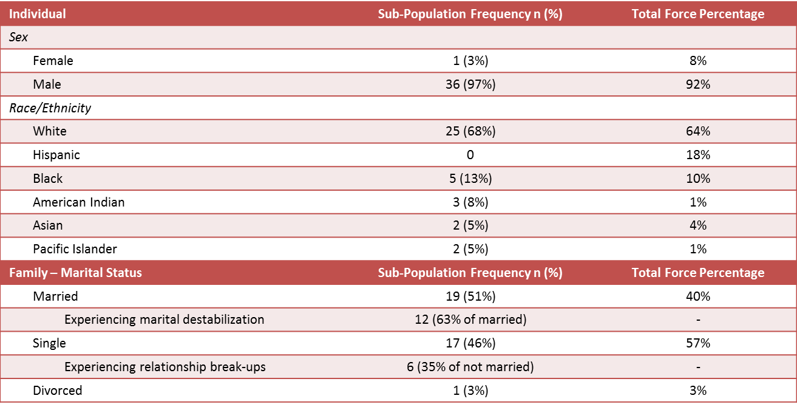
2016 Sociodemographic Characteristics

Slide 9
Age in Years of each Marine who Died by Suicide
Median age was 23 years old
Age range was 19 to 49 years old
Highest frequency age was 22 years old

Slide 10
Rank Distribution
Enlisted
Officer
Expected by rank proportion in population

Slide 11
Means/Methods Distribution
Carbon monoxide poisoning, 1
Over half of the deaths by suicide occurred from a gun shot wound
Nearly 40% of 2016 deaths by suicide occurred from hanging

Slide 12
Risk Profiles of Marines who Died by Suicide in 2016
As reported in the DSRB data sources as information available to Marine Corps personnel prior to the event:
43% of the Marines who died by suicide were not identified with risk factors
Highlights the need for improved detection and sharing of information
33% were identified with at least one risk indicator
Highlights the need for improved identification of risk
24% were identified with robust indications of high suicide risk
Highlights the need for improved mitigation strategies
Notes:
Example bullet one: Girlfriend broke up with Marine on leave
Example bullet two: Administrative separation (ADSEP), exposure to fellow Marine deaths by suicide, divorce, nonjudicial punishment (NJP)
Example bullet three: severe relationship distress, previous suicidal behavior, sexual assault charges,

Slide 13
1st Example of Findings and Recommendation: Target awareness for older Marines at risk for suicide
Findings:
Similar to challenges in civilian suicide prevention among older individuals (Juurlick, Herrmann, Szalai, Kopp & Redelmeier, 2004), it may be that command is less aware of suicide risk indicators in older Marines
Recommendation:
Increase command awareness regarding suicide risk for SNCOs
Ensure communications regarding age as a risk factor accurately reflect risk distribution
Should not exclude the presence of outliers (i.e., older Marines)
13
Notes:
Profile characteristics:
Marital discord
Substance abuse issues

Slide 14
2nd Example of Findings and Recommendations: Greater chain of command awareness of the social factors influencing a Marine’s suicide risk
Findings:
Suicide risk factors often occur outside the scope of duty
Relationship distress was prevalent
A common finding among Marines who died by suicide in 2016 were social risk factors that were unknown to chain of command
In multiple cases, the only perceivable warning sign was communicated through social media
Recommendations:
Additional education regarding the influence of ecological systems (such as relationship breakups, family conflicts, or unit cohesion) on individual behavior
Encourage chain of command to have situational awareness on Marines’ social lives
Social media may be an avenue for recognizing a Marine is at high risk
Notes:
Systems driven

Slide 15
Summary of Recommendations
Mechanisms to address information barriers existing between the Marines and command, medical, and Behavioral Health
Communication strategies to ensure enterprise wide understanding of suicide risk indicators
Improved effectiveness in mitigation strategies for those Marines at greatest risk
Notes:
10 specific recommendations presented to leadership this year.

Slide 16
DSRB Limitations and Way Ahead
Limitations
Problematic data quality and availability impedes the ability to gain valuable information needed to understand Marine deaths by suicide
In some cases, information available on the 8-day Report and the DoDSER contradict within the report or with each other
Additional opportunities for data not currently requested/required on reports (e.g., performance in unit)
Data is secondhand and cannot speak to the Marine’s perceptions
Way Ahead
Address data quality issues and conduct multiyear analyses
Work with sister services to compare methodology and share findings
Review participation in the DSRB to examine for inclusion of additional stakeholders (e.g., Bureau of Medicine and Surgery (BUMED) , Safety, G10, Chaplains)

Slide 17
References
Pouliot, L., & De Leo, D. (2006). Critical issues in psychological autopsy studies. Suicide and Life-Threatening Behavior, 36, 491-510.
World Health Organization. (2012). Public health action for the prevention of suicide: A framework. World Health Organization; Geneva, Switzerland: 2012.

Slide 18
Contact Information
Jessica Jagger, PhD, MSW Jessica.Jagger@usmc.mil
Sandra Morrison, MS
Sandra.Morrison@usmc.mil
HQMC Marine & Family Programs Division, Behavioral Health Branch

