Slide 1
Navy Suicide Deep Dive Process and Lessons Learned
Tina M. Luse, MPH

Slide 2
The views expressed in this presentation are those of the author and do not necessarily reflect the official policy or position of the Department of the Navy, Department of Defense, or the U. S. Government.

Slide 3
Navy Deep Dive History
Deep Dive = Multi-disciplinary suicide case reviews
In 2009, ‘Suicide Prevention Cross Functional Team recommended subject matter experts conduct annual reviews of Navy suicides’
Identify patterns and lessons learned
All available data
First review took place in 2012 and continued annually
Navy Suicide Prevention Office (N171) coordinates deep dives, collects data, and provides findings
2
Notes:
2012 deep dive was for 2010 deaths. Why?

Slide 4
Deep Dive Process – Before
N171 sends a roster of confirmed Navy suicide deaths (DODSER) to identify all available data on each case
NCIS – investigations and local police reports
N1 – provides FITREPS and accession data
Tragedy Assistance Program for Survivors (TAPS) – postvention among family members
Family Advocacy Program – counseling visits
N171 – online media searches, CNO reports, DODSERs
Notes:
Navy deep dives occur more than one year out to provide time for data collection
Can take up to one year to get finalized NCIS invesitgations and medical record reviews take a team of seven epidemiologists several months.
FAP includes domestic violence and mandatory counseling
Social media includes new articles, obituaries, social media (Facebook, twitter): SPARCITY of data

Slide 5
Deep Dive Process – Before
NMCPHC Extracts
Medical records, summarized, and suicide risk factors are captured
Personnel Records – Physical Readiness Tests (PRTs), Pay Records, Deployments
Deployment Health Assessments
Line lists of administrative data
Inpatient, Outpatient, In-theater medical encounters
Pharmacy Transactions
Laboratory Tests

Slide 6
Deep Dive Process - Before
All collected data are sent to N171
N171 collates data onto individual discs
N171 identifies a multi-disciplinary team and invites them to Millington for five days
Psychiatrists, psychologists, counselors, epidemiologists, NCIS officers, senior enlisted personnel, researchers, reserve community, chaplains
Each bring their own unique perspective to the table.

Slide 7
Deep Dive
59 cases over 5 days (CY15 reviews)
Cases divided between two groups
Work in separate rooms
Each person responsible for specific part of review
20-45 minutes to review documentation
15-30 minutes for discussion and data collection
NMCPHC epidemiologists complete data collection, projected on screen
Epidemiologist help guide team for time and help with the consistency of how the group flags variables
Data security before and during the meetings is paramount

Slide 8
Deep Dive Process – Data Collection
For the most recent Deep Dive (May 2017), N171 requested that NMCPHC build a data collection tool
Replaced Excel spreadsheets
NMCPHC & N171 identified variables
NMCPHC built tool, beta tested tool, and created a data dictionary

Slide 9
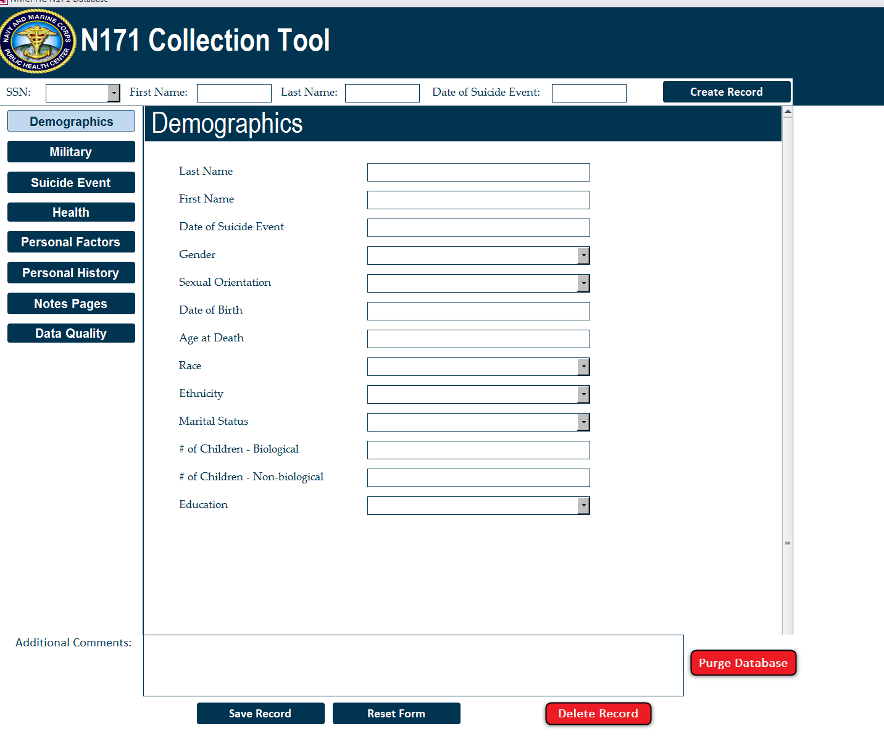
Notes:
Tool Contains 168 variables
Built in Microsoft Access

Slide 10
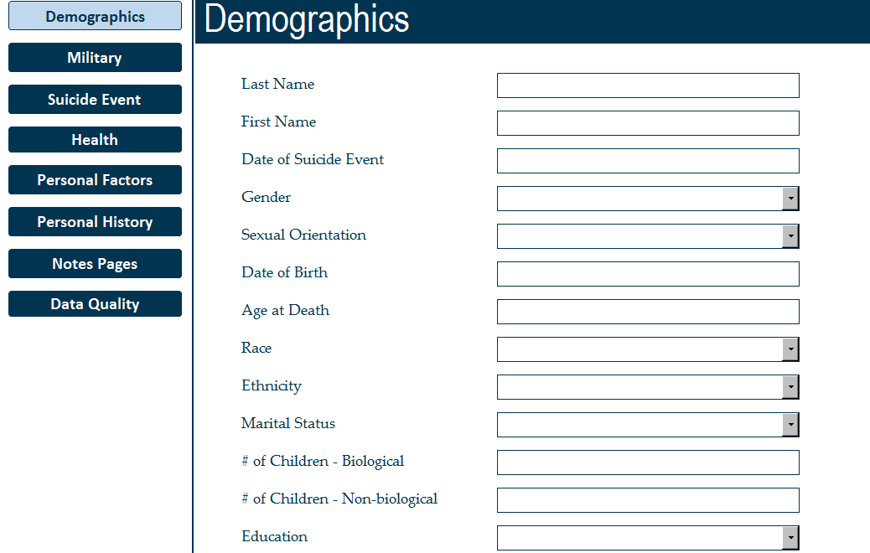

Slide 11
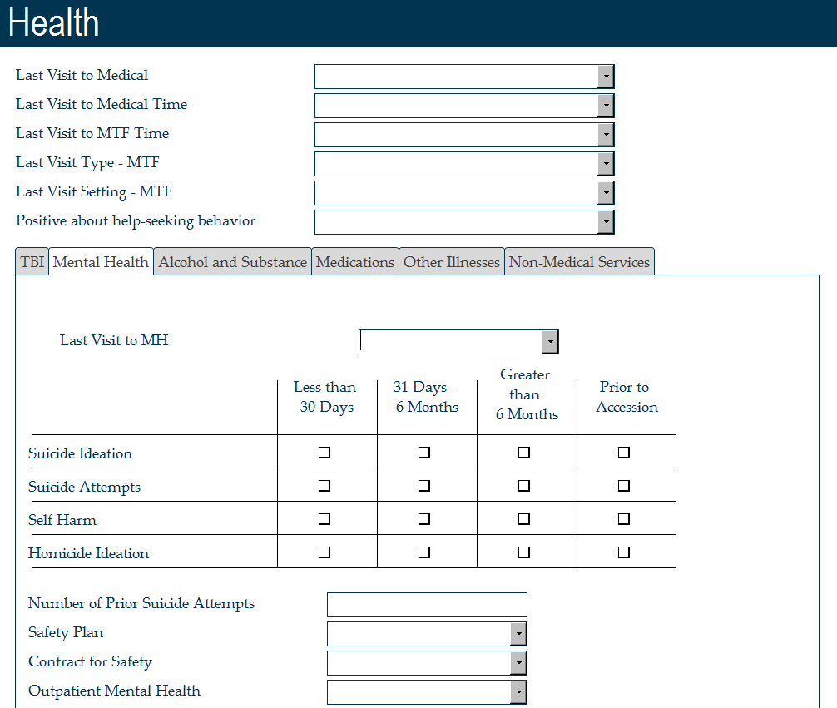

Slide 12
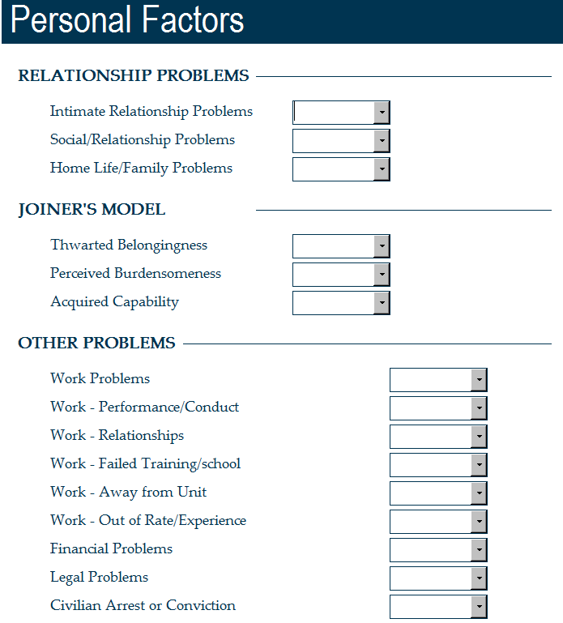

Slide 13
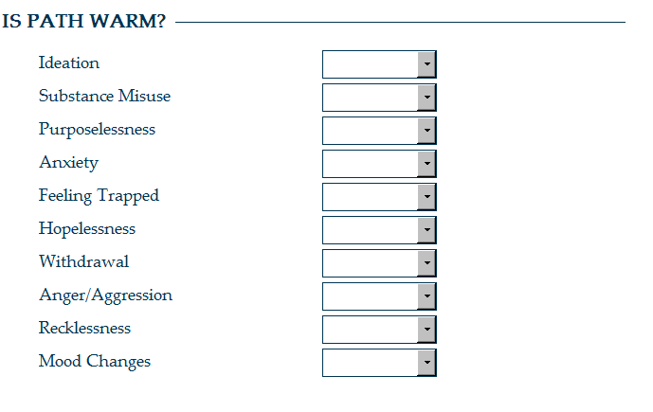

Slide 14
Dictionary

Slide 15
Deep Dive
Final Day
After teams complete case reviews, identify biggest takeaways
Both Deep Dive teams meet together to present findings
Teams brainstorm together
Final recommendations follow 2010 DOD Task Force Report
Organization and Leadership
Wellness Enhancement and Training
Access to and Delivery of Quality Care
Surveillance, Investigations and Research

Slide 16
Deep Dive Process – Post Deep Dive
NMCPHC provides data analytics for N171
Aggregate data from collection tool
Provide cross tabulations of findings
N171 completes a report of aggregated data and summarizes findings
NMCPHC and N171 meet and identify potential areas for improvement for following year’s Deep Dive

Slide 17
Lessons Learned
Multi-Disciplinary team is essential for data interpretation
Data dictionary guides decisions, but teams still interpret differently
Cases are unique and team needs to have flexibility in data capture
Easily navigable data are essential
More interesting data simply gets more attention
Interpretation of social media data problematic
Team knows the outcome so they are inherently biased.
Notes:
We know the outcome so we are inherently biased. Although teams try to be objective we are still placing our ideas about an indivudal into the data.
Interpretation of social media posts. Needs young social media users

Slide 18
Lessons Learned
Data from multiple sources is essential but there are always still unknowns in the suicide death
DODSERs alone are not a comprehensive data source
Data collection tool helped facilitate discussion, allowed for better data capture, and made data analysis post deep dive easier
Deep Dive findings should be widely disseminated to commanders
Team members often say they are influenced by the process and take back what they have learned to their own work and teams
Every year the Deep Dive gets better. A lot of knowledge gained

Slide 19
Acknowledgements
Laura Armstrong-Bauer
Michael Birnbaum
Malia Carpio
Christine Glasheen
James McWhorter
Beth Poitras
Alina Rossini
Jessica Spencer
Sean Tosloskie
N171
CDR Tara Smith
Kimberly Myers
Steve Holton

Slide 20
Questions? Tina Luse, MPH tina.m.luse.civ@mail.mil 757-953-0449

