Slide 1
BEST PRACTICES
FOR SAFE REPORTING
ON SUICIDE
Dr. Daniel Reidenberg
August 2, 2017
Reidenberg 2017. No reproduction or duplication permitted.

Slide 2
Why Are We Talking About Reporting?
Why we need safe reporting and messaging surrounding suicide.
More than 50 research studies worldwide have found that certain types of news coverage can increase the likelihood of suicide in vulnerable individuals.
Covering suicide carefully, even briefly, can change public misperceptions, which can encourage those who are vulnerable or at risk to seek help.
Military personnel are in a unique position to influence public perception of suicide among military members through media interviews.
Reidenberg 2017. No reproduction or duplication permitted.

Slide 3
Why This Matters
Three driving factors for creating best practices.
1
2
3
Media Contagion
Scope of the Problem
WHO Identifies Media as Priority
Reidenberg 2017. No reproduction or duplication permitted.

Slide 4
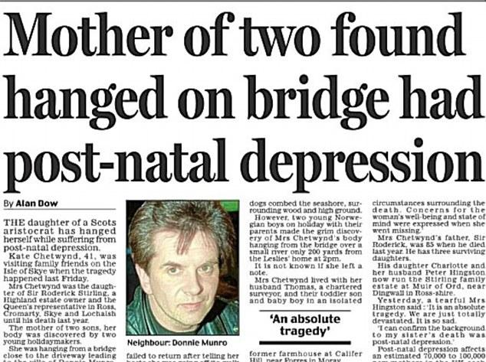
Media Contagion
Suicide contagion is real
An increase in suicides following media reporting is impacted by:
Frequency of reports
Placement of reports
Language used
Prominent examples of contagion:
Vienna ​Subway
Marilyn Monroe​
Mall of America
Reidenberg 2017. No reproduction or duplication permitted.

Slide 5
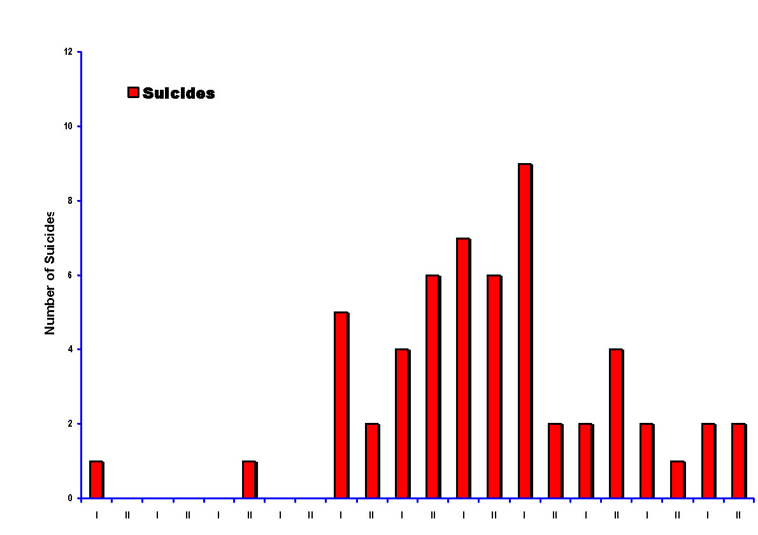
SUICIDES IN THE VIENNA SUBWAY SYSTEM - 1980 through 1990 -
Implementation of
Media Guidelines
1980 1981 1982 1983 1984 1985 1986 1987 1988 1989 1990
I indicates the first six months and II the second six months. The media guidelines of the Austrian Association for Suicide Prevention went into effect in June 1987
From New England Journal of Medicine, Aug. 1992

Slide 6
Science Behind Contagion
Certain content related to suicide can increase risk of suicide or encourage positive behavior.
“Werther effect” refers to Goethe’s novel The Sorrows of Young Werther (1774), where a young man takes his life (contributing to supposedly 2,000 copycat suicides)
“Papageno effect” refers to Mozart’s opera The Magic Flute (1791), where a young man in love becomes suicidal, but copes well thanks to his friends’ intervention
%
Reidenberg 2017. No reproduction or duplication permitted.

Slide 7
Why This Matters
Three driving factors for creating best practices.
1
2
3
Media Contagion
Scope of the Problem
WHO Identifies Media as Priority
Reidenberg 2017. No reproduction or duplication permitted.

Slide 8
Scope of the Problem
Suicide contagion is not a US phenomenon (studies in Austria, Hungary, Germany, Australia, Japan).
Adolescents experience greater risk (Gould et al, 2003, Martin & Koo, 1997).. 5% of teen suicides happen in clusters.
There is a particularly strong effect surrounding suicide deaths of celebrities.
Reidenberg 2017. No reproduction or duplication permitted.

Slide 9
Scope of the Problem
Military exposure increases risk of suicide contagion by 20% (higher if there are multiple suicides in one unit). Ursano, et al. JAMA Psychiatry, 2017.
Reidenberg 2017. No reproduction or duplication permitted.

Slide 10
Why This Matters
Three driving factors for creating best practices.
1
2
3
Media Contagion
Scope of the Problem
WHO Identifies Media as Priority
Reidenberg 2017. No reproduction or duplication permitted.

Slide 11
WHO Prioritizes Responsible Media Reporting
Early identification and treatment
Training of health workers
Follow-up care and community support
Restricting access to means
Responsible media reporting
Introducing alcohol policies
Researching tech-based solutions
Reidenberg 2017. No reproduction or duplication permitted.

Slide 12
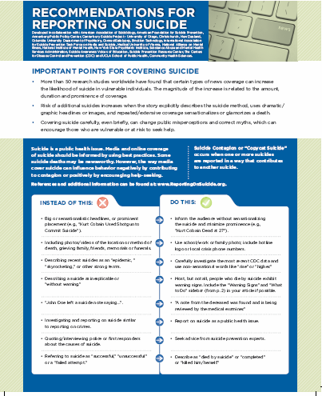
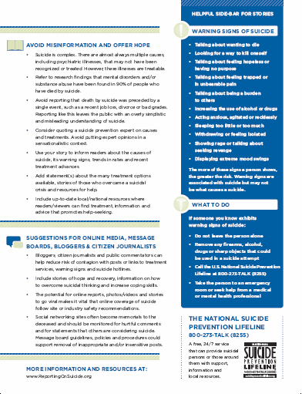
Media Recommendations for Reporting On Suicide
Best practices were developed to reduce risk and encourage effective messaging.
Media Contagion
%
www.ReportingOnSuicide.org
Reidenberg 2017. No reproduction or duplication permitted.

Slide 13
The following best practices come from these three foundational resources...
SPRC’s Safe and Effective Messaging for Suicide Prevention
Guidelines that apply not only to awareness campaigns, such as those conducted through Public Service Announcements (PSAs), but to most types of educational and training efforts intended for the general public.
Recommendations for Reporting on Suicide
The recommendations are based on more than 50 international studies on suicide contagion and marketed for use by media professionals like journalists and reporters. Mainstream messengers can also benefit from the recommendations.
National Action Alliance’s- Framework for Successful Messaging
The Framework was created by the National Action Alliance for Suicide Prevention as part of its priority to change the public conversation about suicide. It's for anyone who is messaging to the public about suicide and suicide prevention.
Reidenberg 2017. No reproduction or duplication permitted.

Slide 14
Concepts that the media is trained on can also be helpful to military personnel as they work with media and speak publicly about suicide.
Reidenberg 2017. No reproduction or duplication permitted.

Slide 15
Key Concepts Found in the Media Recommendations
Reidenberg 2017. No reproduction or duplication permitted.

Slide 16
INSTEAD OF THIS
DO THIS
Big or sensationalistic headlines, or prominent placement (e.g., “Kurt Cobain Used Shotgun to Commit Suicide”).
Inform the audience without sensationalizing the suicide and minimize prominence (e.g., “Kurt Cobain Dead at 27”).
Including photos/videos of the location or method of death, grieving family, friends, memorials or funerals.
Use school/work or family photo; include hotline logo or local crisis phone numbers.
Describing recent suicides as an “epidemic, ” “skyrocketing,” or other strong terms.
Carefully investigate the most recent CDC data and use non-sensational words like “rise” or “higher.”
%
Describing a suicide as inexplicable or “without warning.”
Most, but not all, people who die by suicide exhibit warning signs. Include the “Warning Signs” and “What to Do” in your article.
Reidenberg 2017. No reproduction or duplication permitted.

Slide 17
INSTEAD OF THIS
DO THIS
“John Doe left a suicide note saying…”.
“A note from the deceased was found and is being reviewed by the medical examiner.”
Investigating and reporting on suicide similar to reporting on crimes.
Report on suicide as a public health issue.
Quoting/interviewing police or first responders about the causes of suicide.
%
Seek advice from suicide prevention experts.
Referring to suicide as “successful,” “unsuccessful” or a “failed attempt.”
Describe as “died by suicide” or “completed” or “killed him/herself.”
Reidenberg 2017. No reproduction or duplication permitted.

Slide 18
What To Avoid
Simplistic Explanation
Inexplicable/No Warning
Suicide is complex and rarely can be attributed to a single cause. Avoid explaining suicide the result of common life events like stress, a job loss, divorce or break-up, etc.
Avoid describing that a suicide had no cause. This may incorrectly reinforce a false belief that treatment doesn’t work and suicide cannot be prevented.
Reidenberg 2017. No reproduction or duplication permitted.

Slide 19
What To Avoid
Glorifying/Romanticizing
Method/Location/Details
Portraying suicide as a heroic, romantic, or honorable act may encourage vulnerable people to view it more positively or lead them to desire the positive attention garnered by someone who has died by suicide.
Do not describe or write the method or location of death (may lead to copycat). Do not share many personal life details of person who died (may lead to identification). Instead, limit the details to the facts the audience needs to know.
Reidenberg 2017. No reproduction or duplication permitted.

Slide 20
What To Avoid
Sensational Headlines
Normalizing
Although you likely won’t have control over headlines or placement of stories, you can make a recommendation to avoid text that sensationalizes death by suicide. (e.g., “Kurt Cobain Used Shotgun to Commit Suicide”). Instead use “Kurt Cobain Dead at 27.”
Avoid portraying suicide as a common or an acceptable way to handle problems. Avoid using phrases like, “I would have killed myself too if that happened to me.” Most people who face adversity in life do not go on to die by suicide, but rather seek support in other ways.
Reidenberg 2017. No reproduction or duplication permitted.

Slide 21
What To Avoid
Harmful Language
Misusing Data
Referring to suicide as “successful,” “unsuccessful” or a “failed attempt.” Using the phrase “committed suicide.” Use phrases like “died by suicide,” “completed suicide” or “killed him/herself.”
Overusing or misusing data can enhance the idea that suicide is not preventable. When talking about data avoid describing suicide as an “epidemic” or using other strong words like “skyrocketing” or “increasing rapidly.” Use words like “rise” or “increase” instead.
Reidenberg 2017. No reproduction or duplication permitted.

Slide 22
What To Avoid
Contents of Suicide Note
Treating Suicide as a Crime
Most suicide notes do not include logical or helpful information and may describe personal details that a vulnerable person may identify with. Instead, share that a note was found, but exclude further details.
Avoid talking to the media on suicide similar to talking to the media about crimes. Instead, talk about suicide as an important public health issue.
Reidenberg 2017. No reproduction or duplication permitted.

Slide 23
What To Include
Resources
Prevention Information
Include up-to-date local/national resources where readers/viewers can find treatment, information, and advice that promote help-seeking.
Use your story to inform readers about the causes of suicide, its warning signs, trends in rates, and recent treatment advances.
Reidenberg 2017. No reproduction or duplication permitted.

Slide 24
What To Include
Complexity of Suicide
Quotes from Experts
Suicide is complex. There are almost always multiple causes, including psychiatric illnesses that may not have been recognized or treated.
Consider quoting a suicide prevention expert on causes and treatments. Avoid putting expert opinions in a sensationalistic context.
Reidenberg 2017. No reproduction or duplication permitted.

Slide 25
What To Include
Treatment
Share Research Findings
Add statement(s) about the many treatment options available, stories of those who overcame a suicidal crisis, and resources for help.
Refer to research findings that mental disorders and/or substance abuse have been found in 90 percent of people who have died by suicide.
Reidenberg 2017. No reproduction or duplication permitted.

Slide 26
What To Include
Stories of Hope
Share resources online
Include stories of hope and recovery, information on how to overcome suicidal thinking and increase coping skills.
Bloggers, citizen journalists, and public commentators can help reduce risk of contagion with posts or links to treatment services, warning signs, and suicide hotlines.
Reidenberg 2017. No reproduction or duplication permitted.

Slide 27
Responding to Media Inquiries
And getting information to the media.
%
Reidenberg 2017. No reproduction or duplication permitted.

Slide 28
TIPS FOR TALKING
WITH THE MEDIA
When media contacts you
&
Reaching out to media
Reidenberg 2017. No reproduction or duplication permitted.

Slide 29
What you should know upfront
Reporters have an agenda.
Know that reporters are going to use some of what you tell them and not attribute it to you.
Reporters are on a tight deadline.
Reporters are usually not trying to win an award, but they do want to keep their job.
Reporters might know more than you do about a story.
Not every reporter is ethical or follows the best practices.
They will want to come to you, often for B-roll visuals.
Reporters know that you are going to say more than they can use.
Your surroundings say a lot about you.

Slide 30
PART ONE
When media contacts you
Reidenberg 2017. No reproduction or duplication permitted.

Slide 31
Understand that your roles are different. Their role is to report. Your role is to help them.
Tip: Stay focused on your job.
Reidenberg 2017. No reproduction or duplication permitted.

Slide 32
Know that you get one soundbite, not an elevator speech.
Tip: Prepare a 5-10 second soundbite before they arrive
Reidenberg 2017. No reproduction or duplication permitted.

Slide 33
A call from a media outlet can happen at any time.
Tip: Be prepared and have a media plan in place. Know who will speak with the media (including survivors).
Reidenberg 2017. No reproduction or duplication permitted.

Slide 34
Have a strategy for your one key message.
Tip: Think carefully about their story and your message and develop a soundbite from there.
Reidenberg 2017. No reproduction or duplication permitted.

Slide 35
Be mindful of your surroundings if reporters are videotaping in your office.
Tip: Put away confidential documents.
Reidenberg 2017. No reproduction or duplication permitted.

Slide 36
It is ok to share emotions. Be ready for your emotions and your reactions to come out (during or after the interview). Remember there is pain involved in all suicide stories.
Tip: Be authentic.
Reidenberg 2017. No reproduction or duplication permitted.

Slide 37
Ask reporters to include the warning signs of suicide and at least one suicide prevention website and one crisis resource and one community resource.
Tip: Have these ready and hand them to reporter.
Reidenberg 2017. No reproduction or duplication permitted.

Slide 38
Educate the media about the media guidelines and help them understand how to use them.
Tip: Hand them a copy.
Reidenberg 2017. No reproduction or duplication permitted.

Slide 39
Have a backup plan. If you aren’t available, or have to cancel, give a referral to someone you know and trust.
Tip: Be prepared.
Reidenberg 2017. No reproduction or duplication permitted.

Slide 40
Speak normally. Use terms that are understandable to most. Avoid stating information, data or research that you are not sure about.
Tip: Talk about what you know.
Reidenberg 2017. No reproduction or duplication permitted.

Slide 41
Some stories or reports may present an opportunity to educate or help someone who may be struggling.
Tip: Try to include a message of hope in your interview.
Reidenberg 2017. No reproduction or duplication permitted.

Slide 42
Reaching out to media
PART TWO
Reidenberg 2017. No reproduction or duplication permitted.

Slide 43
It’s okay to shop stories among networks.
Tip: Find someone you can trust to tell your story. You don’t have to wait for them to come to you.
Reidenberg 2017. No reproduction or duplication permitted.

Slide 44
Don’t expect to always get your story on air (no matter how compelling it might be). Don’t be surprised if it does not run or gets bumped.
Tip: Understand that what is important to you may not be to others.
Reidenberg 2017. No reproduction or duplication permitted.

Slide 45
Data creates intrigue.
Tip: Make sure you have the right data. Cite your sources so the reporter can verify.
Reidenberg 2017. No reproduction or duplication permitted.

Slide 46
Know that the media will want to find additional information for their story and that you have no control over that.
Tip: Suggest credible sources for additional story content.
Reidenberg 2017. No reproduction or duplication permitted.
Reidenberg 2017. No reproduction or duplication permitted.

Slide 47
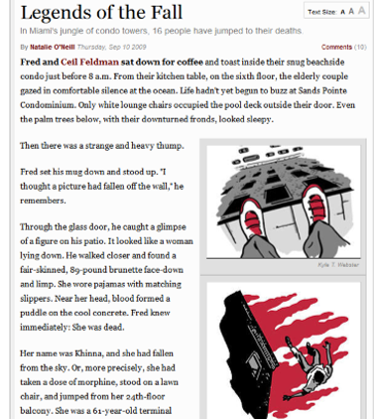
Some media will try to sensationalize your story.
Tip: Don’t be surprised at the final piece.
Reidenberg 2017. No reproduction or duplication permitted.

Slide 48
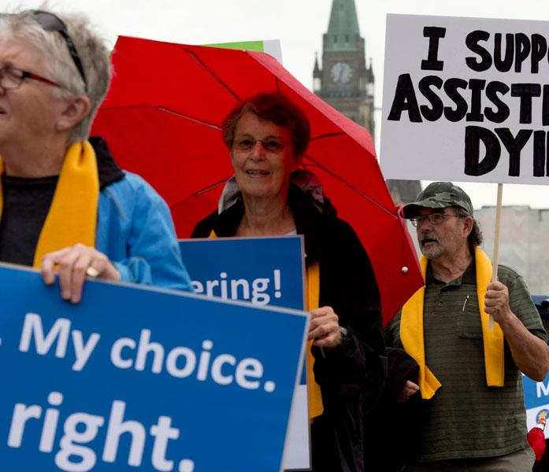
Some media will want the story to have a sense of controversy to the topic.
Tip: Present them your facts.
Reidenberg 2017. No reproduction or duplication permitted.

Slide 49
Your story is time limited in terms of relevance but will live on digitally or in print. Recognize that the facts might change over time.
Tip: Be careful on what you are telling the media.
Reidenberg 2017. No reproduction or duplication permitted.

Slide 50
You may not get the reporter that you want.
Tip: Use the opportunity to help them see the importance in your story.
Reidenberg 2017. No reproduction or duplication permitted.

Slide 51
Political issues related to mental health and suicide are complicated for media stories.
Tip: Do your part to keep them separate when pitching your story idea.
Reidenberg 2017. No reproduction or duplication permitted.

Slide 52
Be prepared for viewer’s response to the story.
Tip: Set boundaries for yourself and remember everyone has a right to their opinion.
Reidenberg 2017. No reproduction or duplication permitted.

Slide 53
Thank you
Contact: dreidenberg@save.org
Reidenberg 2017. No reproduction or duplication permitted.

