Slide 1
Merily Keller hodgekeller@yahoo.com Lisa Sullivan Lisa@infuse.com Holly Robles Holly.Robles@boerne-isd.net
CREATING SUICIDE SAFER SCHOOLS IN TEXAS: IMPLEMENTATION Guide & Tools 2017

Slide 2
Texas Suicide Safer Schools Implementation Guide and Tools
Author Team:
SMEs and Task Team:
Dr. Scott Poland and Dr. Donna Poland
Co-Writers & Editors:
Merily Keller, StopTxSuicides
Michel Froneberger, Assistant Principal Eanes ISD
Lisa Sullivan, StopTxSuicides
Jenna Heise, Texas Suicide Prevention Coordinator, Health and Human Services Commission
Dr. Holly Robles, Boerne Independent School District, Texas
Input and Review: Texas Suicide Prevention Council & Texas School District administrators, counselors, teachers & school resource officers and staff representing schools in:
urban
suburban
rural

Slide 3
Zero Suicide in Texas
Zero Suicides in Systems
A commitment to suicide prevention in health and behavioral health care systems
Includes a specific set of tools and strategies (concept and practice)
39 Suicide Prevention Coordinators at LMHAs across state/ state hospitals
23 Local Mental Health Authorities participating to be Suicide Safe Care Centers
Texas is being used as a model to train all of the SAMHSA Gov. Project Officers
Public Awareness
Texas suicide prevention website, bilingual print materials, suicide prevention toolkits, newsletters , exhibits, 17 youth videos about health and hope & discussion guide and easy to use Apps.
Strong social media engagement through Twitter, Paper.li, Flipboard, Instagram, Periscope,
Texas State Plan for Suicide Prevention
TexasSuicidePrevention.org
The Texas Suicide Prevention Council has 30 + local suicide prevention coalitions & 25+ statewide partners
Training & Tools
Best Practice Based Training
Workforce Survey, Screening & Assessment Tools
ZEST Toolkit

Slide 4
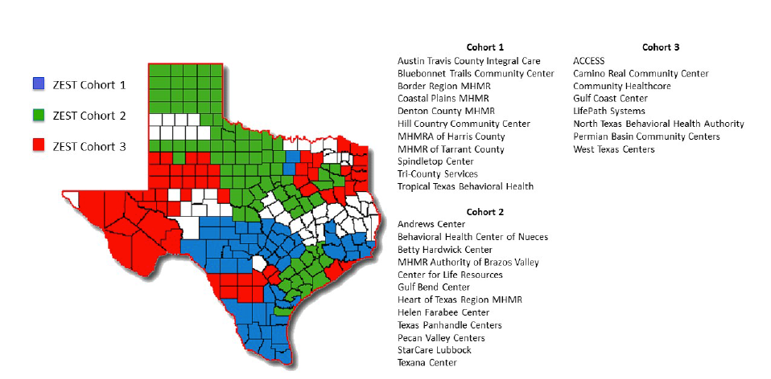
Local Mental Health Authorities Participating in ZEST

Slide 5
Texas Suicide Prevention Council
The Texas Suicide Prevention Council
One of the longest serving Suicide Prevention Councils in the nation
A member of the SMVF State Team
Community implementation partner for Zero Suicide in Texas
Responsible for the Texas State Suicide Prevention Plan
Approximately 30 state partners
Includes: TexVet, Texas Military Department, Texas Veterans Commission- MVPN and VMHP, U.S. Coast Guard Employee Assistance Program, Texas Health and Human Services, Texas Education Agency, Texas Dept. of Family and Protective Services, Texas Department of Health Services.
Approximately 30 local coalitions throughout Texas
Includes:
Bell County (Ft. Hood), Over 100 members
Alamo Area Teen Suicide Prevention Coalition (San Antonio)
El Paso and West Texas Suicide Prevention Coalition (Ft. Bliss Area)

Slide 6
Suicide Safe Care Model and Texas Suicide Prevention Council
Suicide Safe Care State
Council and its 25+ State Partners
Suicide Safe Care Community
30+ Local SP Coalitions
Suicide Safe Care Centers
Texas Suicide Prevention Council

Slide 7
Overview: Suicide Safer Schools in Texas
Suicide Safer Schools
Commitment to Suicide Prevention
Clear Pathways for Student Help
Best Practice Based Training
(Screening )
Referrals & Follow Up in Collaboration with Community

Slide 8
Current Assessment: Youth in Texas
2013 Texas Youth Risk Behavior Survey
Surveyed 3181 Texas H.S students and found:
16.7% considered suicide
15.6% made a suicide plan
10.1% made an attempt (above national average)

Slide 9
RAND Report on Military Children
2011 Report “Effects of Solider Deployment on Children’s Academic Performance and Behavioral Health:
Many school staff members interviewed had little or no connection to military installations;
School staff interviewed had little information on which students are military, when students may be experiencing deployment, and how many students with military parents will be enrolling or leaving the school at any given time;
Some of the challenges teachers and counselors discussed are ones that stem from the high mobility of this population, which can be amplified during deployment;
School staff believed that some parents appeared to be struggling more than their children with deployments, which appeared to underlie some of the challenges that these children faced during these multiple and extend deployments;
Stakeholders interviewed felt the number of available providers with training in child and adolescent services is low;

Slide 10
Recent Initiatives in Texas for Youth and Schools
GLS Grant
School Resources
Include higher education and K-12 representation on the Texas Suicide Prevention Council Initial Suicide Safer Schools Model and Toolkit (Phase 1)
Develop a Suicide Safer Schools Logic Model (Phase 1)
Suicide Safer Schools Implementation Guide (Phase 2)
Expand outreach and engagement with schools and colleges
Provide postvention support to schools and communities dealing with youth suicide
Title V Funding
Texas Suicide Prevention Symposium
Youth focused fact sheets
Bi-lingual fact sheets
ASIST Training for Community Members supporting SMVF
School counselors

Slide 11
Considerations in Texas Suicide Safer Schools Model Development
Best Practices
Schools
Infrastructure
Leadership
District Procedures, Policies, and Guidelines
Training and Screening
Awareness
Suicide lethality
Parent notification, engagement and support
CALM (Counseling on Access to Lethal Means)
Clear pathways for student help
Community resources clearly identified and easily accessible
Continuous Surveillance of community, literature, etc.
Re-entry protocol for students returning to school

Slide 12
Additional Considerations for Successful Model Implementation
All Hands training, re-training across all campuses for:
New employees
Returning staff
Key personnel
Administrator, governance, and senior leadership buy-in district-wide
Student social-emotional education k-12, adding gatekeeper training in middle-high school
Clear and concise flowcharts for staff and teachers to implement
Clear screening packets and protocols for counselors that include parent acknowledgment notices and referral options
Special topics:
Bullying, cyber-bullying, sexting
Address stigma, mental health, substance abuse
Dynamic campaigns to meet students’ demand for constantly changing stimuli
Teacher and staff wellness
Qualified and clearly identified mental health leader as a POC

Slide 13
Bexar, Kendall County and Boerne ISD
Bexar County: “Military City USA”
Affordable housing
One of the most popular military retirement communities
JBSA accounts for ¼ of the total active duty service members in Texas
7,000 active duty from JBSA were projected to transition in 2016
Total JBSA active duty services members: 31,720
42.2% of active duty in Alamo Region have children
Veteran population in Bexar county is 1,293 million
Veterans ages 18-34 comprise a much larger portion of the veteran population in the Alamo Region than the national average
Young families
Kendall County: (Alamo Region)
2nd fastest growing county in the United States
Population 42,500
Veteran Population 3,352
Boerne ISD:
6th fastest growing ISD in the San Antonio Metropolitan Statistical Area
Network of military and civilian workers at Lackland, Randolph, and JBSA.
Integrated network of 200 local small businesses and institutions that support the missions of these bases
Considered a family community for San Antonio commuters
175 students identified in iTCCS as Military Connected
(total enrollment 8,330)

Slide 14
Two Year Results
From 2006-2014, Boerne experienced at least one adolescent suicide annually, with some years of up to three suicides per high school (1200-1600 students each).
Prior to SY 2015-2016, referrals to school counselors for suicidal students did not exceed 17 annually across the district.
Upon hiring a suicide prevention specialist and utilizing all of the prevention strategies in the suicide prevention plan and protocol, the following referrals for suicide assessments were tracked:
SY 2015-2016– 76 (an increase of 447%).
SY 2016-2017 380 (an increase of 2235%).
This increase is attributed to a combination of increased prevention and identification strategies, reduced coping skills, and increased frequency of suicidal ideation.
Number of completed adolescent suicides:
SY 2015-2016: 0 SY 2016-2017: 0

Slide 16
Lessons Learned
Military Occupations Specializations common to JBSA are frequently medical, military intelligence, and cybersecurity
Tend to have higher security clearances
Service member parents who are on mission, deployed with short notice, and/or protracted assignments.
During periods of FM-C crisis, the service member is less likely to be available or supportive of seeking help for mental health concerns.
SM may have difficulty relating to mental health concerns of their children and/or may be dealing with unresolved combat-related trauma or depression themselves.
These factors often leave FM-W in a difficult caregiver role for both an adolescent and a high ranking SM or early retiree.
Educating SM and retirees during TAPS and in the VA system on supporting adolescent emotional needs would be helpful
Basic listening and empathy skills, particularly for SNCO and officers
Command involvement is not generally viewed as wanted or needed due to the high level of privacy expected for FM-C during periods of emotional crisis.

Slide 17
Next Steps
Expand pilot to include:
Urban vs. suburban vs. rural school districts
Cultural competency
Schools with significant SMVF populations
Revise model based on data-driven evaluation
Compare/contrast schools with high populations of SMVF and schools without
Scale Up

Slide 18
Texas Schools Suicide Prevention Implementation Important Links
The Texas Suicide Safer Schools Implementation Guide and Tools
http://www.TexasSuicidePrevention.org
Includes tools for school use in the Appendix section
Sample School Suicide Prevention Plan: http://www.texassuicideprevention.org/wp-content/uploads/2017/03/Texas-Suicide-Safer-Schools-Implementation-Guide-Appendices-Helpful-Tools.pdf

Slide 19
For more information:
Merily Keller --hodgekeller@yahoo.com Lisa Sullivan – Lisa@infuse.com
Holly Robles -- Holly.Robles@boerne-isd.net
Special Acknowledgement: Dr. Scott and Dr. Donna Poland
Texas Suicide Safer Schools (SSS) Implementation Guide and Tools (Part I, Part II, Part III, Part IV and Appendices with tools)
http://www.texassuicideprevention.org/information-library/schools-and-youth-materials/
Introduction Tx SSS Implementation Guide
Policy and Leadership Tx SSS Implementation Guide
Assessment and Procedures Tx SSS Implementation Guide
Re-entry and Postvention Tx SSS Implementation Guide
Helpful Tools Tx SSS Implementation Guide – Appendix I (General Tools), Appendix II (Sample School Plan) , Appendix III (Texas Statutes)
Two-page Handout on Texas Suicide Safer Schools

