Slide 1
Caring Letters for Suicide Prevention: Implementation Strategies in Military and VA Healthcare Systems
David D. Luxton, PhD, MS (University of Washington, Seattle)
Rona Margaret Relova, MD (VA Palo Alto)
Fred MacRae, LCSW (VA Palo Alto)
2017 US Department of Defense and VA
Annual Suicide Prevention Conference
Denver, Co
August 1-3, 2017

Slide 2
Acknowledgments
We are grateful for all involved in the “Caring Letters for Military Suicide Prevention” including our site PIs, research staff, and the inpatient unit staff at MAMC, TAMC, LRMC, NMCSD, VAPAHCS, and WNYVAHCS, as well as staff at The National Center for Telehealth & Technology, Military Operational Research Programs, and the Geneva Foundation.
This project is partially supported by the Department of the Army through the federal grant award, W81XWH-11-2-0123. The Military Operational Medicine Research Programs, 504 Scott Street, Fort Detrick MD 21702-5012 is the awarding and administering acquisition office. The content of this information does not necessarily reflect the position or the policy of the Government, and no official endorsement should be inferred.

Slide 3
Agenda
Background
Suicide risk after treatment discharge
Overview of Caring Contacts Intervention
Evidence-base (and limitations)
Methods and Procedures
Current Randomized Controlled Trial
Safety Protocol
Best Practice Recommendations
Lessons learned from a Randomized Controlled Trial
Benefits and Cost
Integration with current practices in DoD and VA Healthcare Systems

Slide 4
Caring Letters for Suicide Prevention: Implementation Strategies in Military and VA Healthcare System
Background and Overview
David D. Luxton, PhD., M.S.
Is affiliated with:
Department of Psychiatry & Behavioral Sciences
University of Washington, Seattle

Slide 5
Suicide risk very high after discharge from psychiatric hospitalization:
Civilian population: Up to 100 x greater risk for suicide than general population (Geddes et al, 1997; Goldcare et al., 1993)
*Highest risk within one week of discharge
U.S. Service Members: Risk 5 x greater than the general AD U.S. military population (2001-2011) (Luxton, Trofimovich & Clark, 2013)
*8.2 times higher in the first 30 days compared to at one year
Veterans (in VHA care): 12 weeks post-hospitalization approximately 5 x the base rate of the active treatment population and 54 x that of the general U.S. population (1999 – 2004) (Valenstein, et al. 2009)
* Emergency departments (EDs) also see high number of suicide attempters.
Data underscores the need for interventions during and after inpatient stays.

Slide 6
Reasons for high post-hospitalization suicide rates
High risk population to begin with
Suicidality not effectively treated while in care
Brief inpatient stays
Limited staff levels (weekends), especially at emergency departments
Lack of suicide specific treatments
Not found to be “high-risk” at time of discharge
Lack of care transition/discontinuity of care
Return to same environment (i.e., stressful conditions)
Social isolation/lack of support
Luxton, June & Comtois (2012)

Slide 7
“Caring Contacts” Intervention
Caring letters is a suicide prevention intervention that entails the sending of brief messages that espouse caring concern to patients following discharge from treatment.
Original caring letters study (Motto,1976; Motto & Bostrom, 2001)
Example Motto letter:
Simple, non-demanding, expressions of care that...
With multiple contacts, may contribute to a sense of belongingness (via a caring connection)
Reminders of treatment availability may provide route to seek help
May help patients to feel better about treatment and therefore motivate them to adhere to treatment
“Dear ____: It has been some time since you were here at the hospital, and we hope things are going well for you. If you wish to drop us a note we would be glad to hear from you.”

Slide 8
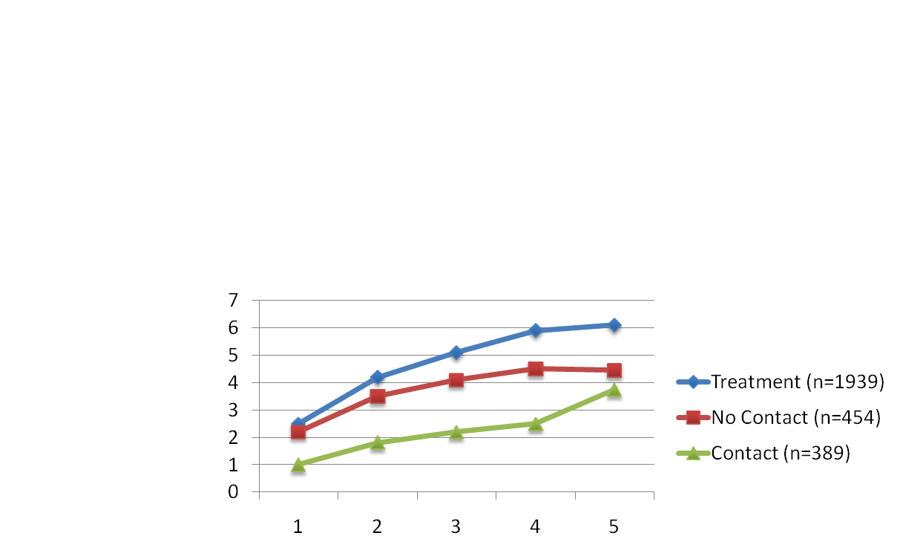
Motto (1976); Motto & Bostrom (2001)
Letters were sent monthly, decreasing to quarterly, for five years.
Patients in the contact group had a lower suicide rate in all five years of the study
Survival analyses revealed a significantly lower rate in the contact group (p=.04) for first two years
Rates differences gradually diminished by year 14

Slide 9
WHO SUPRE-MISS study (Fleischmann et al., 2008)
Randomized Controlled Study in 5 countries
Compared group of previous suicide attempters who received psychoeducation + series of personalized follow-up contact (either by telephone or in person) vs. noncontact control group
Individuals who received the personalized follow-up intervention were less likely to later die by suicide than those in the control group
Notes:
Study was conducted in Durban, South Africa; Campinas, Brazil; Colombo, Sri Lanka; Hanoi, Vietnam; Karaj, Iran and Tallinn, Estonia; and comprised 500 randomly selected participants from each country.

Slide 10
Other Caring Contacts Studies
Outcomes: Self-directed violence or suicide ideation reduction (Luxton, June, & Comtois, 2013)
Postcards (Beautrais et al., 2010; Carter et al., 2005; Carter et al., 2007)
Postal letters (Motto, 1976; Motto & Bostrom, 2001)
SMS Texting (Chen, Mishara & Liu,2010; Comtois, et al)
Email (Luxton et al., 2012)
Mixed modality (in-person, phone, etc.) (Fleischmann et al., 2008)

Slide 11
Evidence Reviews
Luxton, June & Comtois (2013) systematic qualitative review in CRISIS:
3 of 11 studies reviewed showed a statistically significant reduction in repeat suicide attempts
2 studies proved to prevent deaths by suicide (Motto’s caring letters (1976) and the WHO study reported by Fleischmann et al. (2008)
4 studies, showed mixed or non-conclusive results but did show trends toward a preventative effect.
2 studies did not show preventative effects for the follow-up interventions (Beautrais et al., 2010; Cedereke et al., 2002)
Luxton, D. D., June, J. D. & Comtois, K. A. (2013). Can Post-Discharge Follow-up Contacts Prevent Suicide and Suicide Behavior?: A Review of the Evidence. Crisis: The Journal of Crisis Intervention and Suicide Prevention, 34, 32-41. doi: 10.1027/0227-5910/a000158

Slide 12
Evidence Reviews (Cont.)
Milner, Carter, Pirkis, Robinson, & Spittal (2015), meta-analytic review in British Journal of Psychiatry:
14 eligible studies overall, 12 were used in meta-analyses.
For any subsequent episode of self-harm or suicide attempt, there was a non-significant reduction in the overall pooled odds ratio of 0.87 (95% CI 0.74-1.04, p=0.119) for intervention compared to control.
The number of repetitions per person was significantly reduced in intervention versus control (IRR 0.66, 95% CI 0.54-0.80, p<0.001).
There was no significant reduction in the odds of suicide in intervention compared to control (OR 0.58, 95% CI 0.24-1.38).
Milner, A. J., et al (2015). Letters, green cards, telephone calls and postcards: systematic and meta-analytic review of brief contact interventions for reducing self-harm, suicide attempts and suicide. British Journal of Psychiatry, 206(3), 184-190.

Slide 13
Data Limitations
Large samples needed for suicide (mortality) outcomes
Need assessment of possible benefits in well-designed trials in clinical populations
Need to consider contact modality, frequency, etc.
Has not been full replication of Motto study...

Slide 14
Caring Letters for Military Suicide Prevention: A Randomized Controlled Trial (Luxton, PI)
Military Operational Medicine Research Program (MOMRP) funded six site randomized controlled trial
MAMC (Washington State)
LRMC (Germany)
TAMC (Hawaii)
NMCSD (San Diego)
Palo Alto VAHCS (California)
Western NY VAHCS (New York)

Slide 15
Caring Letters for Suicide Prevention: Implementation Strategies in Military and VA Healthcare System
Methods and Procedures
Rona Margaret Relova, MD (VA Palo Alto, Investigator)

Slide 16
VA Palo Alto Site- Personnel
Rona Margaret Relova, MD
Fred MacRae, LCSW
Matilda Stelzer, MD
Gopin Saini, MBBS
Tina Lee, MD
Melody R. Cardona
Valerija Nikolic, RN
Kristine Lalic
David D. Luxton, PhD (Principal Investigator)

Slide 17
Specific Aims
Evaluate ‘caring letters’ as an intervention for suicide prevention in the Military and VA health care systems.
Provide recommendations regarding the best practices for conducting ‘caring contacts’ research trials.
Provide guidelines in navigating the regulatory and compliance processes in DoD and VA systems.

Slide 18
Statistical Methods & Analyses
Hypothesis #1
Frequency of suicide will be significantly lower in the intervention group compared to the usual care group.
Hypothesis #2
Frequency of medically admitted self-inflicted injuries will be lower in intervention group compared to the usual care group.
Hypothesis #3
The time to suicidal behavior will be longer among patients in intervention group compared to usual group.
(Luxton et al., 2014)

Slide 19
Study Design
A prospective randomized controlled trial (RCT) that tests the effectiveness of the caring contacts intervention to prevent suicidal behavior among U.S. service members and veterans at 6 sites:
Madigan Army Medical Center (MAMC)
Tripler Army Medical Center (TAMC)
Landstuhl Regional Medical Center (LRMC)
Navy Medical Center San Diego (NMCSD)
VA Palo Alto
VA Western New York

Slide 20
Study Design (2)
Eligible participants are randomized into two groups:
(1) caring letters (CL) group
(2) no-contact usual care (UC) group
CL group receives 13 scheduled emails over 2 years after discharge from inpatient psychiatry units.
Follow-up contacts for both CL and UC groups are conducted two years after hospital discharge.

Slide 21
Study Design and Procedure
Follow-up and NDI/S Assessments Review
Hospital Discharge
Usual Care (no email contacts)
Referral and Consent
Interview Measures
Randomized
Caring E-mails (13 over two years)
Time in study: 0 Months
24 Months

Slide 22
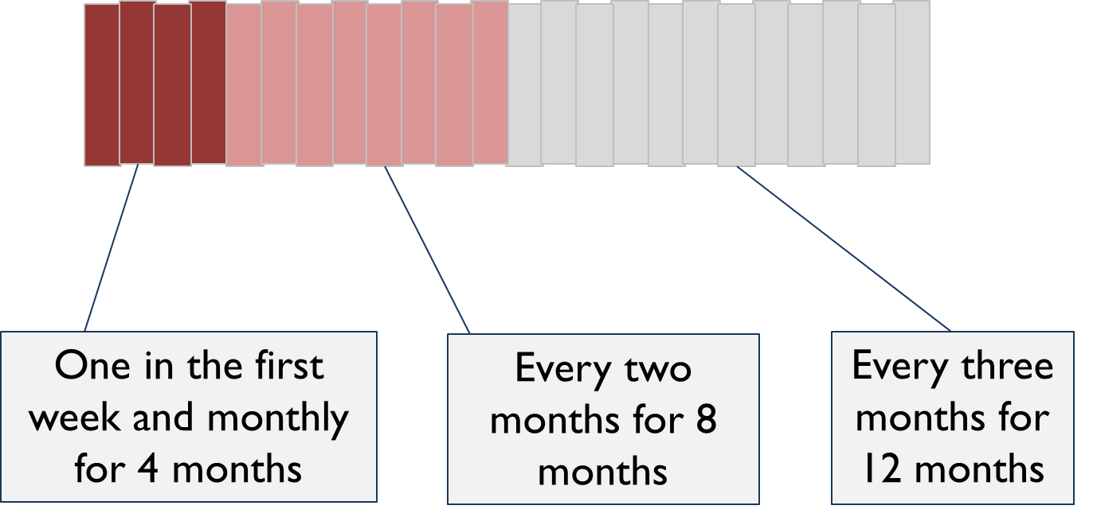
Caring Letters (Emails) Schedule

Slide 23
Participant Demographics
* Palo Alto VA site only

Slide 24
Participant Demographics (2)

Slide 25
Participant Demographics (3)
Marital Status

Slide 26
Participant Demographics (4)
Ethnicity

Slide 27
Participant Demographics (5)

Slide 28
Measures and Outcomes Data
Data is collected during three time periods:
(1) Initial interview:
-Positive Assets Search Semi-Structured Interview Tool (PASSIT)
-Interpersonal Needs Questionnaire (INQ)
-Acquired Capability for Suicide Scale (ACSS)
-Soldier’s Perceptions of Unit Cohesion Scale

Slide 29
Measures and Outcomes Data (2)
(2) Two-year intervention period:
-Email replies
-Undelivered emails
-Content of replies (indicated crisis, expressed gratitude)

Slide 30
Measures and Outcomes Data (3)
(3) Two years after index hospitalization:
-Suicides and all cause mortality rates will be collected.
-Sources: data will be obtained from CDC National Death Index Plus (NDI-Plus), Social Security Administration Death Master File
-Surveys will be conducted to obtain information re: mental health service utilization.
-Electronic health records will be reviewed to assess the accuracy of self-reported data.

Slide 31
Email and Data Management
All Centralized email system for each site is established: continuingcare@va.gov
E-mails are monitored for any potential crisis state; all emails are archived.
Data collected on paper are entered into secure local database. Copy of local database is sent to lead site for inclusion into a master database using encryption.
Local site maintains essential logs: subject recruitment, email tracking, etc.

Slide 32
Letter Example
Dear _________,
We are just checking in with you again to let you know we are thinking about you. Hope you’re doing something that is relaxing and enjoyable. It’s good to take a break and treat yourself to something. We hope everything is going well. If you feel like dropping us a line, we would be happy to hear from you.
Best wishes,
Gopin Saini & Matilda Stelzer
Please note that the following resources are always available to you:
Veterans Crisis Line: 1-800-273-8255 Press “1” as soon as you hear the recording asking if you are a veteran to be connected to a VA counselor immediately.
Online chat is also available at www.veteranscrisisline.net
DoD/VA Suicide Outreach: www.suicideoutreach.org

Slide 33
Safety Protocol
Safety plan is established for instances when a threat for self-harm or harm to others is received in an email reply or follow-up contact (Phone Call or Mailed in Surveys)
There is immediate notification to the treatment team or the Suicide Prevention Coordinator (VA sites) when a participant indicates crisis state.
Contact time - Usually no more than one day from contact of SPC to the contact of Participant and reconnection to care.

Slide 34
Safety Protocol (2)
Timely reconnection to care of the patient is ensured.
Resources will be included in caring emails sent to patients to reinforce availability of support.
Frequency of caring letters is decreased over time to reduce the sense of loss that may be experienced by the recipient.
Preliminary Report:
Participants* (n=29) were reconnected through this study in a timely manner: mean time of 90 minutes.
*Participants indicated distress through email or final survey (completed by phone or mailed-in).

Slide 35
Patient Responses
Thank you for these follow-up emails, they have been nice to receive. I must admit that I was surprised at first and came to enjoy seeing them in my email. There were times that you seemed my only friends, then I woke up and went to church and found them again.
Thanks for the note. Things haven't been going too good. Not only have I been still suffering from depression, anxiety, and varying degrees of EtOH abuse and my 16yr battle with my eating disorder, but, to make matters worse I fell about a month or so ago and ended up badly spraining my ankle as well as a jones fracture… Lost, that’s where I am.
Thank you for reaching out to me. It is easy just to try and stay away from everyone but you give me a channel to reach through. I have a couple more appointments set at the VA to get some help.
Total: 57 patients responded
Indicated crisis: 29
Indicated appreciation: 42

Slide 36
Insights Gained from Progress Report (2)
Greatest strengths of this study: simplicity, portability, low-cost
Able to reach military service members and veterans who choose not to continue care, who do not have easy access to care and who move frequently
Inexpensive to implement
Provides adjunctive support system or additional safety net
Can potentially reduce future costs associated with psychiatric re-hospitalizations, reduce costly service utilizations
Currently study has more than 1300 participants enrolled, suggesting patient engagement to the intervention

Slide 37
Caring Letters for Suicide Prevention: Practicality & Feasibility of a Caring Contact Program
Recommendations
Fred MacRae, LCSW
VA Palo Alto

Slide 38
Existing VA “Contact” Programs
Caring Letters is one type of “contact” program
Our project is research, intended to inform programs
Caring Letters Program is not meant to replace or compete with the already established Mail Program for Veterans Flagged for High Risk of Suicide.
Differences between the programs include…

Slide 39
Mail Program / Caring Letters Program
 | Mail Program | Caring Letters Program
Purpose | Caring Contact | Caring Contact
Modality | Postal Mail | Email
Target Population | High Risk Veterans | Veterans discharged from Inpatient Psych Unit
Frequency | Recommended 1x/Month for 2 years | 13 emails in 2 years (timed and scheduled intervals) initiated from the discharge date
Staffing | SPC Team | Research Staff Volunteers Peer Counselors Etc.

Slide 40
Mail Program/ Caring Letters Program
 | Mail Program | Caring Letters Program
Personalized email or Letter | Some | Yes
Initial Team Contact | Varies Clinician and/or SPC Clinical Assessment | Yes Baseline Assessment by Caring Letters team.
Final Survey | No | Yes Patient Health Questionnaire, Rudd Suicide Ideation Scale, Interpersonal Needs Questionnaire, Acquired Capability for Suicide, mental and medical treatment history (past 2 years).
Standard Treatment/ Treatment Team | Yes | No (Outside of the standard of treatment)

Slide 41
Beginnings and Endings
30-Minutes Initial Assessment
Provides information for personalization of emails.
Builds relationship with individual who will there after represent the caring letter team.
30- Minutes Final Assessment
Formal assessment tools administered by caring person apart from treatment team has provided valuable clinical information apart from treatment team including revelation of acute distress. Immediate intervention by CrisisLine/SPC and or treatment team.
185 Completed the Final Assessment: 12 individuals had highly concerning scores indicating significant suicide risk.
SPC and Treatment Team notified outreach to veteran initiated
*at VAPA out reach to veteran was within 1 day.

Slide 42
Implementation considerations…
Type of contact modality
Email, Postal (letter/postcard), texting, in person
Frequency of contact
Recommendation is one during first week, and then monthly for a six months (longer better).
Personalized contact vs. generic (personalized assumed better)
Target high risk vs. all patients/clients (this is cost/benefit consideration)

Slide 43
Best Practice Considerations
Need process for addressing emergencies/crises (safety plan) see Luxton, Thomas, et al (2014)
Consider duty-to-warn, etc.
Consider impact of sending final contact
Titrate contacts
Let patient know final contact is arriving
Consider institutional policy regarding contact
Site specific safety rules and procedures
Consider legal/regulatory requirements when using technology (data security, etc.)
Consent
Disclaimers/reminders

Slide 44
Per Subject Costs
1 staff hr required for initial assessment and relationship building.
1 staff hr required for final follow-up/assessment.
Approximately 5 minutes/ month for personalization and sending. (Set templates in place)
Additional expected 5 minutes /month for record keeping and data base update.
Reading emails: average 1 minute per entrant per/month on average as very few would be responding monthly
Referral to SPC/Treatment Team: Appox. 10 minutes per distress email
Approximately less than 2 minutes per month on average
Approximately 1 hr SPC time per distress contact

Slide 45
Potential Benefits of the Program
Creates a sense of caring connection to team outside of treatment environment.
Each friendly email gently invites spontaneous and casual response without obligation to reply.
Inability for veteran to establish on going email exchange outside of scheduled times, prevents staff splitting.
The ease of response, is likely to result in veterans reporting times of emotional stress/crisis which allows for treatment team outreach and re-engagement at vulnerable times.
Non clinical staff could administrate program providing handoff to clinical staff at any signs of distress.

Slide 46
Benefits (cont.)
Greatest strengths of this intervention: simplicity, portability, low-cost
Able to reach military service members and veterans who choose not to continue care, who do not have easy access to care as well as for those who move frequently.
Can augment other interventions and treatments for suicide

Slide 47
Implementation Recommendations
Must read….
Reger, M. A., Luxton, D. D., Tucker, R., Comtois, K. A., Katz, I. R., Keen, A. D., et al. (2017). Implementation Methods for the Caring Contacts Suicide Prevention Intervention. Professional Psychology: Research and Practice. http://dx.doi.org/10.1037/pro0000134

Slide 48
Thankyou!
Questions?
Contact:
ddluxton@uw.edu

Slide 49
References
Luxton, D. D., June, J. D. & Comtois, K. A. (2013). Can Post-Discharge Follow-up Contacts Prevent Suicide and Suicide Behavior?: A Review of the Evidence. Crisis: The Journal of Crisis Intervention and Suicide Prevention. 34, 32-41.
Luxton, D. D., Kinn, J. T., June, J. D., Pierre, L. W., Reger, M. A., Gahm, G. A., (2012). The Caring Letter Project: A Military Suicide Prevention Pilot Program. Crisis: The Journal of Crisis Intervention and Suicide Prevention. 33, 311-316.
Luxton D. D., Trofimovich, L., & Clark, L. L. (2013). Suicide Risk among U.S. Service Members Following Psychiatric Hospitalization, 2001-2011. Psychiatric Services.
Luxton, D. D., Thomas, E. K., Chipps, J., Relova, R. M., Brown, D., McLay, R…et al. (2014). Caring Letters for Suicide Prevention: Implementation of a Multi-Site Randomized Clinical Trial in the U.S. Military and Veteran Affairs Healthcare Systems. Contemporary Clinical Trials, 37, 252-260.
Milner, Carter, Pirkis, Robinson, & Spittal (in press), Letters, Green Cards, Telephone calls, and Postcards: A systematic and meta-analytic review of brief contact interventions for reducing self-harm, suicide attempts, and suicide, British Journal of Psychiatry.

Slide 50
References
Motto JA: Suicide prevention for highrisk persons who refuse treatment. Suicide and Life-Threatening Behavior 6:223–230, 1976
Motto JA, & Bostrom AG. (2001). A randomized controlled trial of postcrisis suicide prevention. Psychiatric Services, 52, 828-833.
Reger, M. A., Luxton, D. D., Tucker, R., Comtois, K. A., Katz, I. R., Keen, A. D., et al. (2017). Implementation Methods for the Caring Contacts Suicide Prevention Intervention. Professional Psychology: Research and Practice. http://dx.doi.org/10.1037/pro0000134
Valenstein M, Kim HM, Ganoczy D, et al: Higher-risk periods for suicide among VA patients receiving depression treatment: prioritizing suicide prevention efforts. Journal of Affective Disorders 112:50–58, 2009
Vaiva, G., Walter, M., Al Arab, A. S., Courtet, P., Bellivier, F., Demarty, A. L., Libersa, C. (2011). ALGOS: The development of a randomized controlled trial testing a case management algorithm designed to reduce suicide risk among suicide attempters. BMC Psychiatry, 1, 1–7.

