Slide 1
Clinically Significant Change Following Post Admission Cognitive Therapy for Suicidal Military Service Members with Histories of Trauma: A Pilot Randomized Controlled Trial
Jessica M. LaCroix, Ph.D., Kanchana U. Perera, M.Sc.,
Laura N. Neely, Psy.D., Geoffrey Grammer, M.D., Jennifer Weaver, M.D., and Marjan Ghahramanlou-Holloway, Ph.D.

Slide 2
DISCLAIMER
The opinions expressed are those of the presenter and do not necessarily reflect the views of the Uniformed Services University of the Health Sciences, the U.S. Government, or the Department of Defense.
FUNDING SOURCE
Congressionally Directed Medical Research Program (CDMRP)
Award #W81XWH-08-2-0172
ClinicalTrials.gov (Identifier: NCT01356186)
Notes:
FIX DISCLAIMER

Slide 3
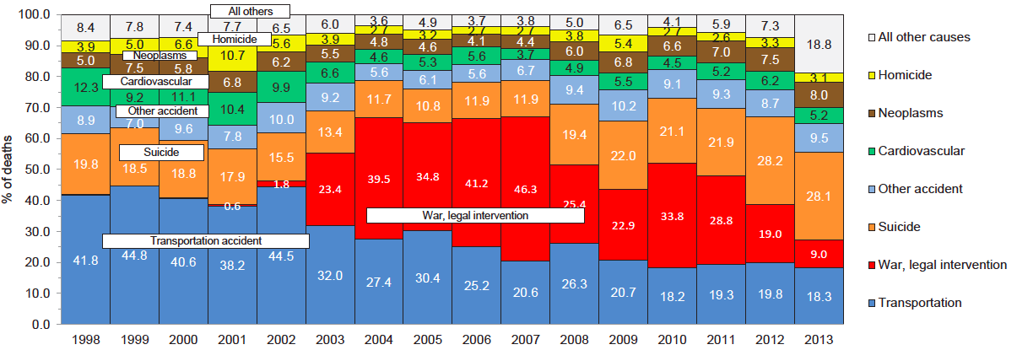
Military Suicide
Suicide
War, legal intervention
Deaths of individuals by proportions attributable to various categories of underlying causes, active component, U.S. Armed Forces, 1998-2013.
Source: Armed Forces Health Surveillance Center, 2014
Notes:
Since 2012, suicide has accounted for a greater proportion of active duty deaths than any other cause of death, surpassing combat-related deaths
Accounts for about 28% of all active duty deaths

Slide 4
PTSD
Bolton et al., 2007; Harris & Barraclough, 1997; Luxton et al., 2013; Ramsawh et al., 2014
Notes:
PTSD has the strongest association with suicide attempts out of all the anxiety disorders
Comorbid PTSD and alcohol abuse is a particularly strong risk factor for suicide attempt
MH issues are the leading cause of hospitalization for active duty military personnel
Hospitalization is standard practice following a suicide attempt
Military personnel with a hx of psych hospitalization are 5X more likely to die by suicide than general active duty military personnel
No evidence-based interventions designed to be delivered on the inpatient unit

Slide 5
PTSD
Alcohol Abuse
Bolton et al., 2007; Harris & Barraclough, 1997; Luxton et al., 2013; Ramsawh et al., 2014
Notes:
PTSD has the strongest association with suicide attempts out of all the anxiety disorders
Comorbid PTSD and alcohol abuse is a particularly strong risk factor for suicide attempt

Slide 6
PTSD
Alcohol Abuse
Hospitalization
Bolton et al., 2007; Harris & Barraclough, 1997; Luxton et al., 2013; Ramsawh et al., 2014
Notes:
PTSD has the strongest association with suicide attempts out of all the anxiety disorders
Comorbid PTSD and alcohol abuse is a particularly strong risk factor for suicide attempt

Slide 7
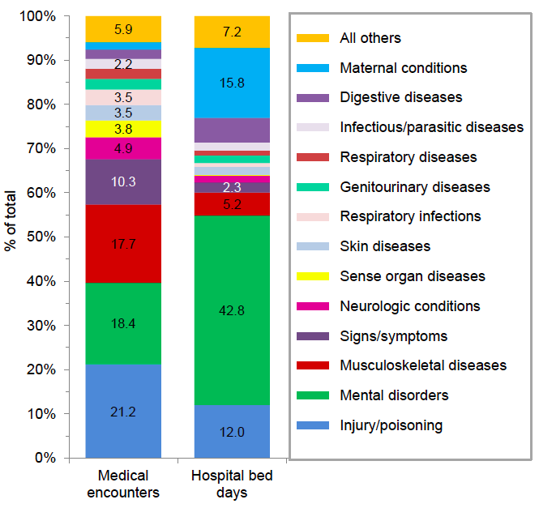
42.8% of all hospitalizations are due to mental health issues
Service members with a history of psychiatric hospitalization are 5X more likely to die by suicide within 12 months (Luxton et al., 2013)
Percentage of medical encounters and hospital bed days attributable to burden of disease categories, active component, U.S. Armed Forces.
Source: Armed Forces Health Surveillance Center, 2015
Notes:
MH issues are the leading cause of hospitalization for active duty military personnel
Hospitalization is standard practice following a suicide attempt
Military personnel with a hx of psych hospitalization are 5X more likely to die by suicide than general active duty military personnel w/in 12 mos (71.6 vs. 14.2)
Army STARRS data show 14X (263.9 per 100,000 vs. 18.5)

Slide 8
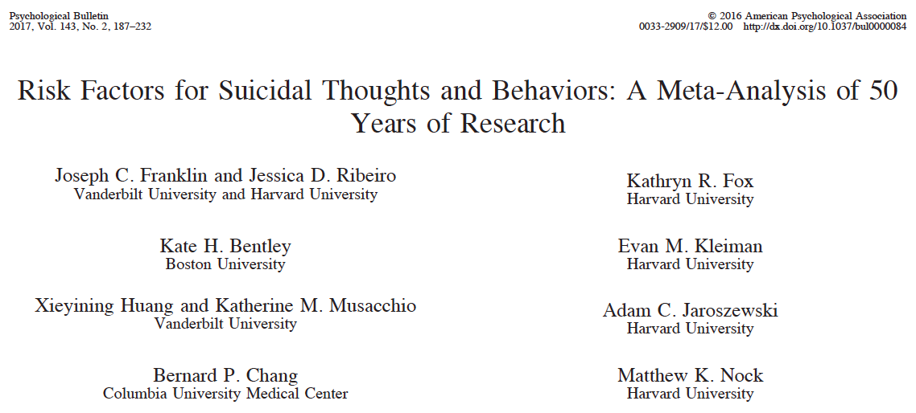
Prior Suicide Attempt
Top 5 predictors of suicide death:
Prior psychiatric hospitalization
Prior suicide attempt
Prior suicide ideation
Lower SES
Stressful life events
Franklin et al., 2017
Notes:
Franklin et al. ks = 31, 19, 10, 10, 23
No evidence-based interventions designed to be delivered on the inpatient unit

Slide 9
Inpatient Psychiatric Care
Group Therapy
Medication
Art Therapy
Physical Therapy
Recreation Therapy
Individual Therapy
None Targeted Directly at Reducing Suicide Risk

Slide 10
Post Admission Cognitive Therapy (PACT)
Engage the patient
Tell the suicide story
Develop a case conceptualization
Develop safety plan
Phase I: Sessions 1-2
Build hope
Teach coping strategies
Expand use of social support
Target problem solving deficits
Phase II: Sessions 3-4
Relapse prevention
Revisit suicide story
Develop safety plan
Promote self-care
Encourage linkage to aftercare
Phase III: Sessions 5-6
Ghahramanlou-Holloway et al., 2012; 2014
Notes:
Six 60-90 minute sessions, 6-9 hours, ideally over 3 days
Based on cognitive behavioral therapy shown to be efficacious in reducing suicide attempts among civilian (Brown et al., 2005) and military (Rudd et al., 2015) outpatients

Slide 11
Stages of Treatment Development Research
Stage 1: Pilot and feasibility testing
Stage 2: Conduct well-powered randomized controlled trial
Stage 3: Evaluate transportability of treatment
Rounsaville et al., 2001

Slide 12
Participants
N = 36 Service Members psychiatrically hospitalized following a suicide attempt
Current or past diagnosis of Acute Stress Disorder (ASD) or PTSD
83% reported multiple suicide attempts
Average age 30.97 years
69% Caucasian
69% male
50% married
N = 23 (64%) provided follow-up data within 3 months
Notes:
Participants were randomly assigned to receive PACT or TAU

Slide 13
Outcomes
Hopelessness (BHS)
PTSD symptoms (PCL-C)
Alcohol use (AUDIT)
Depression (BDI-II)
Suicide ideation (SSI-W)
Notes:
Primary outcome was days until repeat suicide attempt – focus of this presentation is on secondary outcomes

Slide 14
Clinically Significant Change
Is the change statistically reliable?
Is the change clinically relevant?
Small sample sizes
Focus on individual participants
Clear, clinical meaning
Manipulation checks

Slide 15
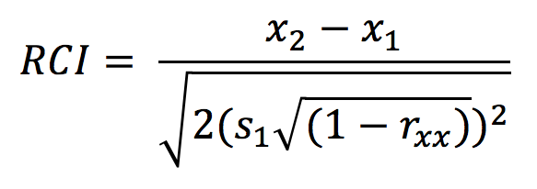
Is the change statistically reliable?
Reliable Change Index (RCI)
Posttest score – Pretest score
Jacobson & Truax, 1991

Slide 16
Is the change statistically reliable?
Reliable Change Index (RCI)
Pretest Standard Deviation
Jacobson & Truax, 1991

Slide 17
Is the change statistically reliable?
Reliable Change Index (RCI)
Test-Retest Reliability
Jacobson & Truax, 1991

Slide 18
Is the change statistically reliable?
Reliable Change Index (RCI)
Jacobson & Truax, 1991
Notes:
We hope that our participants show reductions on our measures, so we’re looking for RCIs less than -1.96

Slide 19
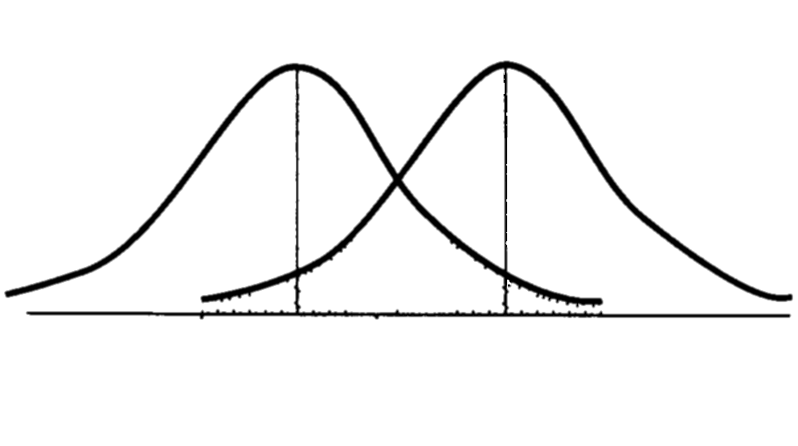
Is the change clinically relevant?
c
Non-Clinical Population Clinical Population
Beck Hopelessness Scale (BHS)
Jacobson & Truax, 1991
Notes:
Participant moves closer to the mean of the functional population than the dysfunctional population

Slide 20
Is the change clinically relevant?
Mean, SD for non-clinical population
Jacobson & Truax, 1991

Slide 21
Is the change clinically relevant?
Mean, SD for clinical population
Jacobson & Truax, 1991

Slide 22
Clinically Significant Change
Is the change statistically reliable?
Is the participant’s RCI statistic greater than |1.96|?
Is the change clinically relevant?
Did the participant cross the cutoff point, point c?

Slide 23
Hopelessness (BHS)
RCI > +1.96
RCI < -1.96
Notes:
Control is “treatment as usual”
Deterioration was not clinically significant because the participant did not cross the point, c, so although statistically reliable (i.e., RCI larger than +/-1.96), it wasn’t clinically relevant
This is the same person who deteriorated on suicide ideation

Slide 24
Hopelessness (BHS)
Notes:
Deterioration was not clinically significant because the participant did not cross the point, c, so although statistically reliable (i.e., RCI larger than +/-1.96), it wasn’t clinically relevant
This is the same person who deteriorated on suicide ideation

Slide 25
Hopelessness (BHS)
= PACT
= Control
Morley & Dowzer, 2014
Notes:
Leeds Reliable Change Indicator, Excel
10 = No Change
1 = Deterioration
9 = Recovered

Slide 26
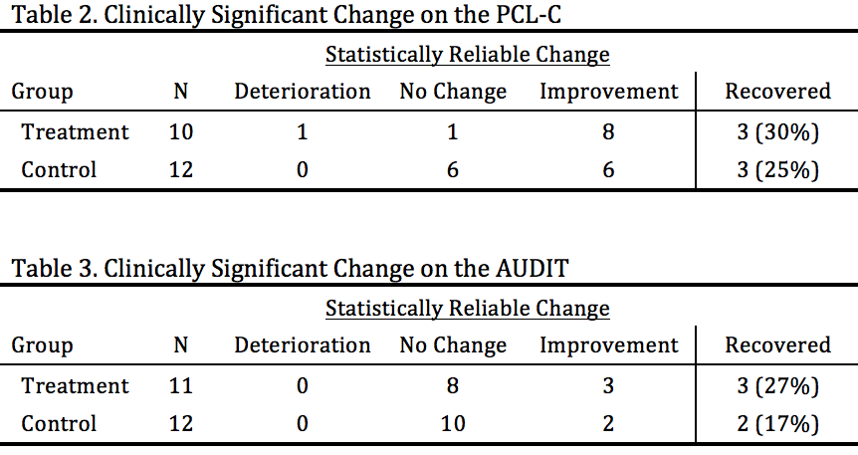
Results

Slide 27
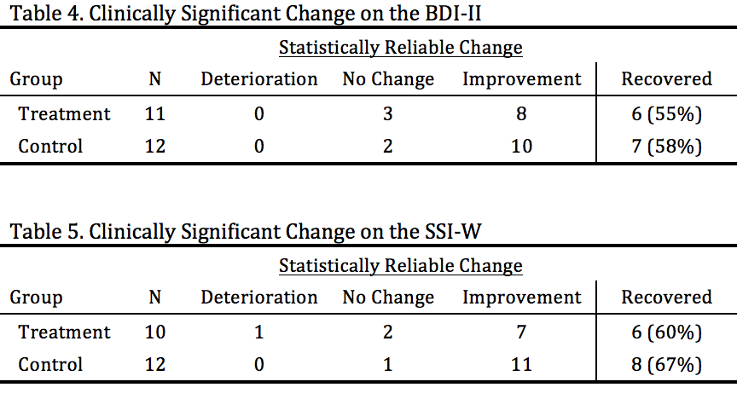
Results

Slide 28
Results
Among more clinically severe participants, more PACT participants met criteria for clinically significant reductions in:
Outcome | Treatment % Recovered | Control % Recovered | Treatment N | Control N
Hopelessness | 83% | 57% | 6 | 7
PTSD symptoms | 100% | 38% | 3 | 8
Alcohol abuse | 100% | 67% | 3 | 3
Depression | 100% | 78% | 6 | 9
✓
✓
✓
✓
Notes:
But not SSI worst, all participants were high risk, i.e., above cutoff

Slide 29
Discussion
PACT > control on hopelessness, PTSD symptoms, and alcohol use
Control > PACT on depression and suicide ideation
PACT > control on all outcomes except suicide ideation among most clinically severe participants

Slide 30
Discussion
Brown et al. (2005)
Rudd et al. (2015)
Outpatient RCT
Community sample
Mixed results re: depression
No reduction in suicide ideation
50% less likely to re-attempt over 18 months
Outpatient RCT
Military sample
No reduction in depression
No reduction in suicide ideation
60% less likely to re-attempt over 24 months
Notes:
Tx group sig lower than control group on the Beck Depression Inventory, but no difference on the Hamilton Depression Rating Scale (Brown et al., 2005)

Slide 31
Strengths and Limitations
One of very few existing pilot trials of an inpatient treatment
Targeted CBT focused on suicidality
High-risk military sample
Small sample size
High attrition
Notes:
N = 23 of 36, so 36% attrition
All had a prior attempt, most had a history of multiple attempts, chronic hopelessness, all had a history of trauma

Slide 32
Impressions of PACT
“It was good because although it was unpleasant to recount all of those memories, it was necessary to see it in a different way – looking at my thought processes in a new way. At the time, you just don’t want to talk about that, but in the end it was ultimately helpful and beneficial.”
“It would be beneficial for anyone who is depressed, not just suicidal.”
“It was extremely valuable to me, especially in the inpatient setting, because last time I was inpatient, I wasn’t able to get the treatment I needed to progress. It was an honor to participate.”

Slide 33
Future Directions
PACT is a novel and promising intervention for military personnel
A well-powered, multi-site randomized controlled trial is currently underway
Notes:
RCT to determine the efficacy of the PACT intervention in reducing suicide risk among psychiatrically hospitalized service members.

Slide 34
Thank you
Jessica M. LaCroix, Ph.D.
Department of Medical & Clinical Psychology
Uniformed Services University of the Health Sciences
11300 Rockville Pike, Suite 1115
Bethesda, MD 20852
Phone: (301) 295-0211
Email: jessica.lacroix.ctr@usuhs.edu

