Slide 1
An Approach for Partnership Across Community and VA/DoD for SMVF Suicide Prevention
Lisa Sullivan, @StopTXSuicides – Texas Suicide Prevention Council
Merily Keller, @StopTXSuicides, Texas Suicide Prevention Council
Perry Jefferies, TexVet Initiative

Slide 2
Enhancing SMVF Community Supports for Suicide Prevention
Objective:
Provide (and evaluate) community resources in SMVF connected communities, the necessary tools/skills to improve suicide prevention outcomes:
Prevention
Intervention
Lethal means awareness
Utilize existing resources and partnerships to ensure programs are:
Relevant to local communities
Improve community collaboration effectiveness
Leverage to support and benefit from complementary approaches
Aligned with the CDC Preventing Suicide Technical Package, Texas State Suicide Prevention Plan, NSSP, Texas Suicide Prevention Council, and the state-wide commitment to the Zero Suicide framework
Sustainable over time

Slide 3
Military/Veteran Community Support
Target areas with SMVF dense populations AND Texas Suicide Prevention Coalition readiness
Focus on best practice trainings and programs already adopted in Texas
Develop and disseminate media, social media campaigns targeting SMVF community organizations
Results in community strategies to envelop SMVF populations to complement DoD and VA programming

Slide 4
Zero Suicide in Texas
Zero Suicides in Systems
A commitment to suicide prevention in health and behavioral health care systems
Includes a specific set of tools and strategies (concept and practice)
39 Suicide Prevention Coordinators at LMHAs across state/ state hospitals
23 Local Mental Health Authorities participating to be Suicide Safe Care Centers
Texas is being used as a model to train all of the SAMHSA GovProject Officers
Public Awareness
Texas suicide prevention website, bilingual print materials, suicide prevention toolkits, newsletters , exhibits, 17 youth videos about health and hope & discussion guide and easy to use Apps.
Training & Tools
Best Practice Based Training
Workforce Survey, Screening & Assessment Tools
ZEST Toolkit

Slide 5
Suicide Safe Care Model and Texas Suicide Prevention Council
Suicide Safe Care State
Council and its 25+ State Partners
Suicide Safe Care Community
30+ Local SP Coalitions
Suicide Safe Care Centers
Texas Suicide Prevention Council

Slide 6
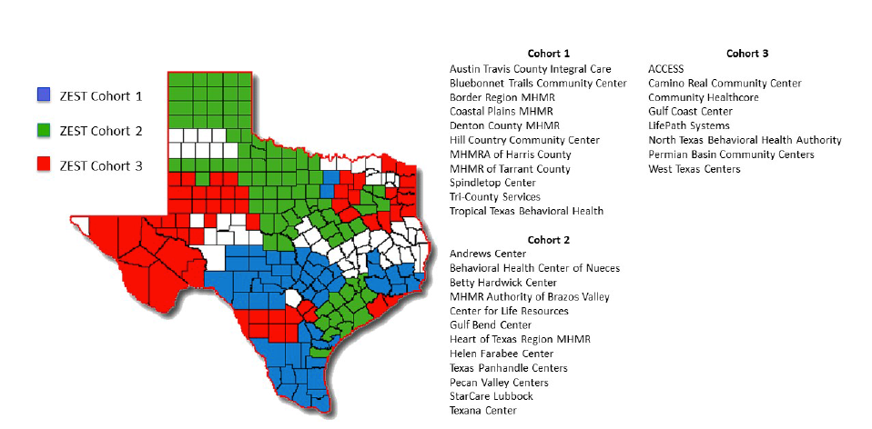
Local Mental Health Authorities Participating in ZEST

Slide 7
Texas Suicide Prevention Council
The Texas Suicide Prevention Council
One of the longest serving Suicide Prevention Councils in the nation
A member of the SMVF State Team
Community implementation partner for Zero Suicide in Texas
Responsible for the Texas State Suicide Prevention Plan
Approximately 30 state partners
Includes: TexVet, Texas Military Department, Texas Veterans Commission- MVPN and VMHP, U.S. Coast Guard Employee Assistance Program, Texas Health and Human Services, Texas Education Agency, Texas Dept. of Family and Protective Services, Texas Department of Health Services.
Approximately 30 local coalitions throughout Texas
Includes:
Bell County (Ft. Hood), Over 100 members
Alamo Area Teen Suicide Prevention Coalition (San Antonio)
El Paso and West Texas Suicide Prevention Coalition (Ft. Bliss Area)

Slide 8
Texas Veterans Commission and VMHP

Slide 9
Veterans Mental Health Program and Military Veteran Peer Network
37 Full-Time Peer Service Coordinators across Texas
Co-located with Texas Local Mental Health Authorities (LMHAs)
Zero Suicide
ASK Trained
CRP Trained (Sep 2017)

Slide 10
TVC’s Veterans Mental Health Program and Military Veteran Peer Network
VMHP
Trains and provides technical assistance to SMVF peers, licensed mental health providers, mental health organizations, community and faith-based organizations and state agencies on the impacts of military-related trauma and the individuals who have been MTA affected.
Includes Criminal Justice and diversion programs for justice involved veterans using GAINS Center SIM
MVPN
Recipient: VA Abraham Lincoln Pillar of Excellence Award for Innovative State Program in 2015
Peer to Peer Support through training, technical assistance and certification to Local Mental Health Authority-based MVPN Peer Service Coordinators to create a statewide network of military trauma-affected Veteran peer support
37 Full-time Peer Service Coordinators across Texas
Train and support a extensive peer network
Peer Service Coordinators are co-located with Texas Local Mental Health Authorities (LMHAs) to provide direct referral to mental health care when needed
Most LMHAs are Zero Suicide sites
Provider Network:
Encourages and engages licensed mental health providers to create a Learning Collaborative surrounding SMVF topics, emerging best practices for SMVF, and developing cultural competency in working with SMVF communities.
Community Partner/ Faith-based Collaborations:
@StopTXSuicides and Texas Suicide Prevention Council to support community initiatives
TexVet Initiative
State Partners include Texas Workforce Commission, Health and Human Services, among others

Slide 11
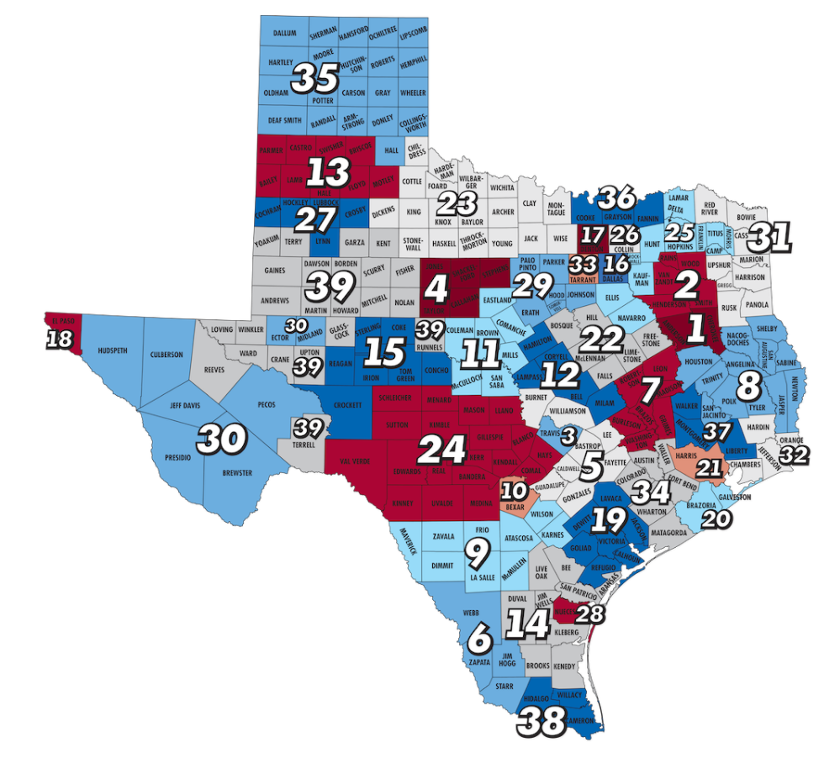
MVPN Peer Service Coordinator Service Areas

Slide 12
Veteran Mental Health Program: Clay Hunt Act
VMHP is the community partner organizations selected to help the VA to implement their pilot in VISN 17
Bexar County
MVPN Peer Service Coordinator directly supports this effort with Chief Mental Health Officer and Suicide Prevention Coordinator at Audie Murphy VA Hospital
Houston
MVPN PSC helping VISN 16 with implementation of their pilot at Michael De Bakey VA Hospital

Slide 13
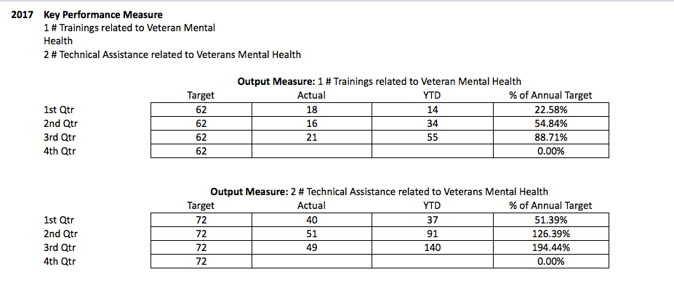
VMHP Outcomes and Summary

Slide 14
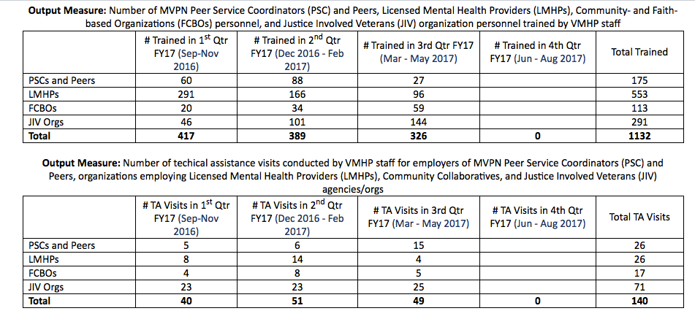
VMHP Outcomes and Summary

Slide 15
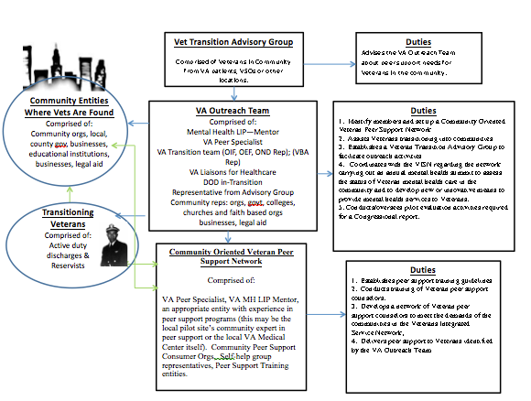

Slide 16
Pilot Program
Utilize a community-centered strategy aligned with the CDC Preventing Suicide Technical Package, Zero Suicide, NSSP, Texas State Suicide Prevention Plan to impact outcomes for SMVF communities.
Leverage across existing networks to benefit SMVF community caregivers throughout the Texas infrastructure
MVPN, VMHP
Texas Suicide Prevention Coalitions and State Partners
Local Mental Health Authorities (LMHAs)
Texas Workforce Boards
Education Service Center Regions
To bring evidence-informed, best practice standards to areas with significant SMVF populations into community resources

Slide 17
Pilot Program Elements and CDC Crosswalk
Strengthen Economic Supports
Train workforce system partners and SMVF employers in community gatekeeper skills
Strengthen Access and Delivery of Suicide Care
Zero Suicide in Texas
Create Protective Environments
CALM (lethal means training)
C-SSRS (screening)
Statewide media, social media campaign targeting men and lethal means:
Gun Shop Project, Man Therapy, Is Your Safety On?
Texas Suicide Safer Schools Model
Teach Coping and Problem Solving Skills
Strengthen outreach initiatives to grow participation in resiliency, social-emotional learning, and parenting/family programs offered in SMVF communities
Promote Connectedness
Strengthen communications partnerships with MVPN, TexVet, others to enhance promotion related to socialization opportunities, resiliency.
Identify and Support People at Risk
ASK Gatekeeper Training in SMVF community supports
BCBT in SMVF community supports
Crisis Response Planning in SMVF community supports
Applied Suicide Intervention Skills Training (ASIST) in SMVF community supports
Lessen Harms and Prevent Future Risk
Strengthen safe reporting and messaging about suicide through existing outreach channels

Slide 18
Texas Suicide Prevention Council SMVF Community Initiatives 2016-2017
Added 3 SMVF members to the Texas Suicide Prevention Council
Approx. 20% of our Twitter followers are directly serving SMVF or are SMVF connected
Enhanced SMVF content at #TxSP16:
DSPO, VA, TVC, TMD, SMVF exhibitors (approx. 20% of all exhibitors were SMVF connected)
2 Day BCBT training with Dr. Craig Bryan, National Center for Veterans Studies
Zero Suicide Update and ASK Training for MVPN at Texas Veterans Commission annual conference
Developed military/veteran video content for Stories of Help and Hope
Military Spouse: http://www.texassuicideprevention.org/training/video-training-lessons-guides/stories-of-help/
Veteran: http://www.texassuicideprevention.org/training/video-training-lessons-guides/stories-of-help/
Participates in the SMVF Academy Team
Collaborated to host ASIST training for community members who support SMVF in San Antonio
Collaborated on ASIST Training for ARNG at Camp Mabry, Texas
Outreach to veterans organizations to improve awareness of SMVF suicide prevention

Slide 19
Demonstrated Need: SMVF Community Outcomes
2013: “Understanding PTSD Among Military Members in Civilian Communities” (Dr. Craig Bryan – National Center for Veterans Studies).
Co-hosted with Texas Governor’s Commission for Women
Attended by 300 participants
Not directed to military or VA personnel
30% indicated they worked with 75 or more SMVF connected persons annually.
7,500+ SMVF persons reached in the Dallas area annually

Slide 20
ASIST for SMVF Community Caregivers June 2017
Approximately how many SMVF connected persons do you typically work with each week?

Slide 21
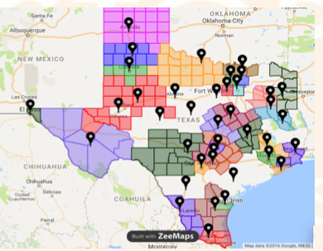
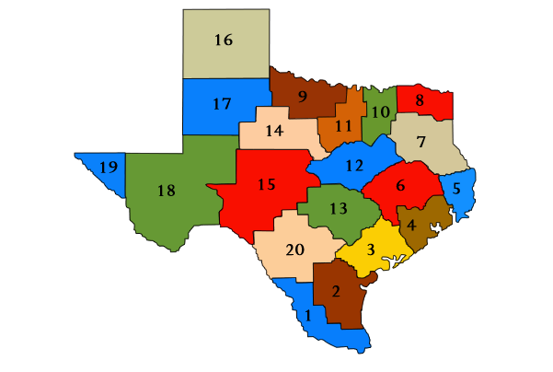
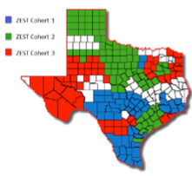
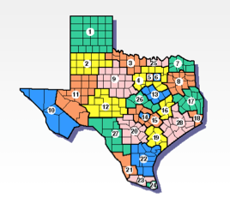
Integrating Suicide Prevention for SMVF Community Supports
MVPN
Education Service Centers
Texas Suicide
Prevention Council, State Partners and Local Coalitions
SMVF Communities
Workforce Development Boards
LMHAs

Slide 22
Summary
Current engagement, strong TVC programs (especially VMHP), and community connections through the Texas Suicide Prevention Council offer an opportunity to enhance and augment existing SMVF-centered programming
Texas has a far-reaching, existing geographical infrastructure that can enable deployment of this pilot more cost effectively
Pilot program requires collaboration and contributions across a wide path of entities that touch SMVF where they live, work, and play
Evaluation is a critical component to be designed to address CDC, DoD, TxSSP, ZEST and other criteria
Through a coordinated pilot rather than the current “ad-hoc” approach, a more effective and efficient strategy can be deployed and evaluated.
Scalability and applicability beyond the targeted geography and SMVF may be possible as lessons are learned and outcomes evaluated.

