Slide 1
Current Findings from the Department of Defense Suicide Event Report (DoDSER) Larry D. Pruitt, Ph.D. National Center for Telehealth & Technology (T2)

Slide 2
DoDSER Overview
Who – Any service member, active duty or reserve, including the National Guard
What – A mandatory data collection following a death caused by suicide or a suicide attempt that results in hospitalization or evacuation from theater
When – Within 60 days of the AFMES determination of cause of death (30 days for a suicide attempt)
Where – Anywhere, worldwide via the DoDSER data-collection web portal, which funnels to Joint Base Lewis-McChord in Washington State
Why – Describe the occurrence of suicide in the military
– Track trends and examine risk factors unique to service members
– Provide data to help evaluate the effectiveness of DoD programs/policies
– Provide senior leaders with high-quality data

Slide 3
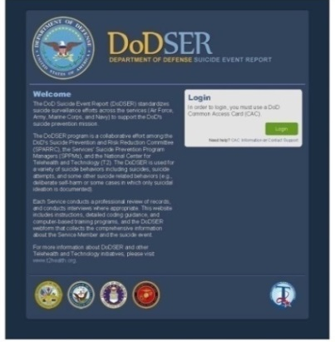
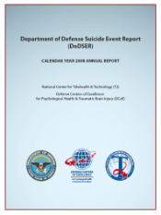
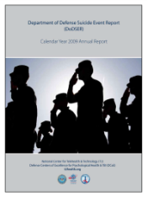
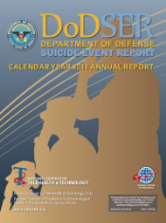
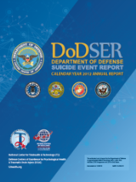
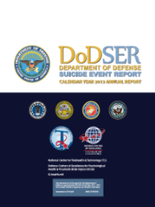
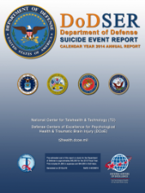
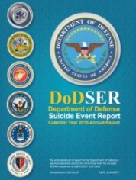
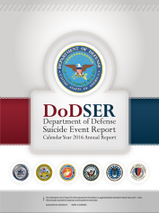
A Joint Data-Collection Effort
DoD Suicide Event Report (DoDSER) System: A web-based application with the functionality to collect core, standardized, DoD suicide-surveillance data, worldwide.
DoDSER Annual Report: An authoritative, descriptive report that characterizes service- member suicide data through the web-based data-collection program and various DoD data portals.
2008 2009 2010 2011 2012 2013 2014 2015
2016

Slide 4
DoDSER Data-Collection Process
Suicide event
AFMES confirms cause of death
Fatal or
non-fatal
event
Fatal
Interviews are often conducted for non-fatal DoDSER reports.
Non-fatal
Services oversee and validate DoDSER data collection: medical and behavioral-health records, personnel records, investigative agency records and records related to the manner of death
DoDSER reports are submitted by behavioral-health providers, other health-care providers or a command-appointed representative. Technicians may submit DoDSER reports under the supervision of one of these professionals.
T2 confirms caseness with AFMES.
DoDSER reports submitted via secure web-based application within 60 days of confirmed suicide and within 30 days of suicide attempt
T2 prepares the DoDSER Annual Report and disseminates data as needed to support the services

Slide 5
CY 2015 Suicide Rates
479 deaths due to suicide
— 266 Active Component suicides
Rate: 20.2 suicides per 100,000 service members
Air Force: 64 deaths
Army: 120 deaths
Marine Corps: 39 deaths
Navy: 43 deaths
— 90 deaths in the Reserves
Rate: 24.7 per 100,000 service members
— 123 deaths in the National Guard
Rate: 27.1 per 100,000 service members
1,199 suicide attempts (resulting in medical attention)
Rates per 100,000
Suicide Rates by Type of Service

Slide 6
Demographic Risk Factors of Suicide Active Component
Rate Per 100,000 SMs
Age
Ethnicity
Race
Sex

Slide 7
Demographic Risk Factors of Suicide Active Component
Rate Per 100,000 SMs
Marital Status
Education
Rank

Slide 8
Method of Suicide
62.3 percent of military suicides were due to injuries caused by firearms
— 94.4 percent of these firearms were personal possessions
— 5.0 percent of these firearms were military-issued
Firearm(s) were present in the immediate environment of 59.2 percent of decedents
DoDSER 2015 Suicide Methods, by Service

Slide 9
Communicated Potential for Self-Harm (in a manner other than a suicide note)
28 percent of decedents had made a known communication about the potential for self-harm prior to the event.
Verbal – 60.5% Text – 37.0% Written – 12.3%
Recipients of Communication Prior to Suicide
CY 2012
CY 2013
CY 2014
CY 2015
Proportion of total
12.5%
8.3%
3.8%
3.1%
4.2%
5.5%
Reported categories are not mutually exclusive

Slide 10
Health Care Utilization Prior to Suicide
64 percent of decedents had engaged with the Military Health System within the 90 days prior to their death.
— 30.8 percent had engaged behavioral-health services at least once.
Known Treatment History, 90 Days Prior to Suicide
CY 2012
CY 2013
CY 2014
CY 2015
57.1%
Proportion of total
26.3%
8.7%
3.8%
4.5%
Reported categories are not mutually exclusive

Slide 11
Behavioral Health History
49.1 percent of suicides had a history of at least one behavioral-health disorder.
— 12.5 percent had a history of major depressive disorder.
— 8.3 percent were known to have a diagnosis of PTSD.
50.2 percent had no known history of a behavioral-health disorder.
CY 2012
CY 2013
CY 2014
CY 2015
Known History of Behavioral-Health Disorder
Proportion of total
19.7%
19.3%
23.2%
24.6%
2.4%
Reported categories are not mutually exclusive

Slide 12
Previous Suicidal Behavior
Cases with Previous Suicide-Related Behavior (2008-2015)
Proportion of total
(Cases of Suicide)
(Cases of Attempted Suicide)

Slide 13
Psychosocial Stressors Relationships
41.2 percent of decedents had experienced known relationship difficulties in the 90 days prior to their death.
Comparable proportion for suicide attempts (42.0 percent)
Relationship Stressors 90 Days Prior to Suicide
CY 2012
CY 2013
CY 2014
CY 2015
38.1%
Proportion of total
9.3%
8.3%
Reported categories are not mutually exclusive

Slide 14
Psychosocial Stressors Legal & Administrative Problems
At least one known administrative stressor in 31.5 percent of cases:
— Civil legal proceedings (8.7 percent) and Non-Judicial Punishment (8.3 percent) were the most frequent legal issues among decedents.
— Medical (9.0 percent) and administrative (9.3 percent) separations from service were frequent stressors among suicide attempts.
Legal/Administrative Stressors 90 Days Prior to Suicide
CY 2012
CY 2013
CY 2014
CY 2015
Proportion of total
8.3%
3.1%
5.9%
3.5%
4.8%
8.7%
6.9%
Reported categories are not mutually exclusive

Slide 15
Operational Deployment
57.4 percent of decedents had a history of at least one previous deployment to OEF and/or OIF/OND:
— 1 Deployment 22.1 percent
— 2 Deployments 15.9 percent
— 3+ Deployments 19.4 percent
Suicides that Occurred on Deployment (CONUS & OCONUS)
Proportion of total (%)
%
%
%
%
%
%
%

Slide 16
Unadjusted Suicide Rates 2008-2015
When we compare the DoD to the U.S. population, overall
20.2
Suicides per 100,000 population members

Slide 17
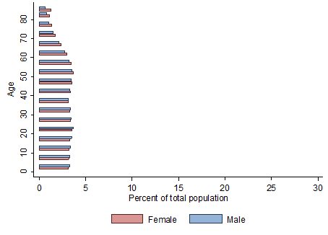
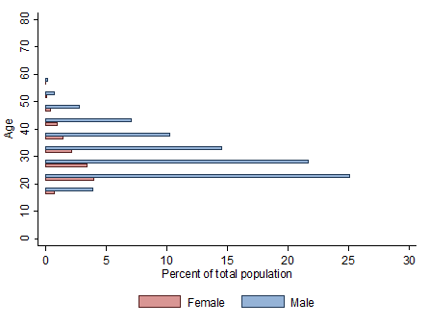
Comparison to the U.S. Population
The service-member population is predominantly young and male.
The general population of the U.S. is much more evenly distributed.
U.S. Population
Service Member Population

Slide 18
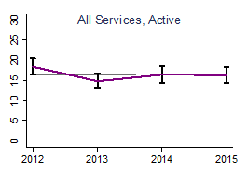
Adjusted Suicide Rate, All Services 2012-2015
DoD
U.S. Overall
All Services, Active Component
Suicides per 100,000 population members

Slide 19
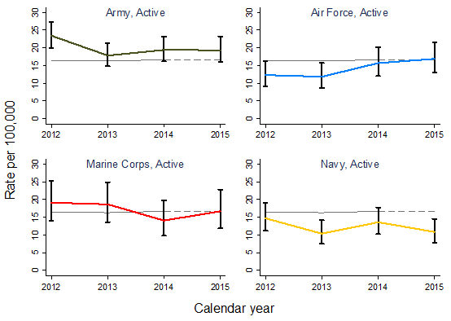
Adjusted Rates, by Service 2012-2015
U.S. Overall
Suicides per 100,000 population members

Slide 20
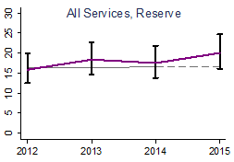
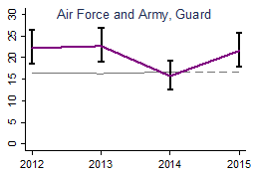
Adjusted Rates, Reserves and Guard 2012-2015
DoD
U.S. Overall
Suicides per 100,000 population members

Slide 21
Data Summary
Young, Caucasian, males, high-school educated, enlisted.
Non-military firearms are still the most common suicide method (62.9 percent).
Half of decedents had a diagnosed behavioral-health condition.
Two thirds had attended a health-care appointment shortly before their death.
Common stressors: failed relationships, disciplinary actions and civil proceedings.
For each of the services, suicides rates have been stable (2012-2015).
The overall military rate of suicide has been stable (2012-2015).
Military suicide rates in CY 2015 were indistinguishable from the age- and sex-adjusted suicide rates of the U.S. general population.

Slide 22
Contact Information
Larry Pruitt, Ph.D.
National Center for Telehealth & Technology
Joint Base Lewis McChord, WA
Larry.d.pruitt21.civ@mail.mil
http://www.t2health.dcoe.mil/programs/dodser

Slide 23
Additional Material

Slide 24
Methods for Attempted Suicide
Most frequent methods for attempting suicide were:
— Drug overdose (58.1 percent)
— Asphyxiation (12.5 percent )
— Sharp or blunt objects (11.5 percent)
DoDSER 2015 Suicide Attempt Method, by Service

