Slide 1
Community Partners in Suicide Prevention Outreach and Education
August 3, 2017

Slide 2
Community Partners in Suicide Prevention
Outreach and Education
Panelists:
Brad Lanto, LtCol, USMC , Military Deputy
Defense Suicide Prevention Office
Amy J. Kulp, MS, Deputy Director
American Association of Suicidology
Ramya Sundararaman, MD, MPH, Suicidologist

Slide 3
Defense Suicide Prevention Office
Mission
The Defense Suicide Prevention Office (DSPO) provides advocacy, program oversight, and policy for Department of Defense suicide prevention, intervention and postvention efforts to reduce suicidal behaviors in Service members, civilians and their families.
Vision
Actively engage and partner with the Military Services, other Governmental Agencies, Non-Governmental Agencies, non-profit organizations, and the community to reduce the risk for suicide for Service members, civilians, and their families.

Slide 4
Community Partners in Suicide Prevention
Outreach and Education
The FY 2013 National Defense Authorization Act authorized the Department to enhance efforts in research, treatment, education, and outreach on mental health and substance use disorders in members of the National Guard and Reserves, their family members, and their caregivers through community partnerships.
To meet the requirements of this legislation, the Defense Suicide Prevention Office (DSPO) through a proposal process, awarded a one year grant to the American Association of Suicidology with the congressionally funded money.

Slide 5
Community Partners in Suicide Prevention
Outreach and Education
Goal:
Establish a pilot program that increases the number of National Guard/Reserve (Reserve Component, or RC) Service Members (SMs) provided treatment or services by community partners.
Grant Partners:
American Association of Suicidology
CALIBRE
CBS Community Partnership Division
National Center for Veteran Studies, the University of Utah

Slide 6
Action
Provide an online central clearinghouse to improve NG/RC service member, family member, and community partner awareness of benefits and educational opportunities
Online learning environment developed to serve as a portal and to house on-demand webinars, and PowerPoint presentations
Website – USMilitaryMatters.org – specifically designed for the pilot project and provides access to the free online trainings (webinars), workshops, and other resources

Slide 7
Objective 1: Education and Awareness
1: Education and Awareness – American Association of Suicidology (AAS)
Increase the number of qualified care providers for treatment of
mental health, substance use disorders, TBI, and suicide prevention by providing standardized training/education and ensuring providers and the RC community is aware of this pilot.

Slide 8
Action
Training Tiers
Tier | Description | Geared Toward
Tier I | 30 minute webinars | Service members and their families
Tier II | 2-hour webinars or in-person trainings | Mental health providers
Tier III | 2-day advanced in-person trainings | Mental health providers

Slide 9
Action
Webinars developed to provide self-paced information on topics relevant to National Guard or Reserve Components, their family members, and mental health treatment providers
Webinars are provided at no cost to attendees
A total of 28 webinars available for “on demand” use
Notes:
Providers can earn continuing education credits
Curriculum content developed by subject matter experts in the field

Slide 10
Tier I Topics for Military Members and Family Members:
Healthy and Unhealthy Sleep
The Case for Self-Care
When Might I Benefit from Something More?
Am I Feeling Ambivalent About Change?
Do My Family and Friends Believe I Need Help, While I Do Not?
Problem-Solving Training: Keeping Problems in Perspective
Stress Inoculation Training
Posttraumatic Stress Disorder: Signs and Symptoms
Postvention/Chaplains
Action
Notes:
Webinars designed specifically for service members and their families
19 total
TIER ONE

Slide 11
Mental Games
Keeping Emotions in Check
How to Build and Utilize My Unit
My Family is New to the Military: What Can I Expect?
My Family is About to PCS: Tips and Tools
Common Challenges Associated with Military Life/Military Transitions
How Can I Help/Get Help for My Family Member?
Suicide Risk: Warning Signs
Substance Abuse – Signs Your Loved One May be Struggling
Traumatic Brain Injury: Signs and Symptoms
Action

Slide 12
Action
Tier II Topics for Mental Health Providers:
Sleep Problems
Military Culture, Language and Customs 101
Impact of Military Transitions and Change on Service Members
Impact of Military Life on Families
Posttraumatic Stress Disorder
Military Sexual Trauma
Suicide
Substance Abuse and Motivational Interviewing
Traumatic Brain Injury
Notes:
Providers can earn continuing education credits
Curriculum content developed by subject matter experts in the field
Webinars geared toward mental health providers
9 total
TIER TWO

Slide 13
Action
Tier III: Two-Day advanced trainings for mental health providers, delivered in Salt Lake City, San Diego, Lafayette, IN and Atlanta
Brief Cognitive Behavioral Therapy for Suicide Risk
(Assessment, Crisis Intervention, and Treatment in the US Military)
Cognitive Processing Therapy
Cognitive Behavioral Therapy for Insomnia
Advanced Skills in the Assessment and Management of Traumatic Brain Injury
Prolonged Exposure Therapy
Evidence-Based Approaches for Assessing and Treating Substance Use Disorders and Motivational Interviewing
Notes:
Providers earn continuing education credits
All workshops and trainings are provided at no cost to attendees
Registration reached maximum capacity for the advanced trainings, with waiting lists
TIER THREE

Slide 14
Action
Develop and populate a National Registry of Qualified Providers
Collaboration between AAS and Star Behavioral Health Providers (SBHP)
AAS trainings aligned with SBHP’s workshops
Increases number of mental health providers in the SBHP registry
Ensures community-based providers are well-prepared to serve military-connected clients
Allows SBHP Registry to add a new state (Utah) to the registry
Notes:
AAS has collaborated with Star Behavioral Health Providers (SBHP) to create a National Registry of Providers for the pilot project.
AAS trainings are aligned with Star’s tiered workshops allowing AAS/DSPO trained providers to be eligible for the SBHP Registry
AAS tier three trainings held in Salt Lake City, Utah, San Diego, California, Lafayette, Indiana, and Atlanta, Georgia
Allows providers who practice in states with existing registries to be eligible for the SBHP Registry
AAS partnered with the Center for Deployment Psychology (CDP).
CDP reviewed curriculum content to confirm alignment with SBHP curriculum

Slide 15
Objective 2: Outreach
2: Outreach – CBS Community Partnership Division
To execute an education and outreach campaign that targets members of the National Guard, Reserves, their family members, caregivers and the general public and encourages them to go to USMilitaryMatters.org to find valuable resources that help with mental health, substance use disorders, suicide prevention and TBI.
Action/Strategy
Our strategy reaches the target via multiple touch points throughout the day, which leverages the effectiveness of each platform and results in higher recall of the message.
The National Advertising Campaign included:
--Broadcast Television --Digital
--Email Marketing --Mobile
Notes:
Advertising Dates: March 7 – April 24, 2016

Slide 16
Action – Broadcast Television
Goal- to execute a broadcast television campaign that encourages behavior change and aligns with the Community Partners in SP mission
Phase one ran between 3/7 and 4/24/16, over 1,254 vignettes ran in key CBS programming such as the NCAA Tournament, The Late Show with Stephen Colbert, The Late Late Show with James Corden, and CBS Network Prime.
Phase two ran between 11/14/16 and 2/6/17, 242 vignettes ran in the Triumph Games, SEC Football, the SEC Championship, the Army/ Navy game, the Late Show with Stephen Colbert and more.
Notes:
Vignettes are :30, :15, :10, and :05 second advertising spots
The identified television markets included:
Los Angeles
Chicago
Philadelphia
Dallas
Minneapolis
Tampa

Slide 17
Action – Broadcast Television
Production for all media platforms was donated in kind hence leveraging funding
17
Notes:
This is an example of the 30 second spot developed by CBS and televised in the target markets

Slide 18
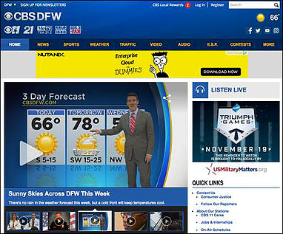
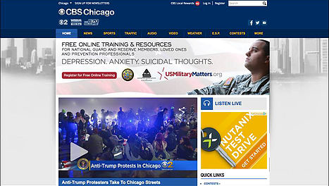
Action – Digital
The CBS Digital platform is a powerful and robust network of 117 radio station sites and 29 television station sites in 28 markets across the country
Messaging ran via an effective blend of leaderboard/message units, video pre-roll, web skins, home/health/news take overs, mobile banners and mobile message units
Phase one delivered 15,661,014 impressions and 65,000 total clicks
Phase two delivered 5,870,761 impressions geotargeted to the five selected markets and 27,766 total clicks
​
Message Unit 300x250
Billboard 970x250
Mobile 300x250
In article video

Slide 19
Action – E Mail Direct
Email direct enjoys a database of over 2.5 million addresses across the country.
In phase one of the campaign, by using custom filters we specifically targeted the National Guard and Active Military members across the country to encourage them to visit USMilitaryMatters.org and to register for training classes
Phase two targeted Doctors, Mental Health Clinicians, Physicians, Active Military, and Veterans in Indiana/ Illinois and Atlanta zip codes
Phase one, a total of 400,000 Emails were deployed on the following dates: 3/16/16, 3/24/16, 4/7/16, and 4/20/16
Phase two, a total of 475,000 Emails were deployed on the following dates leading up to the trainings; 12/16/16, 12/27/16, 1/2/17, 1/9/17 and 1/16/17 in Indiana and on 1/9/17, 1/17/17, 1/24/17, 1/30/17 and 2/6/17 in Atlanta
The guaranteed open rate of 10% was exceeded
Email example

Slide 20
Action – Mobile Plus – Phase one
Mobile Full screen 320x480
Mobile Plus has the ability to target over 2 million mobile devices across the country by device ID.
This cutting edge technology allowed us to "geo-fence" active devices around military bases* across the country to serve the important USMilitaryMatters.org message.
Digital Placement Size Targeting Impressions Clicks
Mobile banner 300x250 Military bases 200,553 424
Mobile full screen 320x480 Military bases 148,207 1,487
Mobile video pre-roll video Military bases 162,409 162
Totals: 511,169 2,073
Mobile Targeting*:
150 National Guard and Air Force Reserves (5 mile radius)
40 US Army Bases (5 mile radius)
60 Active Duty and Air Force Bases (5 mile radius)
Mobile message unit 300x250
©2017 United States Department of Defense

Slide 21
Action – Results
Measures of success:
-Number of impressions associated with our message
-Employ metrics as the principal mechanisms to balance resources, identify and mitigate risks, and determine outreach messaging awareness and education portfolio effectiveness
Television
Phase 1 - 85,333,000 gross impressions
Phase 2 - 15,975,000 gross impressions
1,496 Total Vignettes (Phase 1 & 2)
101,308,000 gross Impressions (includes duplication- Phase 1&2)
Digital
Phase 1 – 15,661,014 impressions
Phase 1- 58,633 clicks
Phase 2 – 5,870,761 impressions
Phase 2 – 22,093 clicks
21,531,775 Tot. Impressions (Phase 1 & 2)
Total Clicks - 80, 726
Mobile
500,000 impressions Geo-Fenced to:
150 National Guard & Air Force Reserves bases
40 US Army Bases
60 Active Duty & Air Force bases
2,073 clicks
Email
Phase 1: 400,000 Emails delivered
Avg. Open Rate- 11.08%
Emails Opened- 44,331
Total Clicks- 4,359 to usmilitarymatters.org
Phase 2: 475,000 Email delivered to target audience
Avg. Open Rate- 11.67
Emails Opened- 50,107
Total Clicks- 5,673
Results: Phase 1 and Phase 2 of the Education and Outreach campaign delivered:
124,214,775 Impressions
92,831 Clicks

Slide 22
Objective 3: Integration (CALIBRE)
Provide a linkage of increased community awareness to current Department of Defense measures of effectiveness, suicide prevention strategy, and the suicide prevention program portfolio.
Indicator of success: Level of integration achieved with the portfolio.

Slide 23
Action
As the project moved forward, additional partnerships were established to support the project’s goals, to expand reach and impact, and to achieve cost savings. These partnerships included:
National Guard Bureau
Department of Veterans Affairs
Center for Deployment Psychology
Military Family Research Institute at Purdue University
Star Behavioral Health Providers
Substance Abuse and Mental Health Services Administration

Slide 24
Evaluation Findings
Using data from various military, health, and media sources, Team AAS set out to evaluate the breadth and effectiveness of the Community Partners in Suicide Prevention Pilot strategy for increasing the number of Reserve Component Service members provided treatment or services by providers with regard to suicide prevention.

Slide 25
Evaluation Findings
Key Question:
Did the Pilot increase the number of National Guard/Reserve Component Service Members provided treatment or services by community partners?
At the core of our measurement effort was to determine if the pilot:
Achieved its outreach goals
Achieved portfolio integration
Increased the number of Registered Providers/Community Partners
Increased service utilization

Slide 26
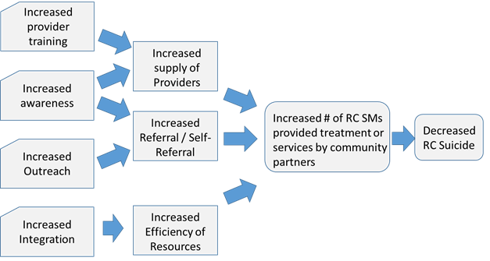
Objective 3: Integration and Evaluation CALIBRE
Notes:
The thought process associated with this pilot is to increase the “supply” of registered community care providers through outreach and training; increase awareness of the community at-large (particularly Military families and RC Service members of their benefits/ available services; and to ensure pilot integration. The above logic model provides the logical trail from inputs, to outputs, to outcome.

Slide 27
Evaluation Findings
Analytic Information
Trainings
1396 providers trained total – training rate of approximately 26 mental health providers per week
434 cumulative number of providers trained through in-person training workshops (all two-day training workshops were filled to capacity, with a wait list)
34 trained providers applied to become part of the Registry
168 service members and their families trained via webinar
USMilitaryMatters.org
Number of website users: 63,961
Number of page views: 123,495
(as of March 31, 2017)

Slide 28
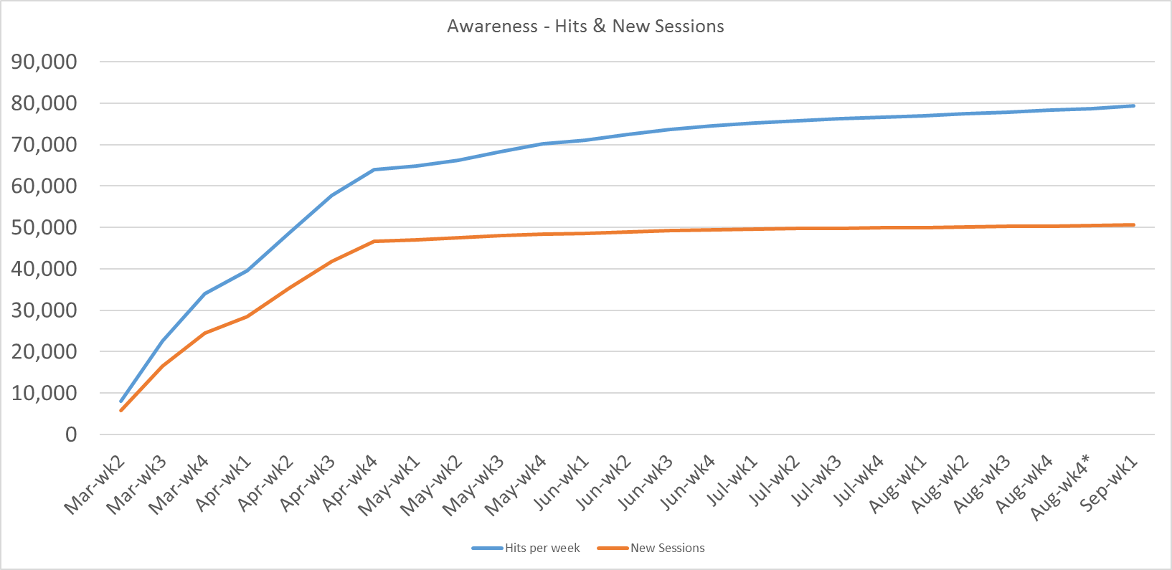
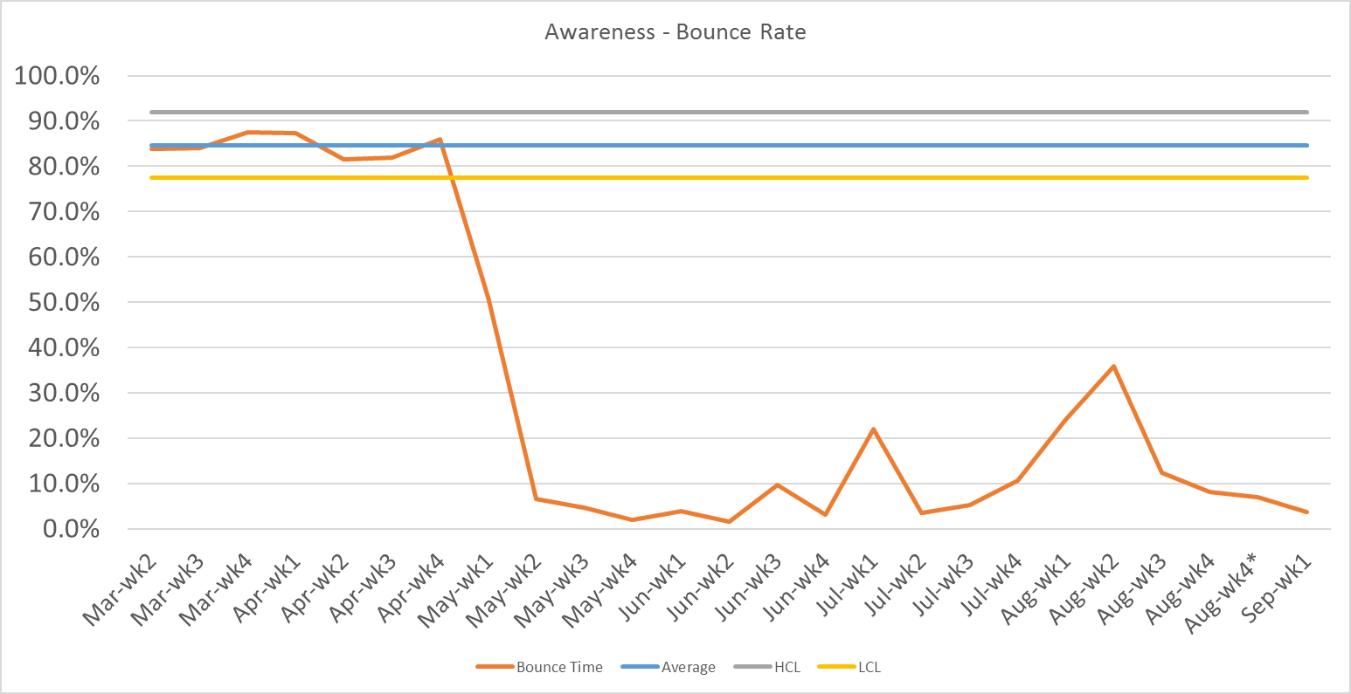
Evaluation Findings
Analysis Summary
Evaluation metrics indicate the pilot was successful in reaching the target audience and increasing awareness
Return visits to USMilitaryMatters.org were purposeful
The CBS education & outreach campaign (March 7 to April 24, 2016) rapidly increased the number of visits to a previously nonexistent website
“Bounce rate” of visits to website decreased by 1700% when campaign ended
The number of “new sessions” on site were correlated with the timing of the outreach campaign
Strong correlation to the awareness metrics and training

Slide 29
Evaluation Findings
Utilization of Services
The number of calls to the Military Crisis Line in the six geographical areas targeted by the pilot project did not deviate from the rest of the country

Slide 30
Discussion
Results of the project provided clear support for the value of a multimodal outreach campaign that is coordinated by agencies and groups with well-established success in advertising and marketing.
The CBS Community Partnership Division exceeded all goals and metrics for disseminating information about training opportunities and resources to each of the target audiences.
The USMilitaryMatters.org website, was accessed over 65,000 within its first three months of existence.
In-person training workshops were rapidly filled to capacity and had wait lists.
Feedback from participants was consistently positive, indicating the trainings were well-received and valued by clinicians.

Slide 31
Discussion
Two additional trainings were scheduled in Indiana and Georgia—two regions that were not targeted in the first phase of the project.
The pilot project achieved an important milestone with respect to portfolio integration: establishing reciprocity of training curricula with the Center for Deployment Psychology.
Mental health professionals trained within the context of the CPSP to be eligible for entry in the Star Behavioral Health Provider national registry.
The pilot project obtained a high degree of integration and cooperation among multiple training entities, thereby laying a strong foundation for future efforts in this area.

Slide 32
Conclusion
The CPSP pilot project achieved all of its objectives during its brief period of performance, and provided clear evidence supporting the feasibility of strategic community partnerships aimed at addressing the mental health needs of the military community.

Slide 33
Future Directions
Future, larger scale efforts should be considered to build on this initial success. Based on the results of this pilot project, future efforts should consider the following:
Emphasize partnerships among agencies with complementary areas of expertise.
Maintain the participation of nationally-recognized subject matter experts.
Complement training efforts with ongoing resources to support effective implementation.

Slide 34
Acknowledgements
Completion of this project would not have been possible without the collaborative support of the National Center for Veterans Studies at The University of Utah, the Center for Deployment Psychology, the Military Family Research Institute at Purdue University, the Star Providers program, and our subject matter experts.
Consistent with the spirit and intent of this project, all of these agencies and individuals worked together and willingly provided access to their curriculum, products, and/or knowledge in a united effort to improve the quality of care for Reserve Component service members and their families.

Slide 35
Acknowledgements
Team AAS appreciates the opportunity to support the Defense Suicide Prevention Office on this pilot grant project, and to share outcomes thus far.

