Slide 1
Developing a Suicide Deep Dive Data Collection Tool for the Navy
Tina M. Luse, MPH
Christine E. Glasheen, MPH
Armed Forces Health Surveillance Branch

Slide 2
The views expressed in this presentation are those of the author and do not necessarily reflect the official policy or position of the Department of the Navy, Department of Defense, or the U. S. Government.

Slide 3
Background: EpiData Center Department
EpiData Center Department (EDC), Navy and Marine Corps Public Health Center supports Navy Suicide Prevention efforts by conducting multiple epidemiologic and analytic projects.
Monthly surveillance of suicide-related behaviors, psychotropic medications, and Post Deployment Health Assessment responses and referrals
Medical record reviews for all Navy/USMC suicide deaths
Clinical/administrative data
Quantitative review of AHLTA clinical notes
Participate in yearly Navy interdisciplinary Suicide Deep Dives
Analysis of risk factors among Navy suicide attempts and death
Ad hoc analyses
2

Slide 4
Background
Navy Suicide Deep Dives
Yearly working group
Consists of a multi-disciplinary team of psychiatrists, psychologists, epidemiologists, social workers, law enforcement, chaplains, and counselors.
Comprehensive record review.
Collect standardized data on each case.
Find common risk factors, opportunities for interventions, and suggest recommendations for future prevention strategies to policymakers

Slide 5
Record Review
Available Data
CNO Report
DODSER
Medical Encounters
Pharmacy Transactions
NCIS/Police Reports
Deployment Histories
Deployment Health Assessments
Family Advocacy Program
Tragedy Assistance Program for Survivors (TAPS)
Personnel Records
FITREPS
PRIMS
Accession

Slide 6
Process
Cases divided between two groups
Work in separate rooms
Each person responsible for specific part of review.
20-45 minutes to review documentation
15-30 minutes for discussion
59 cases over 5 days

Slide 7
Data Collection Request
For the CY2015 deep dive, Navy Suicide Prevention Office (N171) tasked NMCPHC to develop a suicide data collection tool for the Navy deep dive.
Prior to 2015 Deep Dive data were collected in Excel
Lack of data standardization across years
More prone to data entry errors
Did not allow for drop downs selection menus.
Unfriendly interface.
NMCPHC had previously created a deep dive data collection tool for a Marine Corps suicide project.

Slide 8
Step 1: Identify Variables
Used existing N171 Excel tool variables
Met with N171 to identify new variables
Data Categories
Demographics
Military
Suicide Event
Health/Medical
Personal Factors
Personal History
Notes
Data Quality

Slide 9
Step 2: Build the Database
Discussed software with EDC IT staff
Microsoft Access
Easy to use
Easy to change
Export functions
Free
Developed a specification document for IT staff.
Variable name, format, menus, rules.
Multiple revisions

Slide 10
Step 3: Beta Testing
Sent to N171 for review and edits.
EDC Epidemiologists and IT staff tested the dataset over multiple weeks.
Overall design made sense.
Data on front end matched data on back end.
Multiple revisions

Slide 11
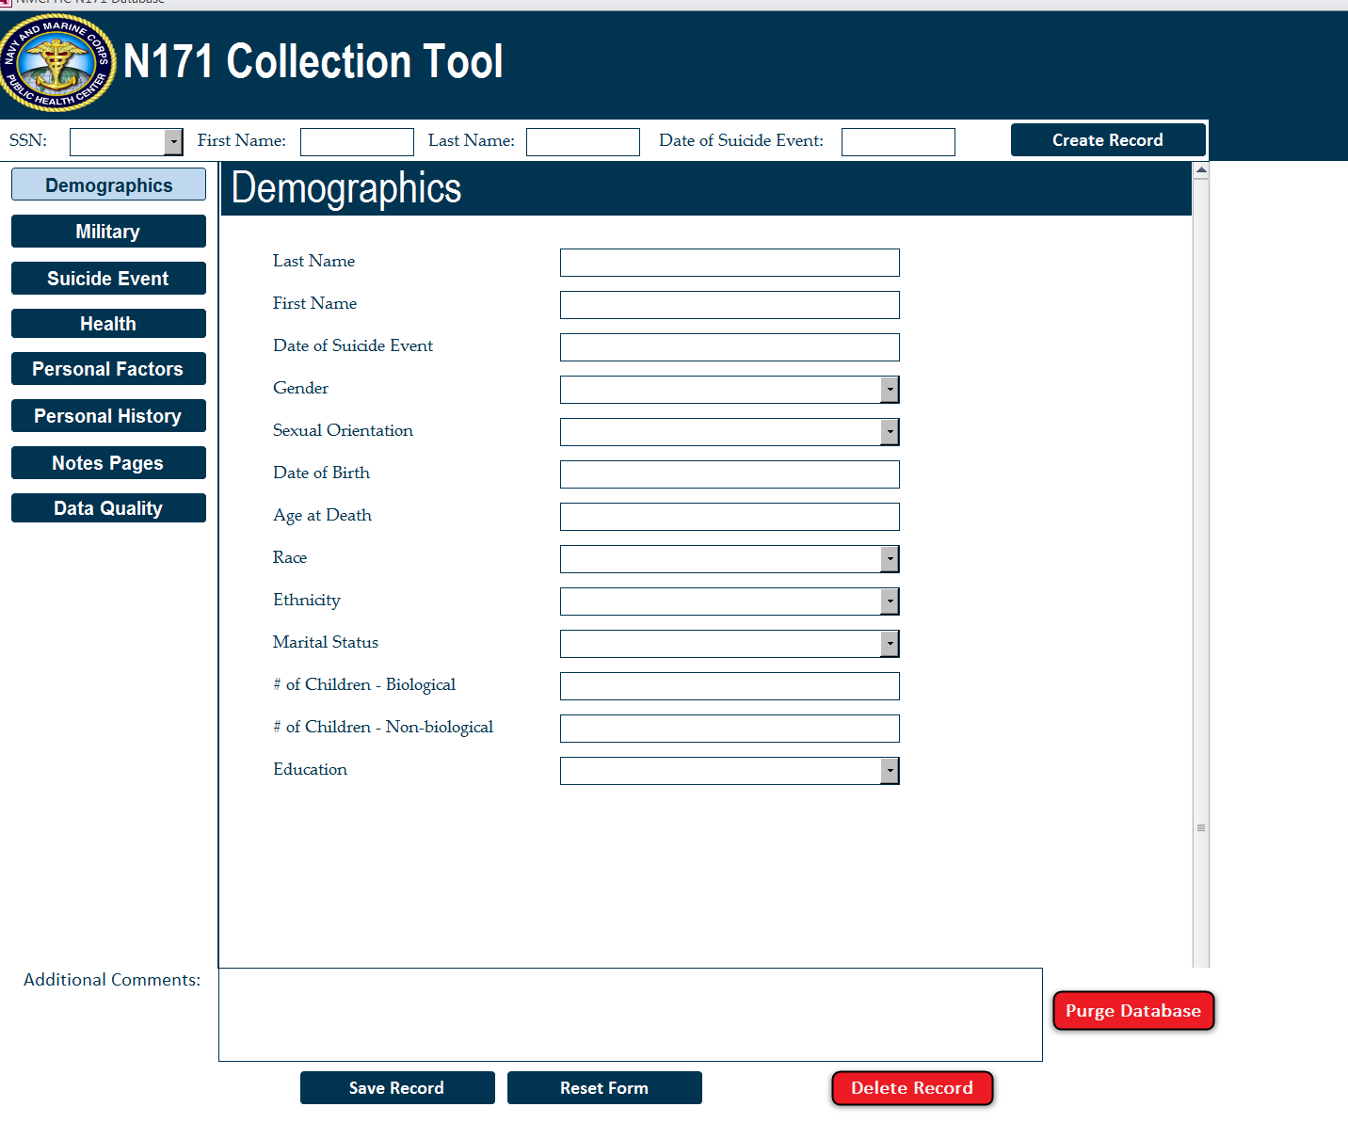
Notes:
Tool Contains 168 variables
Built in Microsoft Access

Slide 12
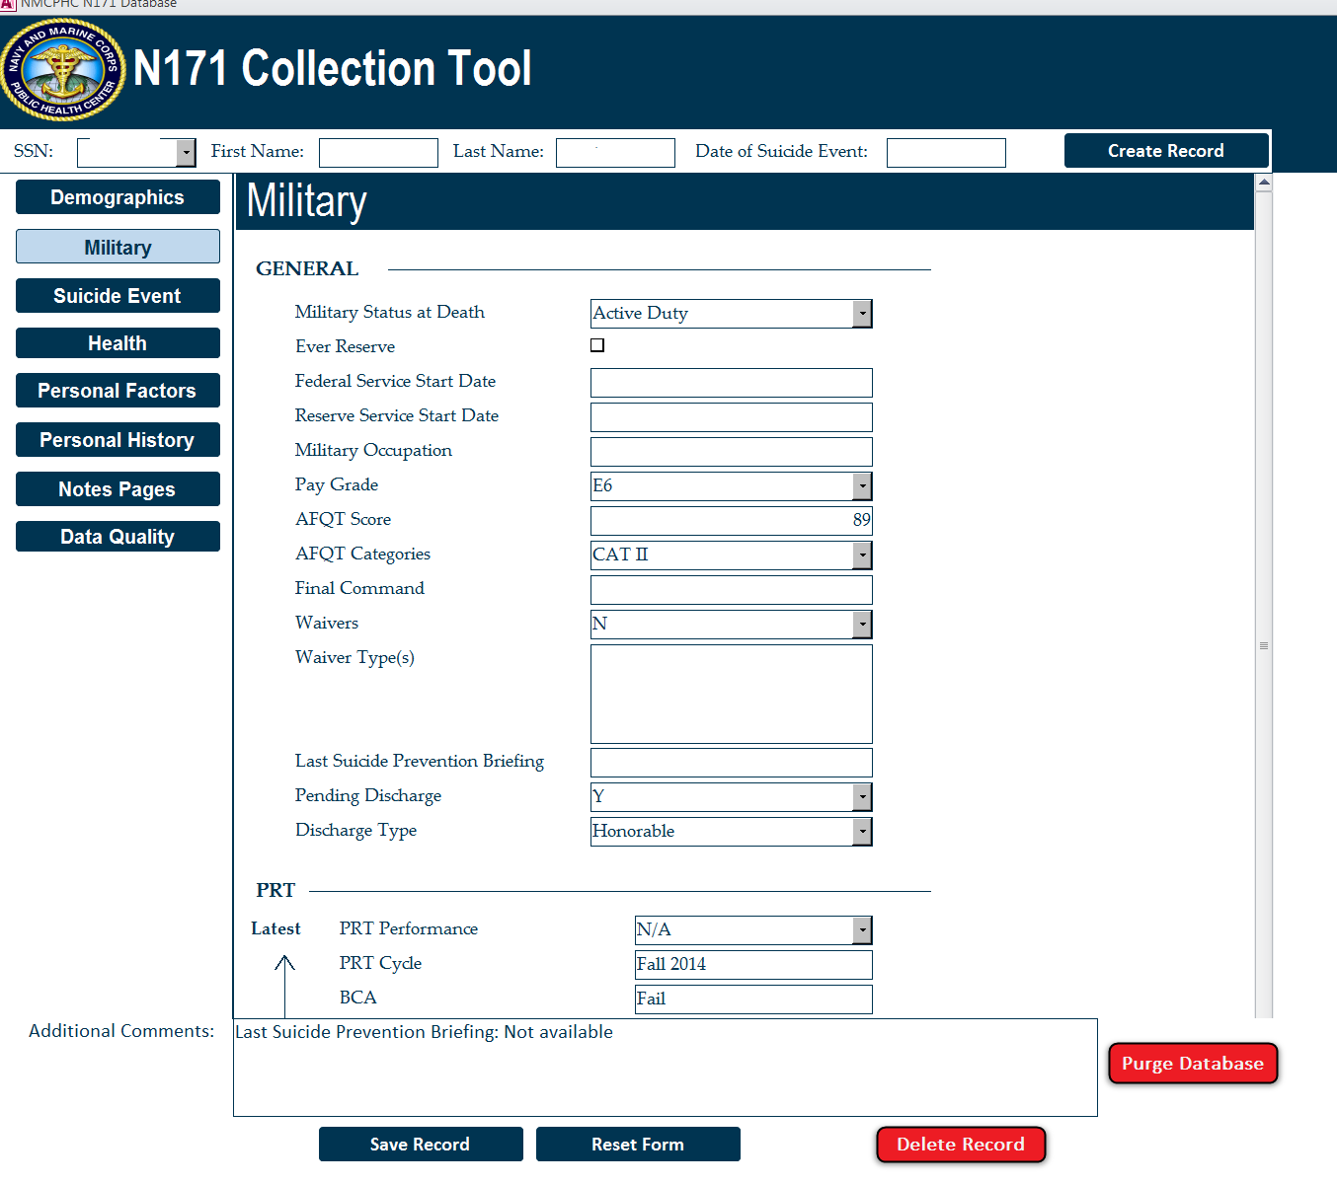

Slide 14
Step 4: Finalize Data Dictionary
Entry created in a data dictionary for each variable available in tool.
Included a description, values, and notes.
Helps to guide Deep Dive team.
Keeps answers consistent across two work groups.

Slide 15
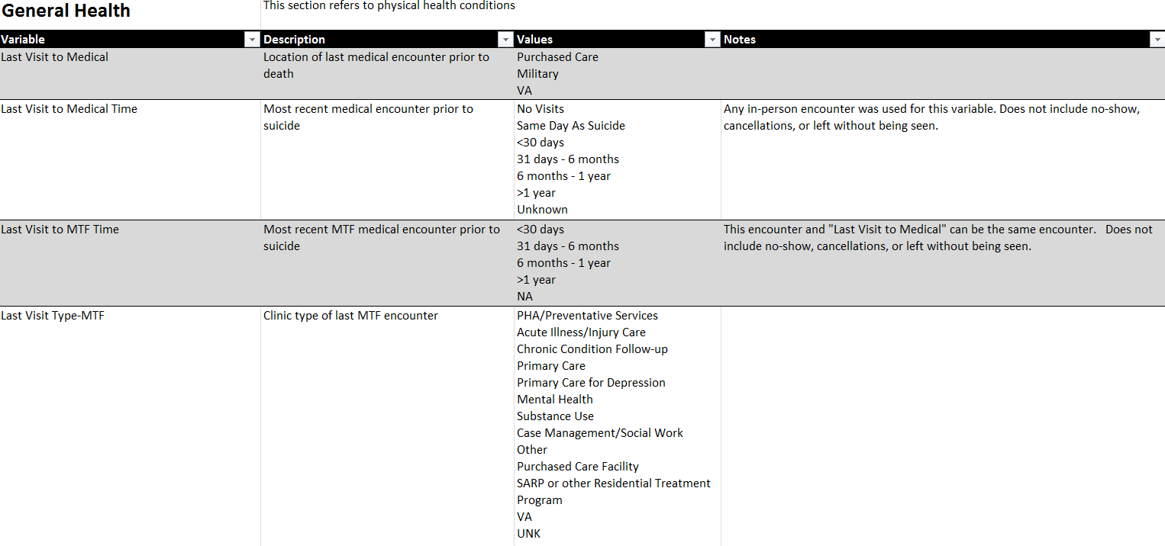
Dictionary

Slide 16
Step 5: Rollout
May 2017 – Deep Dive Work Groups successfully used collection tool
It worked great and helped the teams stay focused.
But there were some lessons learned!

Slide 17
Lessons Learned
Beta testing should occur on computer screen that will be used at Deep Dive (Resolution).
Variable values did not match what was in the available documentation.
Example: Last suicide prevention briefing
Flow of tool should be optimized.
Unknown vs. Blank values
Eliminate as much user error as possible.
Variable constraints, create sub-tabs, autofill subcategories
Comment field that flowed across segments was very helpful.
The most well thought out tool/dictionary cannot account for all circumstances.
Discrepancies still exist between the two work groups.

Slide 18
Acknowledgements
Sean Tosloskie
James McWhorter
Michael Birnbaum
Malia Carpio
Alina Rossini
Andrea Harris
Rakel Cleveland
17

