Slide 1
Community based initiatives and partnerships for military suicide prevention
Keita M. Franklin, LCSW, PhD
Director
Defense Suicide Prevention Office
August 2017

Slide 2
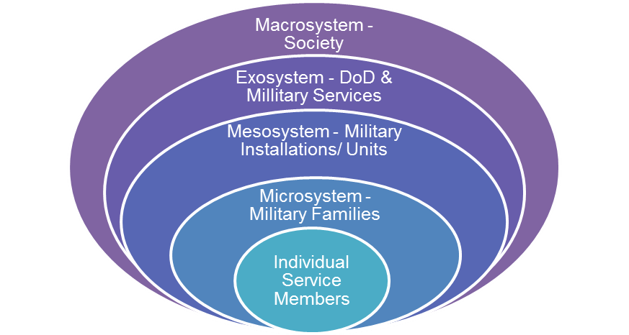
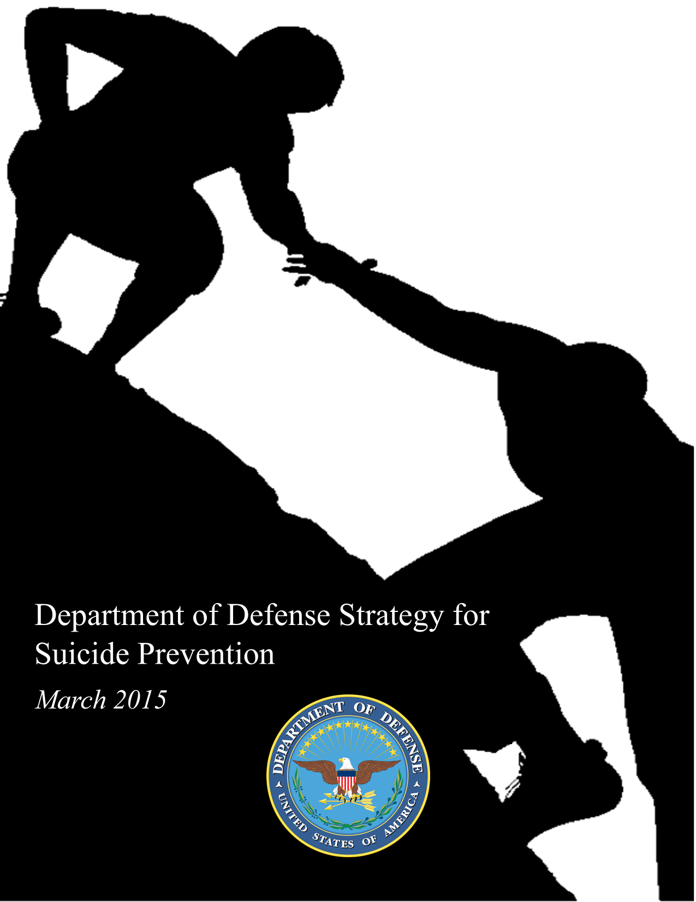
Defense Strategy for Suicide Prevention
Strategic Directions:
1 - Healthy and Empowered Individuals, Families, and Communities
Who and How?
2 - Clinical and Community Preventive Services
What and Where?
3 - Treatment and Support Services
What and Where?
4 - Surveillance, Research, and Evaluation
Who to focus on; How to prevent, etc.; Evidence Basis; Cost-Effectiveness?
Is the overall strategy working?
DoD Ecological Model of Influences for Comprehensive Suicide Prevention
Prevention, Intervention, Postvention up front
IOM Protractor for Care Delivery
The NSSP and DSSP share Strategic Directions and Themes. The continuum of suicide prevention care and influence models as well as the oversight “wrapper” are woven into the DSSP Goals and Objectives

Slide 3
Background on suicide in the military
Across the Services, suicide rates during calendar year 2015 were consistent with patterns observed in the U.S. general population
Many factors that drive suicide rates in the general population also affect the military:
  Gun availability, stigma, mental health issues, geographic location, news media coverage, economic conditions, and relationship problems.
Factors specific to the military are:
  Acquired capability for suicide: training and expertise in using lethal means (e.g., firearms)
  Non-deployment Transitions: Permanent changes of station; 12 months preceding separation from service
While 50% of civilian suicides involve a firearm, nearly 70% of suicides among military Service members involve a firearm
Since 2008, the use of personally-owned (not military issued) firearms in suicide deaths has increased 73%

Slide 4
Current research and training efforts
Gun Shop Owner Intervention Pilot
  Implementation pilot to determine the effectiveness of education materials and distribution of safe storage devices at gun shops on and around military bases
Perceptions and Beliefs about Gun Lock Policies in Military Gun Culture Study
  Understand the perceptions and beliefs about gun lock policies in the military and degree to which guns used in a suicide death were registered on base
Social Media Translation Study
  Develop training and education materials to increase awareness among peers and family members that Service members may provide signals on Facebook and other social networking sites indicating a trajectory towards death by suicide
NVDRS-DODSER Data Linkage
  Can monitor suicides and precipitating circumstances for military personnel and Veterans
  Linking VA data would further distinguish VHA from non-VHA Veterans
Adaptation of “Preventing Suicide: A Technical Package for Policy, Programs, and Practices”
  Adapt CDC suicide technical package for active duty Military Service Members; non-VHA Veterans, and VHA Veterans
National Guard and Reserve Resources
  Training Chaplains in Evidence Based Care
  Project Safe Guard
  Community Partners Grants

Slide 5


Community Partners in Suicide Prevention Grants
In accordance with National Defense Authorization Act (NDAA) 2013, Section 706, DSPO has awarded two grants to fund community partnerships to administer an outreach and education pilot around mental health, substance use disorders, traumatic brain injury, and suicide prevention.
The grants, with a combined value of $5 million, were awarded to the American Association of Suicidology and Massachusetts General Hospital’s Home Base Program. The initiatives associated with these grants began in early October 2015 and finished in late May 2017.
Goal of the grants:
  Increase the number of qualified clinical providers, trained in military culture and evidence-based training in interventions aimed at treatment of mental health, substance use disorders, Traumatic Brain Injury (TBI), and Suicide Prevention (SP).
  Communicate the availability of the program to the entire target market: Ensure clinical providers and the National Guard and Reserve Component (RC) community were aware of this pilot.
www.usmilitarymatters.org
www.homebase.org

Slide 6
Current policy and outreach efforts
Policy
  Memorandum - Guidance for Commanders and Health Professionals in the Department of Defense on Reducing Access to Lethal Means Through Voluntary Storage of Privately-Owned Firearms
  Memorandum - Guidance on Promoting and Increasing Means Safety Regarding Suicide Prevention Means Safety Policy
Outreach
  Participating in the National Action Alliance Lethal Means subgroup, which brings together leaders and representatives from public and private organizations, across suicide means including poison (Poison Control), train (Union Pacific) and firearm (National Rifle Association) industries
  Collaborative partnerships with Give an Hour, PsychArmor, Tragedy Assistance Program for Survivors (TAPS), American Foundation for Suicide Prevention (AFSP), the National Rifle Association (NRA), National Shooting Sports Foundation (NSSF), Armed and Safe, Armed Force Exchange Service, and Marine Corps Exchange Service
  Outreach materials including trifolds and Public Service Announcements with Tim Kennedy (United States Army Ranger, Special Forces sniper) and Dakota Meyer (United States Marine Corps, Medal of Honor recipient) on firearm safety

