Slide 1
Exploring the acceptability of a computerized intervention for anxiety sensitivity in OEF/OIF Veterans with mTBI to potentially mitigate suicide risk
Lisa M. Betthauser, MBA, PhD,^{1,2} Sean Barnes, PhD,^{1,3} Kathryn Cochran,^{1,2}
Suzanne McGarity, PhD,¹ Brian Albanese, MS,⁴ Brad Schmidt, PhD,⁴
Lisa A. Brenner, PhD¹⁻³
¹Rocky Mountain Mental Illness, Research, Education and Clinical Center (MIRECC), ²Department of Physical Medicine and Rehabilitation, University of Colorado, Anschutz Medical Campus, ³Department of Psychiatry, School of Medicine, University of Colorado, Anschutz Medical Campus, ⁴Department of Psychology, Florida State University

Slide 2
Disclaimer
This presentation is based on work supported, in part, by the Department of Veterans Affairs, but does not necessarily represent the views of
the Department of Veterans Affairs or the United States Government.
Acknowledgements:
Thank you to Alexandra Schneider for crunching numbers.
Thank you to the RM MIRECC staff for assistance in recruiting/promoting the study.

Slide 3
Learning Objectives
Review Anxiety Sensitivity (AS)
Discuss the relevance of treating AS
Present a current cognitive-behavioral treatment for AS (CAST)

Slide 4
Learning Objectives
Illustrate the acceptability & feasibility of CAST in an OEF/OIF Veteran sample
Review initial barriers & facilitators
Facilitate preliminary discussion and implications for future research/clinical practice

Slide 5
What is Anxiety Sensitivity?

Slide 7
What is Anxiety Sensitivity?
“Fear of Fear”
Tendency to fear physiological bodily sensations associated with anxiety arousal¹
Amplified reaction to stress

Slide 8
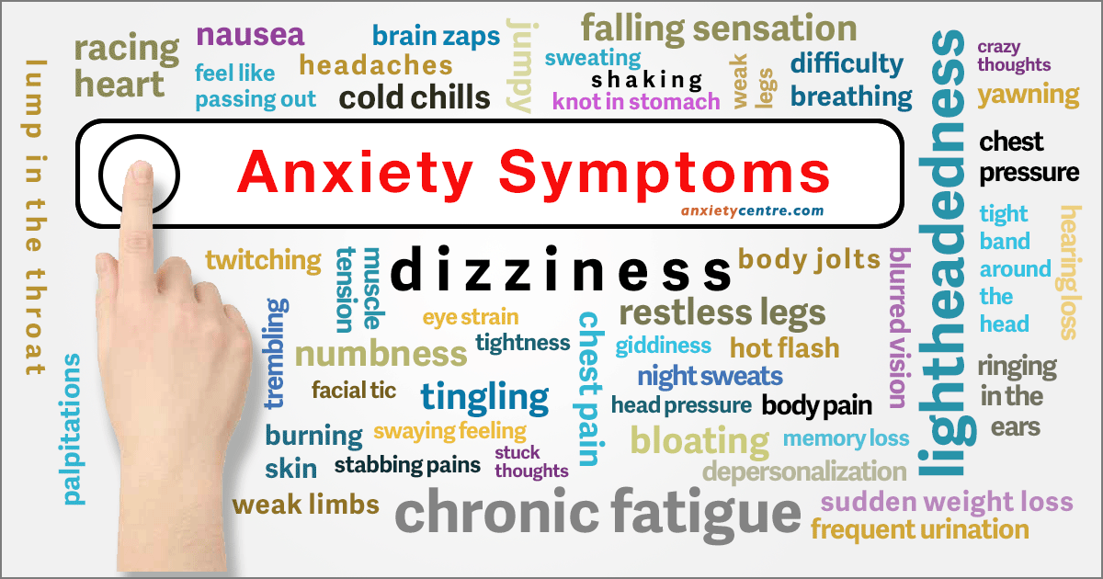
Established in extant literature as a multidimensional construct of anxiety:
Physical
Cognitive
Social

Slide 9
Overall AS is also associated with non-anxiety outcomes
Depression
Substance Use
Suicide
What happens when we look at the primary order facets?
Notes:
Previous work has indicated that AS cognitive concerns are the only facet that independently predicts PTSD and depression.
Most importantly, emerging empirical work has found that AS cognitive concerns is associated with suicidality in clinical outpatient samples, patients with PTSD symptomatology, air force cadets and others
But how are AS cognitive concerns and suicidality related?

Slide 10
AS Cognitive score associated with non-anxiety outcomes
Post-Traumatic Stress Disorder (PTSD)²
Depression^{3,4}
Suicidal Ideation (SI) and Suicide Attempt History⁵⁻⁷
Notes:
Previous work has indicated that AS cognitive concerns are the only facet that independently predicts PTSD and depression.
Most importantly, emerging empirical work has found that AS cognitive concerns is associated with suicidality in clinical outpatient samples, patients with PTSD symptomatology, air force cadets and others
But how are AS cognitive concerns and suicidality related?

Slide 11
AS Cognitive and Suicide Research
Low AS Physical x High AS Cognitive Suicide Attempt History
Outpatients with PTSD Symptoms
Air Force Cadets
Citizens of Moscow, Russia
AS Cognitive SI
Clinical outpatients
Individuals with HIV
Cigarette Smokers
Anxiety outpatients above distress tolerance

Slide 12
Two Primary Research Questions
Can we effectively reduce AS in “at risk” samples?
If so, will this convey preventative benefits?

Slide 13
AS Focused Preventative Interventions
Schmidt, N. B., Eggleston, A. M., Woolaway-Bickel, K., Fitzpatrick, K. K., Vasey, M. W., & Richey, J. A. (2007). Anxiety sensitivity amelioration training (ASAT): A longitudinal primary prevention program targeting cognitive vulnerability. Journal of Anxiety Disorders, 21, 302–319. doi:10.1016/j.janxdis.2006.06.002⁸
Keough, M.E., & Schmidt, N.B. (2012). Refinement of a brief anxiety sensitivity reduction intervention. Journal of Consulting and Clinical Psychology, 80, 766-772.⁹

Slide 14
Overall AS has proven to be amenable to rapid amelioration, but interventions focused on AS Physical
These interventions did yield some change in AS Cognitive concerns
However, given the clear association between suicide and AS Cognitive – it would be important to develop an intervention specifically targeting AS Cognitive
Notes:
….because we have converging evidence that AS can be reduced rather easily
To date the largest AS focused intervention was conducted by Schmidt and colleagues ³⁹. Ps (N = 404)
ASAT condition consisted of a 30-minute computer presentation followed by 10 minutes with an experimenter. who answered questions about the content of the presentation and provided instructions regarding IE
In a recent replication and extension of the ASAT study, Keough et al., ³⁸ had clincians present the psychoeducational material and give personalized training on IE exercises as well as guide them through a full extinction trial.
Great effects - However, this study involved trained clinicians spending an hour with the participants to demonstrate and supervise IE exercises. Which greatly increases cost and reduces portability.
Also, these interventions mainly focused on AS physical concerns with barely any information about AS cognitive concerns.

Slide 15
Schmidt, Capron, Medley, & Allan. (2014). Randomized clinical trial evaluating the efficacy of a brief intervention targeting anxiety sensitivity cognitive concerns. JCCP, 82, 1023-1033.¹⁰

Slide 16
Overall Project Aims for CAST
Efficacy
Can we effectively reduce AS Cognitive concerns and will this impact suicide outcomes?
Dissemination
Can this be done with a brief, computer-delivered format?
Notes:
….because we have converging evidence that AS can be reduced rather easily
To date the largest AS focused intervention was conducted by Schmidt and colleagues ³⁹. Ps (N = 404)
ASAT condition consisted of a 30-minute computer presentation followed by 10 minutes with an experimenter. who answered questions about the content of the presentation and provided instructions regarding IE
In a recent replication and extension of the ASAT study, Keough et al., ³⁸ had clincians present the psychoeducational material and give personalized training on IE exercises as well as guide them through a full extinction trial.
Great effects - However, this study involved trained clinicians spending an hour with the participants to demonstrate and supervise IE exercises. Which greatly increases cost and reduces portability.
Also, these interventions mainly focused on AS physical concerns with barely any information about AS cognitive concerns.

Slide 17
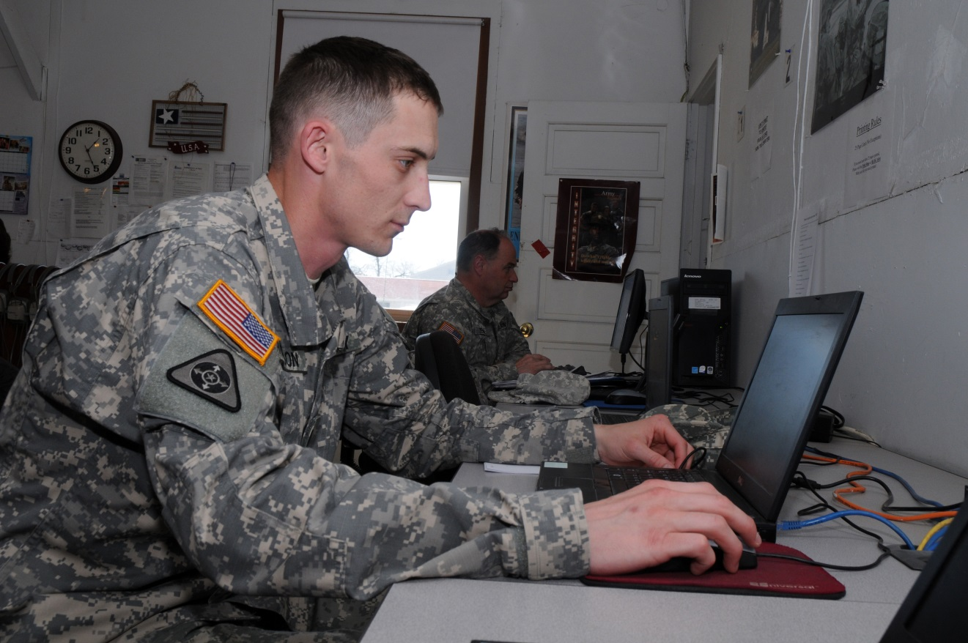
Computer-based Interventions:
Low cost
Portable
Non-stigmatizing
Also capitalizes on desire for
AUTONOMY
Notes:
If we really want to do something about decreasing the burden of anxiety disorders we must address these accessibility issues including this desire to handle things on their own.
This is a tall task to be sure but I think the current intervention meets these criteria.

Slide 18
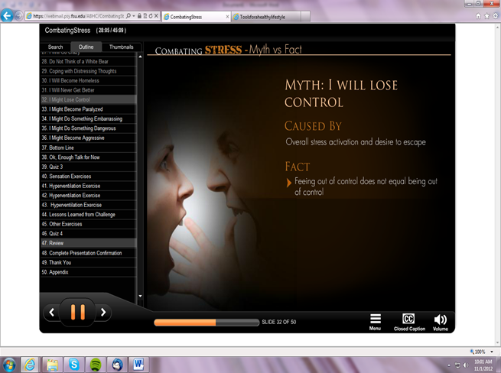
Experimental Conditions: CAST (Active)
Psychoeducation
Interoceptive Exposure
Notes:
I’ve already shown you some slides from the active condition but here is how it looks when participants begin.
We really strove to make it professional looking, engaging and interesting.

Slide 19
CAST Educational Elements
Define stress and its effects on the body
Normalizing unusual and unpleasant feelings
Elaborate on how these stress effects can contribute to certain “myths”
12 myths are discussed
While ideas are understandable, they are also inaccurate
Physical concerns
“I may have a heart attack”
“I may faint”
“I may suffocate”
Cognitive concerns
“I may go crazy”
“I might do something dangerous”

Slide 20
Other Ongoing Studies¹¹⁻¹⁴
CATS
Delivered to actively suicidal sample
DARTS
Includes CBM with a longer follow up
CAST Online
Online Only (Remote) Trial
Notes:
Reductions for AS cognitive concerns were consistent with our a priori hypotheses.
AS cognitive concerns appear to operate differently than the global AS construct. Whereas, global AS is most associated with panic disorder and anxiety, AS cognitive concerns appear to be most related to mood/suicidality pathology. Importantly, this intervention was the firs t to show that a subfactor of AS can be reduced and the first to use a relatively severe community sample
Compare % of psychopathology to other ASAT and AS TX studies to show severity
Suicidality
Our findings are consistent with the only previous report of this kind – showing smokers who went through an AS augmented smoking treatment had significantly reduced suicidality at post-treatment.

Slide 21
Summary
Anxiety sensitivity (AS)
First treatment to target AS Cognitive
Medium to Large ES – appears durable
Suicidal Ideation
Small ES via mediation – longer and expanded outcomes needed
Notes:
Reductions for AS cognitive concerns were consistent with our a priori hypotheses.
AS cognitive concerns appear to operate differently than the global AS construct. Whereas, global AS is most associated with panic disorder and anxiety, AS cognitive concerns appear to be most related to mood/suicidality pathology. Importantly, this intervention was the firs t to show that a subfactor of AS can be reduced and the first to use a relatively severe community sample
Compare % of psychopathology to other ASAT and AS TX studies to show severity
Suicidality
Our findings are consistent with the only previous report of this kind – showing smokers who went through an AS augmented smoking treatment had significantly reduced suicidality at post-treatment.

Slide 22
Current Study
The primary objective of the project is to examine the acceptability and feasibility of CAST in OEF/OIF Veterans with heightened Cognitive Anxiety Sensitivity and mild Traumatic Brain Injury (mTBI)
A secondary objective is to present descriptive analyses on cognitive anxiety sensitivity change pre-to-post-intervention

Slide 23
Why focus on OEF/OIF Veterans with mild Traumatic Brain Injury?
Mild traumatic brain injury (mTBI) is highly prevalent among Veterans
mTBI and PTSD are signature injuries of the wars in Iraq and Afghanistan, they are highly comorbid, and are associated with increased suicide risk
AS Cognitive has a stronger influence on PTSD symptoms among those with a history of TBI
AS may impact speed & quality of recovery from TBI
Notes:
Similarly, Albanese and colleagues have found that AS Cog has a stronger influence on PTSD symptoms among those with a TBI history. This might suggest that TBI would strengthen the association between AS Cog and other related outcomes, such as suicide.
Wood and colleagues (2011) conducted an exploratory study examining the impact of anxiety sensitivity on outcome following minor head injury. It supported the possibility that AS may mediate the perception of and reaction to post-concussion symptoms at an early stage of recovery, increasing the risk of a protracted and incomplete recovery.

Slide 24
DEFINITIONS
Feasibility¹⁵: The ease of administering the intervention
Assessed by:
Study eligibility
Enrollment
Intervention completion rates
Acceptability¹⁵: Veterans’ perceived suitability of the intervention
Assessed by:
Client Satisfaction Questionnaire
Narrative Evaluation Interview (qualitative)

Slide 25
Methods & Materials
Inclusion Criteria
Veterans between ages 18-50 years of age at the time of enrollment
Veterans endorse being an OEF/OIF/OND Veteran → confirmed by eligibility for OEF/OIF clinic via medical record
ASI Cognitive score > 9
mTBI as defined by DoD/VA criteria¹⁶
Must be able to provide signed and dated informed consent
Exclusion Criteria
Participation in conflicting Rocky Mountain MIRECC interventional protocol
Indication of a serious medical condition (as determined by chart review)
Notes:
(Kate)

Slide 26
Feasibility¹⁵: The ease of administering the intervention
Assessed by:
Study eligibility
Enrollment
Intervention completion rates
Notes:
(Kate)

Slide 27
Feasibility of Enrollment (Screening N = 227)
Notes:
(Kate) We began with 227 Veterans who expressed interest in this study. Of those individuals, a bit more than half were ineligible. Then there is this category of “pending”, which means that we have made initial contact or reached out, and are either waiting for scheduling or still need to complete pre-screening. We also have some individuals that we need to reach out to, which is denoted by the “need to contact” piece. And then we have the 11.5% who were eligible. We will discuss these in a moment, but first I’d like to take a look at those who were not eligible.
To start, I should clarify that to reduce burden on the participants, we discontinued the prescreening as soon as one of the “failure” , or exclusion, criteria was met. So with that, about 11% were not OEF/OIF/OND Veterans. Next, we had 13.2% who endorsed being OEF/OIF/OND Veterans but this could either not be confirmed in their charts or they were not eligible for the clinic (possibly due to length of time since transition to care, or some other circumstance). Then, the biggest proportion of those ineligible were due to not meeting the cognitive ASI criteria of 9 or above. Then there were some Veterans who reported either no history of TBI or, on the other hand, moderate to severe TBI. And lastly there were some simply not interested anymore, and the final category of “other”

Slide 28
Screening to Scheduling
26 Eligible
19 Enrolled
to Date
17 Available for Data Analyses
14 Completed CAST
3 CAST technological issues – did not complete CAST intervention
1 Withdraw
2 experienced issues with interactive video components
Notes:
(Kate) 19 enrolled and 17 available for analyses– 1 participant was withdrawn & 1 completed the study after analysis for this presentation, so that data was not ready/included.

Slide 29
Study Visit Flow
Clinical Interviews:
OSU-TBI-ID
SCID-5 – PTSD Module
Self-Report Measures:
ASI-3 (PRE)
BDI-II
PCL-5
Expectancy Scales
Neurobehavioral Symptom Inventory
CAST
Intervention
Self-Report Measures:
ASI-3 (POST)
Client Satisfaction Questionnaire
Credibility Scale
Qualitative Interview:
Narrative Evaluation of Intervention Interview
Notes:
Kate -- typically between 2.5 hr visit with participants, although some fluctuation

Slide 30
Sample Characteristics (N = 17)
Predominantly male (82.4%), White (88.2%), with a combat deployment (94.1%)
 | Mean (SD) | Median (Range)
Age
 | 34.8 (6.21) | 35 (26,46)
Number of Deployments
 | 2.88 (1.96) | 2 (0,8)
TBI (OSU-TBI-ID)
 | 4.2 (2.2) | 4 (1 ,10)
Notes:
McGarity start

Slide 31
 | Mean (SD) | Median (Range)
PCL Symptom Severity (N = 16)
 | 40.5 (19.2) | 40 (3, 71)
BDI Score (N = 16)
 | 24.6 (11.6) | 28.5 (0, 42)

Slide 32
Acceptability¹⁵: Veterans’ perceived suitability of the intervention
Assessed by:
Client Satisfaction Questionnaire
Narrative Evaluation Interview (qualitative interview)

Slide 33
Client Satisfaction Questionnaire (CSQ)
8 item self-report measure used to assess participants’ satisfaction with the CAST intervention
Rated on a 4-point Likert scale
Acceptability determined as > 70% of participants scoring > 24

Slide 35
Narrative Evaluation Interview (NEII)
16 item semi-structured interview designed to elicit qualitative responses regarding 4 domains:
Description of the intervention process
Description of the intervention outcome
Evaluation of the intervention process
Evaluation of the intervention outcome
Addition of 2 study specific questions:
Did the intervention change the way you look at your anxiety symptoms?
Did the intervention change the way you look at your physical symptoms?

Slide 36
Acceptability through the Veteran Lens
Theme 1: Increased understanding of stress & stress response
“Ways to combat the feelings of stress. More of a general knowledge of things that you may not have known before”
“I have a better understanding about what physical responses the body has and what those responses cause rather than what it doesn’t cause. For example the hyperventilation does not cause fainting. Also its good to talk about stuff”

Slide 37
Theme 2: CAST debunks myths about stress
“So what I got from it was the information between the myths versus the realities of the physical responses “
“Focusing on [the myths] and actually addressing those, and then having the practical part of it that someone can actually relate to”
“Yes, I was just realizing that my heartbeat is really crazy doesn’t mean I’m just going to keel over and die or having an upset stomach it doesn’t mean something is terribly wrong. Its just the body’s physical reactions to endorphins being released”

Slide 38
Theme 3: CAST as potentially interactive and engaging
“I’ve never been a fan of the PowerPoint where it’s just one bullet, one bullet, one bullet. I did like the fact that they had the woman in there, actual someone talking and you can see that”
“The practical example and actually showing the female. It’s not just like numbers and saying breath, release. It was actually someone doing the motions and so you can keep the time”

Slide 39
Theme 4: CAST format dislikes
“I watched somebody reading a slide to me. I listened attentively but when listening isn’t required I found that about 20 minutes in, I could have answered texts or done my homework because you could have just looked up and known what the presenter was saying”
“Boredom was a side effect and the hyperventilation caused a little disassociation a little spacey feeling”
“Dry format”

Slide 40
Theme 5: Technological issues
Internet speed/bandwidth
Program difficulties
“If they could fix it freezing yeah. I signed up for the same reason, to help Vets in the future”
“The freezing stressed me out a little bit because I’m pretty good with technology”

Slide 41
Suggestions for improvement
“You know how they should set this up, if I could just make an artistic suggestion? TED talk…set up like a TED talk and have him talk through this breathing exercise with the entire audience, right, how powerful would that be. That would be like a Tony Robbins seminar right, why not put it together like that?”
“Yeah I think that having a group setting, I just do better with groups in general, but I think that doing this in a group setting would be awesome and talking and sharing about what you were going through and what you were feeling at the time, and everyone going through the hyperventilating together and talking about what feelings came to mind”

Slide 42
Benefits
“This is more compact and straight to the point, and it makes it easier for me to take the time off to commit to it”
“This was way more insightful with the knowledge of what happens and what goes on and why it goes on, why you feel the things you do”
“The more knowledge about certain issues and problems, the better you are to understand and deal with it, and maybe eventually move past it”
“It made me understand how my body responds to [anxiety], so when it happens now I know what is going to happen”

Slide 43
Preliminary Descriptive ASI Scores Pre- and Post- CAST Intervention

Slide 44
Notes:
The ASI Median scores for CAST completers (N=14) is similar to the entire sample (N=17)
Only 3 participants did not complete the CAST intervention, thus their data is less interpretable due to small N

Slide 45
Summary
Feasibility of the current study has been limited in 2 primary ways:
Recruitment Issues
Potential solutions: Broaden to additional Veteran cohorts; decrease cognitive ASI score required for inclusion
Technological issues
Potential solutions: Create multi-media formats for use in a variety of settings; provide an “offline” version
Preliminary data support the acceptability of this intervention in Veterans with mTBI
Address technological issues and gather more data

Slide 46
Discussion & Implications
Implementation & Dissemination
Clinical & research implications

Slide 47
Next Steps
Complete acceptability & feasibility pilot study
Submit for funding of an interventional trial

Slide 48
Questions & Comments?

Slide 49
References
Reiss, S., & McNally, R. Expectancy model of fear. (1985). In S. Reiss & R.R. Bootzin (Eds.), Theoretical issues in behavior therapy (pp. 107-121). New York: NY: Academic Press.
Lang, A. J., Kennedy, C. M., & Stein, M. B. (2002). Anxiety sensitivity and PTSD among female victims of intimate partner violence. Depression and anxiety, 16(2), 77-83.
Naragon-Gainey, K. (2010). Meta-analysis of the relations of anxiety sensitivity to the depressive and anxiety disorders. Psychological bulletin, 136(1), 128.
Tull, M. T., & Gratz, K. L. (2008). Further examination of the relationship between anxiety sensitivity and depression: The mediating role of experiential avoidance and difficulties engaging in goal-directed behavior when distressed. Journal of Anxiety Disorders, 22(2), 199-210.
Capron, D. W., Cougle, J. R., Ribeiro, J. D., Joiner, T. E., & Schmidt, N. B. (2012). An interactive model of anxiety sensitivity relevant to suicide attempt history and future suicidal ideation. Journal of Psychiatric Research, 46(2), 174-180. Clinical Psychology. 2014;82(6):1023-1033. doi: 0.1037/a0036651
Capron, D. W., Norr, A. M., Macatee, R. J., & Schmidt, N. B. (2013). Distress tolerance and anxiety sensitivity cognitive concerns: testing the incremental contributions of affect dysregulation constructs on suicidal ideation and suicide attempt. Behavior Therapy, 44(3), 349-358.
Capron, D. W., Kotov, R., & Schmidt, N. B. (2013). A cross-cultural replication of an interactive model of anxiety sensitivity relevant to suicide. Psychiatry research, 205(1), 74-78.
Schmidt, N. B., Eggleston, A. M., Woolaway-Bickel, K., Fitzpatrick, K. K., Vasey, M. W., & Richey, J. A. (2007). Anxiety sensitivity amelioration training (ASAT): A longitudinal primary prevention program targeting cognitive vulnerability. Journal of Anxiety Disorders, 21, 302–319. doi:10.1016/j.janxdis.2006.06.002
Keough, M.E., & Schmidt, N.B. (2012). Refinement of a brief anxiety sensitivity reduction intervention. Journal of Consulting and Clinical Psychology, 80, 766-772.
Schmidt, Capron, Medley, & Allan. (2014). Randomized clinical trial evaluating the efficacy of a brief intervention targeting anxiety sensitivity cognitive concerns. JCCP, 82, 1023-1033.
Schmidt, N. B., Capron, D. W., Raines, A. M., & Allan, N. P. (2014). Randomized clinical trial evaluating the efficacy of a brief intervention targeting anxiety sensitivity cognitive concerns. Journal of consulting and clinical psychology, 82(6), 1023.
Schmidt, N. B., Norr, A. M., Allan, N. P., Raines, A. M., & Capron, D. W. (2017). A randomized clinical trial targeting anxiety sensitivity for patients with suicidal ideation. Journal of consulting and clinical psychology, 85(6), 596.
Short, N. A., Fuller, K., Norr, A. M., & Schmidt, N. B. (2017). Acceptability of a brief computerized intervention targeting anxiety sensitivity. Cognitive behaviour therapy, 46(3), 250-264.
Norr, A. M., Gibby, B. A., Fuller, K. L., Portero, A. K., & Schmidt, N. B. (2017). Online Dissemination of the Cognitive Anxiety Sensitivity Treatment (CAST) Using Craigslist: A Pilot Study. Cognitive Therapy and Research, 1-10.
Feeley N, Cossette S, Côté J, et al. The importance of piloting an RCT intervention. Can J Nurs Res. 2009; 41(2):85-99.
Department of Veterans Affairs and Department of Defense. (2009). VA/DOD clinical practice guideline for management of concussion/mild traumatic brain injury. Retrieved December 2016, from http://www.healthquality.va.gov/mtbi/concussion_mtbi_full_ 1_0.pdf

Slide 50
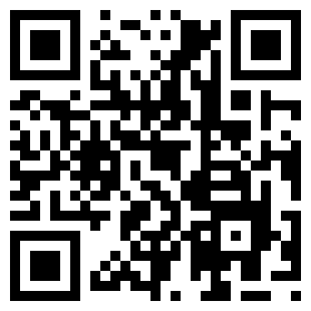
Use your smartphone to visit the Rocky Mountain MIRECC website
@RMIRECC
www.mirecc.va.gov/visn19
Thanks to our collaborators, Veteran participants,
and all who made this possible!

