Slide 1
VHA Suicide Prevention Initiative Aligning Metrics and Initiative Framework Talking Points – Fireside Chat – August 2, 2017
#1 Improve Transition
#2 Know All Veterans
#3 Partner Across Communities
#4 Lethal Means Safety
#5 Improve Access
Mental Health services for Other Than Honorable
VA Medical Centers offer open access to Mental Health
Expand “Press 7” connection to the Veterans Crisis Line
Evidence Based and Treatment Engagement
Major Themes
Expand pre- and post separation services
Expedite VA enrollment
Comprehensive review of all Veterans who have died
Federal, state, and local identification and recognition of Veterans
Increase use of predictive analytics for suicide risk
Suicide Prevention Declaration and local challenge
Clear, consistent communication about suicide prevention
S.A.V.E. Training for Veterans, families, and staff
Improved risk identification and safety planning
Partnerships with gun advocacy groups around safety
Naloxone kits widely available
Lethal Means Safety
VA/DOD Conference
VA/DoD MOA
Auto Enrollment
Transition Reboot
Partnerships
Release of State Data Sheets
Computerized Assessment and Treatment Development
Community Level Engagement
Mayor’s Challenge
SSSP
Law Enforcement
SAMSHA
VEO Partnerships
CVEB
VSO Engagement
Durkheim Project
Shark Tank Expansion
Increasing Use of STORM, Opioid Safety, and MAT for OUD
Local Community Gun Shop Partnership
Expansion of Gunlock Program
Safety Planning Templates
Psych Armor
Open Idea Innovation Challenge
MH Hiring Initiative
Tele-mental Hubs
Post-Discharge Engagement
Special Projects
Proposed Metric
and Goal
% of high risk Veterans transitioned from DoD to VA Services
Goal: Increase % over TBD baseline
Knowing the 20 Splash Metric
Goal: Reach out to the full “20” at risk for Suicide
% of VHA employees with optimal deployment (per revised guidelines) of SAVE training
Goal: 100% of Staff trained
% of unique indicated VHA patients who have received naloxone kit
Goal: Increase % of Veterans who Receive kit above current 80%
% of facilities with outpatient clinical MH staff to 1000 MH patient ratios above Minimum level
Goal: Increase % above current 35%

Slide 2
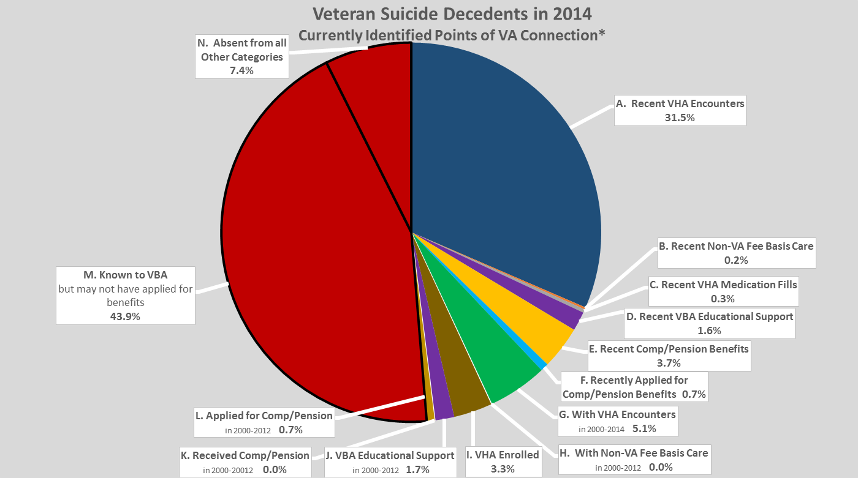
Talking Points
For Internal VA
Use – Not for
Publication or
Official Release
August 2, 2017

Slide 3
Process for learning more and reducing the number of Veteran suicides per day
Analyze the 20 Per Day
Identify how to make an impact
Implement Strategies
Develop models Collect required data to understand the 20 Veteran suicides per day (VBA, Veteran Centers, etc.) Identify partnerships and data resources to support the strategy Analyses and reporting | Population | Identify potential settings and contexts for outreach and programming Coordinate with Federal, State, Local governments and external stakeholders Develop action plans | Impact | Partnerships regarding Veteran outreach (National Violent Death Reporting System, VBA, etc.) Partnerships regarding gun safety programs Push intervention (e.g., public service outreach) | Strategies/Intervention

Slide 4
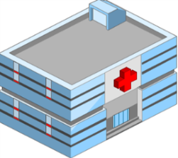
Communications Overview Be There
Central Messaging Platform: ‘Be There’ – everyone has a role to play in Suicide Prevention!
Charge: Coordinate and cross-leverage all Suicide Prevention communication campaign messaging and communication vehicles in order to enhance deployment impact
Description: The Office of Mental Health and Suicide Prevention launches a major suicide prevention campaign beginning in September 2017. This is a multi-pronged approach combining internal and externally facing messaging, outreach, and training.
Approach
Internal Facing Communication
Medical Center & VISN Leadership; Clinicians, Front Line Staff
External Facing Communication
Veteran Communities , Veteran Family & Support Systems, Community Partners

Slide 5
Communications Overview Be There
Leading & Assessing :
Identifying, Consolidating and Leveraging Communications
Aligning Communications: VHA, OMHSP, and Suicide Prevention Program Office Strategy
Implementing Plan: Measuring , Monitoring, Adjusting
Establish Suicide Prevention Program Strategic Plan Establish Suicide Prevention Office Strategic Communications Plan Integrate and Align with OMHSP Define & Establish measurements of success On-board Comms Contractors & SP Detailees | Structure | Elicit and Consolidate all Suicide Prevention Communication Requirements from each priority project Identify & Evaluate cross-cutting actions among priority projects Leverage across work streams as appropriate | Plan | Deploy Communications Strategies Track & Measures Success Evaluate and Adjust | Launch and Monitor

Slide 6
Draft Modernization Proposal Design Phase 1 Summary Mental Health and Suicide Prevention
Office of Mental Health and Suicide Prevention
Executive Officer and Administrative Core [Strategic planning, resource allocation, stakeholder support, task management]
National Director for Suicide Prevention |  | National Director for MHSP Field Support | National Director for Mental Health
Suicide Prevention Core [Strategic planning, national partners and collaborations] | Veterans Crisis Line [National shared service] | Shared Operational Support [Technical assistance; national clinical mental health data, analytics, evaluation, and dashboard support] | Mental Health Core [Best practice identification, centers of excellence, national training resources, facilitation of field-based councils for collaborative policy, program, and training development] | National Center for PTSD [Best practice identification, oversight of Brain Bank, national consultation and training resources as Congressionally mandated]
DoD/VA transition, auto enrollment, lethal means reduction, SAVE Training, VSO and family involvement | World class crisis intervention services, zero rollover, Press 7 expansion | Identification and outreach to non-VA population, enhance Suicide Prevention Coordinator role | Open access, measurement based care | Research and education on trauma and PTSD, bringing the latest research findings to practice, providing clinical consultation to providers

Slide 7
Draft Suicide Prevention Declaration For Feedback and Discussion
Suicide Prevention Declaration - “Be There”
We are committed to be there, to save lives, and to promote the health and well-being of all who have served in the United States Military by:
Believing that suicide is preventable and that one suicide is one too many
Pledging that suicide prevention is everyone’s business
Knowing and offering connection to every Veteran living in our community
Asking about, listening, and understanding the challenges faced by Veterans.
Connecting Veterans with people and resources who can address their needs
Offering immediate help if they are in crisis and sustained care until it is resolved
Supporting families, friends, providers, and all those affected by suicide
Promoting safety for Veterans, families, and loved ones
Learning everything we can to prevent suicide
Being unwavering in our action to show that no Veteran is alone or without hope

