Slide 1
Gun Violence Protection Orders
Adelyn Allchin, MPH
Public Health Analyst
Educational Fund to Stop Gun Violence
DoD/VA Biannual Suicide Prevention Conference
August 1-3, 2017
Notes:
Outline of presentation
What is a Gun Violence Protection Order (GVPO)?
Evidence Courts Can Consider - California
Research from Connecticut
Future Efforts

Slide 2
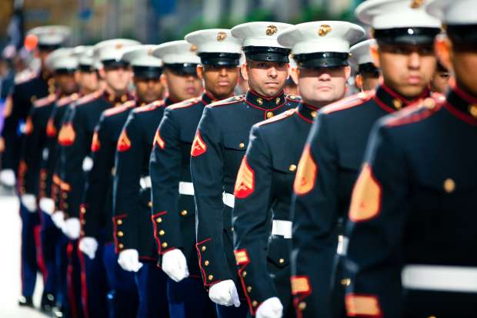
How can we prevent firearm suicides among Service Members and Veterans?
Notes:
Photo source: Photo: "Marines march in 2011 New York Veterans Day Parade "DVDSHUB (CC BY 2.0)

Slide 3
Firearms in times of crisis
Temporarily separating firearms from a Service Member or Veteran, during times of crisis, is an important component of a comprehensive firearm suicide prevention strategy.
One option is to have family members or friends temporarily hold on to one’s firearms – but that does not prevent that individual from purchasing a new firearm when suicidality peaks.
Policy solution?
GUN VIOLENCE PROTECTION ORDERS

Slide 4
Interventions to Prevent Firearm Suicide
Upstream
Downstream
Mental Health Treatment
Gun Violence Protection Orders
Note: These are two examples of potential interventions to reduce and prevent firearm suicide.

Slide 5
What are Gun Violence Protection Orders (GVPOs)?
A GVPO is a civil order where law enforcement and family members can petition a court to temporarily limit access to firearms by individuals who pose a credible risk of harm to self or others.
GVPOs temporarily prohibit an individual from purchasing firearms. Additionally, any firearms currently possessed will be removed for the duration of the order.
Based on domestic violence restraining orders.
Known by many other names:
Gun Violence Restraining Orders,
Extreme Risk Protection Orders, and
Risk-warrants, etc.

Slide 6
How do GVPOs generally work?
STAGE 1 At an initial hearing, a judge considers the written petition and assesses whether the person poses a danger of causing personal injury to self or others in the immediate future. The individual (respondent) may or may not receive notice about the hearing beforehand (without notice, the hearing is “ex parte”).
If issued, an ex parte/temporary GVPO will be in effect for a brief period, about ten days. The individual will be temporarily prohibited from purchasing or otherwise acquiring a firearm. If the respondent owns firearms, he or she must surrender them for the duration of the order.
STAGE 2 Before the ex parte/temporary GVPO expires, a subsequent hearing takes place to address any continued risk of dangerousness. Petitioners are required to testify in a court of law. Respondents will also have an opportunity to present evidence to show that he or she is not a danger to him or herself or others and a GVPO is not necessary.
If the court determines that the respondent presents a continued, significant danger to themselves or others, the order will be extended for up to one year.
To terminate the GVPO before its expiration, the respondent may file a written request presenting evidence to a judge that he or she no longer poses a significant danger. When the order is terminated or expired, as long as the respondent is not otherwise prohibited from purchasing or possessing a gun, the firearms may be returned to the respondent.

Slide 7
Are GVPOs available in every state?
No – GVPO-type laws are only available in four states.
California and Washington allow family members and law enforcement to petition for GVPOs.
Indiana and Connecticut only allow law enforcement to petition for GVPOs.

Slide 8
What type of evidence does the court consider?
The California Example
Gun Violence Restraining Order (GVRO)

Slide 9
CA GVRO – Factors Courts Must Consider
A recent threat of violence or act of violence by the subject of the petition directed toward another, himself, or herself
A recent violation of a protective order of any kind.
A conviction of a violent offense.
A pattern of violent acts or violent threats within the past 12 months, including, but not limited to, threats of violence or acts of violence by the subject of the petition directed toward himself, herself, or another.

Slide 10
CA GVRO - Factors Courts May Consider (among others)
The unlawful and reckless use, display, or brandishing of a firearm by the subject of the petition.
Evidence, including police reports and records of convictions, of either recent criminal offenses by the subject of the petition that involve controlled substances or alcohol or ongoing abuse of controlled substances or alcohol by the subject of the petition.
Evidence of recent acquisition of firearms, ammunition, or other deadly weapons.

Slide 11
Evidence behind Risk-Based Gun Removal Laws
Connecticut’s Risk-Warrant

Slide 12
Connecticut’s Risk-Warrant Law
Passed in 1999 after highly publicized mass shooting
Researchers examined risk-warrants issued from 1999-2013
762 cases from 1999-2013
92% of gun removal subjects were male
Average age of 47
Source: Swanson et al. 2016. Implementation and Effectiveness of Connecticut's Risk-Based Gun Removal Law: Does it Prevent Suicides? Available: http://papers.ssrn.com/sol3/papers.cfm?abstract_id=2828847

Slide 13
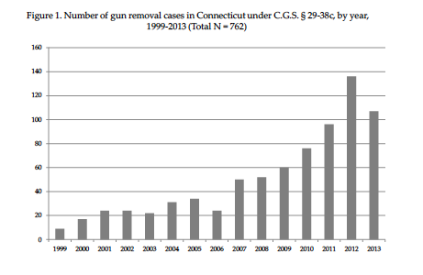
Connecticut’s Risk-Warrant
Following the mass shooting at Virginia Tech in 2007, the annual number of gun removals increased more than tenfold
Source: Swanson et al. 2016. Implementation and Effectiveness of Connecticut's Risk-Based Gun Removal Law: Does it Prevent Suicides? Available: http://papers.ssrn.com/sol3/papers.cfm?abstract_id=2828847

Slide 14
Connecticut’s Risk-Warrant
Of the 762 cases, 702 cases with information written by police on risk- warrant petitions were available for review.
Suicidality/self-injury threat listed as concern in 61% of cases.
The risk-warrant was passed into law to prevent mass shootings – but ended up being used most often to prevent suicides.
Source: Swanson et al. 2016. Implementation and Effectiveness of Connecticut's Risk-Based Gun Removal Law: Does it Prevent Suicides? Available: http://papers.ssrn.com/sol3/papers.cfm?abstract_id=2828847

Slide 15
Connecticut’s Risk-Warrant
21 individuals died by suicide at some point following the gun removal event.
6 by guns – none during the year when firearms were removed/prohibited
15 by other methods
Suicide rate of risk-warrant subjects was 40 times higher than the average annualized suicide rate of 12 per year in the general adult population in Connecticut during the same period.
This means that the risk-warrants reached a very high-risk population.
Using statistical modeling, the researchers predicted that many more risk-warrant subjects would have attempted suicide had they still had access to a gun.
By temporarily separating subjects from firearms during periods of high risk, the risk-warrants averted suicides and saved lives.
Source: Swanson et al. 2016. Implementation and Effectiveness of Connecticut's Risk-Based Gun Removal Law: Does it Prevent Suicides? Available: http://papers.ssrn.com/sol3/papers.cfm?abstract_id=2828847

Slide 16
Key Findings from Connecticut
Police found firearms in 99 percent of instances when a risk-warrant was issued, removing an average of seven guns per warrant.
Nearly one-third of all risk-warrant subjects received mental health and substance abuse treatment after a risk-warrant was issued.
For every 10-20 warrants issued – researchers estimated that at least 1 life is saved.
Source: Swanson et al. 2016. Implementation and Effectiveness of Connecticut's Risk-Based Gun Removal Law: Does it Prevent Suicides? Available: http://papers.ssrn.com/sol3/papers.cfm?abstract_id=2828847

Slide 17
CALIFORNIA

Slide 18
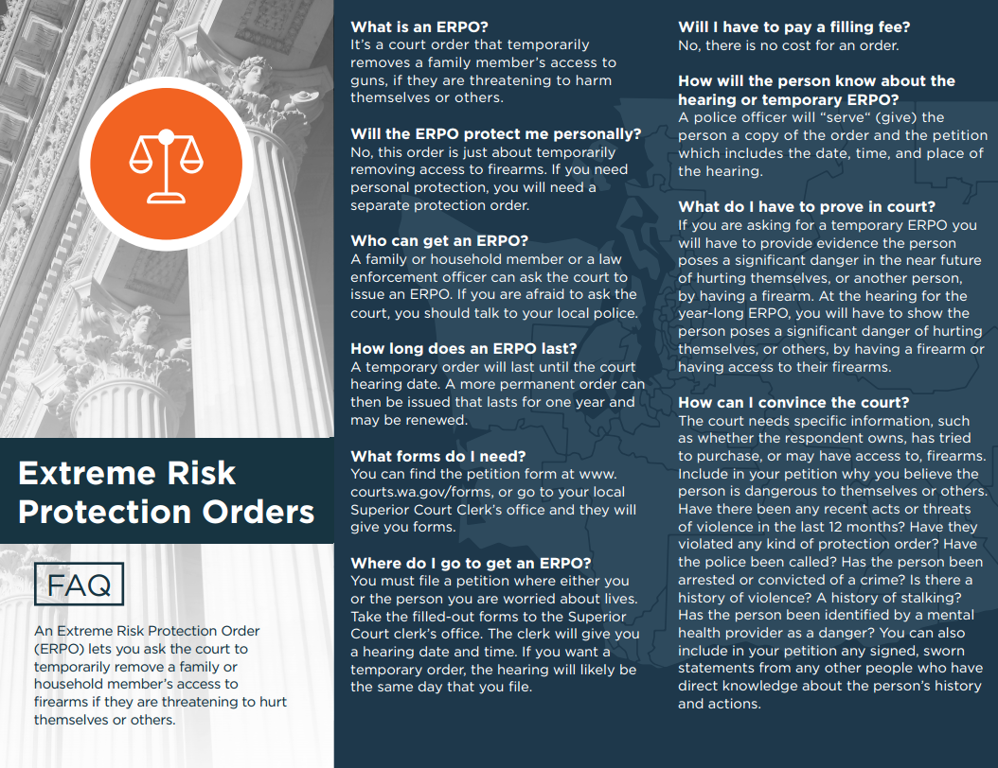
WASHINGTON
http://foundation.gunresponsibility.org/erpo-help/

Slide 19
Future Efforts
Twenty states proposed GVPO-style laws in 2017.
GVPO-style laws can be an important component of a comprehensive suicide prevention strategy as they provide a legal mechanism to temporarily remove firearms from individuals who may be at risk of harming themselves.
Need to raise awareness of GVPO-style laws among Service Member and Veteran communities and how they can be used to save lives.

Slide 20
Additional Resources
Educational Fund to Stop Gun Violence. 2016. Extreme Risk Protection Orders: An Opportunity to Save Lives in Washington. Available: http://efsgv.org/wp-content/uploads/2016/09/FINAL-ERPO-complete-091916-1.pdf
Swanson et al. 2016. Implementation and Effectiveness of Connecticut's Risk-Based Gun Removal Law: Does it Prevent Suicides? Available: http://papers.ssrn.com/sol3/papers.cfm?abstract_id=2828847
The Trace. 2016. Laws That Allow for Temporarily Removing Guns from High-Risk People Linked to a Reduction in Suicides. Available: https://www.thetrace.org/2016/09/gun-violence-restraining-order-suicide-reduction-connecticut/

