Slide 1
Helping Others Hold On
Marjorie Morrison, Founder and CEO

Slide 2
The Challenge
With fewer than 1% of our country serving in uniform, most Americans are unfamiliar with military life and culture. The lack of cultural awareness about the military can make it difficult for veterans to transition back to civilian life; and difficult for military families to feel understood and able to access the supports they need.

Slide 3
PsychArmor Exists to Help Bridge the Gap
PsychArmor’s online library of FREE educational courses are:
• Available on-demand, 24/7
• Short, self-paced modules made for today’s busy schedules
• Developed by nationally recognized subject matter experts
• Evidence-based and clinically informed
• Immersive experiences – animation, gamification, videos and simulations bring the course content to life

Slide 4
We Have Courses For…

Slide 5
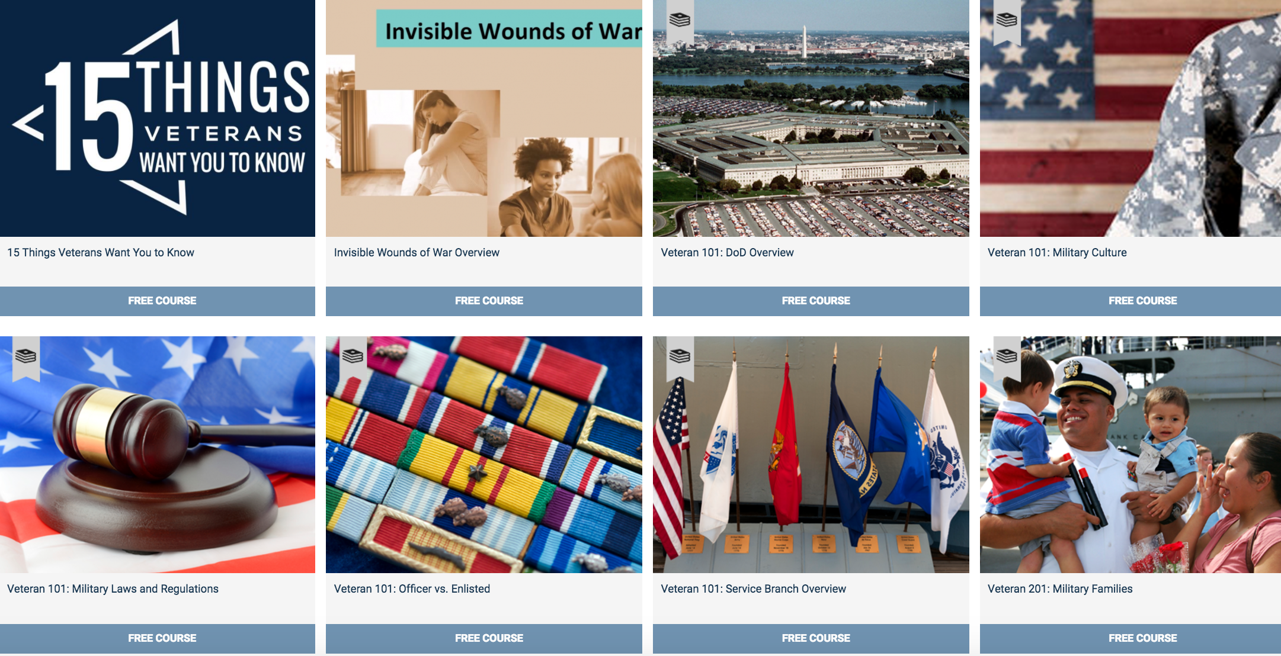
Military Culture School

Slide 6
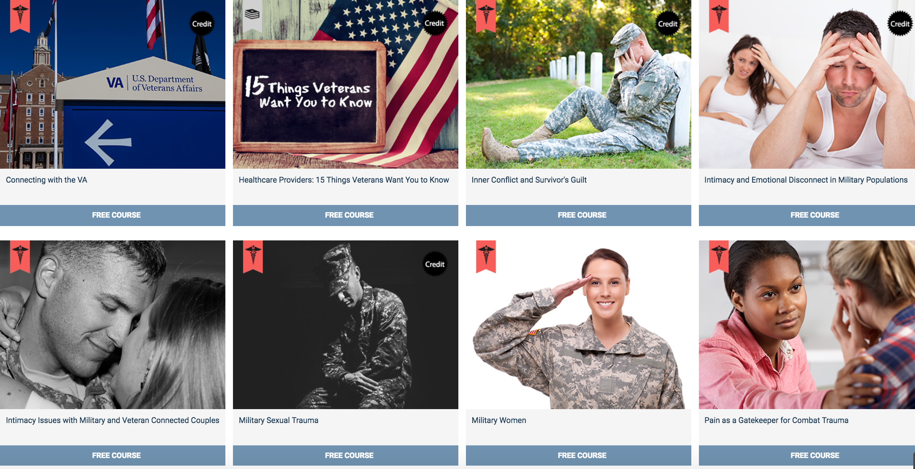
Healthcare Providers School

Slide 7
Employers School

Slide 8
Caregivers and Families School

Slide 9
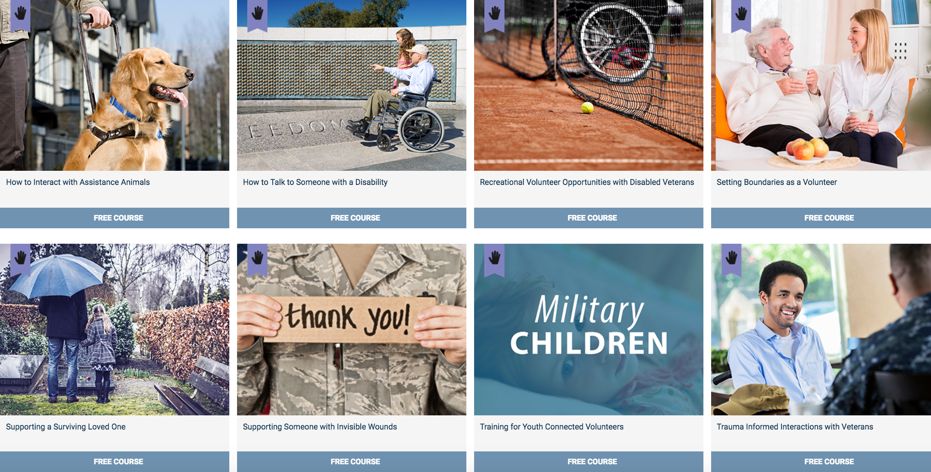
Volunteers School

Slide 10
K-12 Educators School

Slide 11
Educators Who Support Student Veterans School

Slide 12
Courses Coming Soon For…

Slide 13
Helping Others Hold On
Notes:
"PsychArmor is particularly proud of its groundbreaking course with the same name as my talk today. Helping Others Hold On is taught by national subject matter expert Dr. Craig Bryan, the Executive Director for the National Center for Veterans Studies at the University of Utah. Dr. Bryan’s goals for this course, which is intended for volunteers but is applicable to everyone who interacts with veterans, include helping us understand a little bit more about what might be happening with someone who is experiencing suicidal thoughts, and some of the little things we can all do that might singlehandedly save someone’s life.
Helping Others Hold On explains the ambivalence which which most people think about dying, and how this equates to a see-saw that people find themselves on…with the desire to live on one side and the desire to end the pain on the other. For most people, the desire to live is strong and little things can help “tip” them back to the positive side of the see-saw.
Dr. Bryan goes on to describe some of these little things. They include such simple acts as paying attention and saying thank you. Additional ideas include the purposeful scheduling of down time, and working hard at sleep hygiene to help people sleep well. These are important, since both burnout and sleep deprivation have been shown to put people at increased risk. Dr. Bryan teaches us about risk factors, and things to watch for in veterans we might be concerned about. These include complications in a person’s life, as well as mental health conditions such as depression and PTSD. Next, he describes what he calls “coded language,” which he explains is very important to understand in order to have insight into when we should be concerned. Among the things a person might say, something like “I can’t take this any longer” might be a coded method to express his or her intent to die by suicide. Finally, Dr. Bryan concludes the course with specific methods by which every one of us can support a veteran in need.
This is a course for everyone. Every single one of us can be the difference that might save a veteran’s life."

Slide 14
Together We Can Help Others Hold On
We’d love for you to join us. Get in touch:
www.psycharmor.org
Perri Storey, Partnership Manager
Perri@psycharmor.org
(858) 800-3963
Marjorie Morrison, CEO & Founder
Marjorie@psycharmor.org

