Slide 1
Kadena’s Suicide Prevention
Resiliency Tool (SPRT)
Gena Schneider, LCSW
18WG/VPI
Tom Robbins, Ph.D.
18WG/CVB
Capt Erik Menjivar
18MDOS/SGOW

Slide 2
Agenda
  Development & Evolution of SPRT
  2017 Suicide Prevention Curriculum
  Operationalizing Suicide Prevention
  Suicide Prevention Resiliency Tool (Unit Leaders’ Tool)
  SPRT Impact
  Recent Implementation Outcomes
Notes:
As a reminder, these are the key concepts that are being conveyed in the Suicide Prevention didactic
Therefore , these concepts are the ones to be operationalized in the practicum exercise
As you review these concepts, what is assumed about Airmen?

Slide 3
  Development & Evolution of SPRT
Purpose of SPRT: Operationalize the comprehensive Suicide Prevention Training
2016
  Director of Psychological Health/Suicide Prevention Program Manager
  Partnered with Community Support Coordinator & IDS Members
  Briefed at Community Action & Information Board (CAIB)
2017
  Mental Health Flight Commander, Suicide Prevention Program Manager, Violence Prevention Integrator & Community Support Coordinator
  Continued partnership w/ IDS Members
  Briefed at Community Action & Information Board (CAIB)
    Wing Commander fully supportive & encouraged unit participation

Slide 4
2017 Suicide Prevention Curriculum
Key Concepts
  Recognize the warning signs
    Risk Factors, Early & Acute Warning Signs
  Understand one’s barriers
  Reactive responses using the 3Ds
    Direct, Delegate, Distract
    Be proactive - Strengthening Protective Factors
    Belonging/Inclusion
    Contributing to something meaningful
Notes:
As a reminder, these are the key concepts that are being conveyed in the Suicide Prevention didactic
Therefore , these concepts are the ones to be operationalized in the practicum exercise
As you review these concepts, what is assumed about Airmen?

Slide 5
Operationalizing
Suicide Prevention
The Emotional Intelligence Assumption
  Current Air Force Suicide Prevention Programs assumes all people possess high EQ
“Refers to how we manage ourselves and how we manage our relationships…how self-aware we are, how motivated we are….how we handle stressful feelings effectively, how empathic we are…. how well we can tune into other people and how socially skilled and able we are.”
Daniel Goleman, Author
Emotional Intelligence: Why it can matter more than IQ

Slide 6
Operationalizing
Suicide Prevention
Domains of Emotional Intelligence
PERSONAL COMPETENCE
Self-Awareness - Knowing own Emotions
Self-Management – Managing own Emotions
SOCIAL COMPETENCE
Social-Awareness - Recognizing Emotion in Others
Relationship Management Skills – Interpersonal skills

Slide 7
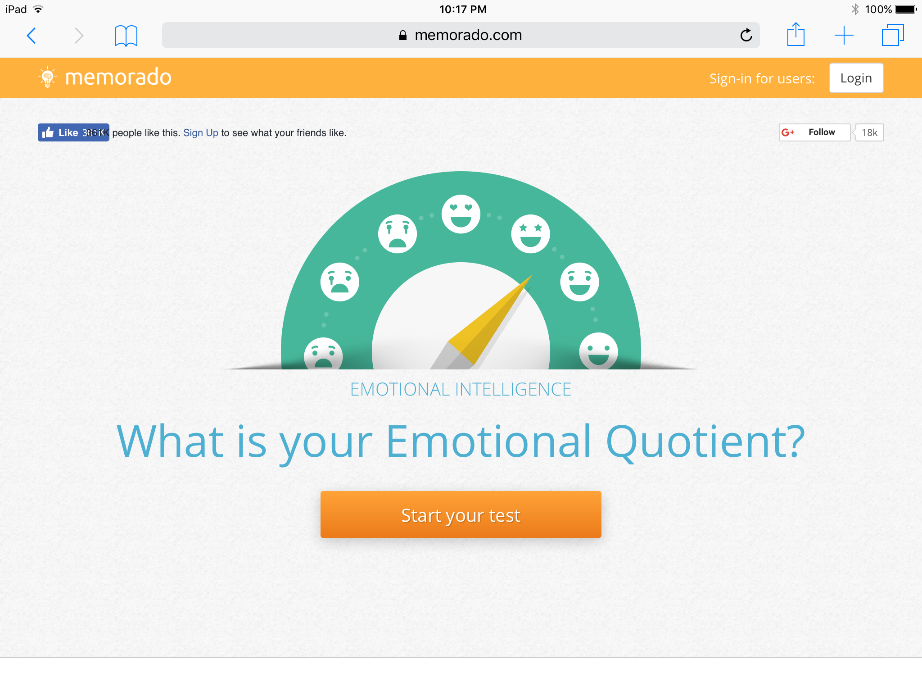
Operationalizing
Suicide Prevention
https://memorado.com/emotional_quotient

Slide 8
Kadena’s Suicide Prevention Resiliency Tool (SPRT)
Unit’s Senior Leadership self-identify & meets w/ SPRT Team
  Leadership’s assessment of unit & choice of duty section
    Healthy duty sections
  Identify desired effects/outcome
  Select actor & set-up 2nd meeting
2nd meeting w/ Unit Leadership (optional include duty section) & actor
  Develop script, timeline & irritate desired effects/outcome
    Select risk factors and early warning signs
Notes:
QAP Observation Tool Excerpt, Examples:
Signs of distress: Anxiety, Agitation, Insomnia
Sources of distress: Deployments, Work, School
Consequences of distress: Decreased efficiency and productivity; Lateness for work; Missed deadlines
Engage: Don’t be afraid to ask; Listen first; Discuss needs
Recognize and Respect Diversity: Culture, Religion, Age
When to Refer: Think help early; Refer before the situation has chance to deteriorate;
Where to Refer: Depends on nature of problem and his/her preference; Help personnel choose where to go for help;
How to Refer: Contact agency/ask for guidance; Make the call w/ the Amn
How to get Urgent Help: Take the person to ER or Mental Health Clinic; Notify your supervisor or call 911; Involve security
Knows facts about Mental Health Services: Those with disciplinary issues may suffer the greatest distress and be most at risk;
Pertaining to ‘run more than one scenario and select a seasoned Amn’ , a squadron elected to run one scenario, however, the Amn selected experienced anxiety and concern about serving as an inject and the impact it could have on his peers/leadership; w/drew from inject on Day 2; Impacted Squadron recommendation.
Pertaining to ‘Trust Impact vs. Realistic Outcome’ refers to the following feedback: This has the potential to break the trust between mid-level and upper-level supervision

Slide 9
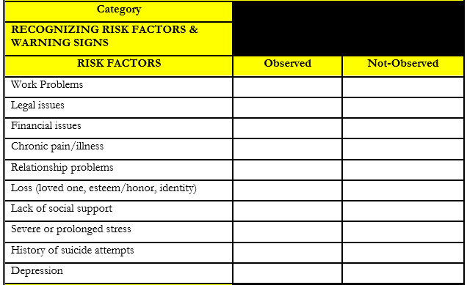
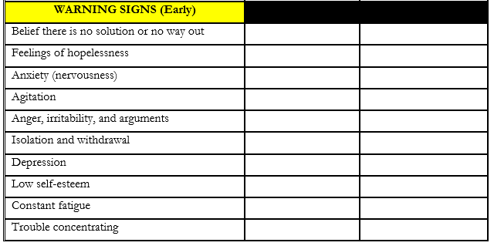
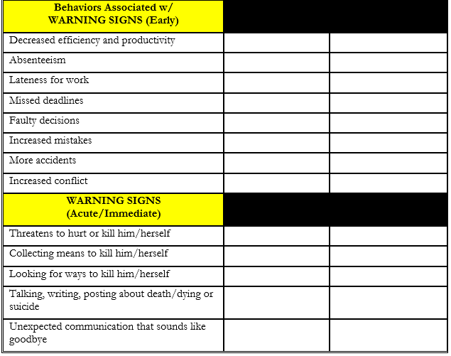
SPRT Rubric

Slide 10
Kadena’s Suicide Prevention Resiliency Tool (SPRT)
Daily monitoring/check-in between unit rep & SPRT Team
  Ideally Suicide Prevention Program Manager/Disaster Mental Health Team Chief
End “exercise” w/ preliminary unit debrief @ unit roll call/formation
  Complete preliminary hot-wash w/ individual players & unit leadership
Hot wash w/ unit @ Commander’s Call
  Commend desired response/outcomes
  IDS members will supplement education from identified areas for growth
Notes:
QAP Observation Tool Excerpt, Examples:
Signs of distress: Anxiety, Agitation, Insomnia
Sources of distress: Deployments, Work, School
Consequences of distress: Decreased efficiency and productivity; Lateness for work; Missed deadlines
Engage: Don’t be afraid to ask; Listen first; Discuss needs
Recognize and Respect Diversity: Culture, Religion, Age
When to Refer: Think help early; Refer before the situation has chance to deteriorate;
Where to Refer: Depends on nature of problem and his/her preference; Help personnel choose where to go for help;
How to Refer: Contact agency/ask for guidance; Make the call w/ the Amn
How to get Urgent Help: Take the person to ER or Mental Health Clinic; Notify your supervisor or call 911; Involve security
Knows facts about Mental Health Services: Those with disciplinary issues may suffer the greatest distress and be most at risk;
Pertaining to ‘run more than one scenario and select a seasoned Amn’ , a squadron elected to run one scenario, however, the Amn selected experienced anxiety and concern about serving as an inject and the impact it could have on his peers/leadership; w/drew from inject on Day 2; Impacted Squadron recommendation.
Pertaining to ‘Trust Impact vs. Realistic Outcome’ refers to the following feedback: This has the potential to break the trust between mid-level and upper-level supervision

Slide 11
SPRT Impact
Status of Airmen (or your service members)
  Insight into readiness and resiliency of unit members
  Real-world setting creates more realistic and actionable data
  IDs areas where helping agencies can support
Reinforces preventative training
  Improved understanding and implementation of risk indicators and interventions
  Sense of inclusion and belonging
Capable of sparking acute need for support
  Mental Health, Sexual Assault, Family Advocacy, etc.
  Must be poised to respond with focused and deliberate support
Provider extender – empowers supervisors and peers

Slide 12
Recent Implementation Outcomes
Selected actor was a high performer & chose to amplify real experience
  Day 1 – Real world events delayed implementation
  Day 2 – Escalated early warning signs (wingman engaged w/ actor)
  Day 3 – Desired Outcome w/ engagement of Frontline Supervisor Training
Unit debrief & preliminary hot wash
  Public commendation for unit responses
  Unit members 100% agreed SPRT should continue
  “We learn about suicide prevention from many different areas (CBT, face-to-face, even Commander’s Calls) but we never have the chance to practice these skills. This was a good that we were able to practice.”
  Stress inoculation training & builds confidence and efficacy
Notes:
QAP Observation Tool Excerpt, Examples:
Signs of distress: Anxiety, Agitation, Insomnia
Sources of distress: Deployments, Work, School
Consequences of distress: Decreased efficiency and productivity; Lateness for work; Missed deadlines
Engage: Don’t be afraid to ask; Listen first; Discuss needs
Recognize and Respect Diversity: Culture, Religion, Age
When to Refer: Think help early; Refer before the situation has chance to deteriorate;
Where to Refer: Depends on nature of problem and his/her preference; Help personnel choose where to go for help;
How to Refer: Contact agency/ask for guidance; Make the call w/ the Amn
How to get Urgent Help: Take the person to ER or Mental Health Clinic; Notify your supervisor or call 911; Involve security
Knows facts about Mental Health Services: Those with disciplinary issues may suffer the greatest distress and be most at risk;
Pertaining to ‘run more than one scenario and select a seasoned Amn’ , a squadron elected to run one scenario, however, the Amn selected experienced anxiety and concern about serving as an inject and the impact it could have on his peers/leadership; w/drew from inject on Day 2; Impacted Squadron recommendation.
Pertaining to ‘Trust Impact vs. Realistic Outcome’ refers to the following feedback: This has the potential to break the trust between mid-level and upper-level supervision

Slide 13
Questions?

Slide 14
Kadena’s Suicide Prevention Resiliency Tool (SPRT)
Purpose:
  Do Individual/Organizational baseline Emotional Intelligence (EQ) Assessment
    Baseline score – quick assessment to prime Mbrs for SPRT
      Completed online – https://memorado.com/emotional_quotient
  High Risk Organization Frontline Supervisor Focus
  Promote base paradigm shift
    Promotion of emotional intelligence assessment and skills as a vehicle to identify Airman in distress before the statement, gesture, or act of suicide
Notes:
QAP Observation Tool Excerpt, Examples:
Signs of distress: Anxiety, Agitation, Insomnia
Sources of distress: Deployments, Work, School
Consequences of distress: Decreased efficiency and productivity; Lateness for work; Missed deadlines
Engage: Don’t be afraid to ask; Listen first; Discuss needs
Recognize and Respect Diversity: Culture, Religion, Age
When to Refer: Think help early; Refer before the situation has chance to deteriorate;
Where to Refer: Depends on nature of problem and his/her preference; Help personnel choose where to go for help;
How to Refer: Contact agency/ask for guidance; Make the call w/ the Amn
How to get Urgent Help: Take the person to ER or Mental Health Clinic; Notify your supervisor or call 911; Involve security
Knows facts about Mental Health Services: Those with disciplinary issues may suffer the greatest distress and be most at risk;
Pertaining to ‘run more than one scenario and select a seasoned Amn’ , a squadron elected to run one scenario, however, the Amn selected experienced anxiety and concern about serving as an inject and the impact it could have on his peers/leadership; w/drew from inject on Day 2; Impacted Squadron recommendation.
Pertaining to ‘Trust Impact vs. Realistic Outcome’ refers to the following feedback: This has the potential to break the trust between mid-level and upper-level supervision

Slide 15
Kadena’s Suicide Prevention Resiliency Tool (SPRT)
Assesses individual/organizations resiliency qualitatively and quantitatively in the areas of emotional intelligence and recognition of stressed/distressed airman
Gauges Frontline Supervisor Training/2017 Suicide Prevention objectives while providing Wing/CC a real time readiness snap shot “Status of Airman at Risk”
  Operationalizes suicide prevention
ID organizational/individual protective factors, strengths, specific skills or needs through IDS/CAIB intervention
MTF/SQ CC determined reward for high assessment scores

Slide 16
SPRT Rubric

Slide 17
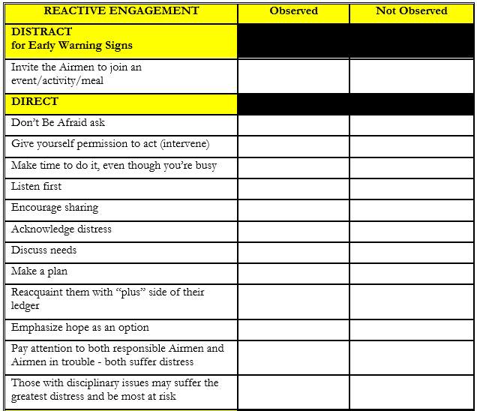
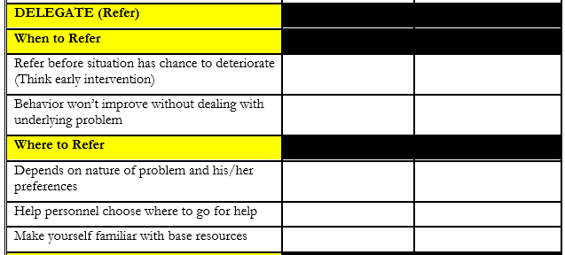
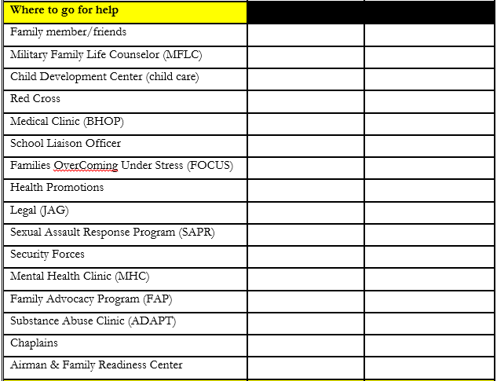
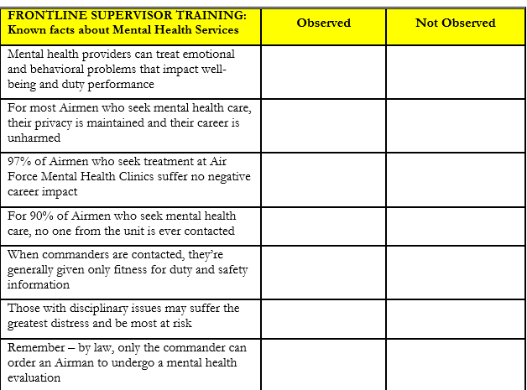
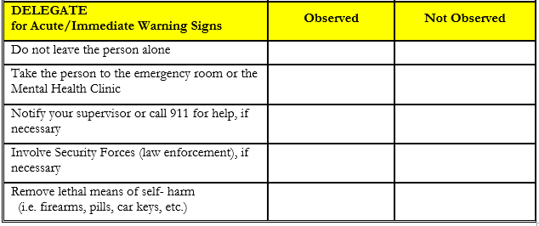
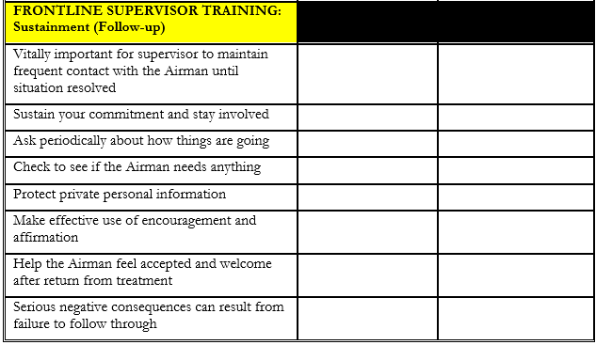
SPRT Rubric

Slide 18
Kadena’s Suicide Prevention Resiliency Tool (SPRT)
Process/Outcome
  Sq/CC and CCF: ID High Risk Flight(s) or subpopulation for 2-7 day SPRT scenario w/ identified Airman who will serve as inject
  Sq/CC and CCF develop tailored scenario embedding SPRT to demonstrated/observed reported data points
  Commander’s Feedback on Program (i.e. Commander’s Call Hot wash).
    Recognition program – CC’s coin
    “Virtual lives saved”
Notes:
SPRT Observation Tool Excerpt, Examples:
Signs of distress: Anxiety, Agitation, Insomnia
Sources of distress: Deployments, Work, School
Consequences of distress: Decreased efficiency and productivity; Lateness for work; Missed deadlines
Engage: Don’t be afraid to ask; Listen first; Discuss needs
Recognize and Respect Diversity: Culture, Religion, Age
When to Refer: Think help early; Refer before the situation has chance to deteriorate;
Where to Refer: Depends on nature of problem and his/her preference; Help personnel choose where to go for help;
How to Refer: Contact agency/ask for guidance; Make the call w/ the Amn
How to get Urgent Help: Take the person to ER or Mental Health Clinic; Notify your supervisor or call 911; Involve security
Knows facts about Mental Health Services: Those with disciplinary issues may suffer the greatest distress and be most at risk;
Pertaining to ‘run more than one scenario and select a seasoned Amn’ , a squadron elected to run one scenario, however, the Amn selected experienced anxiety and concern about serving as an inject and the impact it could have on his peers/leadership; w/drew from inject on Day 2; Impacted Squadron recommendation.
Pertaining to ‘Trust Impact vs. Realistic Outcome’ refers to the following feedback: This has the potential to break the trust between mid-level and upper-level supervision

Slide 19
Kadena’s Suicide Prevention Resiliency Tool (SPRT)

Slide 20

18th XXX Squadron
FST QAP Tool
Kadena’s Suicide Prevention Resiliency Tool (SPRT)
Organization
UNIT XXX
Date/Dates of Scenario
(Start and Finish)
November 17- 19 2015
Actual Length of Scenario
3 Day
Total population
Scenario:
5
(includes: scenario, hot wash participants, and organizational debrief total
Hot wash:
10
participants)
Organizational Debrief:
480
QAP Tool Observations:
7 Total Observed:
(includes: Total Observed and Total Non-Observed in Scenario)
constant fatigue, neglecting responsibilities, lateness for work, family problems, financial issues, decreased efficiency and productivity
2 Non-Observed:
-
(includes: lessons learned
Positive and Negative, How did this activity
One supervisor did not engage member to determine behavioral issues demonstrated.
One supervisor engaged with member and provided constructive criticism and feedback, however, the supervisor never asked why, which would have prompted more communication and issue discovery.
.
Recommendations: (includes lessons learned)
Narrative:
help/not help organizational leadership? Would you recommend this program to other organizations?)
IDS Referral
Items: (Command coordinated through IDS/RAC)
6 Items:
Frontline supervisor education helping agency resources, FAP/ARC relationship class, time management class, financial counseling, and assertive communication class

