Slide 1
Military Suicide Data Surveillance:
Baseline Results from Non-clinical Populations on Proximal Outcomes for Suicide Prevention
Dr. Adam Walsh, Director, Research and Program Evaluation
Dr. Tasanee Walsh, Director, Data and Surveillance
Defense Suicide Prevention Office
Alexandria, VA
July 25, 2017

Slide 2
Introduction
Up until 2016, DoD relied primarily on the Department of Defense Suicide Event Report (DoDSER) for Department-wide suicide risk and outcome data
  While the DoDSER provides a lot of rich information about suicide decedents, methods, and precipitating circumstances, the DoDSER focuses only on those individuals who have attempted or died by suicide
In order to inform early intervention approaches, DSPO needed additional methods to understand population- and unit-level risk that exists for all Service members not just those involved in a suicide event
As a result, DSPO leveraged the Status of Forces Survey for Active Duty Service Members (SOFS-A) to supplement DoDSER data surveillance in two key areas
  Suicide risk and protective factors in non-clinical populations
  Attitudes and behavioral intentions resulting from universal suicide prevention efforts

Slide 3
Overview
The DoD Office of People Analytics (OPA) developed the SOFS-A to assess retention, satisfaction, tempo, stress, and readiness in Active Duty Service members
The SOFS program is a series of web-based surveys of the total force that supports DoD efforts to:
  Evaluate existing programs/policies
  Establish baselines before implementing new programs/policies
  Monitor progress of programs/policies and their effects on the total force
DSPO wanted to leveraged these objectives for DoD-wide suicide prevention efforts

Slide 4
Methodological Notes
OPA uses well-established, scientific procedures to randomly select a sample representing the military population based on combinations of demographic characteristics
  Demographic groups with lower response rates are oversampled
  Weighted response rate was 23 percent
Data are weighted using an industry standard process to produce survey estimates representative of their respective populations
  Results can be generalized to full military population
OPA and DSPO collaborated on development of suicide prevention items; example topics include:
  Suicidal thoughts and attempts
  Awareness and perceived effectiveness of training and outreach
  Resiliency
  Help seeking
  Barriers to care

Slide 5
Suicidal Thoughts
These are the first Department-wide estimates of suicidal thoughts that include Service members not being treated for behavioral health problems
Percent of All Active Duty Members
Margins of error do not exceed ±2%
Percent of Active Duty Members Who Have Ever Had Suicidal Thoughts

Slide 6
Suicidal Thoughts and Attempts
Suicidal thoughts that include a method and/or a plan can be important precursors to lethal or near-lethal suicide attempts
Percent of Active Duty Members Who Have Had Suicidal Thoughts Since Joining the Military
Margins of error do not exceed ±4%
Percent of Active Duty Members Who Have Ever Had Suicidal Thoughts

Slide 7
Suicidal Thoughts and Attempts
During Specific Timeframes
Service Comparisons
Have you ever in your life had thoughts of actually killing yourself?
Have you ever had thoughts of actually killing yourself during the following periods?
USA
15%
17%
USN
USAF
10%
16%
USMC
* 14% Across all Services
Notes:
Suicide Ideation
Overall, 14% of Active Duty members indicated that they ever had suicide ideation
50% of these members had thoughts of suicide before joining the military
75% had thoughts of suicide after joining the military

Slide 8
Talked to Someone Since Joining the Military
About Suicidal Thoughts or Attempts
Percent of Active Duty Members Who Have Ever Had Suicidal Thoughts or Attempted Suicide Since Joining the Military
Margins of error range from ±3% to ±4%
Margins of error range from ±3% to ±12%

Slide 9
Effectiveness of Training in Preparing
Member To Handle Possible Suicide Prevention Situation
Percent of Active Duty Members Who Received Suicide Prevention Training in Past 12 Months
SOFS-A Feb 16 Q68
Margins of error range from ±1% to ±2%

Slide 10
Awareness of Support Services
Percent of All Active Duty Members
Margins of error range from ±1% to ±3%

Slide 11
Effectiveness of Suicide Prevention
Messaging
Percent of All Active Duty Members
Margins of error range from ±1% to ±2%

Slide 12
Effectiveness of Suicide Prevention
Messaging
Percent of All Active Duty Members
Margins of error range from ±1% to ±2%

Slide 13
Effectiveness of Suicide Prevention
Messaging
Percent of All Active Duty Members
Margins of error range from ±1% to ±2%

Slide 14
Effectiveness of Suicide Prevention
Messaging
Percent of All Active Duty Members
Margins of error range from ±1% to ±2%

Slide 15
Effectiveness of Training in Preparing
Member To Handle Possible Suicide Prevention Situation
Percent of Active Duty Members Who Received Suicide Prevention Training in Past 12 Months
KEY:
Higher Response of Agree
5 YOS
9 YOS
Lower Response of Agree
Marine Corps Enlisted
–
–
Marine Corps Officers
Air Force Enlisted
Higher Response of Disagree
Army Enlisted
Air Force Officers
Army Officers
Marine Corps
Navy Enlisted
Enlisted 3
E4
E9
O3
O6
Navy Officers
Total
Army
Navy
Air Force
Enlisted 6
–
–
–
–
E1
E5
O1
O4
Training in past year was
Agree
68
68
70
68
66
66
67
69
69
62
63
70
61
70
69
69
63
67
59
effective in preparing me
to handle possible
suicide prevention
Disagree
10
11
9
11
11
12
9
10
10
13
12
10
15
9
9
11
14
11
14
situation
* Only statistically significant findings are reported. Statistical tests are used to compare current estimates with other subgroups.
Margins of error range from ±1% to ±6%

Slide 16
Knowledge of Risk Factors and Skills To
Take Appropriate Action if Coworker Needs Help
Percent of All Active Duty Members
* Only statistically significant findings are reported. Statistical tests are used to compare current estimates with other subgroups.

Slide 17
Knowledge of Risk Factors and Skills To
Take Appropriate Action if Coworker Needs Help
Percent of All Active Duty Members
* Only statistically significant findings are reported. Statistical tests are used to compare current estimates with other subgroups.
Margins of error range from ±1% to ±4%

Slide 18
Resiliency
Percent of All Active Duty Members
Margins of error range from ±1% to ±2%

Slide 19
Resiliency
Positive Outcomes
Percent of All Active Duty Members
Margins of error range from ±1% to ±6%

Slide 20
Resiliency
Negative Outcomes
Percent of All Active Duty Members
Margins of error range from ±1% to ±6%

Slide 21
Help Seeking Given Suicidal Thoughts
Intimate partners, friends, and parents/parental figures are most likely to be sought for support by members experiencing suicidal thoughts
Phone helplines would be sought 40% of the time among this sample
20% of this sample indicate they would not seek help from anyone if they were experiencing suicidal thoughts

Slide 22
Barriers to Care
Being perceived as “broken” and negative career implications will most likely prevent this sample from seeking care
Unit leaders, prevention/clinical practitioners and suicide researchers are interested in eliminating barriers that prevent service members from seeking care

Slide 23
Reasons Individuals Would Not Seek Mental Health Care
Percent of all Active Duty Members

Slide 24
Reasons Individuals Would Not Seek Mental Health Care
Percent of all Active Duty Members

Slide 25
Implications
Military Leaders: Increased knowledge about whom Service members turn to when they need help and what gets in the way of them accessing care
Prevention Practitioners: Increased knowledge on the full continuum of harm for suicide from thoughts to action as well as new knowledge on help-seeking and progress on stigma reduction efforts
Clinical Practitioners: Increased awareness of suicide-related behaviors not captured in the DoDSER
Researchers: Availability of non-clinical, population prevalence estimates for suicidal thoughts and behaviors

Slide 26

Perceived Barriers to Seeking Support for Suicidal Ideation or Suicide Attempt among Active Duty Service Members
Presented by Tiffany E. Ho, MPH
Behavioral Research Scientist
Northrop Grumman Technology Services (NGTS)
Defense Personnel and Security Research Center (PERSEREC)
August 3, 2017
Any opinions, findings and conclusions or recommendations expressed in this material are those of the author and do not necessarily reflect the views of the Department of Defense, the Office of People Analytics, or the Defense Personnel and Security Research Center

Slide 27
Authors
Northrop Grumman Technology Services
Tiffany Ho, MPH
Kristin Schneider, Ph.D.
Tegan Smischney, Ph.D.
Brandon Carlisle, Ph.D.
Michael Schwerin, Ph.D.
Christina Hesse, MA
Marie Osborn, MA
Defense Personnel and Security Research Center (PERSEREC)
Olga Shechter, Ph.D.
Defense Research, Surveys, and Statistics Center (RSSC)
Kimberly Williams, M.S., M.S., M.A.
Kristin Williams, B.A.
Defense Suicide Prevention Office (DSPO)
Adam Walsh, Ph.D.

Slide 28
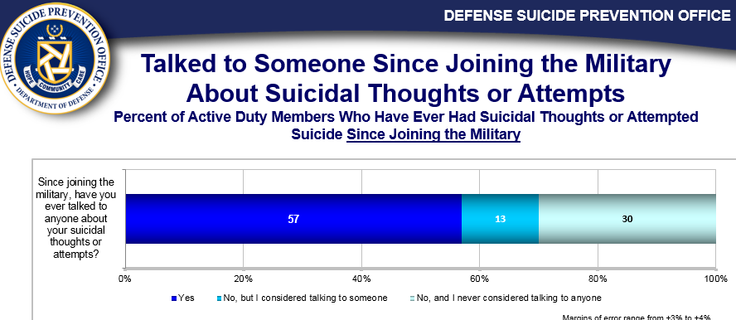
Goal
Examine characteristics associated with:
  Help-seekers
  Non-help seekers (considered)
  Non-help seekers (never considered)

Slide 29
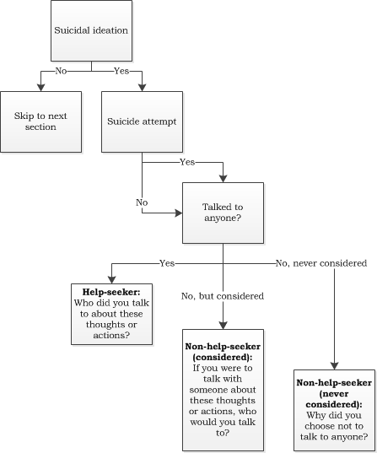
2016 SOFS-A Help-Seeking Questions
The order of SOFS-A questions assessing help-seeking for suicidal ideation or suicide attempt(s).

Slide 30
Conceptual Framework
Characteristics
Individual Factors
Age
Gender
Rank
Race/ethnicity
Marital status
Family status
Resiliency
Stress
Financial Health
Barrier Factors
Stigma
Knowledge
Skills
Career concerns
Perceptions of Mental Health Care
Help-Seeking Behaviors
Engagement in Mental Health Care
Seeking social support
Occupational Factors
Stress
Tempo
Military satisfaction
Deployment
Combat exposure
Conceptual framework of factors associated with mental health help-seeking adapted from the Behavioral Model of Mental Health Service Utilization (Andersen, Davidson & Baumeister, 2013).

Slide 31
Frequency of Help-Seeking
14.5% reported a history of suicidal ideation during military service
14.6% of those with a history of suicidal ideation, reported a suicide attempt
43.3% of active duty Service members who reported suicidal ideation or a suicide attempt since joining the military did not talk to anyone
 | Total | Army | Navy | USMC | USAF
Help seeker (%) | 56.7 | 60.1 | 52.5 | 51.8 | 60.0
Non-help seeker (%) | 43.3 | 39.9 | 47.5 | 48.2 | 40.0
Considered talking to someone (%) | 12.9 | 13.1 | 14.4 | 12.1 | 10.5
Never considered talking to someone (%) | 30.4 | 26.8 | 33.1 | 36.1 | 29.4
Note. Data weighted for sample selection probability, nonresponse, and population characteristics.

Slide 32
Barriers to Care
The most commonly endorsed barriers include:
  Negative impact to career or progress
  Loss of privacy/confidentiality
  Fear of being perceived as “broken” by chain of command or peers

Slide 33
Characteristics of Help-Seekers
Results of bivariate analyses showing statistically significant differences between help seekers and non-help seekers:
 | Help-Seeker | Non-Help-Seekers |  | χ²/F
 |  | Considered | Never Considered
Individual factors (%)
Sex
Male | 77.37 | 74.72 | 85.17 | 6.90*
Female | 22.63 | 25.28 | 14.83
Rank
Enlisted | 88.08 | 84.79 | 83.07 | 8.40*
Officer | 11.92 | 15.21 | 16.93
Reported Barriers to Treatment Seeking (mean ± SD)
Knowledge of suicide prevention | 4.22 (0.05) | 3.88 (0.13) | 3.88 (0.06) | 12.31*
Skills in addressing suicide | 4.27 (0.04) | 4.00 (0.14) | 3.91 (0.05) | 14.22*
Negative Career Impact | 3.73 (0.07) | 4.06 (0.08) | 3.93 (0.07) | 5.20*
Not knowing who to turn to | 3.13 (0.07) | 3.42 (0.10) | 3.10 (0.09) | 3.52*
Note. *p < 0.05

Slide 34
Factors Associated with Non-Help Seekers
Results from the multinomial logistic regression where help-seekers serve as the reference group.
Factor | Type of Non-Help Seeker
 | Considered |  |  | Never Considered
 | Estimate | OR | 95% CI | Estimate | OR | 95% CI
Rank
Enlisted | -- | -- | -- | -- | -- | --
Officer | 0.29 | 1.33 | [0.90, 1.96] | 0.39 | 1.48 | [1.11, 1.97]
Sex
Female | -- | -- | -- | -- | -- | --
Male | -0.08 | 0.92 | [0.52, 1.64] | 0.51 | 1.67 | [1.11, 2.51]
Knowledge & Skills ª | 0.43 | 1.53 | [1.08, 2.18] | 0.54 | 1.72 | [1.39, 2.13]
Career Impact Concern | 0.21 | 1.23 | [1.01, 1.51] | 0.16 | 1.18 | [1.00, 1.39]
Not knowing who to turn to | 0.09 | 1.09 | [0.92, 1.30] | -0.12 | 0.89 | [0.76, 1.04]
Note. The reference group of the dependent variable is help-seekers. ORs significant at p < .05 are bolded.
ª For ease of interpretation, the “Knowledge & Skills” item was reverse coded, so that a unit increase represents a decrease in knowledge and skills of suicide prevention.

Slide 35
Characteristics of Non-Help Seekers (never considered)
Compared to help-seekers, non-help seekers (never considered) were:
  More likely to be officers than enlisted personnel
  More likely to be men than women
  Less likely to report knowledge and skills of suicide prevention

Slide 36
Characteristics of Non-Help Seekers (considered)
Compared to help-seekers, non-help seekers (considered) were:
  Less likely to report knowledge and skills of suicide prevention
  More likely to report concerns about negative career impact

Slide 37
Conclusions
Non-help seekers differ from help-seekers in terms of individual factors and report concerns about different barriers.
Non-help seekers (never considered) were more likely to be officers and male, and report less knowledge and skills in suicide prevention. However, they were not more likely to report career impact concerns.
Whereas, non-help seekers (considered) were more likely to report career impact concerns.

Slide 38
Contact Information
Tiffany E. Ho, MPH
Behavioral Research Scientist
Northrop Grumman Technology Services
PERSEREC/OPA
Tiffany.E.Ho.ctr@mail.mil
Tiffany.Ho2@ngc.com
Olga G. Schechter, Ph.D.
Project Director
Office of People Analytics (OPA)
Defense Personnel and Security Research Center (PERSEREC)
olga.g.shechter.civ@mail.mil

