Slide 1
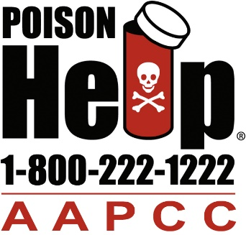
Poison Control, Suicide Prevention, & Military Outreach
2017 DoD / VA Suicide Prevention Conference #BeThere – It Takes a Community August 3, 2017
Stephen T. Kaminski, JD
Executive Director
American Association of Poison Control Centers
Kaminski@aapcc.org
(703) 894-1871

Slide 2
About AAPCC
Non-profit member organization founded in 1958
Represents 55 U.S. poison centers and ~1700 poison center staff
Support 55 member poison centers through:
Advocacy and Government Affairs
Accreditation (centers)
Certification (experts)
Communications
Promotion of local services
Public education
National meetings
Collate and disseminate national data (NPDS).
Located in Alexandria, VA
AAPCC.org
PoisonHelp.org

Slide 3
Poisoning is the #1 Cause of Injury Death in the U.S.
Each year in poisoning accounts for:
41,600 fatalities
1.5 million days of acute hospital care admissions
438,000 hospitalizations
Death rate for drug poisoning has more than quadrupled since 1979.
Drug poisoning death rate exceeded the motor vehicle traffic death rate beginning in 2009.
CDC MMWR. Source can be accessed at: http://1.usa.gov/1Bq0A9N

Slide 4
About Poison Control Centers
55 poison control centers in the U.S. provide information and treatment advice, 24/7/365, through the national Poison Help line –
+1 (800) 222-1222
Poison Help line covers 100% of the U.S. population; help is provided in 150 languages.
Calls to Poison Help are free, confidential, and answered by experts: primarily specially trained pharmacists and nurses, with 24/7 Board-certified clinical and medical toxicologist oversight.
Poison specialists: assess, triage, manage, monitor, and follow-up on all calls.
Approximately 3 million calls annually (over 8,000 per day).

Slide 5
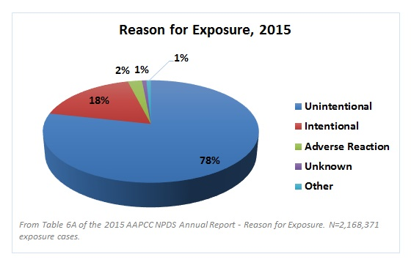
Who Calls Poison Control Centers?
About 21% of call volume comes from health care practitioners, 71% from private residences, rest from, e.g., school and workplaces.
Contrary to popular belief, less than half of all exposure calls are about children.
Public
Physicians
Nurses
Pharmacists
Veterinarians
Urgent Care Centers
Occupational Medicine Centers
Health Departments
Government
911 PSAP (Public Safety Answering Point)
Paramedics
Police
Fire Services
Prison Officials
Coroners
Industry
Schools

Slide 6
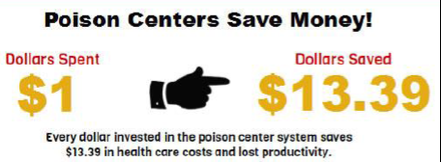
Value of Poison Control Centers: Healthcare System Cost Savings
Total cost to fund the national poison center system is about $150 million annually; current HRSA support is $18.8M appropriated of $30.1M authorized.
Poison centers save an estimated $307.6M in Medicare dollars and $382.4M in Medicaid dollars annually ($689.6M total of federal dollars) and approximately $1.8B overall in medical care and lost productivity.

Slide 7
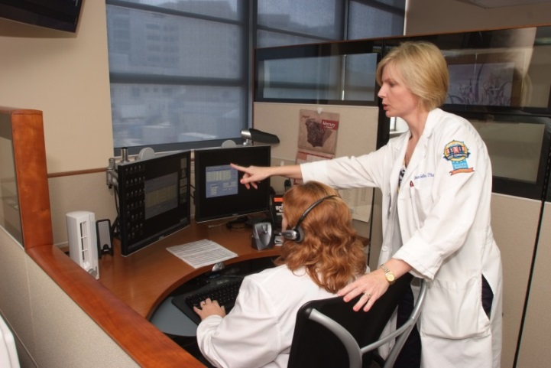
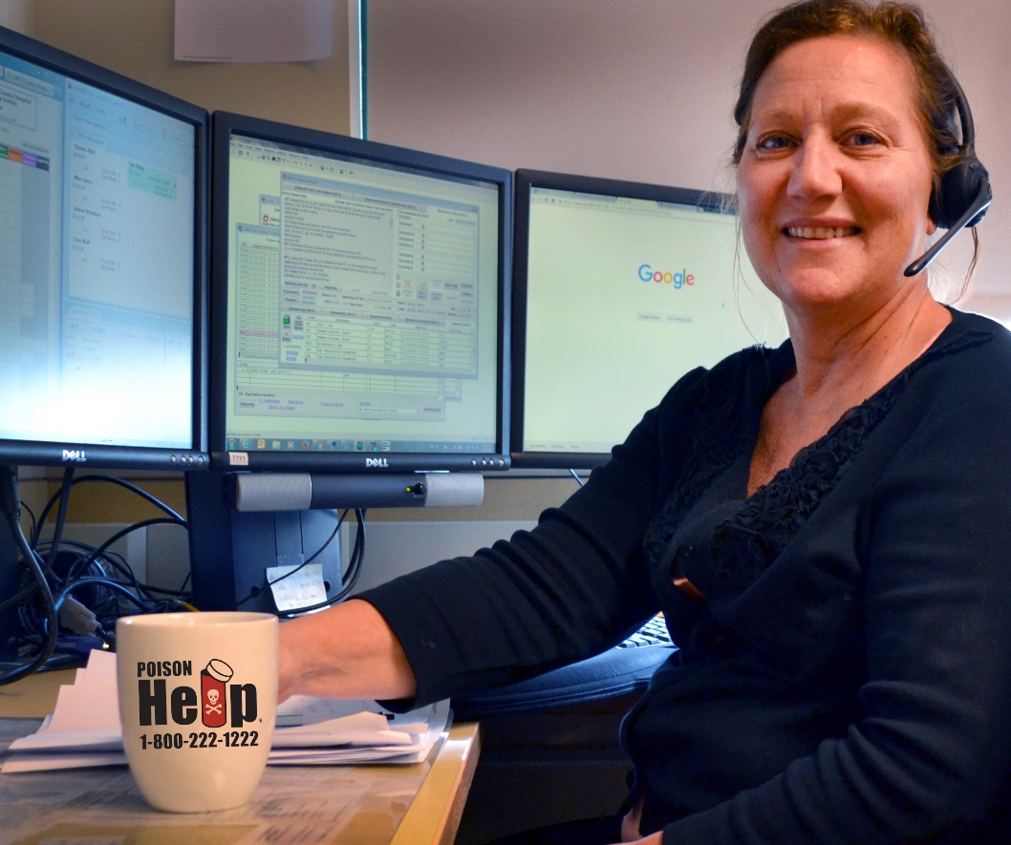
About Poison Control Centers’ Cases and Data
PCCs continuously feed call data into the National Poison Data System (NPDS)— the only near real-time comprehensive poisoning surveillance database in the U.S.
Each year, poison centers manage approximately 3 million cases -- one every 11 seconds.
57% of human exposures involve pharmaceuticals. Other exposures include household products, plants, mushrooms, pesticides, animal bites and stings, carbon monoxide, and many other substances.

Slide 8
Value of Poison Centers: National Poison Data System (NPDS)
NPDS as a nationwide repository of info/exposure data
The only near real-time comprehensive poisoning surveillance database in the U.S.
Standardized, systematic, defined data fields
Data automatically uploaded in near-real time (avg. every 8 min.)
Product-specific identifiers used
420,000+ products with product identifiers (product name, strength, dosage form, manufacturer
Geocoded data (caller location as granular as 5-digit ZIP code)
Captures information calls and exposure events
*Data collection began in 1983, providing >30 years of data and more than 60 million exposure case records

Slide 9
Total Number of Suspected Suicides Reported to PCCs By Age
Age Group | 2012 | 2013 | 2014 | 2015 | 2016
< = 5 years | 137 | 167 | 39 | 8 | 12
6-12 years | 1,892 | 2,465 | 2,998 | 3,311 | 3,674
13-19 years | 51,033 | 56,844 | 65,149 | 71,868 | 76,495
20-29 years | 53,620 | 51,958 | 52,703 | 55,117 | 58,060
30-39 years | 40,032 | 39,587 | 40,100 | 41,034 | 41,907
40-49 years | 37,120 | 35,912 | 35,667 | 35,345 | 35,008
50-59 years | 24,082 | 25,126 | 26,395 | 27,105 | 27,648
60-69 years | 7,466 | 8,127 | 8,940 | 9,594 | 10,523
70-79 years | 2,104 | 2,363 | 2,568 | 2,722 | 3,055
>= 80 years | 1,012 | 1,087 | 1,133 | 1,157 | 1,224
Unknown Age | 7,594 | 6,444 | 6,111 | 5,698 | 5,255
Total: | 226,092 | 230,080 | 241,803 | 252,959 | 262,861
Notes:
*Note: If age is not provided, an estimated age group is used.
READ: As you can see, suspected suicides are most prevalent amount Adults ages 19+

Slide 10
Total # of Suspected Suicide Cases Reported to PCCs, By Gender (2012-2016)
Gender | 2012 | 2013 | 2014 | 2015 | 2016
Female | 144,023 | 149,443 | 159,453 | 167,604 | 174,498
Male | 80,720 | 79,326 | 81,110 | 84,181 | 87,046
Pregnant | 340 | 331 | 362 | 318 | 373
Unknown | 1,009 | 980 | 879 | 856 | 944
Total | 226,092 | 230,080 | 241,804 | 252,959 | 262,861
Notes:
As the number of suspected suicides has increased over the years, so has the number of Female suspected suicides.

Slide 11
2016 Top Suspected Suicide Exposure Substances
Generic Code Name | 2016
Benzodiazepines (i.e. Xanax, Valium) | 47,173
Ethanol (Alcoholic Beverages) | 33,987
Atypical Antipsychotics (i.e. Latuda, Seroquel ) | 28,173
Ibuprofen (i.e. Advil, Motrin) | 21,348
Acetaminophen Alone (i.e. Tylenol Extra Strength) | 17,043
Trazodone (i.e. Oleptro) | 14,587
Other Antihistamines Alone (Excluding Cough and Cold Preparations) (i.e. Allegra, Zyrtec) | 12,880
Gabapentin (i.e. Neurontin) | 10,467
Sertraline (i.e. Zoloft) | 9,444
Other Types of Sedative or Anti-Psychotic Drug (i.e. Ambien) | 9,220
Acetaminophen with Hydrocodone (i.e. Vicodin) | 8,236
Other Types of Selective Serotonin Reuptake Inhibitor (i.e. Vilazodone) | 2,446
Other Types of Antidepressant (i.e. Venlafaxine) | 223

Slide 12
Suspected Suicide By Medical Outcome
Medical Outcome | 2012 | 2013 | 2014 | 2015 | 2016
Death | 890 | 785 | 790 | 814 | 902
Major effect (i.e. cardiac arrest, coma) | 12,001 | 11,680 | 12,617 | 13,006 | 13,407
Moderate effect (i.e. high fever, disorientation) | 62,079 | 64,923 | 67,868 | 72,854 | 76,938
Minor effect (i.e. drowsiness, cough) | 71,110 | 72,010 | 77,242 | 81,129 | 86,103
No effect | 42,448 | 44,498 | 47,601 | 49,841 | 51,308

Slide 13
Intersections of Suicide, the Military, and Poison Control Centers
Studies indicate that suicide has become a leading cause of death among the US military, with rates possibly greater than that observed among the civilian population.¹⁻³
The US has 65 military hospitals worldwide and 150 VA hospitals. Currently, information on poisonings managed at military and VA hospitals is limited.

Slide 14
AAPCC Developing a Comprehensive Military Outreach Strategy
Two Goals:
Raise awareness- what is poison control, why would I want to take advantage of the resource, and how do I do so?
Get the poison control contact information into smartphones
Targeting by Audience:
Active Duty: Families
Active Duty: Single Soldiers/New Recruits
Veterans/Retirees

Slide 15
How can military families and active duty members benefit from Poison Centers?
Frequent moves and long deployments place a tremendous amount of stress on service members, and can often leave their families in unfamiliar territory, with a lack of resources.
Poison centers offer free, confidential, expert medical advice 24 hours a day, seven days a week, to both stateside and overseas military installations, through the Poison Help line at 1-800-222-1222 and online at www.PoisonHelp.org.
By texting “POISON” to 797979, members and their families can save the poison contact information in their smart phones, and can call for advice on anything from alcohol poisoning and food poisoning, to common household poisoning hazards.
Poison centers can also provide both print and digital resources to installations for use in the workplace, child development and youth centers, community centers, and installation medical facilities.

Slide 16
How can AAPCC reach military families and active duty members?
General Online Resources: Both long and short-form opportunities to via Military OneSource
Social Media: Targeting the Twitter and Facebook pages of each military branch and relevant support & resource groups, contributing digital assets to specific campaigns like the “101 Critical Days of Summer Campaign”
Parents and Caregivers of Children: Reaching out to each branch’s Child & Youth Services departments and DOD schools with free program- “Over-the-Counter Medicine Safety”
Military Medicine: Military Health System News, medicine by branch, Tricare
Military Installations: Community centers

Slide 17
How can veterans benefit from Poison Control Centers?
An estimated 1.6 million military personnel have served in the Iraq and Afghanistan wars, from which at least 300,000 troops have returned with some type of mental health issue or substance abuse problem.⁴
More than 2 of 10 Veterans with post-traumatic stress disorder (PTSD) also have substance use disorders (SUD).⁵
War Veterans with PTSD and alcohol problems tend to be binge drinkers. Binges may be in response to bad memories of combat trauma.
Almost 1 out of every 3 Veterans seeking treatment for SUD also has PTSD.

Slide 18
How can veterans benefit from Poison Control Centers?
Pharmaceutical treatment of mental and physical disorders has led to additional poisoning risks within the veteran population. Prescription medications have been cited as the cause of both intentional deaths and unintentional deaths in veterans, often as a result of inappropriately combining prescriptions.⁵
The involvement of alcohol use or antidepressant medications may be associated with worse clinical outcomes in poisoning cases among veterans compared to other substances.
Studies have shown an association between the use of antidepressant medications and opioid analgesics in attempted suicides among veteran poisonings.

Slide 19
How can AAPCC reach veterans?
Department of Veterans Affairs and National Association of State Directors of Veterans Affairs
Tricare
Information dissemination via associations and other groups: National Association of American Veterans, AARP, National Organization of Veterans' Advocates, National Veterans Services Fund, Retired Enlisted Association, and many more.
Social media and online resources (similar to active duty and family outreach)

Slide 20
Questions, comments, or suggestions?
Stephen T. Kaminski, JD
Executive Director
American Association of Poison Control Centers
Kaminski@aapcc.org
(703) 894-1871

Slide 21
References
Armed Forces Health Surveillance Center (AFHSC). Deaths by suicide while on active duty, active and reserve components, US Armed Forces, 1998e2011. MSMR 2012;19:7e10.
Black SA, Gallaway MS, Bell MR, Ritchie EC. Prevalence and risk factors associated with suicides of army soldiers 2001e2009. Mil Psychol 2011;23:433e51.
Ramchand R, Acosta J, Burns RM, Jaycox LH, Pernin CG. The war within: preventing suicide in the US military. Santa Monica,CA: RAND Corporation; 2011.
University of South Florida College of Public Health. (n.d.). Characterizations of Veteran’s Poisonings in the State of Florida. Retrieved from http://health.usf.edu/cms_author/docs/Templates/COPH/ceoram/pdfs/06-veterans-poster.pdf
U.S. Department of Veterans Affairs. (2015). PTSD and Substance Abuse in Veterans. Retrieved from https://www.ptsd.va.gov/public/problems/ptsd_substance_abuse_veterans.asp

