Slide 1
“Project Life Force” Suicide Safety Planning Group Intervention for High Risk Suicidal Veterans
Marianne Goodman, M.D.
James J. Peters VAMC
VISN 2S MIRECC
DoD/VA Conference– August 2017

Slide 2
Suicide Safety Planning (SSP)
Developed initially by Greg Brown as part of a 10 session CBT treatment for suicide attempters
Stanley and Brown adapted for VA use
Minimal research on safety plan as “stand alone” intervention
Despite this, SSP is considered a “best practice” by the Suicide Prevention Resource Center
VA now mandates safety plans be constructed for all Veterans admitted for suicidality

Slide 3
Qualitative Study of SSP use (Kayman et al., 2015)
20 Veterans interviewed after SSP construction and 1 month later
Findings notable for :
wide range of use (none to several times daily)
Importance of clinician collaboration
Problems/obstacles:
Lack of social network
Social withdrawal/depression
Avoidant style of coping
Burden too great to carry out plan alone
Facilitators of use of the plan:
Sharing of plan with significant others
Mobile formats of the plan
Individualize plan
PLF incorporates:
1) teaching of distress tolerance and emotion regulation skills applied to individual steps of the SSP,
2) Introduces use of a mobile SSP Application,
3) Helps Veterans identify individuals they can call for help, and practice asking for help,
4) Aims to development detailed, personalized and meaningful SSPs
PLF aims to address these concerns
➔
Notes:
70% had someone to call
65% looked at plan at least once

Slide 4
Project Life Force Session Content

Slide 5
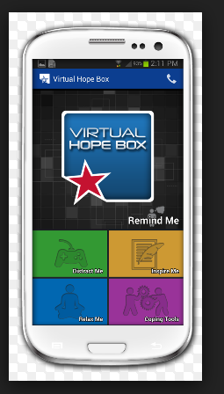
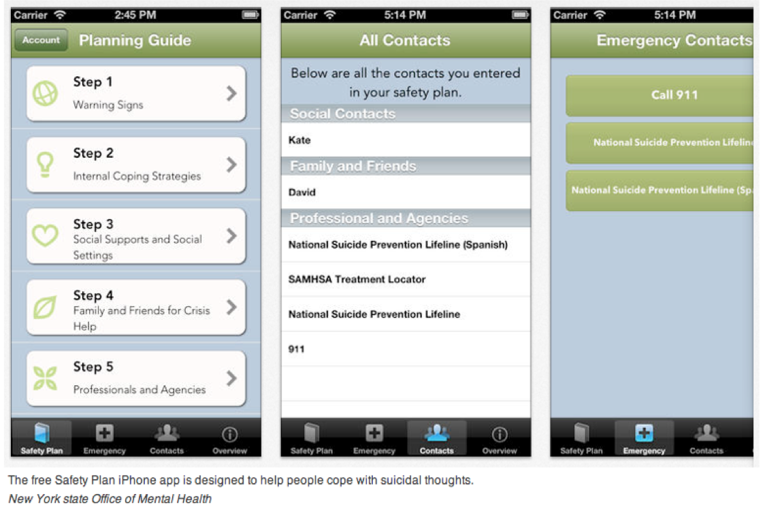
NY Office of Mental Health Suicide Safety Plan Mobile App & Virtual Hope Box

Slide 6
Project Life Force “PLF” = safety planning in a group format
PLF is one of the only manualized outpatient group treatments for suicidal individuals
This is surprising given that groups:
1) diminish social isolation and increasing social support, a protective factor against suicide;
2) it’s cost effectiveness and maximizing staff time;
3) the peer movement among those who have experienced suicidal crises is strong and growing; and
4) Veterans and military service members are used to working with a team approach to problems.

Slide 7
Study Aims
Test feasibility and tolerability of intervention on 50 Veterans
Initial effectiveness in depression, suicidal symptoms, hopelessness and community integration (exploratory)
Feedback on each session from patient, and PLF therapist
Plus post-intervention feedback from treating clinician(s)

Slide 8
Feasibility Ratings

Slide 9
Clinical Trial Progress to date
Flow diagram for currently funded PLF Pilot Study January 2016- April 2017 data to date
Assessed for eligibility* and signed consent: (N= 38)*Veteran recently completed a suicide safety plan
Did not meet study criteria (N=1)
Declined to participate (N=2)
Moved out of state or received care outside of JJPVAMC (N=2)
Dropped before baseline assessment (N=6)
Started full time job/school (N=3)
Pre-Treatment Trial Period
Started Project Life Force Pilot
N=24
Drop out after session 1 (N=2)
Drop out after session 3 (N=1)
Drop out after session 6 (N=1)
Still ongoing in treatment (N=3)
Begin PLF Treatment
Completed Project Life Force Pilot
N=17
Finish PLF Treatment
Average # of sessions attended by treatment completers: 9.1
Acceptability rating: 4.7 (out of 5)
*75% have completed >7.5 of 10 sessions

Slide 10
Qualitative Feedback on PLF-I
Hope/Improved Depressive and Suicidal Feelings
-“I wake up wanting to live now.” (004)
-“Hanging up my safety plan and making it visible was reinforced in PLF. Seeing it daily is a positive reminder that help is out there.” (005)
-“PLF has had profound effects on my will to live, the most in the past 4 years. I now have a reason to get out of bed in the morning and can last through the week until the next PLF meeting.” (013)

Slide 11
Qualitative Feedback on PLF-II
Increased Connection & Sense of Belongingness/Lessened Loneliness
-“It was most helpful to hear other veteran’s stories, feedback and perspectives. It made me realize I was not the only one struggling with this.” (001,007)
-“The program led me to call friends I haven’t spoken to in a while and become more open to starting new friendships, especially with other group members.” (015)
-“I got to listen to the stories of my brothers. It opened up sympathy and empathy in my heart because I could relate so much. I thought I was a misfit even though you hear about people struggling with suicide. To actually connect with my brothers in this fight was powerful. It’s another battle we are facing.” (011)
-“The group helped me get over my embarrassment of struggling with mental illness” (04)
‘came out’ to some of my family members as having these struggles as a result of talking with the group members.” (008)

Slide 12
Qualitative Feedback on PLF-III
More Effective Use of Safety Plan
-“I learned about the Crisis Line, and used the text feature.” (001,002)
-“Virtual hope box app was a favorite.” (002, 004, 011)
-“Going through each step in depth makes it a living document, instead of just filling it out on the fly and never using it. Knowing warning signs, when a bad feeling was coming and knowing which distractions are available to get me through, that was huge.” (002)
-“I put the safety plan on my phone.“ (004)
-“Actually calling people on my plan.” (015, 016, 018)

Slide 13
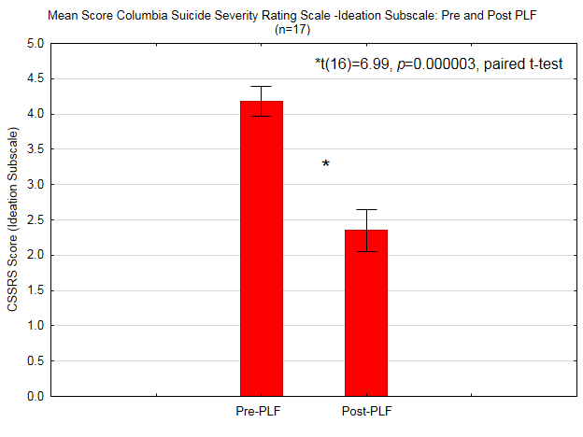
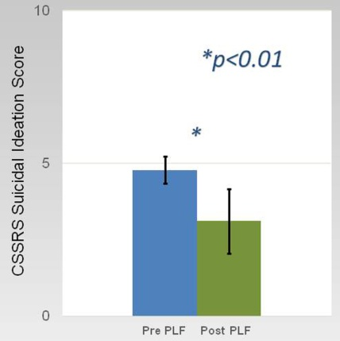
Pre/post PLF Suicidal Ideation scores
Mean values for CSSRS Ideation score are shown (error bar is SD) for 17 Veterans pre- and post- PLF intervention. A significant decrease in suicidal ideation was observed (paired t=6.469, df=16, p<0.000003).

Slide 14
Pre/post PLF Outcome Measures
CSSRS= Columbia Suicide Severity Rating Scale, BDI= Beck Depression Inventory BHS= Beck Hopelessness Scale BSS= Beck Suicide Ideation Scale

Slide 15
Next Steps
Manual now finalized
Pilot test adherence ratings
MERIT grant application for multi-site trial

