Slide 1
August 2017

Slide 2
Disclosure
This presentation is based on work supported by the Department of Veterans Affairs, but does not necessarily represent the views of the Department of Veterans Affairs or the United States Government.
The REACH VET program is funded by the Department of Veterans Affairs Office of Mental Health and Suicide Prevention.

Slide 3
What is REACH VET?
Based on the finding that although suicide rates in VHA patients have decreased relative to the US adult population as a whole, they remain high
Supported by senior VA leadership as part of establishing suicide prevention as a major priority
Goes beyond intercepting people on the trajectory towards suicide
Uses predictive models to identify Veterans whose care should be enhanced
Supplements current clinical strategies to identify at-risk Veterans
Complements other VHA initiatives designed to identify new opportunities to enhance care for Veterans

Slide 4
Background: The Predictive Model
Developed by VA and NIMH researchers
Includes clinical and administrative data for each Veteran who utilizes VHA health care services
Calculated Risk
*As compared to overall VHA population
Outcome | Top .1% Top Risk
Suicide (one month) | 33 x
Suicide (one year) | 15 x
Suicide attempt (one year) | 81 x

Slide 5
Preventing Other Adverse Outcomes

Slide 6
Model Predictors
Demographics
Age >= 80
Male
Currently married
Region (West)
Race/ethnicity (White)(Non-white)
Service Connected (SC) Disability Status
SC > 30%
SC > 70%

Slide 7
Model Predictors
Prior Suicide Attempts
Any suicide attempt (prior 1 month), (prior 6 months), (prior 18 months)
Diagnoses
Arthritis (prior 12 months) (prior 24 months)
Bipolar I (prior 24 months)
Head and neck cancer (prior 12 months) (prior 24 months)
Chronic pain (prior 24 months)
Depression (prior 12 months) (prior 24 months)
Diabetes mellitus (prior 12 months)
Systemic lupus erythematosus (prior 24 months)
Substance Use Disorder (prior 24 months)
Homelessness or services (prior 24 months)

Slide 8
Model Predictors
VHA utilization
Emergency Dept visit (prior month)(prior 2 months)
Psychiatric Discharge (prior month)(prior 6 months) (prior 12 months) (prior 24 months)
Any mental health (MH) tx (prior 12 months) (prior 24 months)
Days of Use (0-30) (in the 13th month prior)(in the 7th month prior)
Emergency Dept visits (prior month)(prior 24 months)
First Use in Prior 5 Years was in the Prior Year
Days of Inpatient MH (0-30) (in 7th month prior) (Squared)
Days of Outpatient (0-30) (in 7th month prior) (in 8th month prior)(in 15th month prior) (in 23rd month prior)
Days with outpt MH use in prior month, squared

Slide 9
Model Predictors
Medications
Alprazolam (prior 24 months)
Antidepressant (prior 24 months)
Antipsychotic (prior 12 months)
Clonazepam (prior 12 months)(prior 24 months)
Lorazepam (prior 12 months)
Mirtazapine (prior 12 months)(prior 24 months)
Mood stabilizers (prior 12 months)
Opioids (prior 12 months)
Sedatives or anxiolytics (prior 12 months) (prior 24 months)
Statins (prior 12 months)
Zolpidem (prior 24 months)

Slide 10
Model Predictors
Interactions
Between Other anxiety disorder (prior 24 months) and Personality disorder (prior 24 months)
Interaction between Divorced and Male
Interaction between Widowed and Male

Slide 11
REACH VET is an alert system that provides opportunities for enhanced care
Enhanced Care
Notes:
Clinical vs statistical risk
Veterans we are already aware of and those who we didn’t know are at risk

Slide 12
REACH VET Steps
REACH VET Coordinators
Access the dashboard
Identify appropriate provider
Communicate with identified provider
Document in EMR
MH and Primary Care Providers
Receive notification about a high risk Veteran
Re-evaluate care
Consider treatment enhancement strategies
Outreach the Veteran
Document in EMR
Notes:
Include alert system slide; Mention that names are released every month

Slide 13
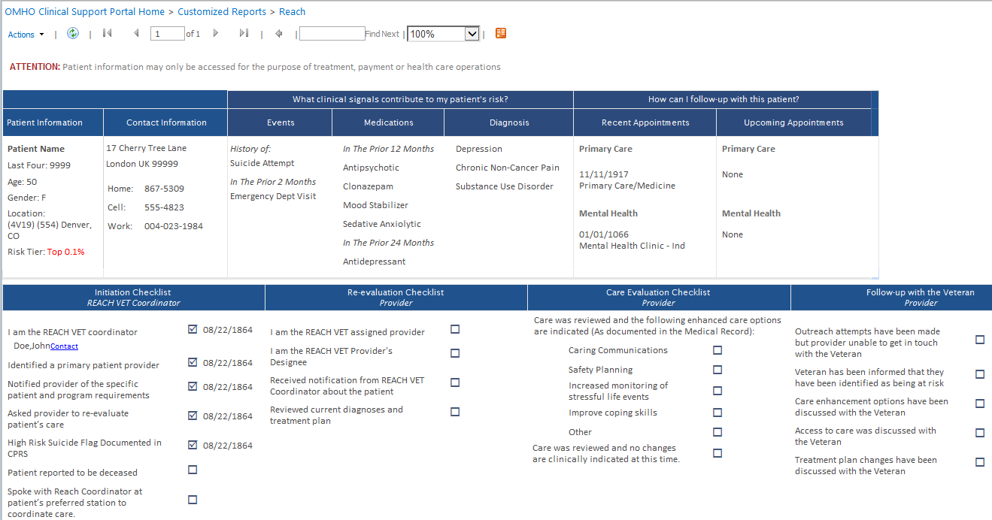
REACH VET Dashboard

Slide 14
Re-Evaluation of Care
Reviews medical record to re-evaluate the care the Veteran has been provided.
Care should be evaluated in a comprehensive manner and not limited to the services that are provided by that provider.
Reviews screening evaluations and re-screen as needed.
Reviews diagnoses, current problems and treatment plans.
Ensures patients have access to all services requested and needed and are receiving evidence-based care.

Slide 15
Care Enhancement Strategies
Considers additional treatment enhancement strategies
Enhanced communication (e.g., via caring communications)
Safety planning
Increased monitoring of stressful life events
Interventions designed to enhance coping strategies

Slide 16
Provider to Veteran Outreach
Provides information about REACH VET
Informs the Veteran that s/he has been identified as a patient who may benefit from enhanced care
Checks-in regarding current symptoms and stressors
As is clinically indicated, collaboratively discusses changes to the treatment plan and/or care enhancement strategies

Slide 17
Veteran Outreach Increasing Awareness of Risk
“So far I only have one Veteran on the REACH VET program. I educated him about how Veterans are “selected” for the designation... I then educated about how this would impact his treatment by pointing out he was already engaged as we would want him to be. Veteran expressed gratitude for the increased awareness of suicidality as well as for the CAMS group, which he finds very helpful. I think it’s a relief for him to know we are all aware of his risks – seems to have increased his accountability!”
- Lexington, KY

Slide 18
Veteran Outreach An Opportunity for Re-engagement
“I explained REACH VET by informing [the] Veteran he had been identified as being at higher risk due to diagnosis and inpatient VA utilization. Veteran responded by stating he felt he could benefit from mental health counseling to assist with depression and anxiety issues.”
- Lexington, KY

Slide 19
Veteran Outreach An Opportunity for Re-engagement
“Yesterday, I nudged a provider to “try one more time.” He [the Veteran] was just discharged from a non-VA BH facility; he AGAIN told her no….but about an hour later he called back and scheduled an appointment!”
- Alexandria, LA

Slide 20
Veteran Outreach Enhancing Care
“Regarding the REACH VET program… most of [our providers] conveyed that the Veterans “were grateful for the extra concern.” In many instances, Veterans did engage in enhanced services, and clinicians felt that the additional attention and interventions were beneficial. One of our therapists noted that the Veterans on her panel were “optimistic and grateful for the additional attention.”
- Erie, PA

Slide 21
Dashboard Updates

Slide 22
Sharing risk data
REACH VET
STRATIFICATION TOOL for OPIOID RISK MITIGATION (STORM)
The Veterans Crisis Line
CPRS

Slide 23
Randomized Program Implementation Evaluation
A VA HSR&D Service Directed Research (SDR) randomized program evaluation grant was funded to evaluate REACH VET
(PI Landes, SDR-16-195)
Focused on the implementation outcomes of REACH VET and the effect of the implementation strategies used
Implementation as usual (IAU)
Coordinator and provider training, provision of resources on MIRECC website, and technical assistance as requested
IAU + Virtual External Facilitation
Facilitation: A process of interactive problem solving and support that occurs in a context of a recognized need for improvement and a supportive interpersonal relationship

Slide 24
Effectiveness Evaluation
Led by SMITREC
Does REACH VET decrease Veteran suicide?
What other impacts are there from REACH VET?

Slide 25
Where Are We Now
~ 6 months in after full implementation
Identifying ~6,700 Veterans per month
Identified more than 20,000 unique Veterans to date
Launched CPRS templated that substantially decrease administrative burden

Slide 26
Where are we going?
Evaluation
Update modeling
Streamline process
Share risk data
Expand use of predictive analytics

Slide 27
REACH VET Point of Contact
Aaron Eagan, RN, MPH
REACH VET Program Manager
Aaron.Eagan@va.gov

