Slide 1
Reaching Geographically and Culturally Diverse Regions to Expand Suicide Prevention Impact: Diffusing Vital Suicide Prevention Information, Data through Social Media Channels
Lisa Sullivan @StopTXSuicides - Texas Suicide Prevention Council @LisaSul
Merily Keller, @StopTXSuicides – Texas Suicide Prevention Council @hodgekeller
Perry Jefferies, @TexVet - TexVet Initiative, @PerryJefferies
#

Slide 2
Zero Suicide in Texas
Zero Suicides in Systems
A commitment to suicide prevention in health and behavioral health care systems
Includes a specific set of tools and strategies (concept and practice)
39 Suicide Prevention Coordinators at LMHAs across state/ state hospitals
23 Local Mental Health Authorities participating to be Suicide Safe Care Centers
Texas is being used as a model to train all of the SAMHSA Gov Project Officers
Public Awareness
Texas suicide prevention website, bilingual print materials, suicide prevention toolkits, newsletters , exhibits, 17 youth videos about health and hope & discussion guide and easy to use Apps.
Texas State Plan for Suicide Prevention
TexasSuicidePrevention.org
The Texas Suicide Prevention Council has 30 + local suicide prevention coalitions & 25+ statewide partners
Training & Tools
Best Practice Based Training
Workforce Survey, Screening & Assessment Tools
ZEST Toolkit

Slide 3
Suicide Safe Care Model and Texas Suicide Prevention Council
Suicide Safe Care State
Council and its 25+ State Partners
Suicide Safe Care Community
30+ Local SP Coalitions
Suicide Safe Care Centers
Texas Suicide Prevention Council

Slide 4
SoME Suicide Prevention Outreach Goals
Outreach objectives Aligned with Zero Suicide in Texas (ZEST), NSSP, and CDC Preventing Suicide Technical Pkg :
Expand Reach Geographically, Culturally, and for At-Risk Populations
Reduce Stigma Associated with Suicide
Increase Acceptance and Use of Suicide Prevention Tools and Training
Improve Connectivity across Time, Distance
Leverage Opportunities across Disparate Communities
Create Communities of Engagement

Slide 5
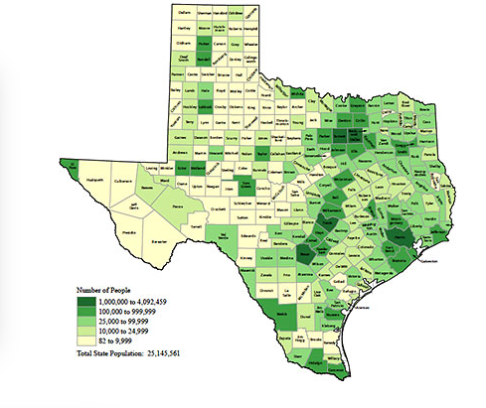
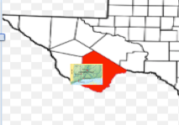
Texas Geography
254 autonomous counties
268,000 Square Miles
Widely distributed population

Slide 6
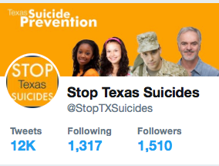
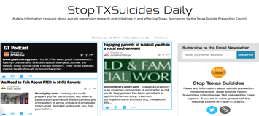
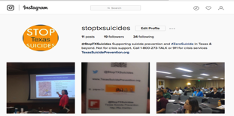
Texas SoMe Suicide Prevention Assets
≅20% SMVF
Notes:
Overall portal for:
Information and Resources
Texas Suicide Prevention Symposium Portal
Mobile apps, PSAs
Training resources
ASK, CALM Others
Protocol and Best Practices for prevention, intervention and postvention

Slide 7
Community Engagement, Promote Resources, Lived Experience, Suicide Safe Practices
Notes:
Reinforce actions communities are taking that align with suicide safe best practices.
Inform clinical & research studies
Safe messaging

Slide 8
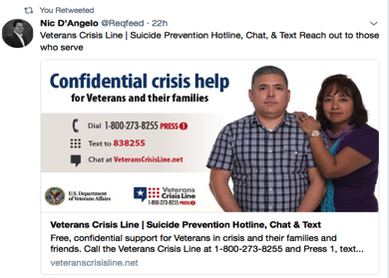
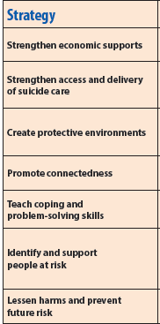
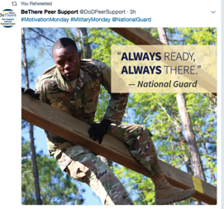
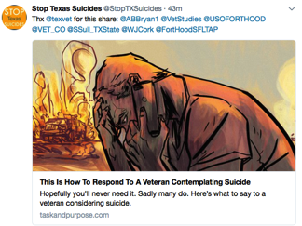
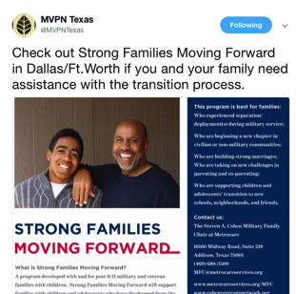
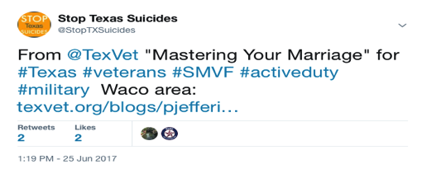
SoME aligns with CDC Technical Recommendations

Slide 9
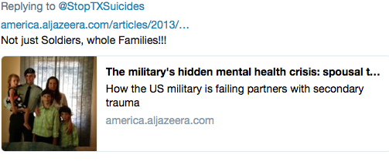
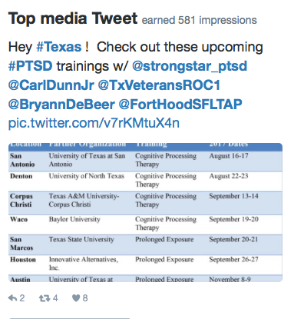
Outcomes
Building community resources to better align with SMVF needs
Amplify participation in community programs that support service members and veterans
Building the capability to direct SMVF persons at risk to MVPN or other local resources
Promote engagement for veteran organizations, events, trainings across Texas to new audiences
Expand engagement in Zero Suicide and Texas Suicide Prevention initiatives
Support far flung teams, expand Texas Suicide Prevention coalition SMVF engagement, and improve communication across SMVF and community resources
Notes:
EXAMPLE:
#1 ASIST Training with Reserve unit in San Antonio.
#2: Aggressive outreach to support veteran events across the state to drive participation
#3 FT HOOD SPOUSE and connecting to MVPN
#4 Employer outreach for a person at risk
# 5 Promoting STRONG STAR PTSD trainings, clinical trials, NIMH clinical trials, community training events
Promote help seeking behavior in community and SMVF
Reinforce positive suicide prevention actions underway in communities across the state

Slide 10
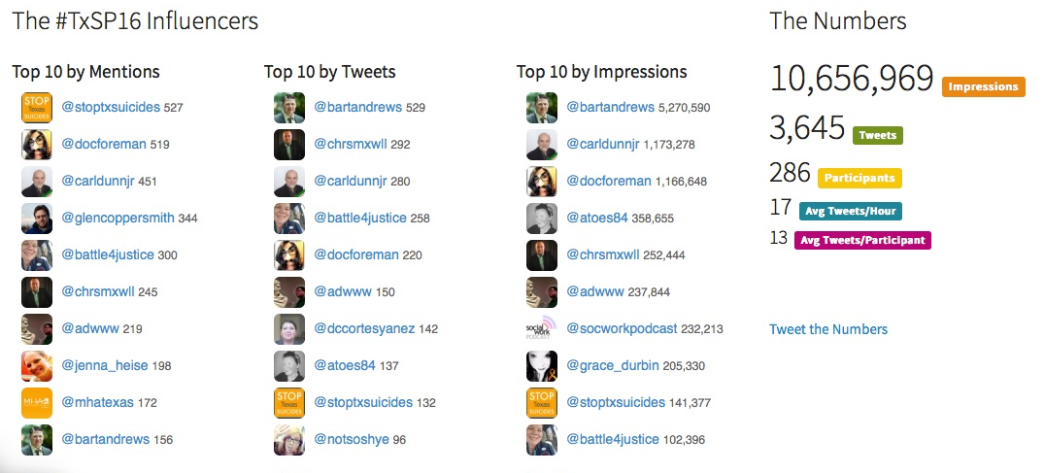
SoMe Outcomes for #TxSP16
Notes:
Turn over to Perry Jefferies from TexVet to discuss SoMe from his organization’s perspective.

Slide 11
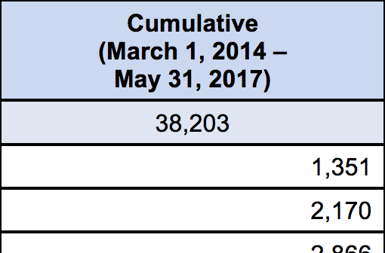
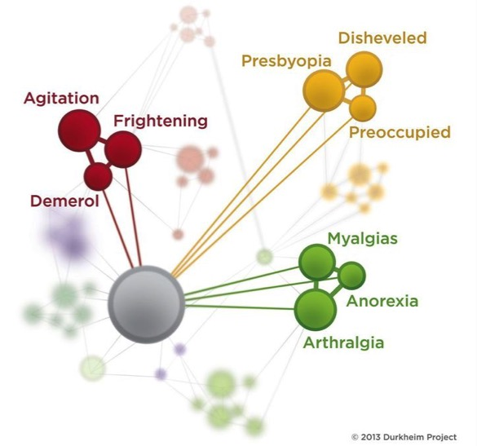
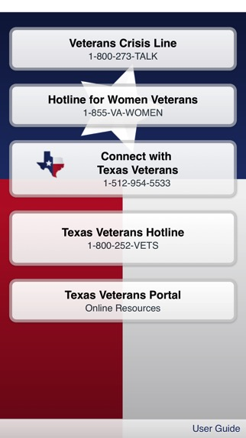
Using Social Networks to Identify Suicidality
Durkheim Project
1300+ Calls
to VA Crisis Line

Slide 12
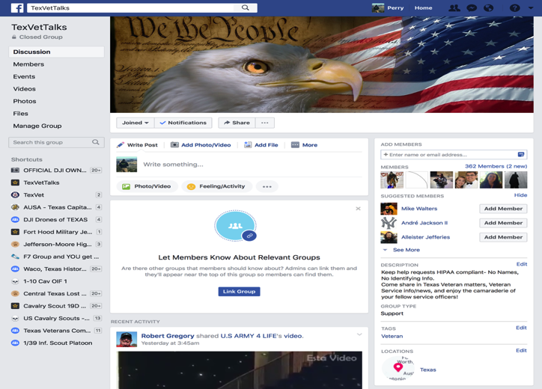
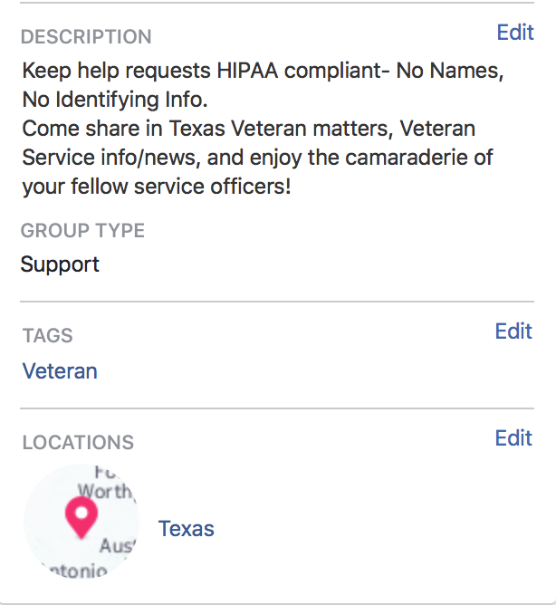
Build Community
Notes:
DO make a Facebook group and understand that pages rarely make it to someone’s feed unless they are looking for your content. We get better leverage out of a 300 person group full of social workers and veteran advocates than we do 5,000 semi-interested people

Slide 13
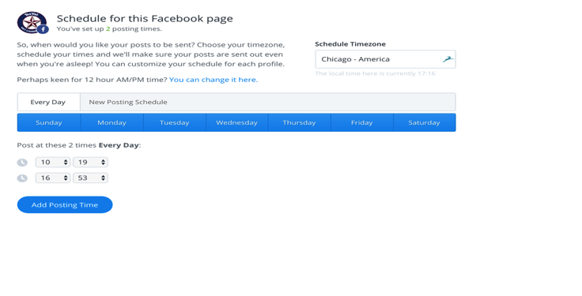
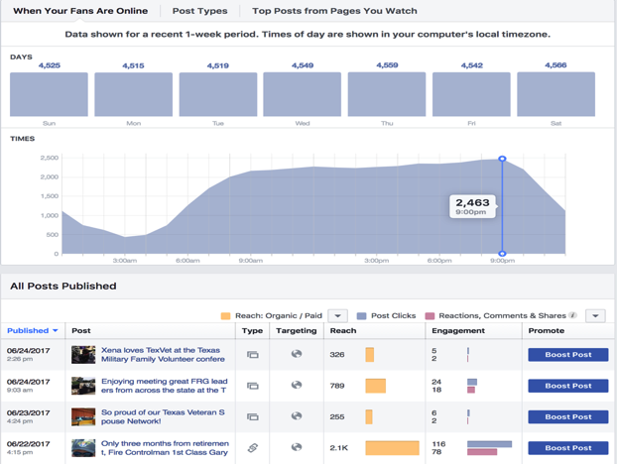
Use Free Tools
Hint: They’re cheap
Notes:
Use schedulers, check the analytics provided. Unless you are a big, big or commercial organization you probably don’t need and don’t have the time to use the “big-iron” tools that the Hootsuites and all will sell you.

Slide 14
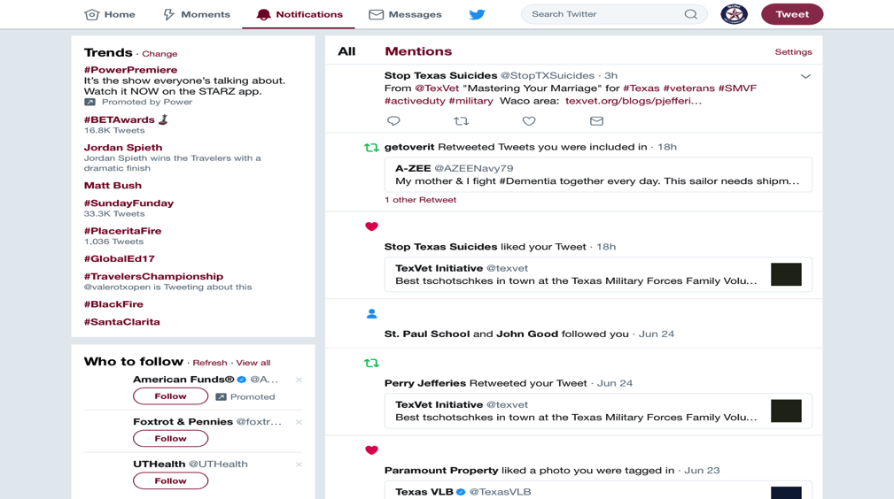
Make Friends and Play Nice

Slide 15
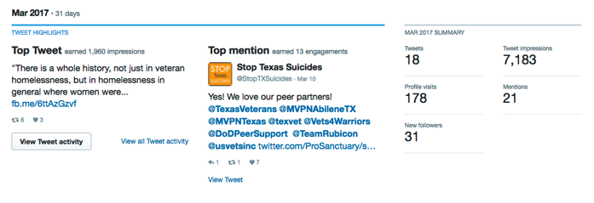
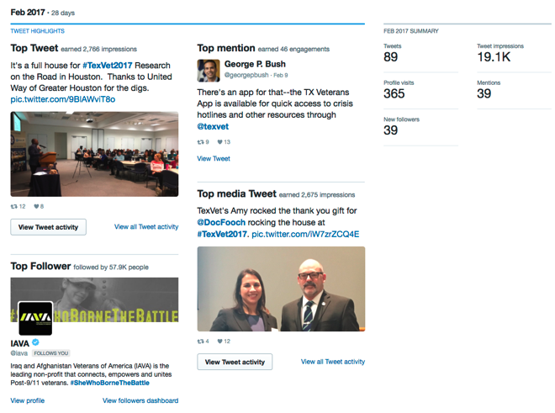
Friends Matter

Slide 16
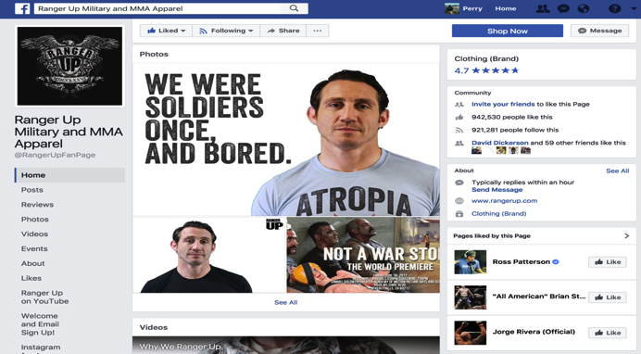
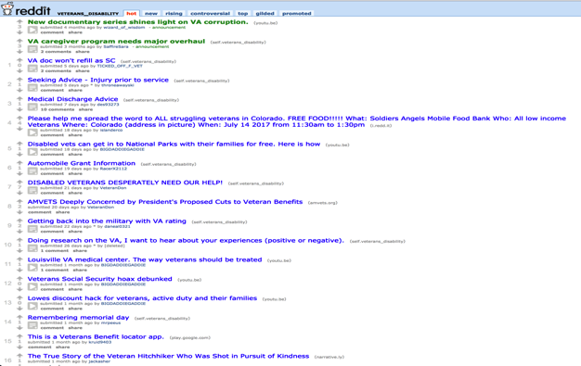
Go Where the Veterans Are
Notes:
We scan a bunch of groups and Reddit - probably a good idea to not be too easily offended. We find and reach out to folks on Reddit all the time.

Slide 17
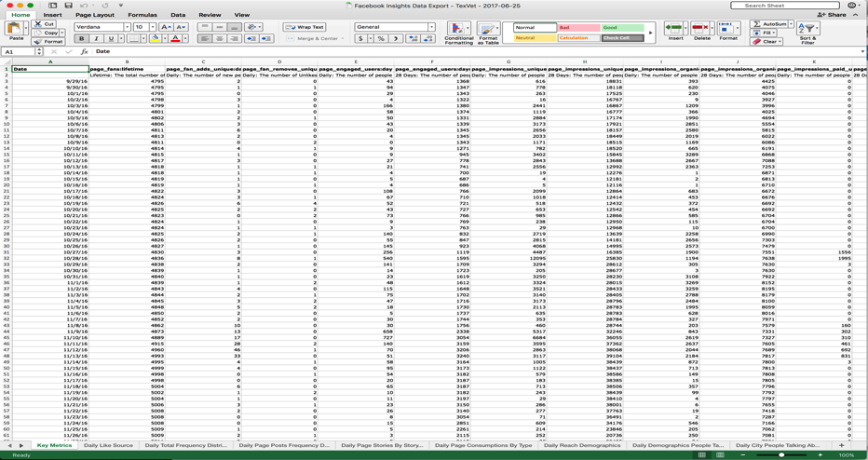
Don’t make yourself crazy
Notes:
There’s plenty of data you can get for free (3 months of hits on Facebook)

Slide 18
How to NOT go viral
Try to go Viral
Notes:
I wish I did have the secret. But I don’t trust anyone that says they do.
In human services you don’t have the always fun and, as an agency, should stay away from the edge

Slide 19
Notes:
You can try and try to make a meme that’ll catch everyone’s attention (this didn’t)

Slide 20
Notes:
Then you find out that Betty’s “Fleagles are the most re-posted and viewed thing on your site.

Slide 21
Contact Information
@StopTXSuicides
TexasSuicidePrevention.org
TexVet.org

