Slide 1
Reaching Veterans Outside of the VA System: Texas’ Multi-Faceted Strategy
Lisa Sullivan, Texas Suicide Prevention Council

Slide 2
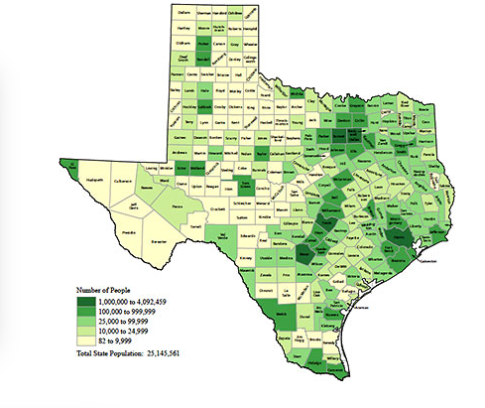
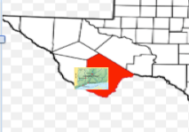
Texas Overview
Zero Suicide State
Geography
240,000+ square miles
160 million acres --
130 million classified as rural
Population
1.8 million Veterans
123k Active Duty
55k Guard and Reserve
Collaboration and Alignment

Slide 3
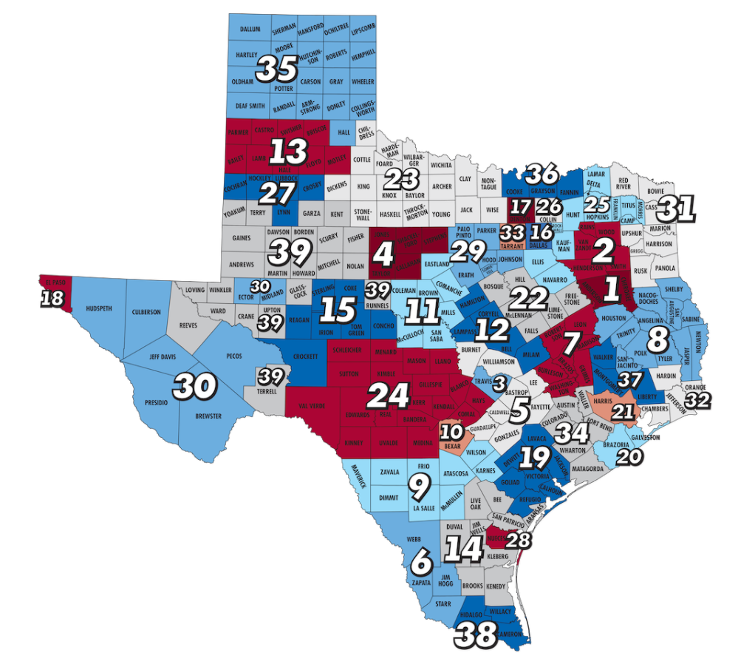
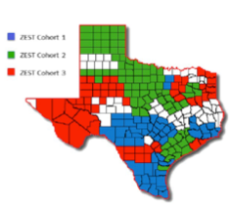
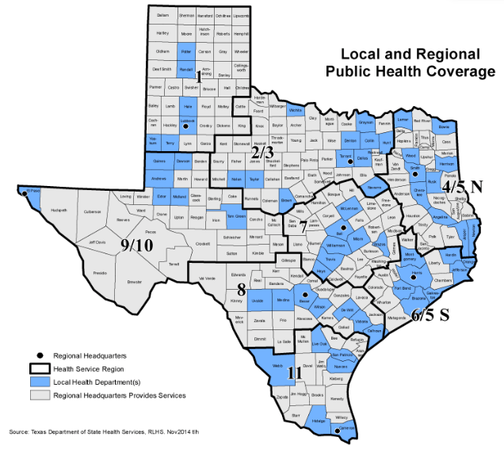
Texas Veteran Mental Health Program and MVPN
Zero Suicide in Texas
Texas Public Health Coverage
37 Full Time Peer Coordinators
ASK and CRP training
153 registered providers
3,514 registered peers
SMVF Academy Team Tim Keesling
Co-located at LMHAs
Community partner for Clay Hunt Act implementation:
VISN 16 and 17 working through PCs
32 LMHAs, ≅ 30 ZS sites
SMVF Academy Team Jenna Heise
All Staff:
ASIST, safeTALK , ASK
Direct Providers:
C-SSRS
Safety Planning
CALM
Specialty Providers
CAMS
CBT-SP
Cross Training w/ Zero Suicide Sites
VA Best Practices infused into
this work

Slide 4
Suicide Safe Care Model and Texas Suicide Prevention Council
USAR, 4th Sustainment Command (EXP), ASPP-JBSA-FSH, Texas Military Department, Texas Veterans Commission- VMHP, U.S.C.G – E.A.P. VA representatives NTX, STX, CTX, others
Suicide Safe Care State
25+ State Partners
Suicide Safe Care Community
30+ Local SP Coalitions
Suicide Safe Care Centers
Texas Suicide Prevention Council
Bell County (100+)
SA Area SP Coalition
El Paso-West TX SP Coalition
Texas State Suicide Prevention Plan
(aligned w/ NSSP DSPO VA SAMHSA CDC)

Slide 5
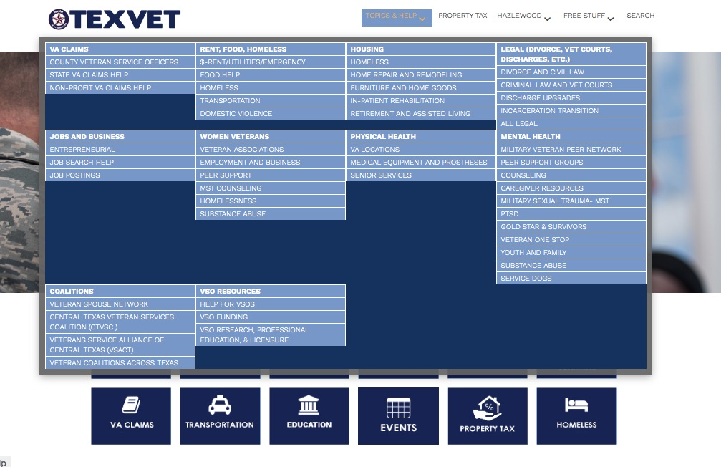
TexVet: Driving Traffic to Veterans Services

Slide 6
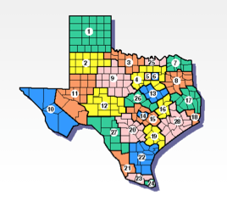
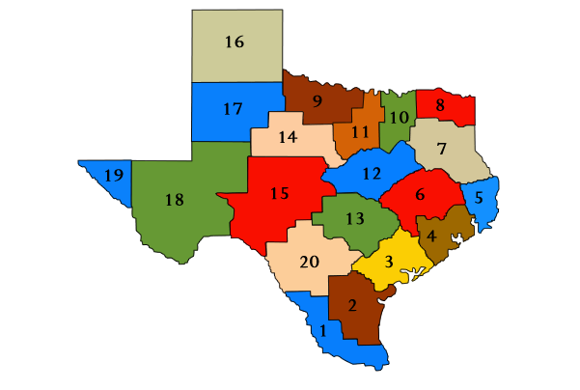
Examples of Extended Reach
Texas Workforce Commission
Social Media
Education
Texas Veteran Leadership Program
ASK Trainers on staff
TWC Veteran Outreach Personnel
ASIST trained
20% are SMVF
Provides a mechanism to drive traffic to SMVF services
SP training required for educators annually
SP training required for entering college students

Slide 7
Summary
Texas engaged in aligned, integrated efforts to provide identification of veterans, families at risk and channel to appropriate resources
Actively engaged in supporting cross agency, cross resources to support veterans, families at risk
Engaged local initiatives through evidence informed, best practice tools aligned with the Texas State Suicide Prevention Plan

