Slide 1
Notes:
CDP Lead: Jeff Mann

Slide 2
The Risk Management Trifecta - Emotional Regulation, Suicidal/Non-Suicidal Self-Directed Injury (NSSI) and PTSD Translating research into treatment planning within the Military Health System and VHA
Center for Deployment Psychology
Uniformed Services University of the Health Sciences
Jeffrey C. Mann, PsyD, Sharon Birman, PsyD, Laura Cho-Stutler, PsyD

Slide 4
The Challenge
Individuals with this symptom combination generally present:
Chronically elevated suicide risk
Low threshold for attempts or NSSI
High-levels of provider stress and burnout
The best evidence supports high-fidelity DBT, but:
It’s frequently not available
Often not a practical alternative
Provide the most efficacious treatment possible, given the constraints of the large institutional Active Duty and Veteran treatment facilities

Slide 5
Ethical Responsibilities
We have strong evidence in support of high fidelity treatment approaches
These treatments are not widely available
APA Ethics
2.01 (d) Boundaries of Competence
2.02 Emergency Services
2.04 Bases for Scientific and Professional Judgment
Notes:
2.01 (d) When psychologists are asked to provide services to individuals for whom appropriate mental health services are not available and for which psychologists have not obtained the competence necessary, psychologists with closely related prior training or experience may provide such services in order to ensure that services are not denied if they make a reasonable effort to obtain the competence required by using relevant research, training, consultation, or study.
2.02 In emergencies, when psychologists provide services to individuals for whom other mental health services are not available and for which psychologists have not obtained the necessary training, psychologists may provide such services in order to ensure that services are not denied. The services are discontinued as soon as the emergency has ended or appropriate services are available.
2.04 Psychologists' work is based upon established scientific and professional knowledge of the discipline.

Slide 6
Overview of Suicide Data
DoD
Prevalence: 19.9/100k (Service range 16.3-23.8)
Number: 269 (Service range 64 – 122)
VHA Users
Prevalence: 39/100k (2014)
Attempts: ~650-700/month and trending up
National
Prevalence: 13/100k
Attempts: 8-25 per death
DoDSER Annual Report (2016), Am Assoc of Suic (2017)

Slide 7
Management of Immediate Risk
The first priority is safety focused Tx
DBT Skills, CBT for Suicidal Patient
Choosing the treatment that is most appropriate for your patients situation/circumstances
Moderate-High Risk - must address suicide NSSI FIRST
Low Risk - should proceed with a trauma focused therapy
Bryan, C.J (2016)
Notes:
Bryan, C.J. (2016). Treating PTSD within the context of heightened suicide risk. Current Psychiatry Reports, 18, 73

Slide 8
Management of Immediate Risk
Evidence Based approaches
Written Crisis Response Plan
Means restriction
More frequent check-ins
Focus on problem solving and skill building
Assistance of invested individuals
Common … but potentially problematic approaches
Frequent involuntary hospitalization
One-to-one observation

Slide 9
Components of DBT
High Fidelity DBT contains several key components
Pre-Treatment, Skills Training Group, Individual Therapy, Phone Coaching, Therapist Consultation Team
Treatment involves multiple encounters per week in individual AND group modalities
Continues for one year

Slide 10
DBT Skills Research
DBT Skills Group as a stand alone treatment
Significantly reduces relevant symptoms
Improved reasons for living
Skills training specifically correlated with reduced NSSI and faster improvement of mood symptoms
Research is limited by small numbers
Some mixed results in non-experimental implementations
Linehan et al (2015), Valentine et al (2015)
Notes:
Reduced suicide attempts, suicide ideation, medical severity of intentional self-injury, use of crisis services owing to suicidality

Slide 11
Moving to Trauma Treatment
Life threatening symptoms MUST be addressed first
Skills use demonstrates ability to tolerate trauma focused treatment
Trauma focused treatment
Consider the circumstances of patient in choosing the treatment
Should be paused when/if life threatening behaviors re-emerge
Scheiderer et al (2017), Granato et al (2015)
Notes:
Scheiderer
Case study of DBT-PE in a VA hospital. 24 months of outpatient psychotherapy—76 individual therapy appointments and 65 skills group appointments. Approximately 22 months of DBT prior to the initiation of a 2-month, 11-session course of concurrent PE. DBT did not include 24/7 phone coaching, due to VA constraints, only available during business hours. Admitted to traditional inpatient psychiatric treatment (i.e., care outside of the DBT model) for stabilization of NSSI and suicidal ideation on three occasions, the longest of which lasted approximately 10 days.
Consider Modifications to the Usual DBT Phone Coaching Protocol - Consider working with established programs in your facility that may have increased accessibility during non-business hours
Make Full Use of Consultation - The consultation process is paramount to ensuring model fidelity and effective flexibility, as well as providing needed supports for clinicians working with high-risk patients.
Attend to Consistency of PE Availability and Access - would suggest that clinic structures be in place for consistent PE availability and access (e.g., 90-min session slots).
Consider the Use of Different Individual Clinicians for DBT and PE, Implemented in an Integrated Format
Consider Shorter Duration of Stabilization - Length of stabilization utilized in previous literature ranges from 2 to 6 months without self harm. The present case study provides support for shorter duration of stabilization from NSSI, given the 4- to 6-week period used.
Granato
41 sessions! Of a case study. And DBT PE with 27 of those sessions! Researches suggest that increasing skills for decreasing dissociation and self-harm can aid in effectively implementing DBPT and PE treatment for a client who experiences dissociation and self-harm.

Slide 12
Research for Combined Tx
Combination of BPD and PTSD significantly increase the risk of NSSI
Combined protocol of DBT-PE developed to address this issue
Treating PTSD significantly reduces risk of NSSI and suicide in the context of BPD
Harned et al (2010), Harned et al (2014), Harned et al (2008)

Slide 13
Consideration for Starting Trauma Tx
Time period of behavioral stability
Ranges from 1-3 months in research studies
Relevant modification or protocols to manage safety issues
PE protocols were modified to monitor exposure activities
Duration of treatment
Most studies involves provide treatment for 1-2 years
Scheiderer et al (2017), Granato et al (2015)

Slide 14
Systemic Challenges
Propensity to hospitalize without means of addressing self-harm/SI
Poor access to provider for skills coaching
Lack of training in DBT among providers
Lack of provider time for more intensive cases and consultation
Lack of provider continuity when transitioning from DoD to VA

Slide 15
Systemic Recommendations
Establish consultation team
DBT Skills training groups
Internal or community based
Individual therapy that reinforces skills use and discourages treatment interfering behavior
Access to coaching and risk assessment with knowledgeable provider

Slide 16
Online Learning
The following online courses are located on the CDP website at:
http://www.deploymentpsych.org/content/online-courses
NOTE: All of these courses can be take for free or for CE Credits for a fee
Cognitive Processing Therapy (CPT) for PTSD in Veterans and Military Personnel (1.25 CE Credits)
Prolonged Exposure Therapy for PTSD in Veterans and Military Personnel (1.25 CE Credits)
Epidemiology of PTSD in Veterans: Working with Service Members and Veterans with PTSD (1.5 CE Credits)
Provider Resiliency and Self-Care: An Ethical Issue (1 CE Credit)
Military Cultural Competence (1.25 CE Credits)
The Impact of Deployment and Combat Stress on Families and Children, Part 1 (2.25 CE Credits)
The Impact of Deployment and Combat Stress on Families and Children, Part 2 (1.75 CE Credits)
The Fundamentals of Traumatic Brain Injury (TBI) (1.5 CE Credits)
Identification, Prevention, & Treatment of Suicidal Behavior in Service Members & Veterans (2.25 CE Credits)
Depression in Service Members and Veterans (1.25 CE Credits)
All of these courses and several others are contained in the Serving Our Veterans Behavioral Health Certificate program, which also includes 20+ hours of Continuing Education Credits for $350.

Slide 17
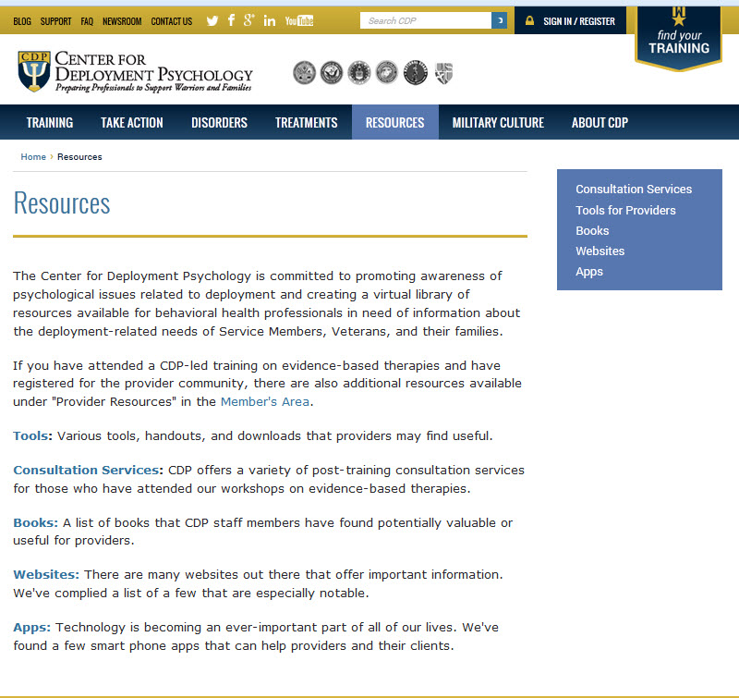
Provider Support CDP’s “Provider Portal” is exclusively for individuals trained by the CDP in evidence-based psychotherapies (e.g., CPT, PE, and CBT-I)
Features include:
Consultation message boards
Hosted consultation calls
Printable fact sheets, manuals, handouts, and other materials
FAQs and one-on-one interaction with answers from SMEs
Videos, webinars, and other multimedia training aids
Participants in CDP’s evidence-based training will automatically receive an email instructing them how to activate their user name and access the “Provider Portal” section at Deploymentpsych.org.

Slide 18
How to Contact Us
Center for Deployment Psychology
Department of Medical & Clinical Psychology
Uniformed Services University of the Health Sciences
4301 Jones Bridge Road, Executive Office: Bldg. 11300-602
Bethesda, MD 20813-4768
Email: General@DeploymentPsych.org
Website: DeploymentPsych.org
Facebook: http://www.facebook.com/DeploymentPsych
Twitter: @DeploymentPsych

