Slide 1

BeThere Peer Support and
Center of Excellence for Advocacy,
Education and Outreach
Shared Experience Model for Peer Support
BeThere Call Center
Development of a CoE
Meeting needs …Filling gaps, across DoD

Slide 2
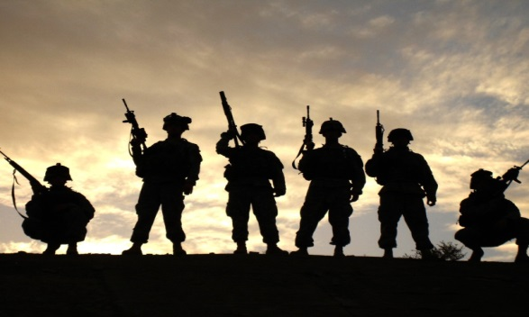
Blake Chaffee, PhD
VP, Integrated Behavioral Health
TriWest Healthcare Alliance
Mona Polom, LCSW, MBA
Director, Behavioral Health
TriWest Healthcare Alliance
Mary Reznicek, BSN,RN
Manager, BeThere Peer Support
Center of Excellence
David Schoo, MBA
Sr. Project Manager, Be There Peer Support
TriWest Healthcare Alliance
Nino E. Gray Jr. SSG, U.S. Army (RET)
Supervisor, Puyallup Hub, BeThere Peer
Support Call and Outreach Center

Slide 3
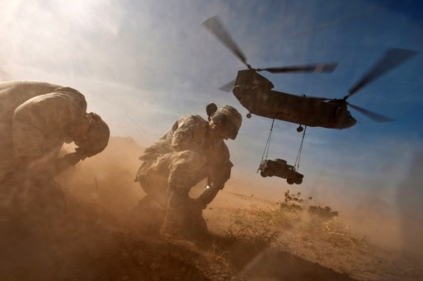
What is a shared experience model?
Military Culture promotes taking care of each other
  Peers are often the first point of contact
Common experiences bond individuals together
Shared experiences are the foundation of peer support
  Foster trust / credibility
  Decreases stigma

Slide 4

Current Status

Slide 5

Peer Support Call and Outreach Center
      Anonymous
      Confidential
      Staff and Peer Support Specialists with prior military experience
        Phone, chat, text, video chat, email
      Clinician Support
        Outreach services
https://www.betherepeersupport.org

Slide 6
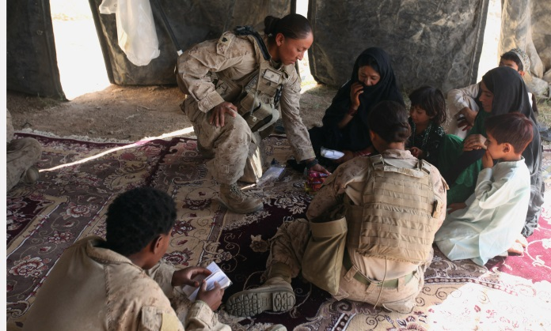
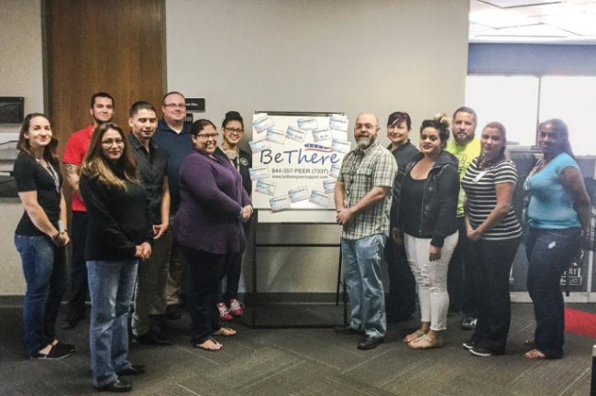
A Peer’s Perspective
We’ve been there. Now, we’re here for you.
      Common bonds
      No stigma
      No concern is too small
      Warm transfers
      Follow ups
We are UNIQUE!
      Unlimited
      Confidential
      24/7/365
      Call, text, chat, video chat, email
      ALWAYS speak with a Veteran

Slide 7
Current Status

Slide 8
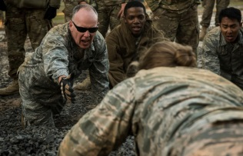
Findings Across the DoD
As Is Study
  94 programs included
  65 programs outreached
  23 programs selected for comparison (19 DoD, 4 non DoD)
  6 had peer support as a main function, 10 more had peer support available at some level
  3 of the 6 peer programs were DoD programs
  All 6 had training programs
  1 of the 6 was available service wide (1 was Academy based, 1 was service specific, 1 was National Guard, 1 was for caregivers, 1 was for survivors)

Slide 9
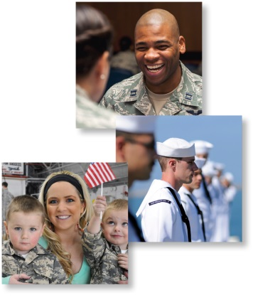
Findings Across the DoD
Gap Analysis
  Command
  DoD Programs
  Small groups
  Individuals
  Programs in support of DoD
  Peers
Needs Assessment
  Training
  Resources
  Materials
  Program development
  Evidence-based standards
  Clinical support

Slide 10
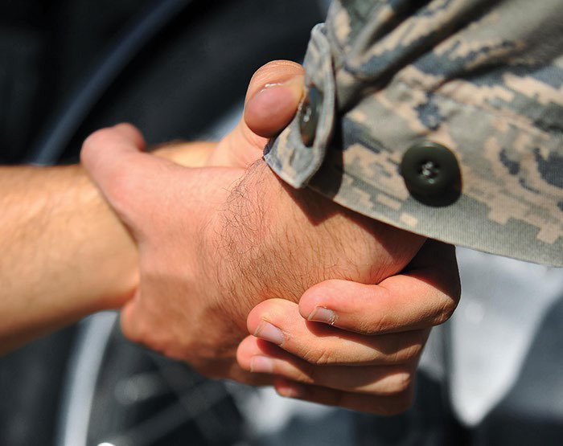
A Center of Excellence
Meets the Needs & Fills the Gaps
A CoE will provide an active repository for:
  Research
  Education
  Downloadable toolkits / modules
  Best practice standards
  Contacts / Resources
  Program databases and sharing
  Evidence-based updates
  Training guidelines
  Customized assistance
  Command support
  Mentor program
Providing evidence-based, best practice peer support advocacy, education and outreach across the DoD

Slide 11
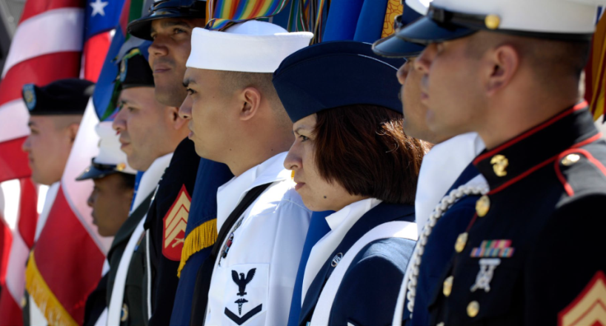
BeThere Peer Support Center of Excellence for Advocacy, Education and Outreach
Available to all Active Duty, Guard, Reserve, Family Members and the groups that service and support them
“bring all programs
to the fight”

Slide 12

Being Present Can Save Lives
Marya Jauregui
July 17, 2017
on CatholicMom.com
“They have been a Godsend to me personally because I usually process things by talking things out with someone. When I can’t sleep I have had conversations with them from 12 until 2 AM. They listen and validate my concerns. Sometimes they offer advice or suggestions. They empathize with the specific circumstances of deployment and the challenges of military life. I always feel like they are listening. I always feel the empathy. They make sure that they reiterate that they are glad that you called them, and that they are there to receive your call 24/7.”

Slide 13
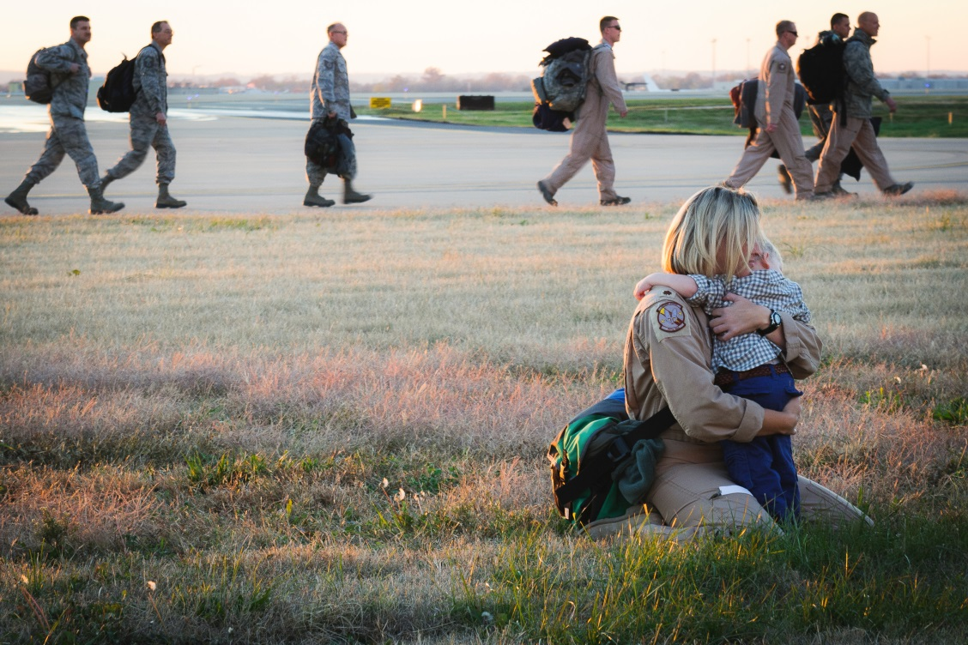
Shared Experience Peer Support can…
Foster social networking
Improve quality of life
Promote wellness
Decrease stigma
Improve coping skills
Support acceptance of situation
Improve compliance
Reduce concerns
Increase satisfaction
Increase resiliency
  Provide upstream suicide prevention

Slide 14
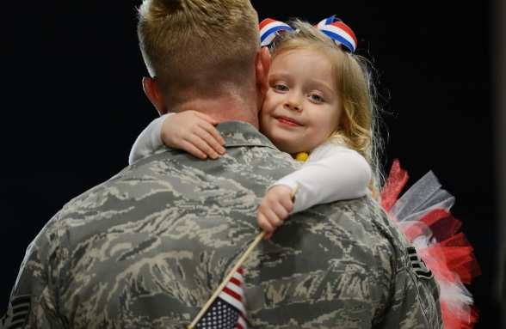
Thank you

