Slide 1
Suicide Among VHA Users, 2001-2014 Rates Among Veteran and Non-Veteran Users, by Age and Sex
Talya Peltzman, MPH, Eric Caine, MD,
Ira R. Katz, MD, PhD, John F. McCarthy, PhD, MPH
Office of Mental Health and Suicide Prevention
Department of Veterans Affairs

Slide 2
Outline
Background
Veterans Health Administration (VHA)
Suicide among VHA patients
Objectives
Compare suicide among VHA patients by Veteran status
Methods
Data sources
Definitions
Analysis
Results
Implications

Slide 3
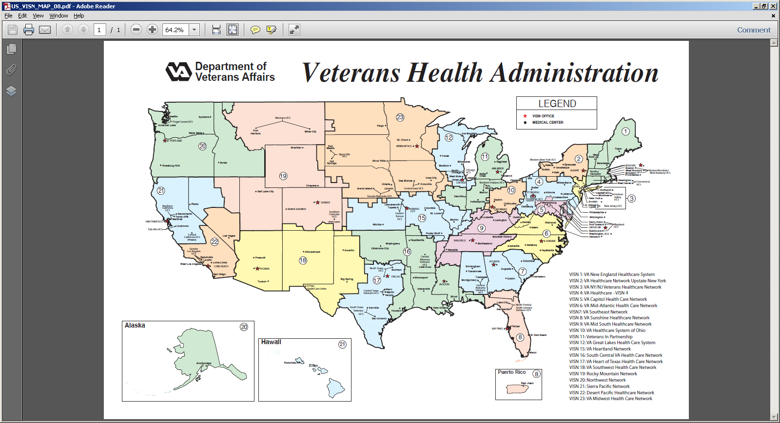
References National Center for Veterans Analysis and Statistics. https://www.va.gov/vetdata/docs/Quickfacts/Homepage_slideshow_06_04_16.pdf
Notes:
The VA health system, the Veterans Health Administration (VHA), is the largest integrated health system in the United States.
As of FY 2015, there were almost 9 (8.97) million enrollees in the VHA healthcare system.
and between 6 and 7 million receive VHA care in a given year.
Reference:

Slide 4
Suicide Among VHA Users
Notes:
The key point here is that we have tracked suicide among individuals receiving care in the VHA. This slide shows rates for cohorts of VHA patients who were alive at the start of the year and with VHA inpatient or outpatient encounters in that year or in the prior year. The bars show rates for all VHA patients, in grey, for men (in light blue) and for women (dark blue).

Slide 5
Analyses of Suicide Mortality among VHA Patients Have Not Distinguished Patients by Veteran Status
For example:
Congressional Committee on Veterans’ Suicides (2008)
McCarthy et al., Suicide Mortality Among Patients Receiving Care in the Veterans Health Administration Health System. American Journal Epidemiology. (2009) 169:1033–1038.
McCarthy et al., Suicide Among Patients in the Veterans Affairs Health System: Rural–Urban Differences in Rates, Risks, and Methods. American Journal of Public Health. (2012) 102: S1.
Brenner et al. Suicide and Traumatic Brain Injury Among Individuals Seeking Veterans Health Administration Services. Journal of Head Trauma and Rehabilitation. (2011) 26:4.
McCarthy et al., Predictive Modeling and Concentration of the Risk of Suicide: Implications for Preventive Interventions in the US Department of Veterans Affairs. American Journal of Public Health. (2015) 105:9.
Blow et al., Suicide Mortality Among Patients Treated by the Veterans Health Administration From 2000 to 2007. American Journal of Public Health. (2012) 102:S1.
Katz et al. Changes in Suicide Rates and in Mental Health Staffing in the Veterans Health Administration, 2005–2009. Psychiatric Services. (2013) 64:7.
Valenstein et al. Antidepressant Agents and Suicide Death Among US Department of Veterans Affairs Patients in Depression Treatment. Journal of Clinical Psychopharmacology. (2012) 32:3.
VA Office of Suicide Prevention. Suicide Among Veterans and Other Americans 2001-2014. Part I: Suicide Among VHA Patients With Comparison to the U.S. General Population. 2016, https://www.mentalhealth.va.gov/docs/2016suicidedatareport.pdf
Notes:
From all of this, over many years,
However, these analyses did not distinguish among VHA users by Veteran status, due to limitations of existing indicators (availability and consistency over time)

Slide 6
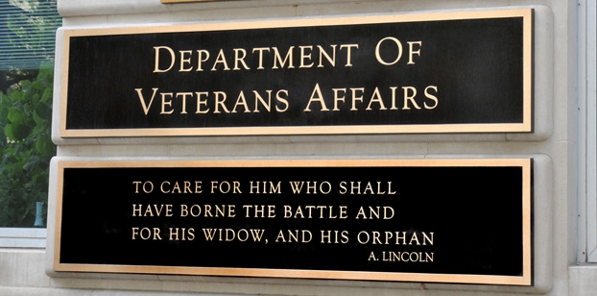
VHA Patients Include Non-Veterans
‘For the purposes of VA health benefits and services, a person who served in the active military service and who was discharged or released under conditions other than dishonorable is a Veteran.’¹
As of FY2014, non-Veteran patients represent 11% of all VA patients.’ ²
Non-Veteran VHA patient population consists of service members’ family, children, VA employees, and humanitarian care, among others.
Active duty service members are also classified as Non-Veterans if they received VHA Care. ^{2,3}
References:
1. ‘Veteran Eligibility’, Department of Veterans Affairs Health Benefits, http://www.va.gov/healthbenefits/apply/veterans.asp
2. ‘The Number of Veterans That Use VA Health Care Services: A Fact Sheet’. Congressional Research Service. https://fas.org/sgp/crs/misc/R43579.pdf
2. Period Of Service’ Value and Descriptions’, VA Information and Resource Center http://vaww.virec.research.va.gov/MedSAS/Documentation.htm
3. Identifying Non-veterans. HERC 3006.
Notes:
‘Veteran Eligibility’, Department of Veterans Affairs Health Benefits, http://www.va.gov/healthbenefits/apply/veterans.asp
‘Period Of Service’ Value and Descriptions’, VA Information and Resource Center http://vaww.virec.research.va.gov/MedSAS/Documentation.htm
‘The Number of Veterans That Use VA Health Care Services: A Fact Sheet’. Congressional Research Service. https://fas.org/sgp/crs/misc/R43579.pdf
Describe what we know about the non-Veteran users of VHA care.
Say that there isn’t a lot that has been published about non-Vet users of VHA. And that it is important to understand suicide rates and risks among VHA users who are Veterans, in addition to the overall patient population, and to understand rates specific to the non-Veteran segment of the Vha patient population.

Slide 7
Objectives
Identify and compare VHA Users by Veteran Status
Assess rates of suicide among VHA Users by Veteran Status
Notes:
Improve precision of current measurements
clarify difference between VHA users vs VHA using veterans
Add understanding to suicide risk assessments of VHA Veterans
Generate understanding of suicide risk assessment of Non-VHA Veterans
family of service members, active duty.
Improve methods for defining veteran status and identifying veteran VHA users

Slide 8
Methods: Data Sources, Definitions
Suicide
VHA Users
Veteran Status
VA/DOD Suicide Data Repository
National Death Index search results
VHA Electronic Health Records
Medical SAS inpatient and outpatient data
VHA Health Records and Administrative Data Multiple VA and VHA eligibility indicators
Source | Table | Positive Indication of Veteran Status
CDW | Spatient Eligibility Enrollment | Veteranflag=1 Veteranflag=1 Enrollmentpriority in group 1-8
VETSNET | Vetsnet | Payee_typ_cd in (99, 00)
VSF | Vital Status Master | Vet_flg =1 or vba_vet_flg =1 or ptf_vet_flg =1 or fee_vet_flg =1 or enr_vet_flg=1 or enc_vet_flg=1 or dss_vet_flg=1
Primary Cause of Death
(ICD-10): X60-X84, Y87.0
Annual cohorts of recent users
Alive at the start of the index year
At least one inpatient or outpatient encounter in the index year or year prior.
Excluded if
Age missing or less than 18
Missing sex information
Last VHA use in Guam, Manilla, or American Samoa
VHA use > 6 months after the NDI provided date of death
Working Definition
Expanded on VA Information and Resource Center (VIREC) best practice recommendation (CDW Veteran Flag without indication of ineligibility)¹
Looked forward and backward in time across all data sources
Veteran defined as any positive indication in any above VA source in any year.
1. References Gonsoulin, M. and Cao, L. Are all members of my cohort Veterans? The Researcher’s Notebook; no. 5. Hines, IL: VA Information Resource Center (VIREC); 2015.
Notes:
Measurement design
- this is a working definition which may change as our work continues
- we looked over many years, including forward and backward
- this is the most inclusive approach and may introduce some measurement error, as individuals’ Veteran status may actually have changed over time (active duty people use VHA care and then come back later, after service, and so their earlier use would here be classified as by a Veteran.)

Slide 9
Methods: Analyses
Among Cohorts of Recent VHA Users, 2001-2014:
Compared Veterans and non-Veterans, overall and by sex and age
Assessed frequency and rates of suicide by Veteran status
Suicide rates per 100,000 person years
Risk time began at the start of the year for those with use in prior year, otherwise it began at first use in the year
Risk time ended at the end of the year or death, whichever came first.
Compared Veteran and non-Veteran suicide rates
Age and Sex adjusted rates were calculated using the direct method of standardization (2001 U.S. population was the standard population)
Compared suicide decedents by Veteran status, overall and by sex and age
Notes:
Non Veteran users were characterized by categories of eligibility for VHA care.
Differences in category distribution were assessed between Non-Veteran Suicide decedents and Non-Veterans overall

Slide 10
Results
Number, Percent of VHA Users by Veteran Status 2001- 2014
 | 2001 | 2002 | 2003 | 2004 | 2005 | 2006 | 2007 | 2008 | 2009 | 2010 | 2011 | 2012 | 2013 | 2014
% Non-Veterans | 5.8% | 4.8% | 4.2% | 3.8% | 3.5% | 3.4% | 3.4% | 3.5% | 3.5% | 3.4% | 3.3% | 3.5% | 3.6% | 3.6%
Notes:
Re-iterate that cohort are of recent VHA users and omit people with certain exclusion criteria
This fact in addition to the more inclusive approach of defining veteran status may result in our cohorts findings a higher % of veterans as compared to the congressional report
The vast majority of VHA patients are in fact Veterans, but that there are non-Vet users too.

Slide 11
Characteristics of Non-Veterans VHA Users 2001-2014
Detailed Definitions, using VHA medical record data Period of Service (POS) variable
Active Duty POS=’Active Air Force’, ‘Active Army’, ‘Active Coast Guard’, ‘Active Navy, Marine’ Humanitarian POS=’Humanitarian Non-Vet’ Medical Remedial Enlist POS=’Medical Remedial Enlist’ Other Non Veteran POS=’Donors (non-vet)’, ‘Observation/Examination’, ‘Other Non-Veterans’, ‘Other Reimburse’, ‘Special Studies (Non-Vet)’, | Other VHA-Beneficiary POS=’Beneficiaries of Foreign Government’, ‘Job Corps/Peace Corps’, ‘Merchant Seamen USPHS’, ‘Office of Workers Comp’, ‘Other USPHS Beneficiaries’, ‘Retired Uniformed Force’, ‘Railroad Retirement’ Dependent Beneficiaries POS=’ChampVA- Spouse, Child’, ‘Other Federal Dependent’, ‘Tricare’ | Unverified Veteran POS= ‘WWI’, ‘WWII’, ‘Vietnam Era’, Post-Vietnam’, ‘Pre-Korean’, ‘Korean’, ‘Post-Korean’, ‘Persian Gulf War’, ‘Spanish American’, ‘Operation Desert Shield’, ‘Czechoslovakia-Poland SVC’, ‘CAV/NPS’. Unknown POS= ‘Missing’, ‘Unknown at this time’, ‘Other or None’; No Period of Service information available; More than one Period of Service variable listed

Slide 12
Results
VHA User Demographic Characteristics by Veteran Status*
 | 2001 | 2002 | 2003 | 2004 | 2005 | 2006 | 2007 | 2008 | 2009 | 2010 | 2011 | 2012 | 2013 | 2014
Average Age
Total | 59.5 | 60.4 | 60.8 | 61.0 | 61.1 | 61.1 | 61.0 | 60.8 | 60.5 | 60.4 | 60.3 | 60.2 | 60.0 | 59.9
Veteran | 60.3 | 61.1 | 61.4 | 61.6 | 61.7 | 61.7 | 61.6 | 61.4 | 61.1 | 61.0 | 60.9 | 60.8 | 60.7 | 60.6
Non- Veteran | 46.2 | 46.0 | 45.9 | 45.2 | 44.9 | 44.9 | 44.8 | 44.3 | 44.1 | 44.0 | 43.5 | 42.4 | 41.5 | 41.3
% Female
Total | 9.8% | 9.2% | 8.9% | 8.9% | 8.9% | 9.1% | 9.3% | 9.6% | 9.7% | 9.7% | 9.8% | 10.1% | 10.4% | 10.6%
Veteran | 6.4% | 6.3% | 6.5% | 6.7% | 6.9% | 7.1% | 7.3% | 7.6% | 7.7% | 7.8% | 8.0% | 8.2% | 8.4% | 8.7%
Non- Veteran | 65.9% | 65.0% | 64.8% | 64.4% | 63.7% | 64.2% | 65.0% | 65.5% | 64.9% | 64.2% | 63.6% | 62.4% | 61.9% | 62.6%
*For Veteran vs. non-Veteran comparisons, the within year differences of average age and percent female were statistically significant at α=.05 for all years.
Notes:
Non veterans are significantly younger and more female than veteran vha users.

Slide 13
Results
Distribution of Suicides Among VHA Users by Veteran Status 2001- 2014
Notes:
distribution of observed suicides, as a percentage by year and Veteran status
The count of suicides among non-Vets in a given year ranged from 14 to 51, and represented from less than 1% to more than 2.1% of suicide deaths.
Compare to observed distribution earlier- non-veterans represent fewer suicides than their share in the patient population (approx. 4%)

Slide 14
Results
Suicide Rate Among VHA Users, Overall and by Veteran Status, 2001- 2014
 | 2001 | 2002 | 2003 | 2004 | 2005 | 2006 | 2007 | 2008 | 2009 | 2010 | 2011 | 2012 | 2013 | 2014
All | 39.9 | 39.0 | 34.9 | 35.9 | 34.9 | 35.9 | 35.1 | 38.4 | 37.0 | 36.4 | 38.9 | 38.0 | 38.8 | 39.2
Male | 42.6 | 41.7 | 37.2 | 38.0 | 36.8 | 38.5 | 37.3 | 40.8 | 39.3 | 38.5 | 41.3 | 40.4 | 41.5 | 41.6
Female | 14.4 | 11.7 | 10.7 | 13.3 | 14.7 | 9.0 | 12.5 | 14.3 | 14.8 | 15.4 | 16.3 | 16.0 | 14.4 | 16.7
Veteran | 41.1 | 40.3 | 36.0 | 36.7 | 35.7 | 36.6 | 35.7 | 39.0 | 37.6 | 37.1 | 39.5 | 38.5 | 39.5 | 39.7
Male | 42.9 | 42.0 | 37.6 | 38.4 | 37.0 | 38.6 | 37.5 | 40.9 | 39.4 | 38.7 | 41.3 | 40.3 | 41.7 | 41.6
Female | 15.8 | 15.6 | 12.4 | 14.1 | 17.7 | 9.9 | 13.3 | 14.8 | 16.0 | 17.1 | 18.4 | 18.6 | 15.3 | 19.2
Non-Veteran | 18.1 | 10.3 | 7.5 | 11.6 | 12.3 | 13.6 | 14.4 | 19.9 | 19.7 | 14.5 | 19.8 | 21.1 | 17.9 | 25.9
Male | 29.9 | 22.5 | 9.2 | 15.0 | 25.8 | 27.7 | 23.4 | 33.5 | 37.0 | 24.7 | 40.6 | 46.3 | 29.9 | 53.1
Female | 12.0 | 3.8 | 6.6 | 9.9 | 4.8 | 5.7 | 9.6 | 12.9 | 10.6 | 9.0 | 8.1 | 6.2 | 10.7 | 9.7
Notes:
Top 3 rows represents information we currently report and Bottom breakouts are added information from this analysis.

Slide 15
Results
Age adjusted Suicide Rates among VHA Users by Veteran Status and Sex
Notes:
The effect of adjusting for age

Slide 16
Results
Comparison of Suicide Decedents by Veteran Status*
 | 2001 | 2002 | 2003 | 2004 | 2005 | 2006 | 2007 | 2008 | 2009 | 2010 | 2011 | 2012 | 2013 | 2014
Average Age
Total | 59.2 | 60.1 | 60.2 | 60.7 | 61.3 | 61.3 | 61.2 | 60.9 | 60.8 | 59.4 | 59.2 | 59.5 | 59.3 | 58.8
Veteran | 59.5 | 60.3 | 60.3 | 60.9 | 61.5 | 61.6 | 61.4 | 61.2 | 61.1 | 59.7 | 59.5 | 59.9 | 59.6 | 59.2
Non-Veteran | 47.7 | 45.0 | 46.1 | 38.9 | 44.6 | 40.6 | 40.4 | 39.3 | 41.2 | 41.7 | 40.0 | 36.9 | 34.5 | 36.7
% Female
Total | %3.5 | %2.7 | %2.7 | %3.1 | %3.6 | %2.2 | %3.2 | 3.5% | 3.8% | 4.1% | 4.0% | 4.2% | 3.8% | 4.6%
Veteran | %2.5 | %2.5 | %2.2 | %2.6 | %3.4 | %1.9 | %2.7 | %2.8 | %3.3 | %3.6 | %3.7 | %3.9 | %3.3 | %4.2
Non-Veteran | %43.9 | %23.8 | %57.1 | %55.0 | %25.0 | %27.3 | %45.5 | %42.4 | %35.3 | %40.0 | %26.5 | %18.9 | %38.2 | %23.5
For Veteran vs. non-Veteran decedents: within year differences of average age and percent female are statistically significant at α=.05 across all year
Notes:
Age among veteran suicide decedents is higher and has stayed more consistent as compared to non-veteran decedents who are getting younger
% of female suicide decents is much higher among non-veteran vha users
Veteran vha users decedents are becoming increasingly female

Slide 17
Characteristics of Non-Veterans VHA User Suicide Decedents 2001-2014
All Non-Veteran VHA users vs. Non-Veteran VHA User Suicide Decedents
 | Active Duty | Humanitarian | Medical Remedial Enlist | Unknown | Other Non-Veteran | Other- VHA Beneficiary | Unverified Veteran | Veteran Dependent
All (Slide 11) | 6.0% | 3.1% | 0.3% | 16.1% | 67.7% | 0.5% | 0.3% | 6.0%
Suicide Decedents | 21.4% | 7.5% | 0.2% | 9.7% | 54.7% | 0.0% | 0.7% | 5.6%

Slide 18
Conclusions
The VHA patient population includes non-Veterans. In 2014, these represented 3.6% of patients with recent use. This is lower than what has been reported previously, and may reflect the inclusive longitudinal approach used in the current analysis.
Non-Veteran VHA patients were younger and more likely to be female than Veteran VHA patients.
Among VHA patients, suicide rates differ by Veteran status.
Suicide rates among Veteran VHA users were greater than those for the overall VHA patient population.
For example, in 2014:
-- Rate among Veteran VHA patients: 39.7/100,000 vs. 39.2/100,000 among all patients
-- Rate among female Veteran VHA patients: 19.2/100,000 vs. 16.7/100,000 among all female patients
VA is continuing to refine approaches for consistently identifying Veteran status among cohorts of VHA users.
Notes:
S

Slide 19
Talya Peltzman Talya.Peltzman@va.gov Office of Mental Health and Suicide Prevention Department of Veterans Affairs
Thank you!

