Slide 1
Suicide Mortality Following VA Irregular Discharges: 2001-2013
Brian Shiner MD, MPH
Natalie Riblet MD, MPH
John S. Richardson, MPH
Talya R. Peltzman, MPH
Bradley V. Watts, MD, MPH
John F. McCarthy, PhD, MPH

Slide 2
BACKGROUND: IRREGULAR DISCHARGE AS A POTENTIAL RISK FACTOR FOR DEATH BY SUICIDE

Slide 3
Lessons from Root Cause Analysis
RCA: method of investigating systematic vulnerabilities that led to adverse events
Team convenes shortly after an adverse event
Review Artifacts
Conduct Interviews
Determine Root Causes
Recommendations to Hospital Leadership
Reports stored in searchable VA National Center for Patient Safety database.

Slide 4
RCA Reviews and Suicide Prevention
Inpatient Suicide
Considered a sentinel event (“never event”)
RCA is always required by Joint Commission
Systematic reduction of hazards identified in VA RCA reports led to sustained reduction in inpatient suicide (Watts et al., 2012 & 2017)
Post-Discharge Suicide
Joint Commission requires RCA if within 3 days
VA has an additional requirement within 7 days of mental health discharge
Watts et al. (2012) Archives of General Psychiatry, 69(6):588-92.
Watts et al. (2017) Psychiatric Services, 68(4):405-07.

Slide 5
RCA Reviews: Post-Discharge Suicide
Common Root Causes: Medical Units
Assessment of Suicide Risk
Management of Known Suicide Risk
Common Root Causes: Mental Health Units
Suicide Risk Communication
Challenges Following Established Care Processes
Unexpected Finding: Irregular Discharges
16% of medical cases (Riblet et al., 2017a)
43% of mental health cases (Riblet et al., 2017b)
Generally Discharge Against Medical Advice (AMA)
Riblet et al. (2017a) General Hospital Psychiatry, 46:68-73.
Riblet et al. (2017b) Journal of Nervous and Mental Disease, 205(6):436-42.

Slide 6
Literature on AMA Discharge & Suicide
Taipai Psychiatric Center, Thailand
11,040 Patients 1998-2005 (Kuo et al., 2010)
Risk of Suicide 50% Higher after AMA Discharge
Risk Persisted after Controlling for Risk Factors
Geha Mental Health Center, Israel
8,052 Patients 1984-2005 (Valevski et al., 2012)
Risk of Suicide was Doubled for AMA Discharge
Post-AMA Suicides Occurred Closer to Discharge
Kuo et al. (2010) Journal of Clinical Psychiatry, 71(6):808-09.
Valevski et al. (2012) European Psychiatry, 27(7):496-99.

Slide 7
Literature on AMA Discharge in VA
National Medical Admissions 2004-2008
1,930,947 Admissions
32,819 Patients (1.7%) Discharged AMA
Accounting for Demographics and Comorbidity
Negative Outcomes for AMA Discharge
32% Increase in 30-day Readmissions
10% Increase in 30-day All Cause Mortality
Potential Explanations
Patients’ conditions not fully treated
Poor communication with patients
Glasgow et al. (2010) Journal of General Internal Medicine, 25(9):926-29.

Slide 8
OUR STUDY: CONFIRMING IRREGULAR DISCHARGE AS A RISK FACTOR FOR DEATH BY SUICIDE

Slide 9
Research Questions
Is irregular discharge really a risk factor for suicide?
RCA process may miss cases after 3-7 days
RCA reports include few patient characteristics
Non-VA studies are single site
Do deaths by suicide following irregular discharge happen quickly?
If deaths happen quickly, we may need to intervene quickly

Slide 10
Data Sources
National VA Acute Care Discharges 2001-2013
All Discharges: 4,876,934
Irregular: 2.0% (96,703)
Alive on Day of Discharge
Stratified into Mental Health and Medical
National Death Index 2001-2014
VA/DoD Suicide Data Repository
Cause of Death for VA Users who Died within 1 year of Inpatient Discharge
Deaths by suicide: 4,954
Deaths by any cause: 641,593

Slide 11
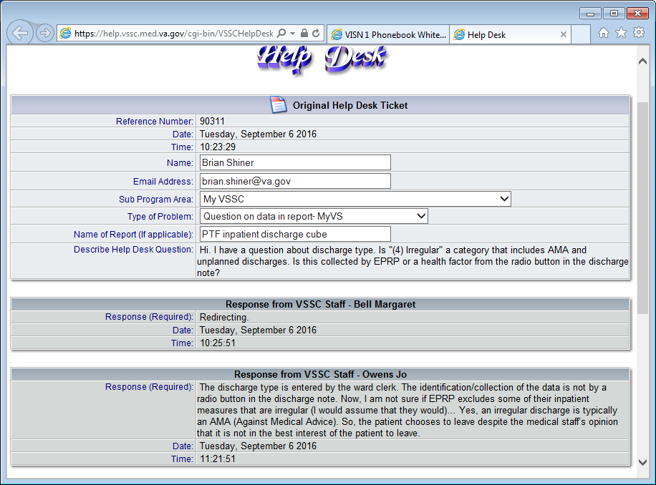
Irregular Discharge: Data Explanation

Slide 12
Method
Compared suicide mortality rates per 100,000:
Mental Health versus Medical Discharge
Irregular versus All Other Discharge
Overall
Mental Health Units
Medical Units
Performed survival analysis, stratified by irregular versus regular discharge.
Adjusted for: Sex, Age, Facility

Slide 13
One Year Suicide Mortality: Mental Health v. Medical Discharge
Ward Type | Discharge Type | Suicide Mortality Rate (per 100,000) | Raw Hazard Ratio (95% CI) | Adjusted Hazard Ratio (95% CI)
Mental Health | Any | 308 | 4.22 (3.98, 4.47) | 4.28 (3.99, 4.60)
Medical |  | 74
Mental Health | Irregular | 340 | 1.59 (1.23, 2.05) | 1.78 (1.28, 2.48)
Medical |  | 218
Notes:
4.28 3.986 4.595

Slide 14
One Year Suicide Mortality: Regular v. Irregular Discharge
Ward Type | Discharge Type | Suicide Mortality Rate (per 100,000) | Raw Hazard Ratio (95% CI) | Adjusted Hazard Ratio (95% CI)
Any | Irregular | 260 | 2.37 (2.08, 2.71) | 2.00 (1.75, 2.28)
 | All Other | 110
Mental Health | Irregular | 340 | 1.11 (0.92, 1.35) | 1.15 (0.95, 1.40)
 | All Other | 306
Medical | Irregular | 218 | 3.06 (2.56, 3.65) | 2.93 (2.45, 3.52)
 | All Other | 71

Slide 15
Time to Death by Suicide Following Irregular Discharge, by Unit Type Distribution as a percentage of all suicide deaths
Time from Irregular Discharge | Mental Health Discharge | Medical Discharge
1 Day | 4% (4) | 2% (3)
3 Days | 7% (8) | 7% (9)
1 Week | 11% (12) | 10% (13)
2 Weeks | 19% (20) | 16% (20)
1 Month | 27% (29) | 24% (31)
3 Months | 44% (48) | 39% (50)
6 Months | 72% (77) | 67% (87)
1 Year | 100% (108) | 100% (129)

Slide 16
Time to Death by Suicide Following Irregular Discharge, by Unit Type Distribution as a ratio of suicide deaths per 10,000 hospitalizations
Time from Irregular Discharge | Mental Health Discharge (n=31,648) | Medical Discharge (n=65,055)
1 Day | 1.3 | 0.5
3 Days | 2.5 | 1.4
1 Week | 3.8 | 2.0
2 Weeks | 6.3 | 3.1
1 Month | 9.2 | 4.8
3 Months | 14.9 | 7.7
6 Months | 24.0 | 13.4
1 Year | 33.5 | 19.8

Slide 17
CONCLUSIONS
Irregular Discharge is a Risk factor for Death by Suicide & this may be more concerning for non-mental health discharges.
Irregular Discharge remains a risk factor after adjusting for patient characteristics.
Death by suicide following irregular discharge is concentrated proximal to discharge.

Slide 18
IMPLICATIONS
People who are discharged from the hospital irregularly have an elevated risk of suicide.
There is an opportunity to target this population for enhanced care:
Identifying unmet needs in the hospital.
Quickly putting discharge plans into place at the time of irregular discharge.
Continuing to work closely with patients to meet their needs following irregular discharge.

Slide 19
Limitations
Risk of misclassification in the case of death by suicide on the day of discharge may have resulted in bias towards the null.
RCA data indicated some deaths by suicide occurred on the day of discharge
We excluded patients who were dead on the day of discharge in this analysis.
We will use discharge type to avoid this blanket exclusion:
Discharge Type 6: Death with Autopsy
Discharge Type 7: Death without Autopsy

Slide 20
Acknowledgements
SMITREC, VA Office of Mental Health and Suicide Prevention
VA National Center for Patient Safety: Patient Safety Center of Inquiry Program
Dr. Shiner is supported by a VA HSR&D Career Development Award (CDA11-263)

