Slide 1
Upstream Suicide Prevention Through Shared Experience Model of Peer-to-Peer Support 24/7/365 Assistance Line and CoE Office for Advocacy, Education & Outreach

Slide 2
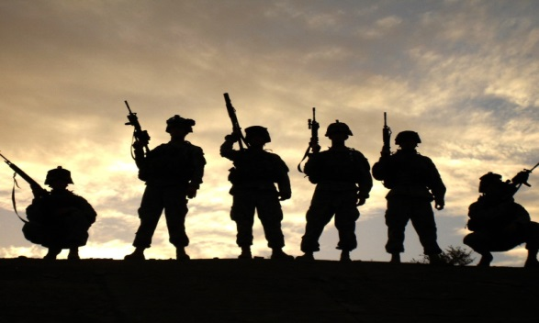
Blake Chaffee, PhD VP, Integrated Behavioral Health TriWest Healthcare Alliance
Mona Polom, LCSW, MBA Director, Behavioral Health TriWest Healthcare Alliance
Mary Reznicek, BSN,RN Manager, BeThere Peer Support Center of Excellence
David Schoo, MBA Sr. Project Manager, Be There Peer Support
TriWest Healthcare Alliance
Nino E. Gray Jr. SSG, U.S. Army (RET) Supervisor, Puyallup Hub, BeThere Peer Support Call and Outreach Center

Slide 3
Introduction
Active Duty / Guard / Reserve / Families
Shared Experience Model of Peer Support
Jump starts engagement
Leverages activation
Broadens reach
Rationale
Stigma
Normalizes help seeking
Builds resilience

Slide 4
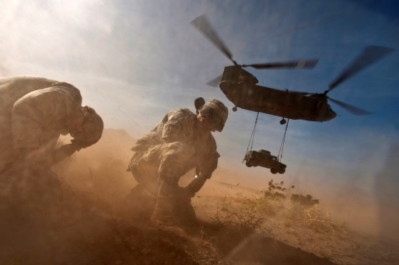
BeThere Peer Support Call and Outreach Center
Anonymous
Confidential
Staff and Peer Support Specialists with prior military experience
Phone, chat, text, video chat, email
Clinician Support
Outreach services

Slide 5
BeThere Peer Support Call and Outreach Center

Slide 6
BeThere Peer Support Call and Outreach Center

Slide 7
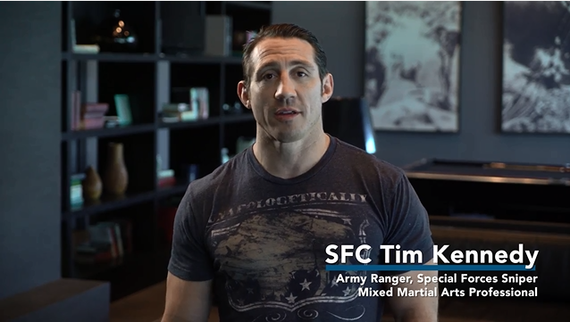
BeThere Peer Support Call and Outreach Center
Getting the word out:
All service branches/Guard/Reserve and immediate family
First-termers w/ deployment, relationship, financial, PTSD and other issues. Strategies
Social
@BeTherePeerSupport
@DoDPeerSpport
www.betherepeersupport.org
Download resources, request materials
Public service announcements
Chain of command
https://www.youtube.com/watch?v=5eBXJnGZKxo

Slide 8
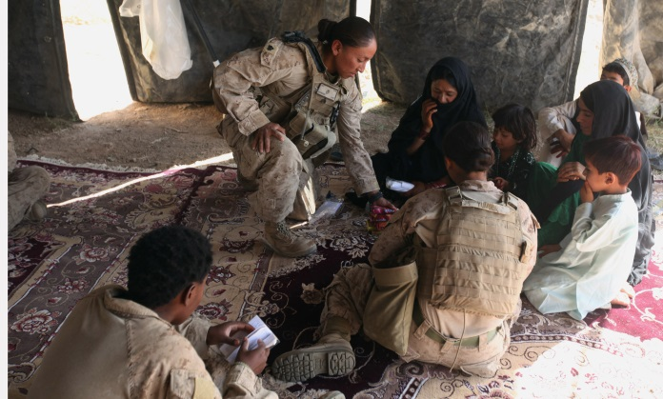
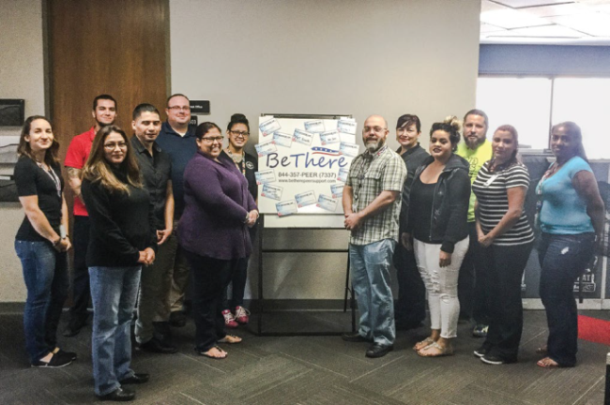
BeThere Peer Support Call and Outreach Center
We’ve been there. Now, we’re here for you.
Common bonds
No stigma
No concern is too small
Warm transfers
Follow ups
We are UNIQUE!
Unlimited
Confidential
24/7/365
Call, text, chat, video chat, email
ALWAYS speak with a Veteran

Slide 9
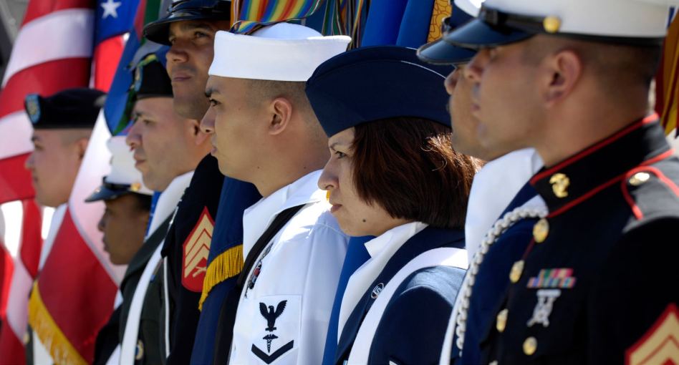
BeThere Peer Support Center of Excellence
Advocacy
Outreach
Education
Commands
DoD programs
Small groups
FRGs
Individuals
Programs in support of DoD
We envision an environment throughout the DoD where peer support is fostered, stigma for reaching out is absent, and peer support is available 24/7/365 to every Service Member and their family.

Slide 10
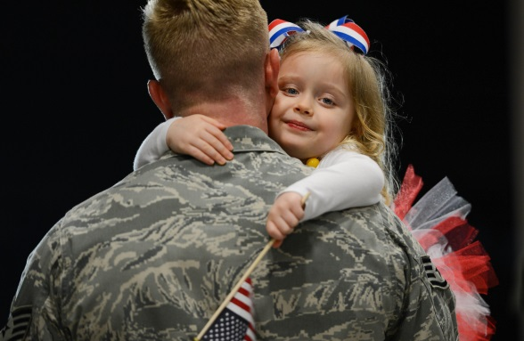
BeThere Peer Support Center of Excellence
A CoE will provide all things PEER SUPPORT across the DoD
Best Practices
Training and Education
Resources
Ambassador / Mentor Program
Command Support
Certification
via website, office contacts, and call center

Slide 11
https://www.betherepeersupport.org

Slide 13
Additional Resources
https://www.youtube.com/watch?v=r0lebtvwyCc
Dakota Meyer Peer Support
https://www.youtube.com/watch?v=aU6HTz6ri0E
Kennedy Firearm safety
https://www.youtube.com/watch?v=f-wixE7yxm4
Be There PSA

