Slide 1
“Boot Camp Stories” A Novel Peer-to-Peer Intervention
Shauna Springer, Ph.D.
Suicide Prevention Senior Advisor
Co-Executive Director, TAPS Red Team

Slide 2
What is “boot camp stories”
A group I developed with a Veteran peer with two goals in mind

Slide 3
“BCS” facilitates MCT
Military-to-Civilian transition…
Is a psychological and cultural evolution
Requires a new definition of wellness
Shifts from a collectivist community into an individualistic one

Slide 4
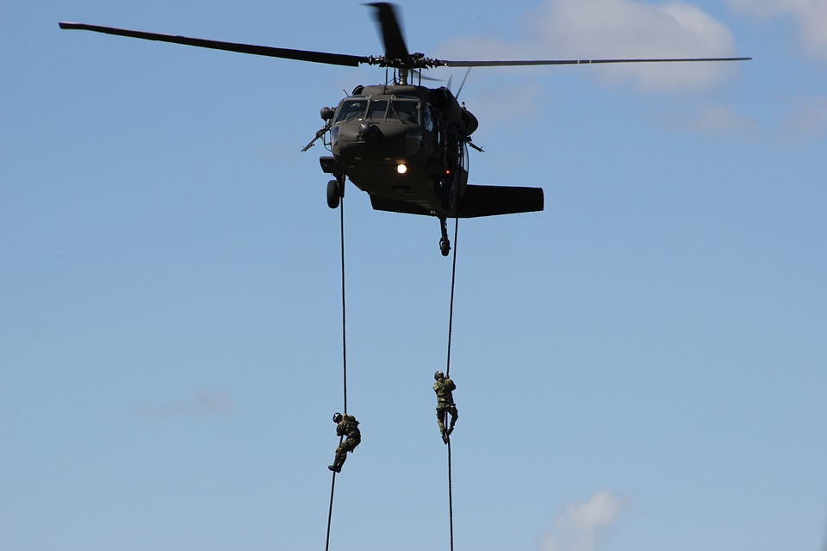
Active Duty and Veteran Care Applications
Transitional units
Transitional assistance programs (TAP)
Behavioral health clinics and Vet Centers

Slide 5
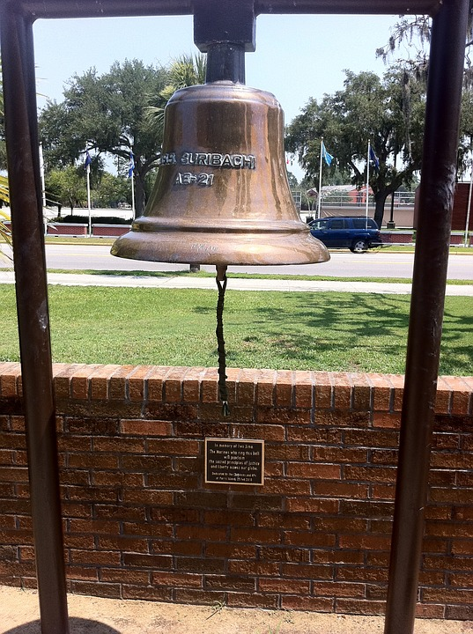
Three challenges

Slide 6
So why might Veterans not see the value of therapy?

Slide 7
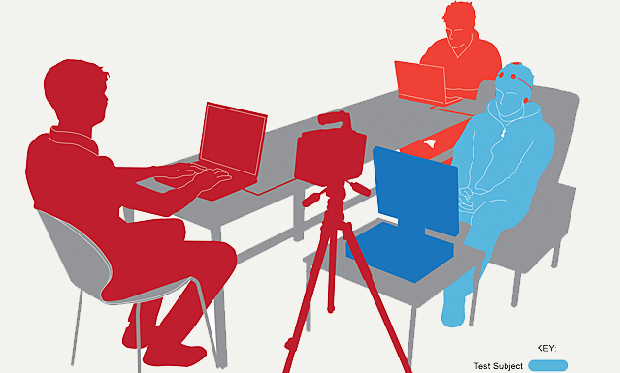
Veterans’ prior experience with mental health providers?
Psychological Evaluations
Fitness for Duty Assessments
Mental health screenings at the time discharge
(see a theme?)

Slide 8
A counter-cultural proposition
A new definition of wellness
Mission Readiness is the priority Restoring your health is the mission
Every action is judged No one is here to judge you
Follow standard procedure Think outside the box
It doesn’t matter what you think What you think matters and is critical to moving on
Strength is handling things on Getting help makes you
your own stronger in the end

Slide 9
Putting a face on VA Mental Health

Slide 10
“Access to care” Scandal

Slide 11
Is VA really an impenetrable fortress?
(Not where I worked)
But what if that is still the perception regardless of the reality?

Slide 12
Perception Matters!

Slide 13
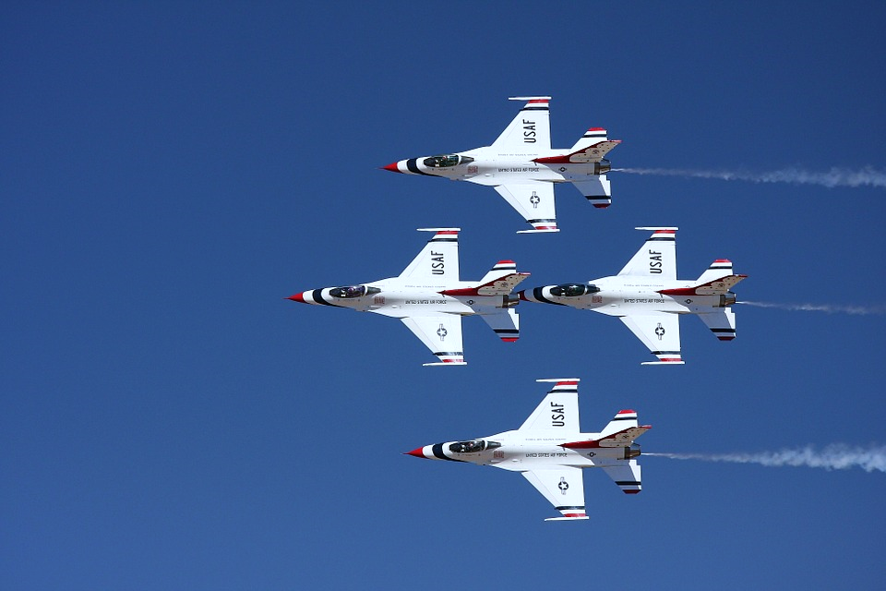
“The best defense is a good offense”
True in war, in football, and in healthcare.

Slide 14
Best time to combat negative perceptions?
AS SOON AS POSSIBLE

Slide 15
Primary Care Presence
Opportunity to innovate…

Slide 16
Facilitating MCT at the Gates of Care
Focus for today

Slide 17
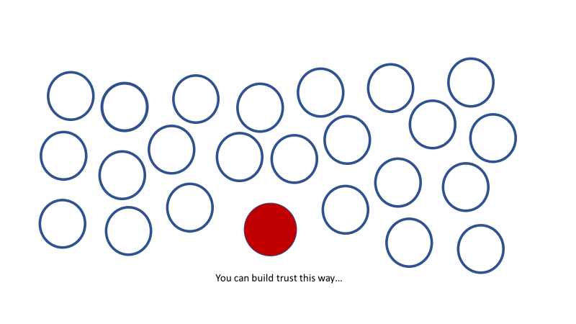
Why is collaboration necessary?

Slide 18
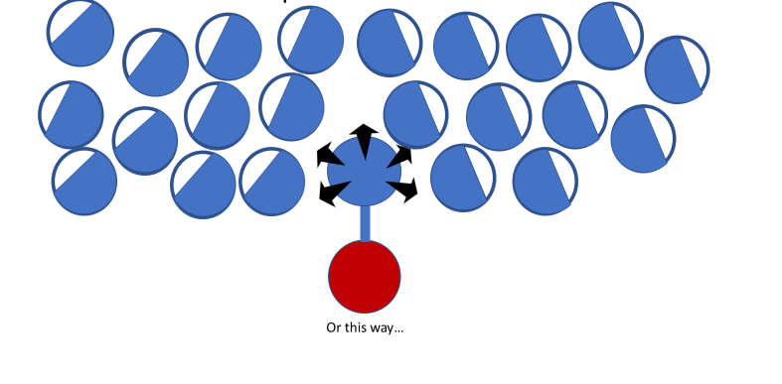
Principle of Transfer of Trust

Slide 19
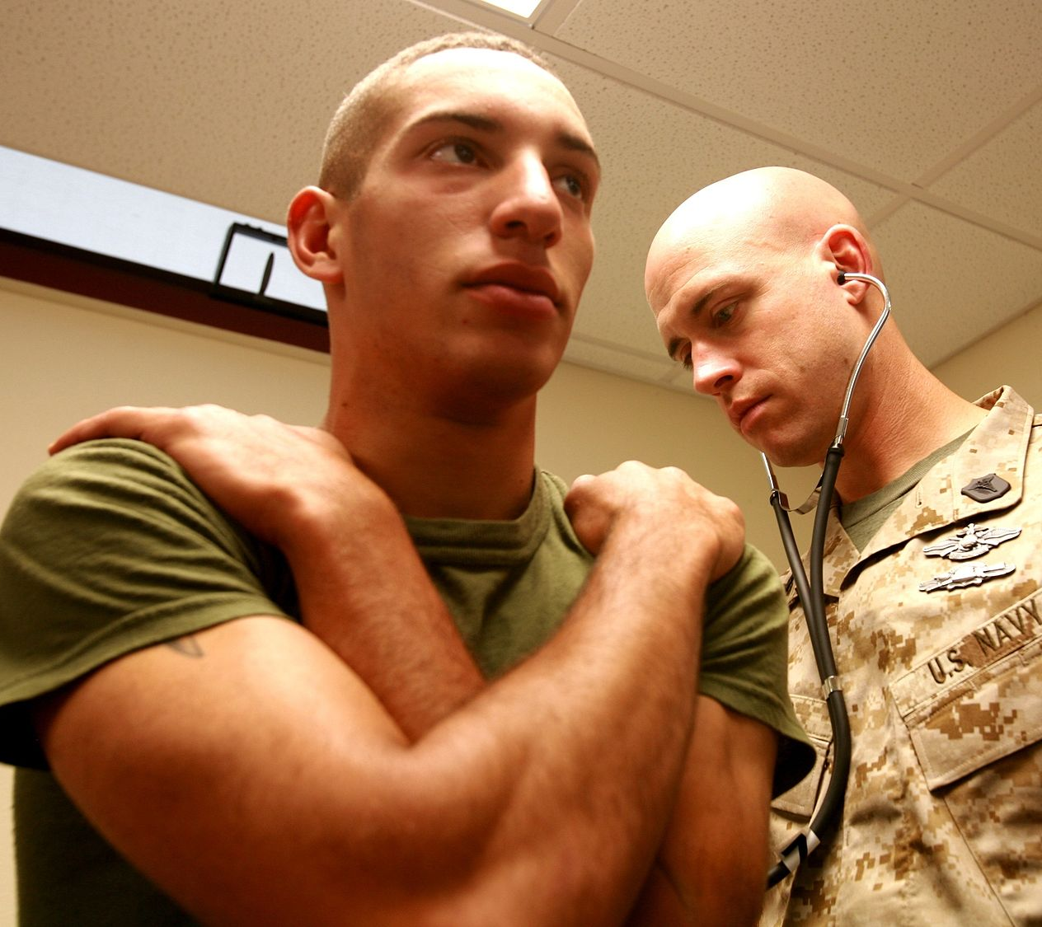
A new kind of relationship?
What if VA and DoD clinicians could become like trusted medics?

Slide 20
Boot Camp Stories Structure

Slide 21
Strategic flow of “Boot Camp Stories” group
Story-telling
Access memory of “CMT”
Values analysis
Military values as asset
Identity integration

Slide 22
1. Finding “Tribe” through storytelling

Slide 23
Why start with boot camp stories?
Identity-defining (Google it)
Every Vet has a war story
Bonding happens in 2 ways
Give Veterans a positive initial experience

Slide 24
Engaging Veterans in creative, respectful ways doesn’t mean treating them delicately or without using a sense of humor.

Slide 25
Spoiler Alert

Slide 26
2. Remembering CMT promotes deeper insight into MCT

Slide 27
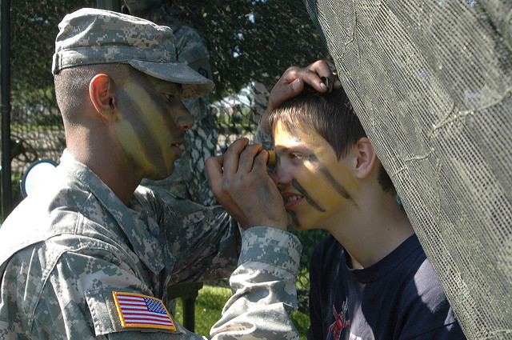
Reflecting on the C-M-T Transition
When you entered the military, what new values were instilled in you?
What were the biggest changes in your personality?
What are the biggest differences between military and civilian culture?

Slide 28
3. Comparative analysis of values
(military and supportive therapy)

Slide 29
Unacknowledged cultural differences are a reason Veterans drop out of treatment

Slide 31
4. Discussion of how military values can be an ASSET to therapy

Slide 32
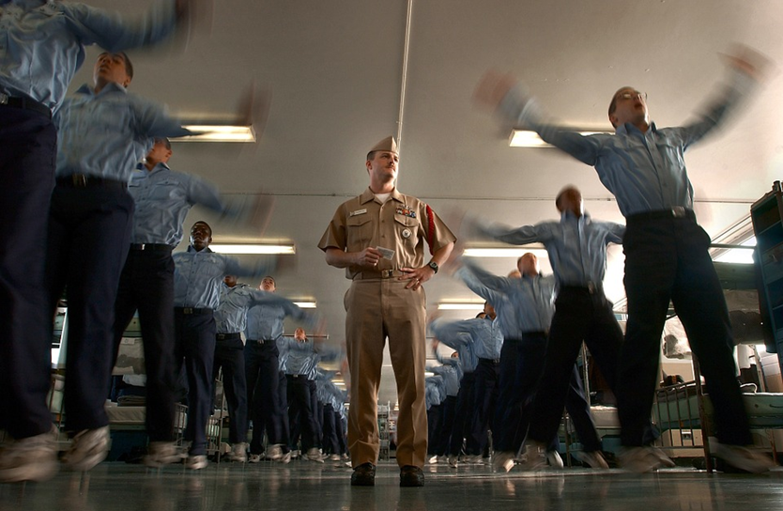
Reflection
How has your military experience helped, or hindered, your post-military adjustment?
What has your military training equipped you to do in new situations?

Slide 34
5. Identity integration and cultural transition

Slide 35
Final Reflection
Can your core military training values be an asset in treatment?
Do you think that one set of values must be given up to move forward?
How can merging both sets of values benefit your future quality of life?

Slide 36
Would you like to schedule an appointment with one of the members of our team? ☺

