Slide 1
COMPREHENSIVE POSTVENTION
Kim Ruocco MSW
Co-Executive Director, TAPS Red Team
DOD/VA Suicide Prevention Conference August 2017

Slide 2
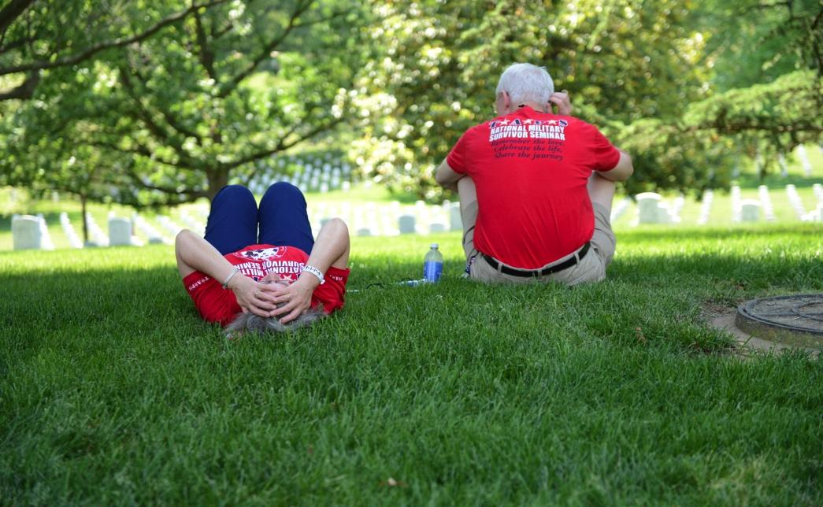
What is Postvention?
Postvention is an intervention following a death by suicide. It is intended to decrease risk and promote healing.

Slide 3
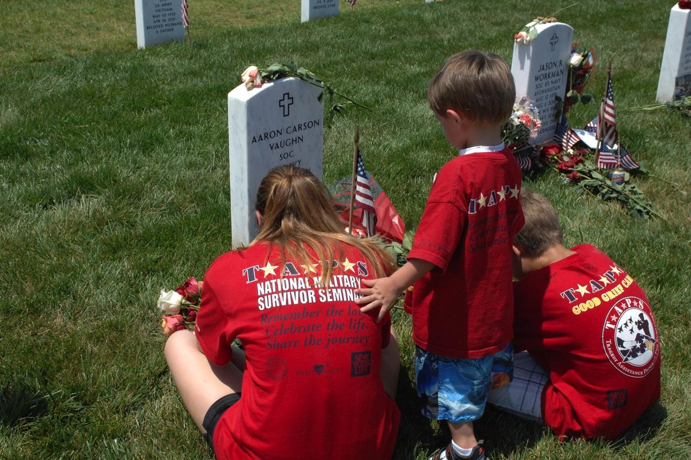
Why is Postvention Important?
Postvention is prevention
Research tells us those exposed are at increased risk.

Slide 4

Goals of Postvention:
Help set a foundation for a healthy grief journey
Identify and refer those at most risk.
Safely memorialize the deceased

Slide 5
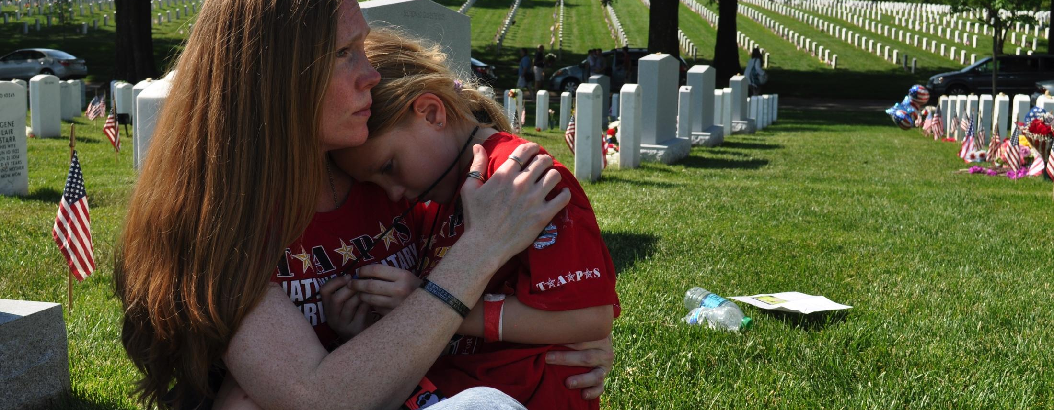
SUICIDE IS DIFFERENT
The military’s emphasis on HOW one dies can increase shame in suicide loss survivors.

Slide 6
THREE PHASES OF POSTVENTION
A TAPS BEST PRACTICE MODEL
STABILIZE
GRIEVE
GROW

Slide 7
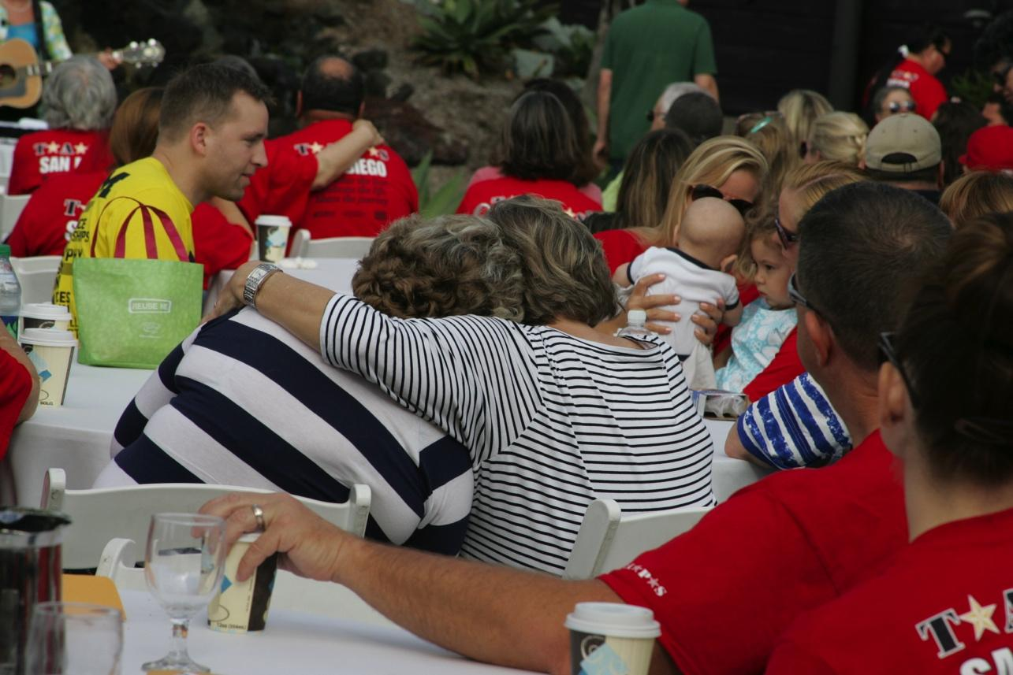
STABILIZATION
There are specific issues associated with suicide loss that if not addressed will significantly increase risk and decrease possible healing.

Slide 8
SPECIFIC ISSUES
WHY
RELIGION
SECRETS
FAMILY DYNAMICS
TELLING CHILDREN
TELLING OTHERS
RELATIONSHIP
EMOTIONS
TRAUMA
CLEAN UP
THE MEDIA
INVESTIGATION

Slide 9
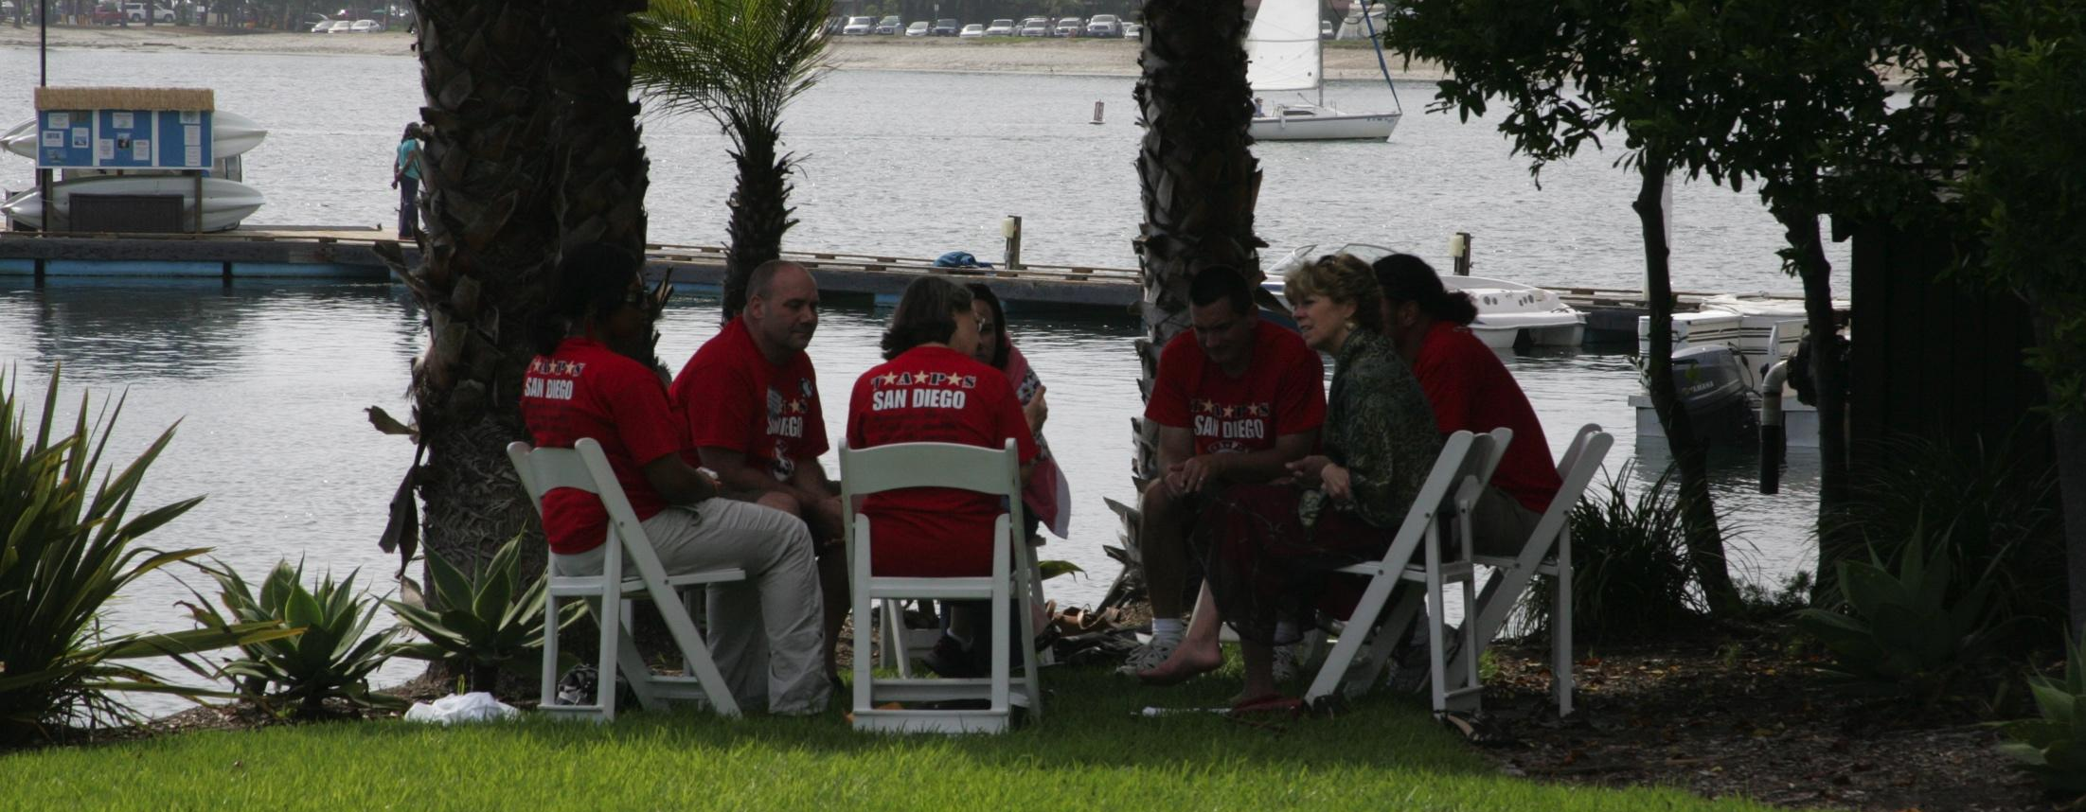
WHY?????
Survivors of suicide loss can become consumed with WHY their loved one died by suicide and can blame themselves and/or others.

Slide 10
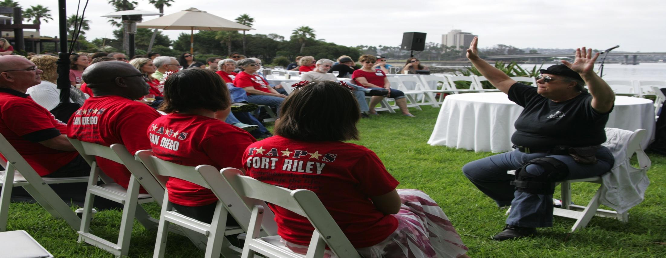
RELIGIOUS MESSAGES
Messages from childhood, teachings from religious institutions and faith communities can add fear, guilt and shame to the grief journey.

Slide 11
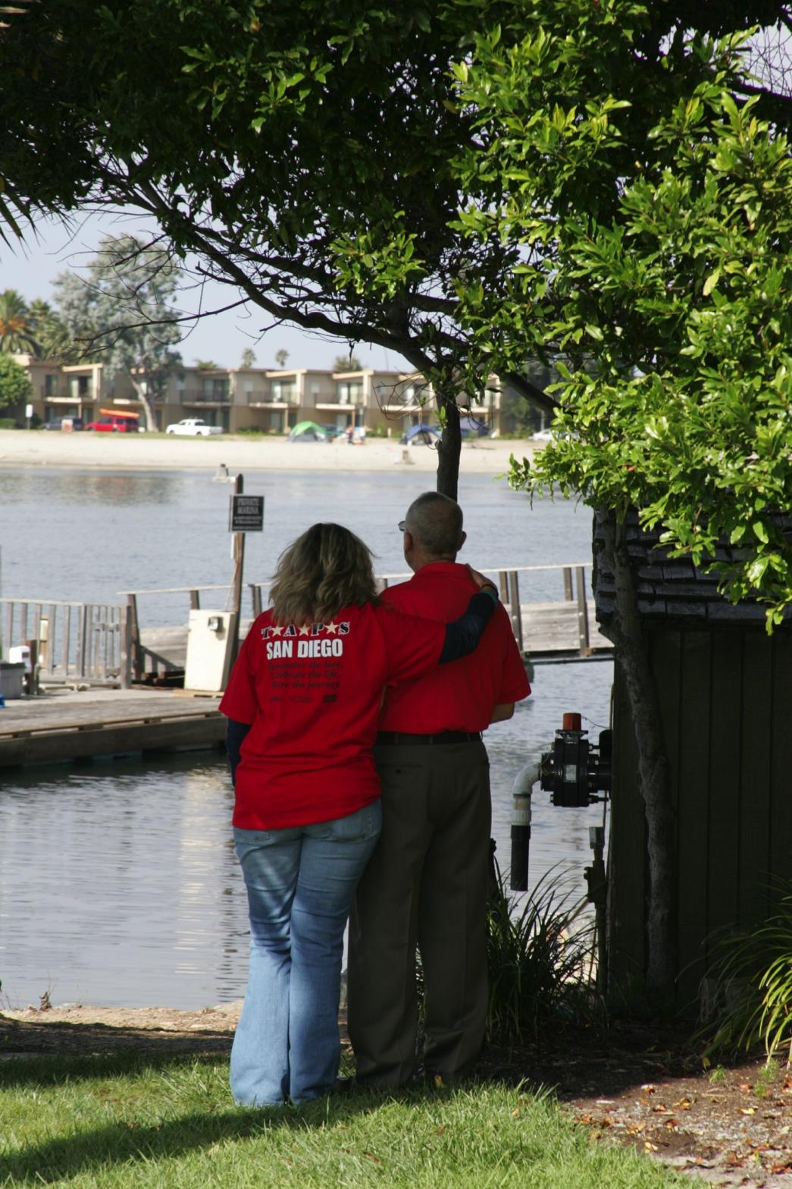
SECRETS
After a loved one dies by suicide it is common for the survivor to discover information about the deceased that they had no knowledge of. This can cause the survivor to question everything about their relationship.

Slide 12
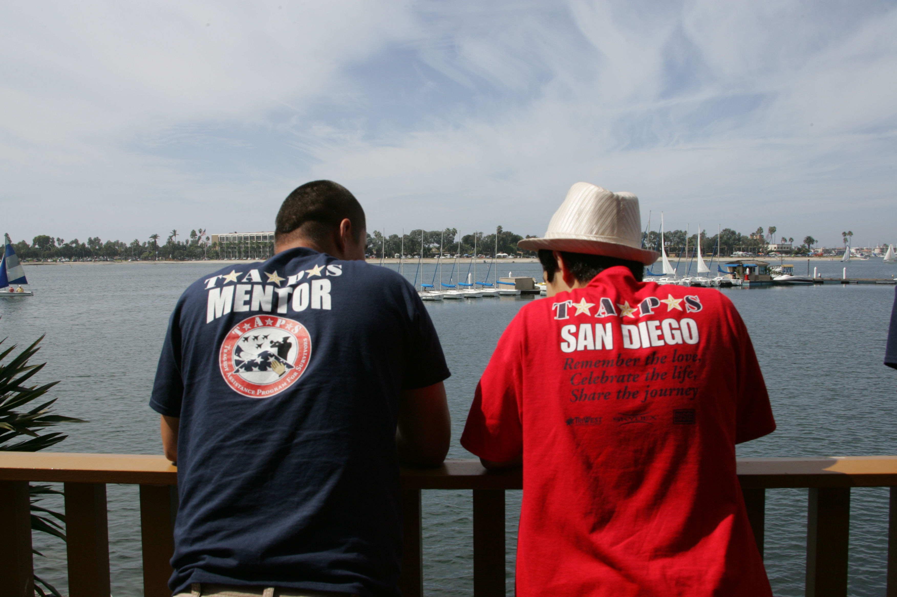
FAMILY DYNAMICS
Suicide is a multifactor event that leaves a wake of questions, blame, guilt and shame. In military families this can lead to additional losses and conflict if not resolved.

Slide 13
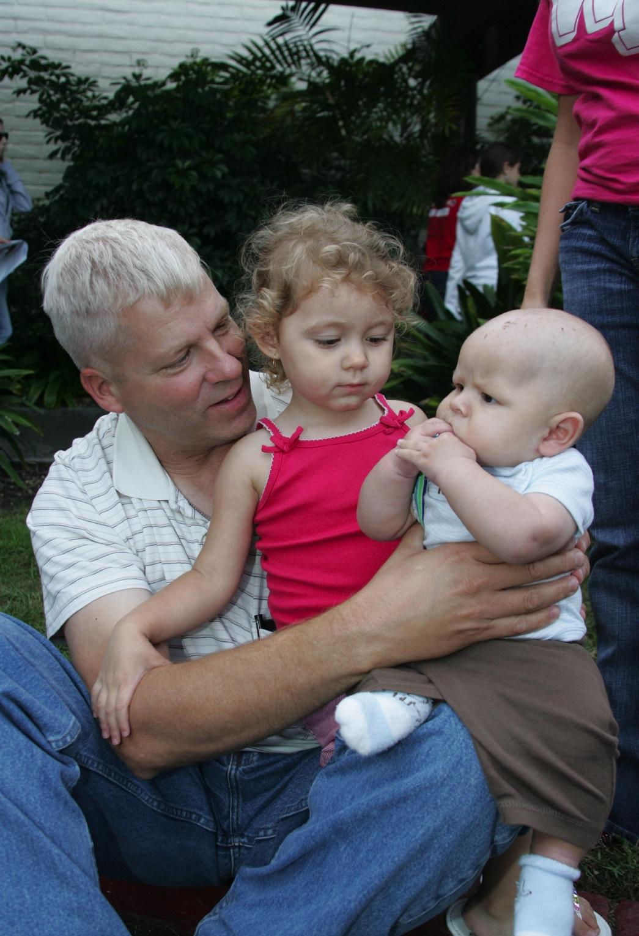
CHILDREN
Every child grieves differently. They need to know that the death is not their fault and that whatever they are feeling is ok. Experts also agree that most children should be told the truth in a developmentally appropriate way.

Slide 14
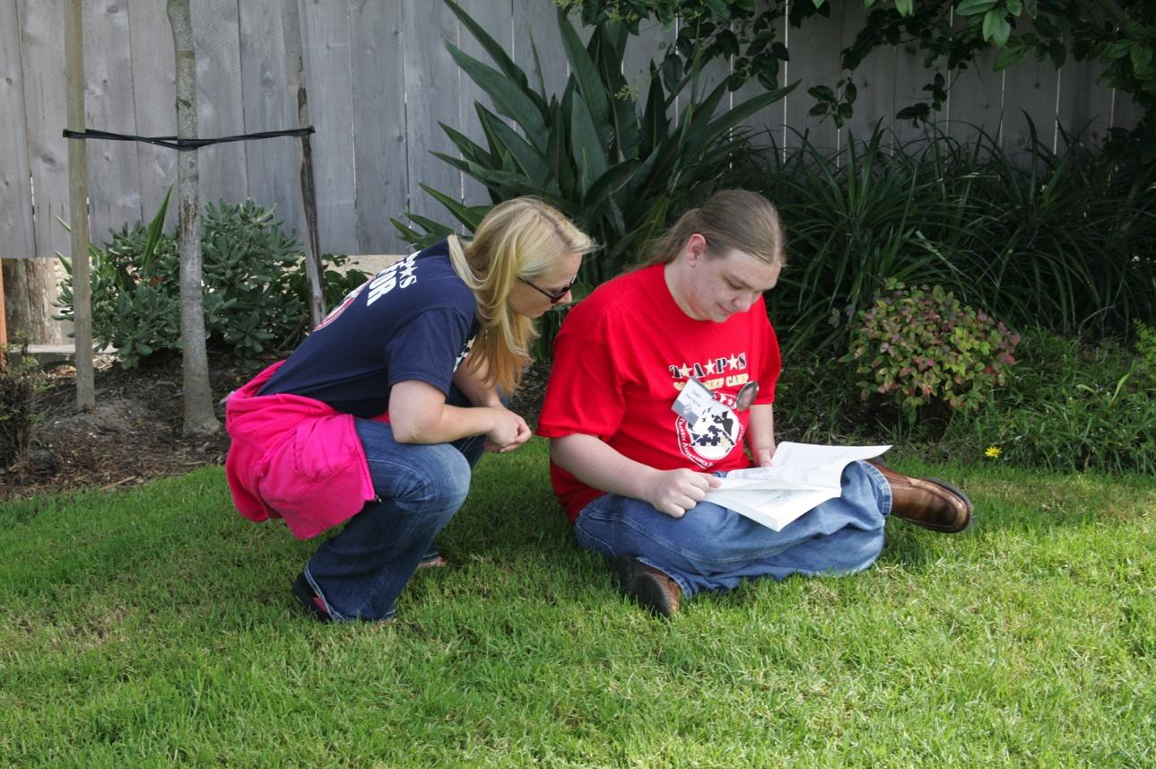
TALKING ABOUT THE DEATH
Families often struggle with how to talk about a death by suicide. Without guidance families can recluse themselves in order to avoid questions.

Slide 15
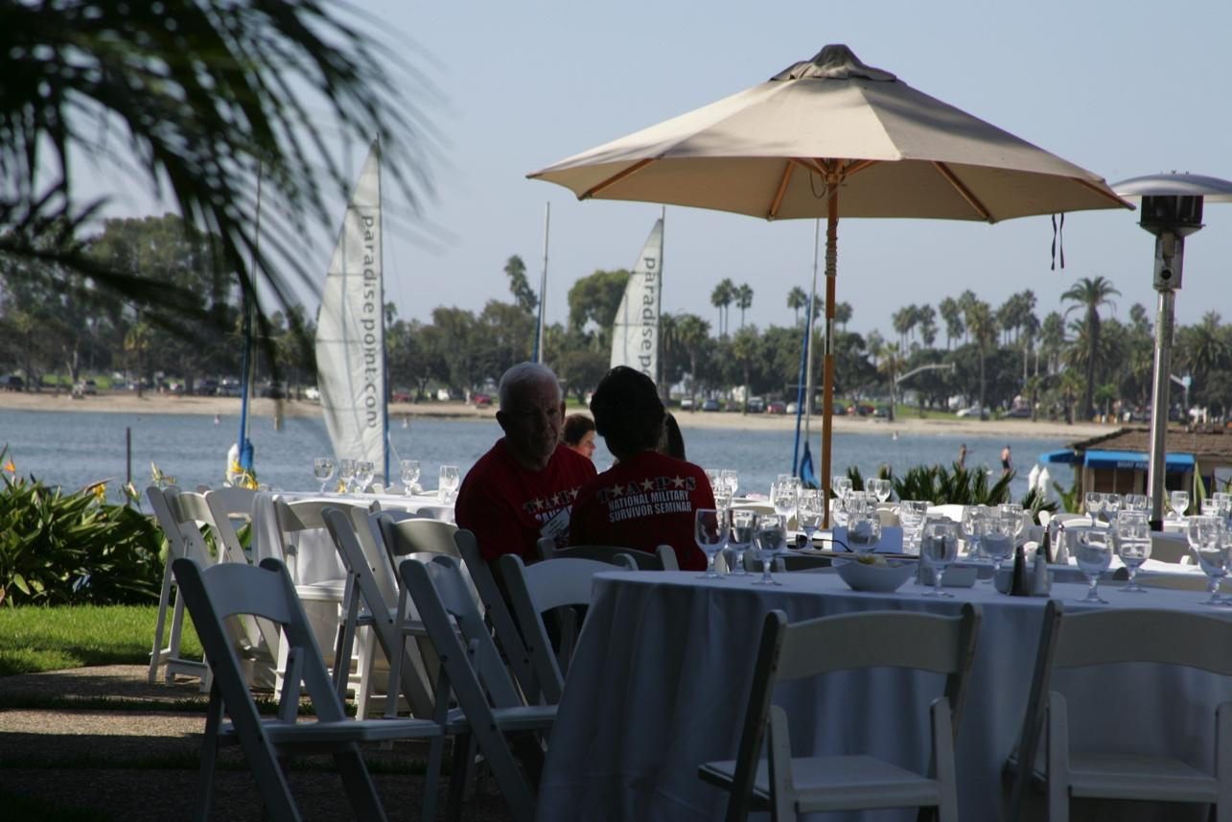
RELATIONSHIP SPECIFIC ISSUES
Understanding the relationship between the deceased and the survivor can help identify and address specific issues.

Slide 16
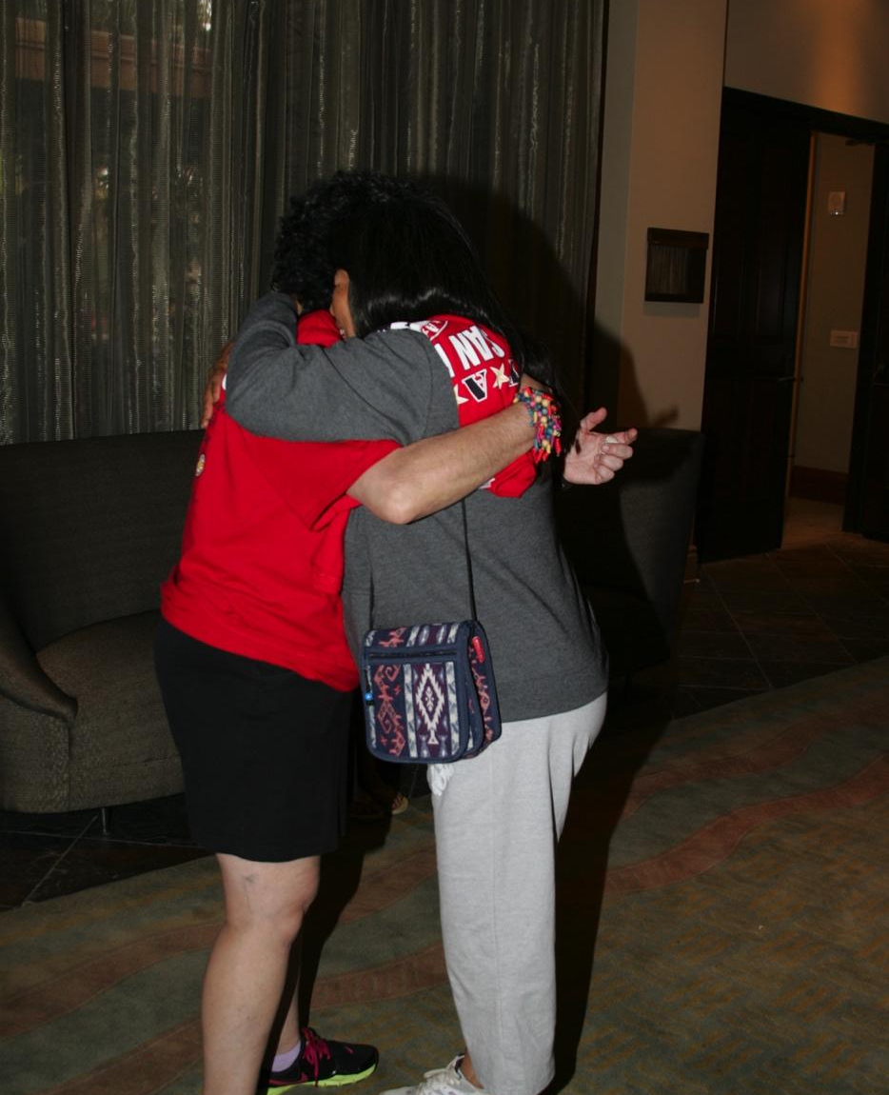
ROLLERCOASTER OF EMOTIONS
No order or stage
Compound and conflicting
No timeframe
Socially unacceptable
Differs among survivors of the same event.

Slide 17
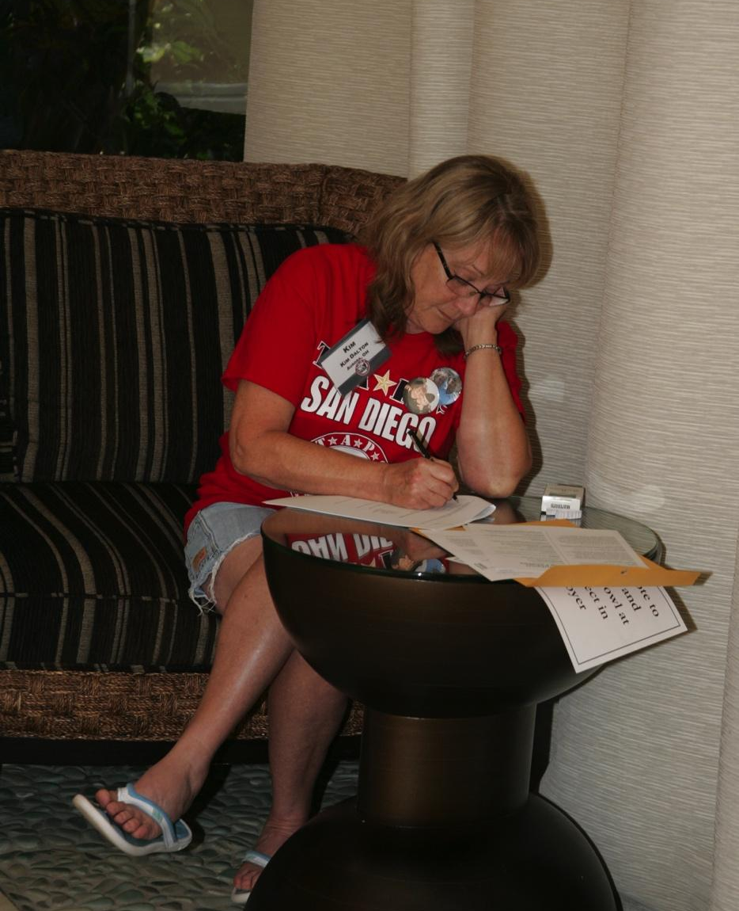
MEDIA
Safe messaging
Public statements
Family interviews
Obituary’s

Slide 18
TRAUMA
Most suicides happen in a persons home.
Barracks
Friends home
workplace
51%
14%
6%
4%
(DODSER 2014)

Slide 19
POST-TRAUMATIC GROWTH

Slide 20
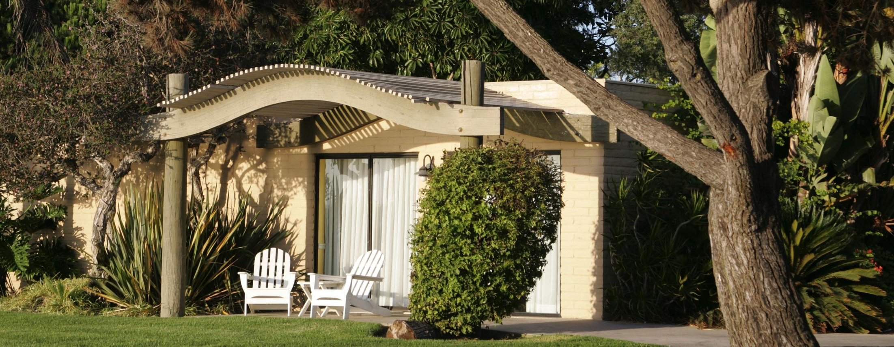
CLEAN UP
Something we don’t often think about and is left to the survivor family to take care of.

Slide 21
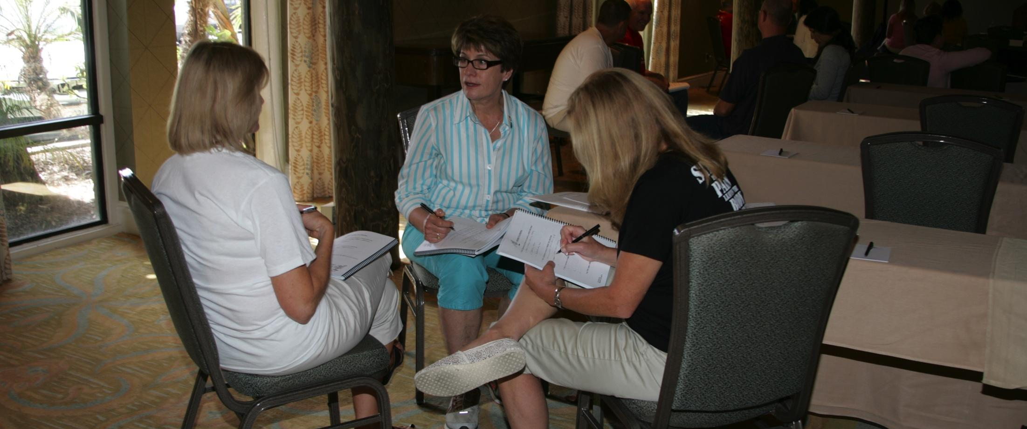
THE INVESTIGATION
Suicide investigations can take a long time to complete and may impede the grief journey.

Slide 22
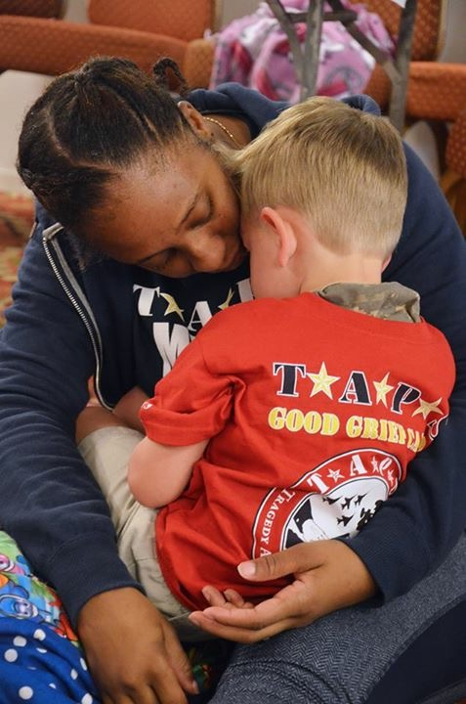
GRIEF WORK
Suicide loss grief can be complex and confusing. It has no timeline and everyone experiences it differently.

Slide 23
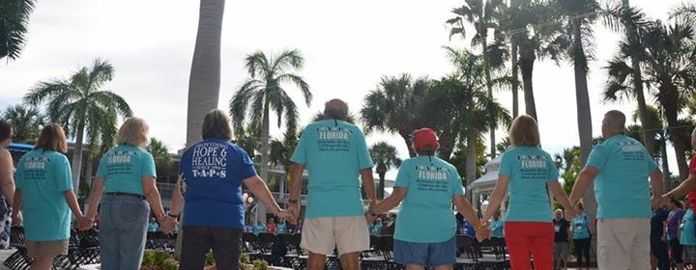
POST-TRAUMATIC GROWTH
Post-traumatic growth is a positive, psychological change that happens because of an adversity or challenge.

Slide 24
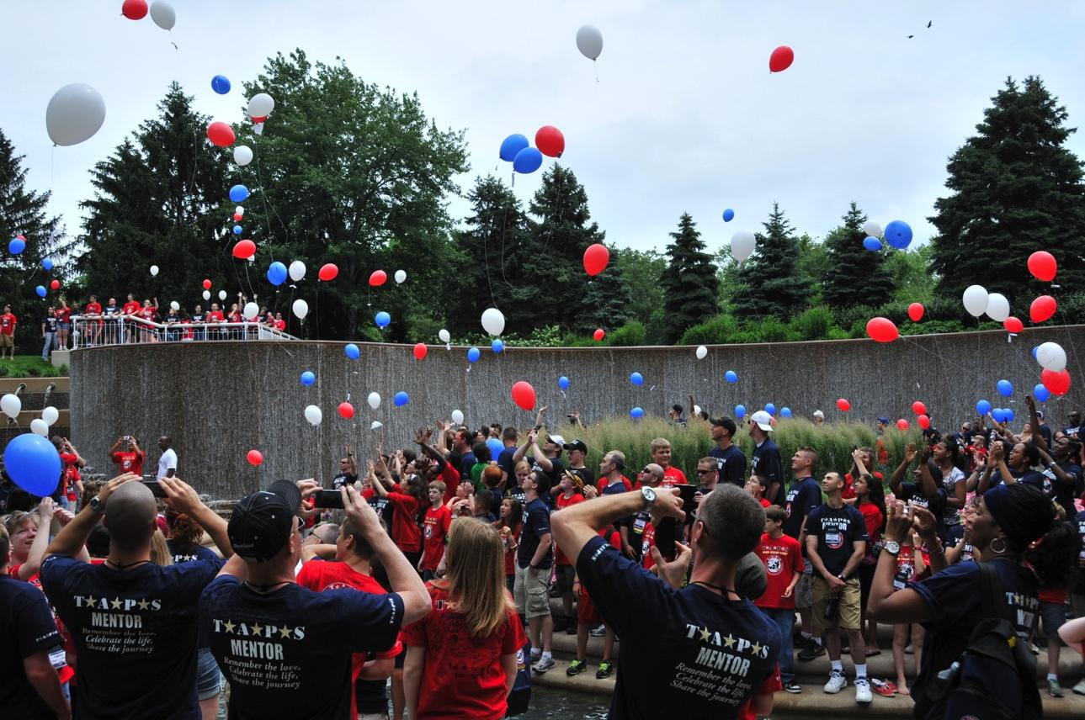
HOPE HEALING AND GROWTH
Suicide survivors are uniquely perched for finding post-traumatic growth following loss.

Slide 25
TAPS PROGRAMS
24/7 peer line
Peer mentor program
Casework
Community care
Outreach
Seminars and retreats
Honor your loved one
Meet and greets

Slide 26
CONNECT TO TAPS
MOU
Website taps.org
Call line 800-959-8277

Slide 27
kim@taps.org
800-959-8277
Kim Ruocco MSW
kim@taps.org

