Slide 1
Applying Machine Learning Techniques to Identify Quality and Staffing Measures Associated with VHA Facility Suicide Rates in 2013-2014
John S. Richardson, MPH
John F. McCarthy, PhD, MPH
Ira R. Katz, MD, PhD
VA Office of Mental Health and Suicide Prevention

Slide 2
Background
Health system characteristics may be associated with patterns of suicide mortality. Prior work suggests associations between staffing and suicide rates (Katz et al., 2013).
To date there are no published studies regarding patterns of suicide mortality across Veteran Health Administration (VHA) facilities.
Significant regional variations in suicide among Veterans have been identified, and they mirror patterns seen in the general US population (e.g., higher rates in the West) (Department of Veterans Affairs, 2016).
The goals of this study were:
  To examine variation in suicide rates across VHA facilities among recent users.
  To identify, from a set of facility quality, performance, and staffing measures, those that best predicted variation in suicide rates.
Background
Methods
Results
Conclusions

Slide 3
Methods – Population Studied
Recent VHA users: Veterans and non-Veterans who received care at a VHA facility in the index year (2013 or 2014) or the prior year (2012 or 2013) and were alive at the start of the index year.
  Users assigned to the administrative parent facility of last use.
Exclusion criteria: missing sex; missing age; age less than 18; last use was outside of the 50 states or the District of Columbia; or had VHA use six months after their recorded date of death.
Suicide rates:
  Numerator – Deaths identified using National Death Index search results included in the VA Suicide Data Repository.
  Denominator – Person years at risk of death.
    Start: the beginning of the index year, or the first use in the index year for those who did not have use in the prior year
    End: the end of the year, or the date of death for those who died in the index year.
Background
Methods
Results
Conclusions

Slide 4
Methods – Analytic Approach
Descriptive Analyses:
  Suicide rates by facility among recent VHA users in 2013 and 2014. Results were mapped and summarized in tables.
Statistical Analyses:
  Three ordinary least squares regression models
    Outcome: Suicide rates in 2013 and in 2014 at each of the 140 administrative parent facilities.
    Adjusted for within-site correlation across the two years using robust standard errors
  1. Base model predictors
    Facility size, age and sex distributions, region, and state-level suicide rates among non-VHA users.
  2. Quality model predictors
    Variables from base model, plus: VHA facility quality indicators from the Mental Health Information System (MHIS) that were selected using LASSO regression.
  3. Quality and Staffing model predictors
    Variables from quality model, plus: facility mental health staffing ratios.
Background
Methods
Results
Conclusions

Slide 5

Methods –Selection of Quality Indicators
Quality indicators: 76 MHIS quality indicators. Present across all 140 administrative parent facilities in last quarters of calendar years 2013 and 2014, and had variation across at least 5 facilities per year.
Selection technique: LASSO regression, a form of penalized regression that fits beta coefficients that minimize the following error term:
This technique creates a tradeoff with each covariate between reducing the error by reducing the residual sum of squares, but also increasing the error by adding to the penalty term given the size of the coefficient.
Coefficients that do not sufficiently reduce the overall error term are reduced to 0.
The non-zero coefficients were selected for use in quality models.
The amount of weight given to the penalty term (λ) is determined using cross-validation.
What is minimized in OLS
(The residual sum of squares)
The penalty term specific to LASSO
Background
Methods
Results
Conclusions

Slide 6
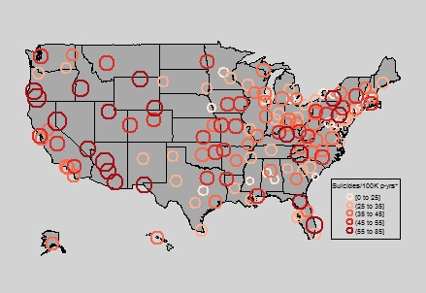
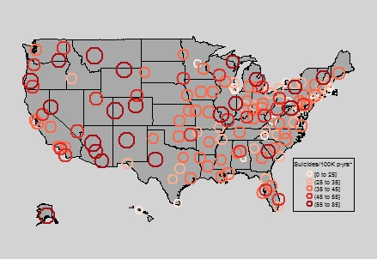
Results – Descriptive Analysis
Variations in facility-level suicide rates among recent VHA users
2013
2014
Background
Methods
Results
Conclusions

Slide 7
Results – Base Model
Reference group was women VHA users, aged 75+, in the Midwest region.
R-squared: 0.3801; Adjusted R-squared: 0.3594
Background
Methods
Results
Conclusions

Slide 8
Results – Quality Model
Same covariates in base model
6 of the 76 MHIS variables were selected and included based on a separate LASSO regression model
Abbreviations: RRTP, Residential Rehabilitation Treatment Program; PC-MHI, Primary Care Mental Health Integration; PTSD, Post Traumatic Stress Disorder
Reference group was women VHA users, aged 75+, in the Midwest region.
R-squared: 0.4359; Adjusted R-squared: 0.4039
Background
Methods
Results
Conclusions
Notes:
Specialty services for PTSD or MST are identified in the handbook from the following questions: Q134. A specialized outpatient PTSD program with the ability to provide care and support for Veterans with PTSD (either a PTSD Clinical Team (PCT) or PTSD specialists, based on locally-determined patient population needs)
Q135. SUD specialty services provided by a SUD Specialist associated with the specialized outpatient PTSD Program (PCT or equivalent)
Q136. A PTSD Day Hospital or PTSD track in a PRRC, or an equivalent program
Q139. OEF/OIF mental health services provided by staff with training and expertise to serve the population either through an OEF/OIF Team, Serving Returning Veterans-Mental Health (SeRV-MH) Team, or PTSD program staff
Q142. The identified range of mental health services to Veterans diagnosed with mental health conditions related to military sexual trauma, utilizing clinicians with particular expertise in sexual trauma treatment
Q143.The option of being assigned a same-sex MH provider, or opposite-sex provider if the trauma involved a same-sex perpetrator for patients (women and men) being treated for MH conditions related to MST

Slide 9
Results – Quality and Staffing Model
Same covariates in quality model
Abbreviations: RRTP, Residential Rehabilitation Treatment Program; PC-MHI, Primary Care Mental Health Integration; PTSD, Post Traumatic Stress Disorder
Reference group was women VHA users, aged 75+, in the Midwest region.
R-squared: 0.4455; Adjusted R-squared: 0.4118
Background
Methods
Results
Conclusions
Notes:
MH providers are the following providers that delivered care in a MH setting: Clinical Nurse Specialist, Clinical Pharmacists, LPCs, MFTs, Nurse Practitioner, Other Counselor, Other MD, Other RN, Other Staff, Pharmacists, Physician Assistant, Psychiatrist, Psychologist, Social Worker, Unknown

Slide 10
Summary
Descriptive analyses indicate that suicide rates varied substantially by facility beyond the typical regional variations we would expect.
The following facility characteristics were significantly associated with this variation:
  Percentage of service connected Veterans receiving VA mental health services (suicide rates ).
    Is this an indicator of engagement, particularly, engaging patients with potential mental health needs?
  Mental health provider to patient ratios (suicides rates ).
    Are facilities with more mental health providers able to better address mental health needs of patients?
  Ratio of the number of Veterans who received at least one day of RRTP to the number of Veterans on the National Psychosis Registry (suicide rates ).
    Is this an indicator of their being higher risk individuals at the facility?
  Percentage of patients with PTSD receiving a benzodiazepine (suicide rates ).
    Is this a signal of poor care, care that may even be increasing risk of suicide?
Our quality and staffing model accounted for ~45% of the variation in suicide rates.
  Adjusting for changes in the number of covariates, adding quality and staffing measures explained an additional 5% of the variation from the base model, from 36% to 41% explained.
Background
Methods
Results
Conclusions

Slide 11
Limitations
This study examined correlation and not causation.
LASSO regression does not handle highly collinear variables very well. Using a different random seed for cross validation, could result in selection of slightly different sets of variables.
  For example: percentage of service connected Veterans receiving VA mental health services was selected vs. percentage of mental health service connected Veterans receiving VA mental health services
Background
Methods
Results
Conclusions

Slide 12
Implications and Future Analyses
Findings regarding facility characteristics could be used to supplement ongoing VA suicide predictive modeling (REACH VET).
Findings may inform ongoing VA operations and quality improvement activities.
A substantial portion of the variation in suicide rates was related to contextual or patient population measures, suggesting the importance of engaging communities in suicide prevention efforts.
Future assessments should investigate the mechanisms underlying the observed associations and opportunities to enhance suicide prevention.
Background
Methods
Results
Conclusions

Slide 13
Thank you!
For more information please contact John Richardson:
John.Richardson9@VA.gov

Slide 14
Appendix

Slide 15
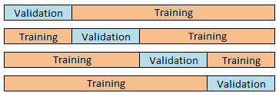
Description of k-fold cross-validation
Step 1: Randomly sort the data and divide into k equal sections or “folds” (in this example k=4)
Step 2: For each of the 4 folds, use the remaining ¾ of the data to develop or “train” a set of models. Each of these models has a different fixed level of lambda.
Step 3: Use the trained models to predict the outcome in the validation fold, and calculate the error in the prediction.
Step 4: For each level of lambda tested you will have 4 unique error estimates. Take the average.
The lambda that produces the minimum average error is the optimal lambda.
Notes:
Some suggest taking the largest lambda that produces an average error estimate that is within 1 standard errors of the minimum average error.

Slide 16
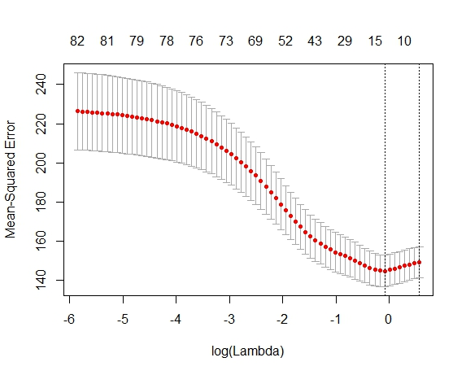
Cross-validation for determining lambda
Number of Non-Zero Coefficients
Natural Log of Lambda
(negative if lambda is between 0 and 1, 0 if lambda is 1, and positive if lambda is greater than 1)

Slide 17
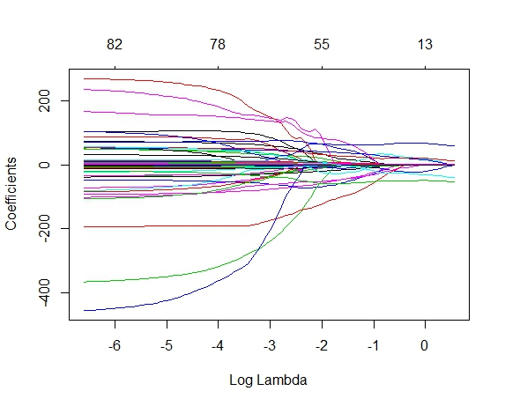
Shrinkage plot of covariates in LASSO model
Number of Non-Zero Coefficients
Magnitude of Coefficients
Natural Log of Lambda
(negative if lambda is between 0 and 1, 0 if lambda is 1, and positive if lambda is greater than 1)

